Slide 1

The Ataxias: Research in FRDA, SCA, MSA
Susan L. Perlman M.D.
Clinical Professor of Neurology
David Geffen School of Medicine at UCLA

Slide 2

Disclaimer
The information provided by speakers in any presentation made as part of the 2015 NAF Annual Membership Meeting is for informational use only.
NAF encourages all attendees to consult with their primary care provider, neurologist, or other health care provider about any advice, exercise, therapies, medication, treatment, nutritional supplement, or regimen that may have been mentioned as part of any presentation.
Products or services mentioned during these presentations does not imply endorsement by NAF.

Slide 3
Presenter Disclosures
Susan L. Perlman M.D.
The following personal financial relationships with commercial interests relevant to this presentation existed during the past 12 months:
Investigational site for drug trials sponsored by:
Edison Pharmaceuticals
Shire/Viropharma
Teva Pharmaceuticals

Slide 4
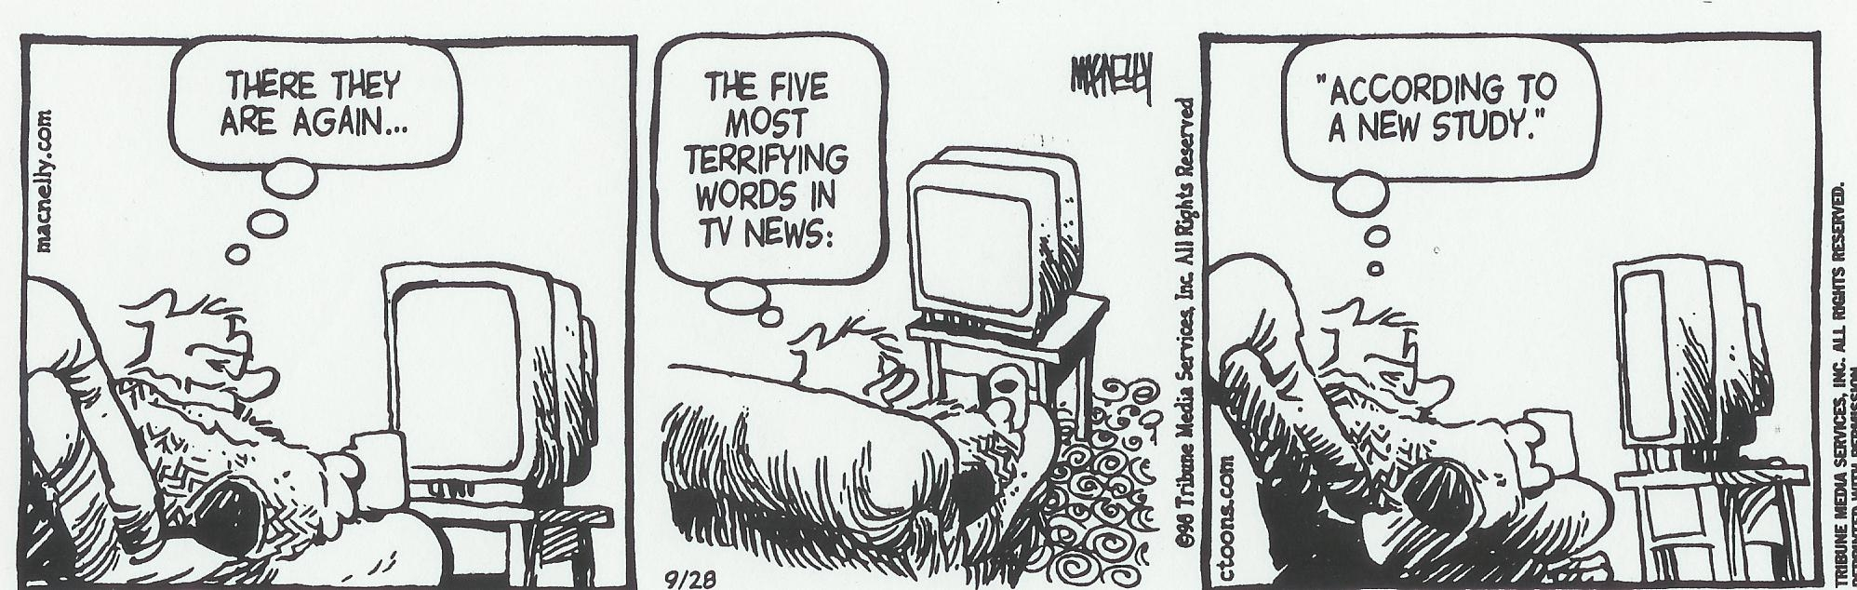

Slide 5
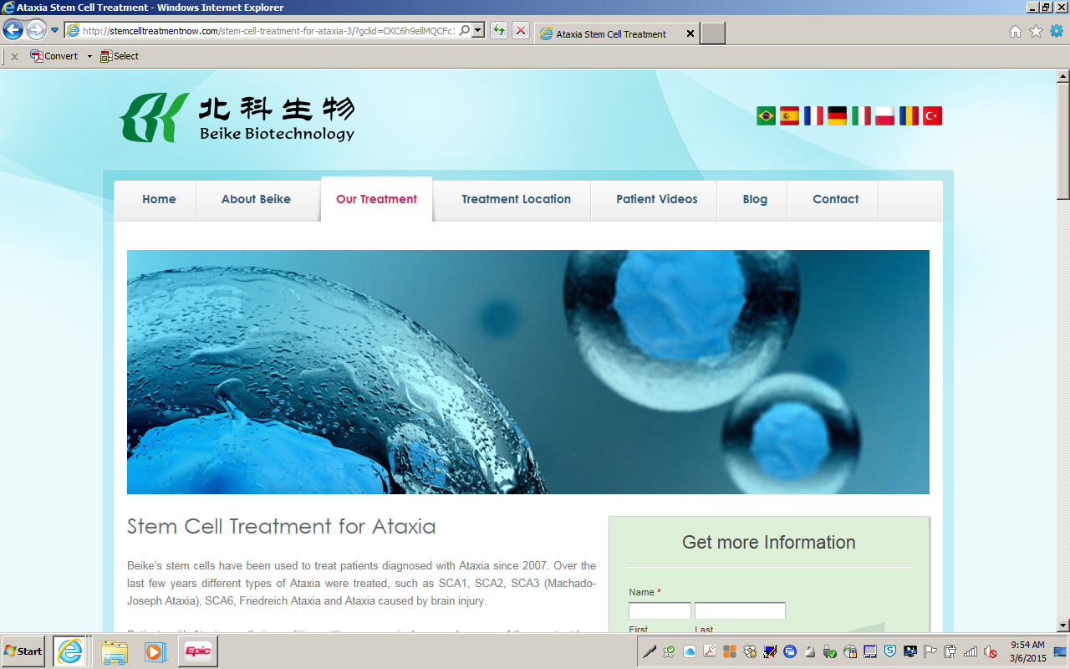
However, no matter what you read on the Internet… there is still no cure for ataxia

Slide 6
We are all interested in scientific discovery and constantly amazed at what science and technology are able to do… and intensely hoping that a cure for ataxia will come out of it.
Milestones in Neuroscience Research (from Eric Chudler PhD at the University of Washington, Seattle)
1824 - F. Magendie provides first evidence of cerebellum role in equilibration
1837 - Jan Purkyne (Purkinje) describes cerebellar cells; identifies neuron nucleus and processes (named for him in 1866)
1863 - Nikolaus Friedreich describes a progressive hereditary degenerative CNS disorder (Friedreich's ataxia)
1913 - Edwin Ellen Goldmann finds blood brain barrier impermeable to large molecules
1932 - Max Knoll and Ernst Ruska invent the electron microscope
1953 – Watson and Crick suggest a model for the structure of DNA
1977-96 – Techniques to sequence genetic material developed
1993 - The gene responsible for Huntington's disease is identified
1990-2003 – Human Genome Project
The past 20 years have been an explosion of gene discovery in ataxia

Slide 7
Examples in the History of Drug Development
1897 - Acetylsalicylic acid (aspirin) is synthesized by Felix
1898 - Bayer Drug Company markets heroin as non-addicting cough medicine
1899 - Bayer AG markets aspirin
1960 - Oleh Hornykiewicz shows that brain dopamine is lower than normal in Parkinson's disease patients
1961 - Levadopa successfully treats parkinsonism
1973 - Sinemet is introduced as a treatment for Parkinson's disease
13 years from the first bright idea about dopamine and PD until Sinemet released.
Has this process been speeded up?

Slide 8
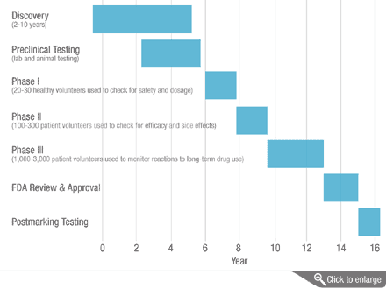
OFFICIAL PIPELINE FOR NEW DRUGS
Up to 15 years and $500-700million to get to market
Discovery—clinicians and scientists working out the cause of the disease, the “dominos” that fall over, and targeted candidate drugs.
Preclinical testing—test tube and animal studies.
Phase I—dosing, safety
Phase II—safety, possible efficacy
Phase III—efficacy
FDA Approval
Phase IV--Post-marketing studies for long-term side-effects and good effects.
To help with promising drugs for serious diseases with unmet needs:
NIH—Rapid Access to Intervention Development (RAID)
FDA—Orphan Drug Status

Slide 9
FUNDING A PUBLIC-PRIVATE PARTNERSHIP
Discovery—clinicians and scientists working out the cause of the disease, the “dominos” that fall over, and targeted candidate drugs.
$25-80,000 per yr over many years
Preclinical testing—test tube and animal studies.
$100,000 per year for at least 2 yr
Phase I and Phase II--
$500-700,000 per year for 4 yr
$2-4 million to get to this point
Phase III—$4-5 million ($10K/subject)
FDA Approval
Post-marketing studies for long-term side-effects and good effects and possible other uses of the drug.
Government
Private research foundations
Government
Private research foundations
Pharmaceutical companies
Government
Private research foundations
Pharmaceutical companies
Pharmaceutical companies

Slide 10
Things You Need to Ask Yourself When Looking at a Research Study
1. Is it based in “good science?”
2. Is it potentially dangerous?
3. Is it being conducted ethically?
4. Can I afford the time and money it may cost me?
5. Is there any potential benefit for me?
6. Is it something I could do on my own?
Issues of study design that often come up include use of placebos, compassionate availability, and delays.

Slide 11
The Bottom Line
Every ataxia patient must participate in clinical trials—natural history, biomarker, drug treatment.
Every researcher designing a clinical trial must make it accessible to all ataxia patients.
There will be exceptions but...

Slide 12
Every Ataxia Patient Must Participate in Clinical Trials
Registries will enable you to be found.
These are rare diseases with very small numbers of patients who can participate. Every person counts.
2. Be knowledgeable about what makes a good clinical trial—don’t make bad investments.
Speak up about the roadblocks to participation. Become involved in planning the trials.
Be prepared to make sacrifices.

Slide 13
Every Researcher Designing A Clinical Trial Must Make It Accessible To All Ataxia Patients.
Design trials that can use the fewest patients over the shortest period of time (this usually means testing better drugs and using biomarkers).
What is the rationale for excluding certain patients? Can those excluded be used in other ways? Parallel or compassionate studies?
But remember that a patient can participate in only one trial at a time and that participation in some trials may permanently disqualify participation in others.
Reimbursing travel costs is essential for recruitment and compliance. Telemedicine?
Don’t expect the patients to make unreasonable sacrifices.

Slide 14
Registries
Ataxia patients are some of the most highly motivated research subjects around, but ...
The Cooperative Ataxia Research Networks and the National Ataxia Foundation are not mind-readers.
Every ataxia patient must be in a Registry.
For all ataxias--https://www.sanfordresearch.org/CoRDS/CoRDSRegistryForm
For episodic ataxia--http://rarediseasesnetwork.epi.usf.edu/cinch/index.html
For Friedreich’s Ataxia--http://www.curefa.org/registry.html

Slide 15
TYPES OF CLINICAL TRIALS
TYPE | # SUBJECTS | LENGTH | AIM OF STUDY
N of 1 | 1 | Ongoing | Do I get better or stop getting worse on this drug?
Pilot | Up to 20 All get drug | Weeks to months | Is a larger study worth doing, will there be problems?
Phase 1 | 20-80 normal or patient in groups of 3 All get drug | 2 years | Escalating doses to learn side effects, safety, best dose
Phase 2 | 20-300 Placebo and drug groups Compassionate trials do not use placebo. | 2 years | To assess potential for good effects, as well as side effects. Also designed as “futility” study—to show a drug doesn’t not work(fewer subjects, less$)
Phase 3 | 300-3000 Placebo and drug groups | 3-5 years | To prove efficacy May include crossover design, open extension trial
Phase 4 | 100’s-1000’s Open drug use | Ongoing | To find out more about the effects of an approved drug.

Slide 16
Research in FRDA, SCA, and MSA
Since the last AMM, there have been 1748 articles about ataxia in PubMed.
We will review each of them in detail…

Slide 17
Research in FRDA, SCA, and MSA
Human Subjects
natural history
biomarkers of disease onset and progression
mechanisms of tissue damage including genetics
Basic Science
animal models
cellular models including IPSC
epigenetic controls
translational research
Treatment trials
Since the last AMM, there have been 79 publications about ataxia treatment.
Clinicaltrials.gov lists 57 open studies dealing with ataxia.

Slide 18
Collaborative Groups Doing the Research (and many more individual researchers)
CRC-SCA—North American Collaborative Research Consortium for Spinocerebellar Ataxia under the direction of Dr. Tee Ashizawa
EUROSCA—European Integrated Project on Spinocerebellar Ataxia
under the direction of Prof. Olaf Riess
CCRN—Collaborative Clinical Research Network for Friedreich’s Ataxia
under the direction of Dr. Dave Lynch
EFACTS--European Friedreich's Ataxia Consortium for Translational Studies
under the direction of Dr. Massimo Pandolfo
Global MSA Taskforce, North American MSA Study Group, European MSA Study Group, and others
under the direction of Dr. Ryan Walsh and others

Slide 19
Recent and Active Studies in SCA
Natural History Study of and Genetic Modifiers in Spinocerebellar Ataxias
(SCA 1, 2, 3, 6; 12 US sites; visits every 6 months for 2 years)
Separate blood/tissue banking study at U Utah.
Transcranial Magnetic Stimulation in Spino-Cerebellar Ataxia
(Genetic SCA; Beth Israel Medical Center in Boston; 5 days per wk for 4 wks)
Parkinsonism in Spinocerebellar Ataxia Type 6 (University of Chicago)
MRI/MRS imaging of the Brain in SCA1, 2, 3, 6 (U Minnesota)
MRI in SCA1, 2, 3, 6, 8 (Johns Hopkins)
Natural History of SCA7 (NIH)
Cerebellar Control of Voluntary Motion (UC Berkeley; Princeton)
NOT YET RECRUITING
An Open-label Trial of Intravenous Immune Globulin (IVIG)in Treating Spinocerebellar Ataxias (SCA 1, 2, 3, 6, 10,11; U South Florida; 5 days per mo for 3 mo)
Study To Assess Safety, Tolerability and Efficacy of Intravenous Cabaletta in Patients With Machado-Joseph Disease

Slide 20
SCA Pipeline—industry sponsored
Company | Agent | MOA | Status
Astra Zeneca | Myeloperoxidase inhibitor | Blocks microglial activation/inflammation. | Phase 2 For MSA
Others |  | Reducing neuroinflammation
Ataxion | CNS ion-channel modulators | Stabilizes Purkinje cell electrical potentials | Pre-Phase 1
Bioblast | Trehalose | Prevent aggregate formation | Phase 2 for SCA3
Isis Pharma | ASO ISIS-HTT_{Rx} | Antisense drugs bind to messenger RNAs (mRNAs) and inhibit the production of disease-causing proteins | Pre-Phase 1 For Huntingtons disease
Prana Biotech | PBT2 | Prevents the accumulation of toxic huntingtin proteins and the resultant damage inside neurons, and improve neuronal health and function by restoring normal copper and zinc levels which are disturbed when neurodegeneration takes place. | Completed Phase 2 study in Huntington’s disease.

Slide 21
Recent and Active Studies in Friedreich’s Ataxia
Early and Longitudinal Assessment of Neurodegeneration in the Brain and Spinal Cord in Friedreich's Ataxia (U Minnesota)
Cerebellar Control of Voluntary Motion (UC Berkeley; Princeton)
Characterization of the Cardiac Phenotype of Friedreich's Ataxia (Cornell NYC)
An Open-label Study of the Effects of Acetyl-L-Carnitine on Cardiovascular Outcomes in Friedreich's Ataxia (U South Florida; every 6 months for 2 years)
RTA 408 Capsules in Patients With Friedreich's Ataxia – MOXIe
(UF at Gainesville, Emory, Ohio State, CHOP; 16-40y/o; multiple visits over 3 mo)
NOT YET RECRUITING
Efficacy, Safety, and Pharmacokinetic Study of ACTIMMUNE® (interferon gamma-1b) in Children and Young Adults with Friedreich’s Ataxia
FINISHING
EPI-743 in Adults with Friedreich's Ataxia
Safety and Pharmacology Study of VP 20629 in Adults With Friedreich's Ataxia

Slide 22
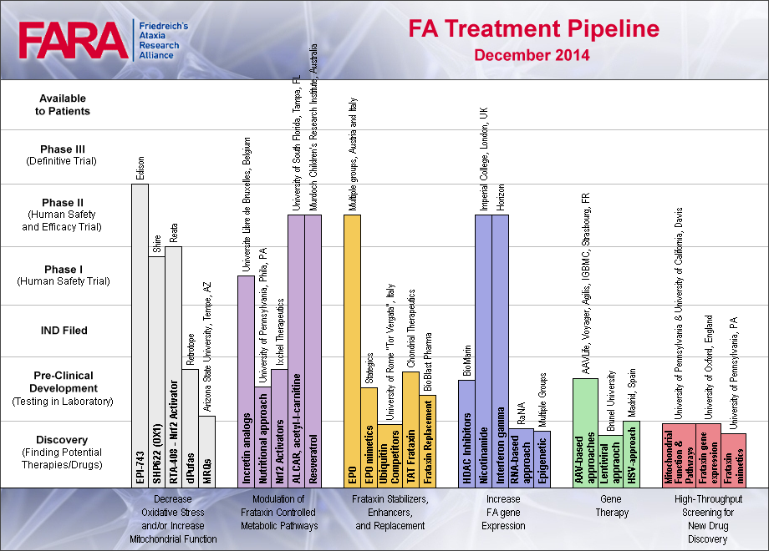
Friedreich’s Ataxia Pipeline

Slide 23
Recent and Active Studies in Idiopathic Ataxia and MSA
MRI/MRS imaging of the Brain in MSA-C (U Minnesota)
PET Imaging Study of Neurochemical and Autonomic Disorders in Multiple System Atrophy (MSA) (U Michigan)
Exome sequencing genetic studies
RECENTLY APPROVED
NORTHERA (droxidopa) is indicated for the treatment of orthostatic dizziness, lightheadedness, or the “feeling that you are about to black out” in adult patients with symptomatic neurogenic orthostatic hypotension (NOH) caused by primary autonomic failure [eg. multiple system atrophy].
BEING STUDIED IN EUROPE
Phase I vaccine study (France); EGCG green tea extract (Germany)
FUTURE PLANS—Global MSA Taskforce for a Research Roadmap

Slide 24
Is Anyone Doing Research into Fatigue in Ataxia?
Once medical issues, nutritional issues, sleep problems, depression, deconditioning have been ruled out…
Functional MRI studies
Radiol Med. 2012 Dec;117(8):1398-407. Specogna I ^{et al}
Functional MRI during the execution of a motor task in patients with multiple sclerosis and fatigue.
Patients with fatigue have greater activation of the motor-attentional network when performing a simple motor task.
Neuro-inflammation studies

Slide 25
Partners in Neurogenetics Research at UCLA
Daniel Geschwind, M.D., Ph.D., Neurogenetics Program Director
Susan Perlman, M.D., Ataxia Clinic Director (Ataxia Database, Drug Trials)
Brent Fogel, M.D., Ph.D. (Molecular Genetics, Biospecimens bank)
Robert Baloh, M.D. (Neuro-Otology)
The Bartzokis group (Neuroimaging, Biomarkers)
Yvette Bordelon, M.D., Ph.D. (Huntington’s disease, Biomarkers, Drug Trials)
Stephen Cederbaum, M.D. (Medical Genetics, Metabolic Disorders)
Giovanni Coppola, M.D. (Molecular Genetics)
Ming Guo, M.D., Ph.D. (Drosophila)
Joanna Jen, M.D., Ph.D. (Episodic Ataxias, Drug Trials)
Arik Johnson, Psy.D. (Psychology)
Shamran Khamsa, M.D., Juan Alejos, M.D. (Cardiology)
William Oppenheim, M.D. (Orthopedics)
Noriko Salamon, M.D. (Neuroradiology)
Ernest Wright D.Sc., Ph.D, Vladimir Kepe Ph.D,, Jorge Barrio Ph.D. (Neuroimaging, Biomarkers)
Clinic Coordinator (310) 794-1195
Brian Clemente, Ph.D. Research Coordinator (310) 206-8153
Nagmeh Dorrani, M.S. — Genetic Counselor (310) 206-6581
Hillary Zebberman, MSW, social work consultant — Social Work Coordinator (310) 794-1225

Slide 26
Thank You
National Ataxia Foundation—
sponsor of grants for our internal database, our DNA bank, our web-based database project, and the SCA3 Chantix study.
The Collaborative Research Network for Spinocerebellar Ataxia—
sponsor of the grant for the SCA Natural History Study.
NINDS RC1 NS68897 and NIH Office of Rare Diseases Research
Muscular Dystrophy Association and
Friedreich’s Ataxia Research Alliance—
sponsors of the grant for the collaborative project on “Clinical Outcome Measures in Friedreich’s Ataxia”.
The Bettencourt Family Foundation
The Norman Lapin Fund
The Mariette Monnet Fund
The Smith Family Foundation
And to our patients and their families for their willingness to work with us and to share with us their ideas and hopes.

