Slide 1
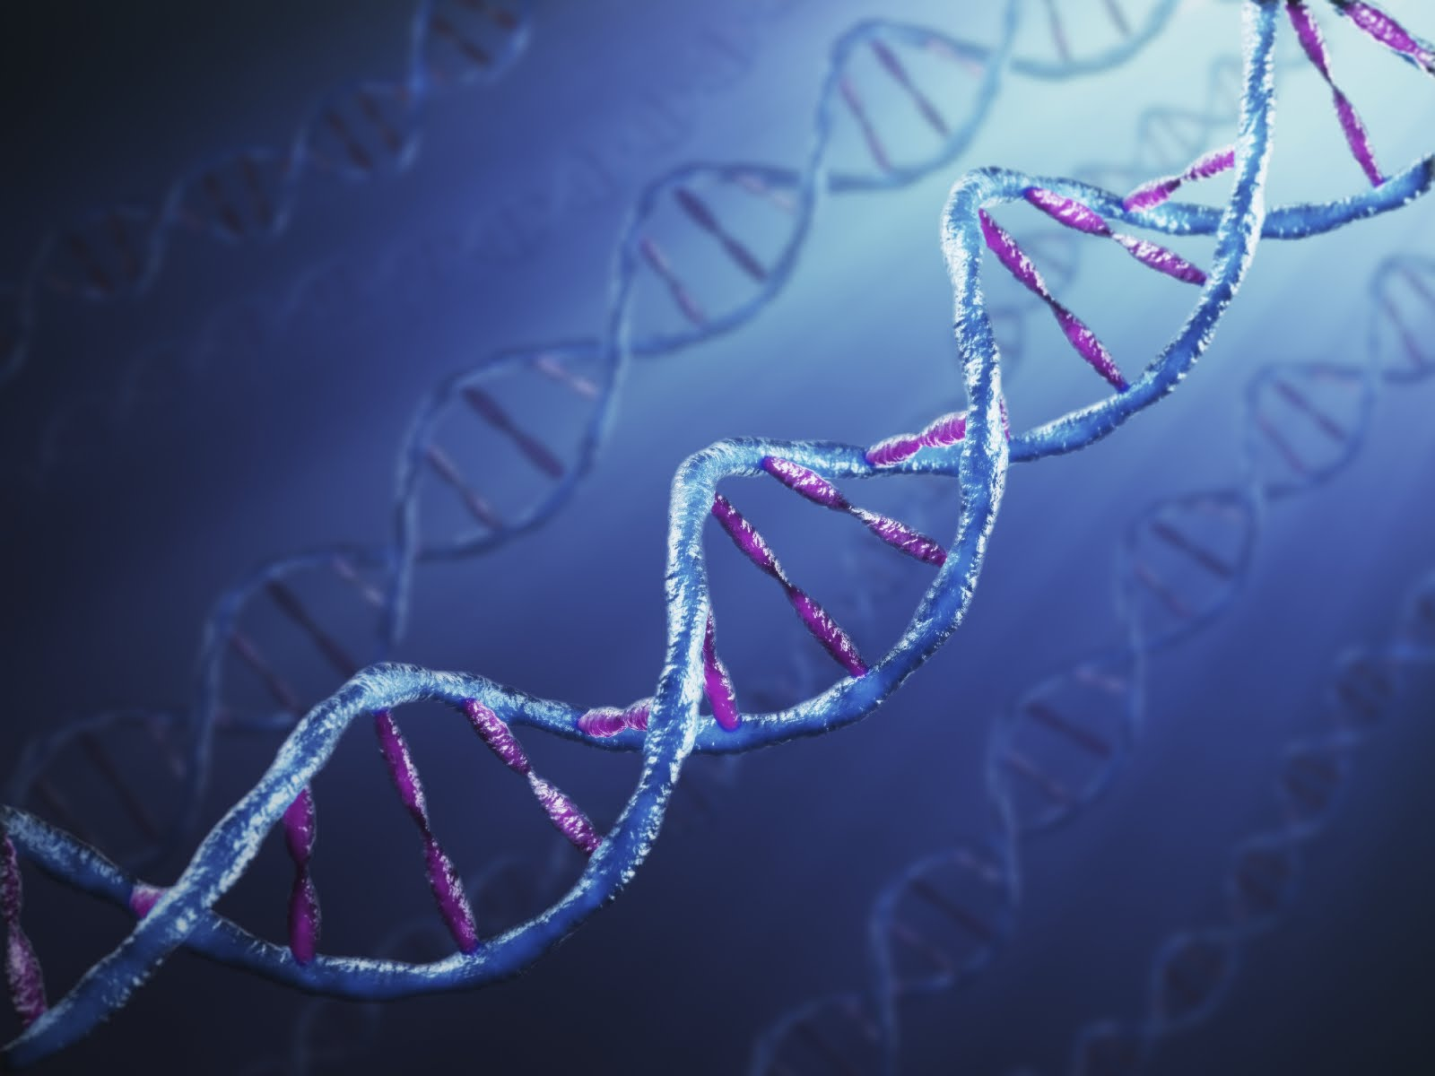
Advances in the Genetic Diagnosis of the Cerebellar Ataxias
Brent L. Fogel, M.D., Ph.D.
Associate Professor
UCLA Department of Neurology
Program in Neurogenetics
David Geffen School of Medicine
at UCLA
March 11, 2017
http://esciencecommons.blogspot.com/2011/01/undersea-cables-add-twist-to-dna-study.html

Slide 2
Disclaimer
The information provided by speakers in any presentation made as part of the 2017 NAF Annual Ataxia Conference is for informational use only.
The NAF encourages all attendees to consult with their primary care provider, neurologist, or other health care provider about any advice, exercise, therapies, medication, treatment, nutritional supplement, or regimen that may have been mentioned as part of any presentation.
Products or services mentioned during these presentations does not imply endorsement by the NAF.

Slide 3

Disclosures
Dr. Fogel receives funding from the National Institutes of Health.
Dr. Fogel is employed at an academic medical institution that offers diagnostic clinical exome sequencing. Dr. Fogel has no financial relationships related to this testing.
Dr. Fogel has no personal financial relationships with commercial interests relevant to this presentation during the past 12 months to disclose or list.

Slide 4
Ataxia is a symptom…NOT a disease!
Term provides no information on cause, severity, or prognosis
Upper respiratory Infection (viral) (“a cold”)
Influenza (viral) (“the flu”)
Pneumonia (bacterial or viral)
Tuberculosis (mycobacterial)
Coccidioidomycosis (fungal) (“Valley Fever”)
Ebola (viral)
COUGH

Slide 5
The Importance of a Thorough Medical Evaluation:
Many Causes of Cerebellar Ataxia!
Nutritional
Endocrine
Dominant
Metabolic
Recessive
Infectious
Acquired
Causes
Genetic
Causes
“Familial, Hereditary,
etc.”
Mitochondrial
Inflammatory
Neoplastic
Metabolic
Paraneoplastic
X-linked
Autoimmune
Other
Toxic
Idiopathic
Causes
1 in 5,000 persons
worldwide have ataxia
1 in 10,000 persons
have a genetic ataxia
“Sporadic Ataxia”
Unexpected
No clear family history
…but can be acquired, genetic, or idiopathic!
Neurodegeneration
Notes:
Important considerations are alcohol (toxic), diabetes (endocrine), autoimmune, paraneoplastic

Slide 6
Diagnostic Reservoirs Hiding Neurogenetic Disease
Shared
Clinical
Phenotype
Cerebral palsy
Intellectual disability
Epilepsy
Movement disorders
Ataxia
Dementia
Multiple sclerosis
Peripheral neuropathy
Diagnosis
Presumed identical or similar cause
Same
Management
for Everyone?
Traditional Medical
Approach

Slide 7
Individualized
Symptomatic
Treatment or Surveillance
Heterogeneous
Clinical
Phenotype
Diagnosis
Diagnosis
Genetic Counseling & Psychosocial Benefits
Diagnosis
Specific or unique
molecular cause
Disease Modification
or Cure
Precision Health
Approach

Slide 8
Ataxia is Common in Neurogenetic Disease
More than 680 genes are associated with ataxia
as a primary or secondary symptom*
Total Genes Inheritance
~ 396 Autosomal Recessive
~ 229 Autosomal Dominant
~ 46 X-linked
~ 12 Mitochondrial
(…and estimates suggest that we currently only know about
half of the genes that cause hereditary ataxia!)
Effective strategies are necessary for optimal clinical evaluation.
*Source: Online Mendelian Inheritance in Man, OMIM®. 11/2016. http://omim.org/

Slide 9
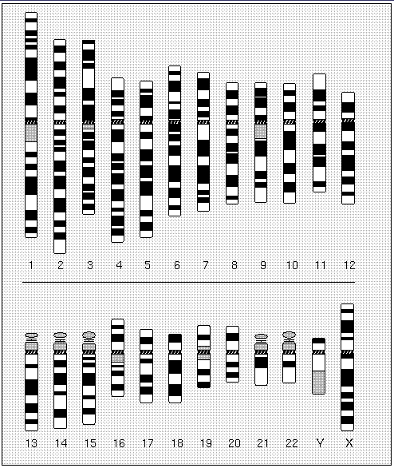
DNA & Genetics - Chromosomes
PATERNAL
MATERNAL
Definitions
Gene = basic unit of inheritance
Chromosome = linear organization of genes
23 pairs of chromosomes (one set each from mother and father)
Genome = all the DNA (chromosomes) within a person
David Adler, University of Washington

Slide 10
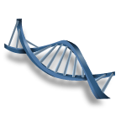
DNA & Genetics - Inheritance

Slide 11
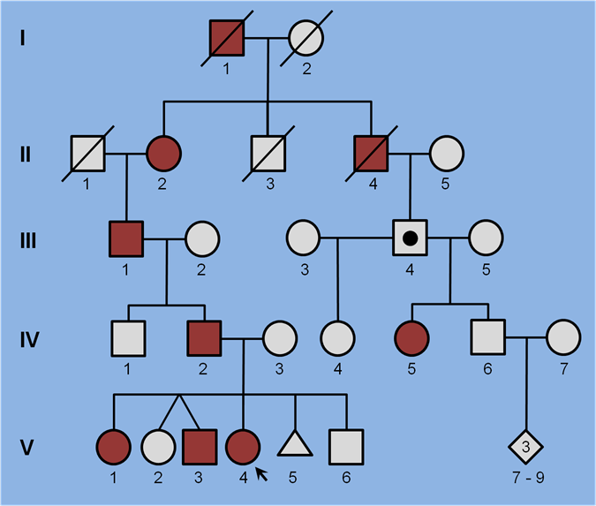
The Autosomal Dominant Cerebellar Ataxias
Commonly referred to as the Spinocerebellar Ataxias (SCAs)
Phenotype of slowly progressive, clinically heterogeneous ataxia
Currently 43 distinct clinical forms with 30 identified genes
Fogel and Geschwind,
Neurology in Clinical Practice,
2012

Slide 12
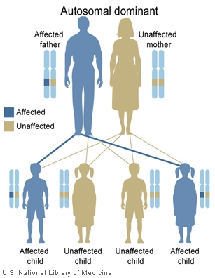
Autosomal Dominant Cerebellar Ataxia
Adult onset, typically between 20-50 years of age
Overall ~ 4 cases per 100,000 people worldwide
Most Common
SCA3
SCA1
SCA2
SCA6
SCA7
(~50% of total)
Most Recent
2014
SCA21 (France)
SCA34 (Canada)
SCA38 (Italy)
SCA40 (China)
2015
SCA41 (USA)
SCA42 (France, Japan)
2016
SCA43 (Belgium)
Inherit one “damaged” copy of the gene
(from either
mom or dad)
http://ghr.nlm.nih.gov/handbook/illustrations/autodominant

Slide 13
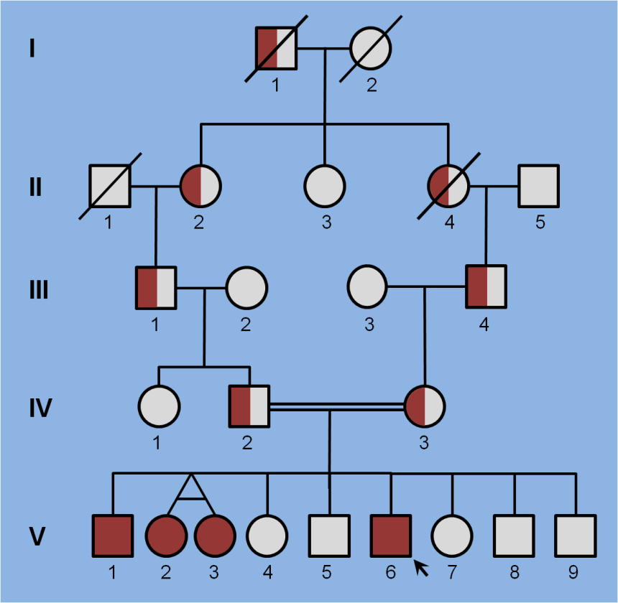
The Autosomal Recessive Cerebellar Ataxias
New diseases being named Spinocerebellar Ataxia, Recessive (SCARs)
Slowly progressive often with sensory/sensorimotor polyneuropathy
Several diseases involve organ systems outside the CNS (biomarkers)
At least 40 identified genes cause primary recessive ataxia
Fogel and Geschwind,
Neurology in Clinical Practice,
2012
Notes:
Consanguinity is an important clue
FRDA also most common hereditary ataxia overall
Not including disorders (e.g. mitochondrial, some metabolic, etc.) where ataxia is an associated feature.

Slide 14
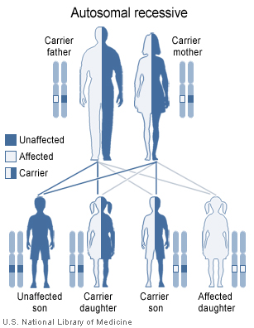
Autosomal Recessive Cerebellar Ataxia
Onset typically before age 20 years
Milder variants can present in adulthood
Overall ~ 4 cases per 100,000 people worldwide
Most Common
Friedreich
ataxia
(~50%)
Most Recent
2014
SCAR17 (Turkey, Netherlands)
SCAR20 (Portugal, Middle East)
SCAR23 (Ireland, Egypt)
2015
SCAR19 (Turkey)
SCAR21 (Europe, Cuba)
2016
SCAR22 (Japan)
SCAR24 (China)
Inherit two
“damaged”
gene copies
(one from
mom & dad)
http://ghr.nlm.nih.gov/handbook/illustrations/
autorecessive
Notes:
Phenotype often due to “loss of function”

Slide 15

Genetic Testing – Types of Genetic Testing
Full gene sequencing (Traditional Sanger method)
  Most complete test but also most expensive per gene
  Can potentially discover novel coding mutations
  REMEMBER: Not every sequence change causes disease!
Targeted mutation analysis
  Less expensive, useful in families to detect pre-defined mutations
  REMEMBER: Negative test rules out the specific mutations only!
Repeat expansion testing
  Required for common dominant
  SCAs and Friedreich Ataxia
  Cannot identify sequence
  changes or other types of
  mutations
Notes:
Useful for diseases where many different mutations throughout the gene are known to cause disease

Slide 16

Genetic Testing – Traditional Gene Panels
Often combine multiple types of testing for several different genes
  Full gene sequencing (Traditional Sanger method)
  Targeted mutation analysis
  Repeat expansion testing
Can be very expensive per gene
  Range US$500 - US$30,000 or more
  Insurance coverage varies
These panels don’t test every ataxia gene
  Not all ataxia genes are known!
  Not all genes have specific tests
  Some genes only cause ataxia
  rarely (e.g., not in all patients) so
  they aren’t included
Notes:
Useful for diseases where many different mutations throughout the gene are known to cause disease

Slide 17




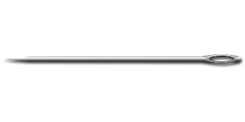
Genetic Testing Bias
Should you look at hay by the handful
for anything that might be sharp?
…or should you look through
the whole haystack for the
needle?

Slide 18

Classic Question: Single or Multi-Gene Panel?
Major Caveat to Biased Single Gene or Multi-Gene Panel Testing
  Clinical Heterogeneity: The same phenotype common to one disorder may be an atypical form of another, how do you know?
  Genetic Expressivity: Currently documented phenotypes may not represent the only forms of disease caused by a gene.
  Examples:
  - Late-onset Friedreich Ataxia (up to 25% of cases)
  - Fragile X-Syndrome & Fragile X-Tremor/Ataxia Syndrome (premutation)
  - Adult Polyglucosan Body Disease & Glycogen Storage Disease Type IV
  - X-linked Adrenoleukodystrophy & Adrenomyeloneuropathy
  - AOA2 (ataxia & polyneuropathy) vs. ALS4 (motor neuron)
How can one minimize such confounders and maximize genetic testing efficacy?

Slide 19
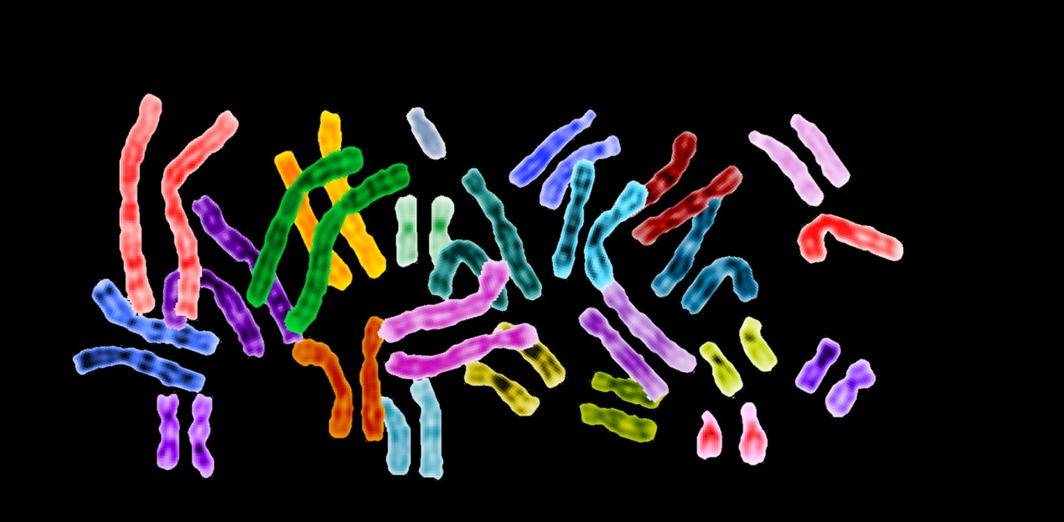
Exome Sequencing: An Unbiased Tool for Diagnosis
Genome
3.3 x 10⁹ base pairs
~20,000 genes
Exome
~1% of genome
~3 x 10⁷ base pairs
~20,000 genes
Examination of every gene simultaneously provides an
unbiased method of genetic testing
~26% overall diagnostic rate
(~3,000 neurologic cases)
http://www.genome.gov/dmd/index.cfm?node=Photos/Graphics

Slide 20
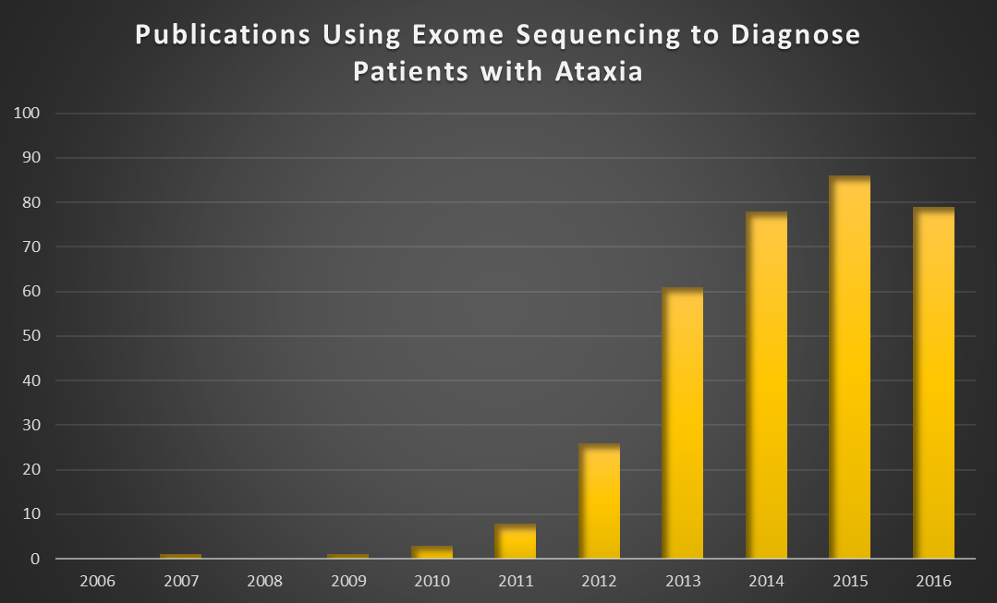
The Rise of Exome Sequencing in the Diagnosis of Ataxia
Introduction of
Clinical Exome
Sequencing

Slide 21
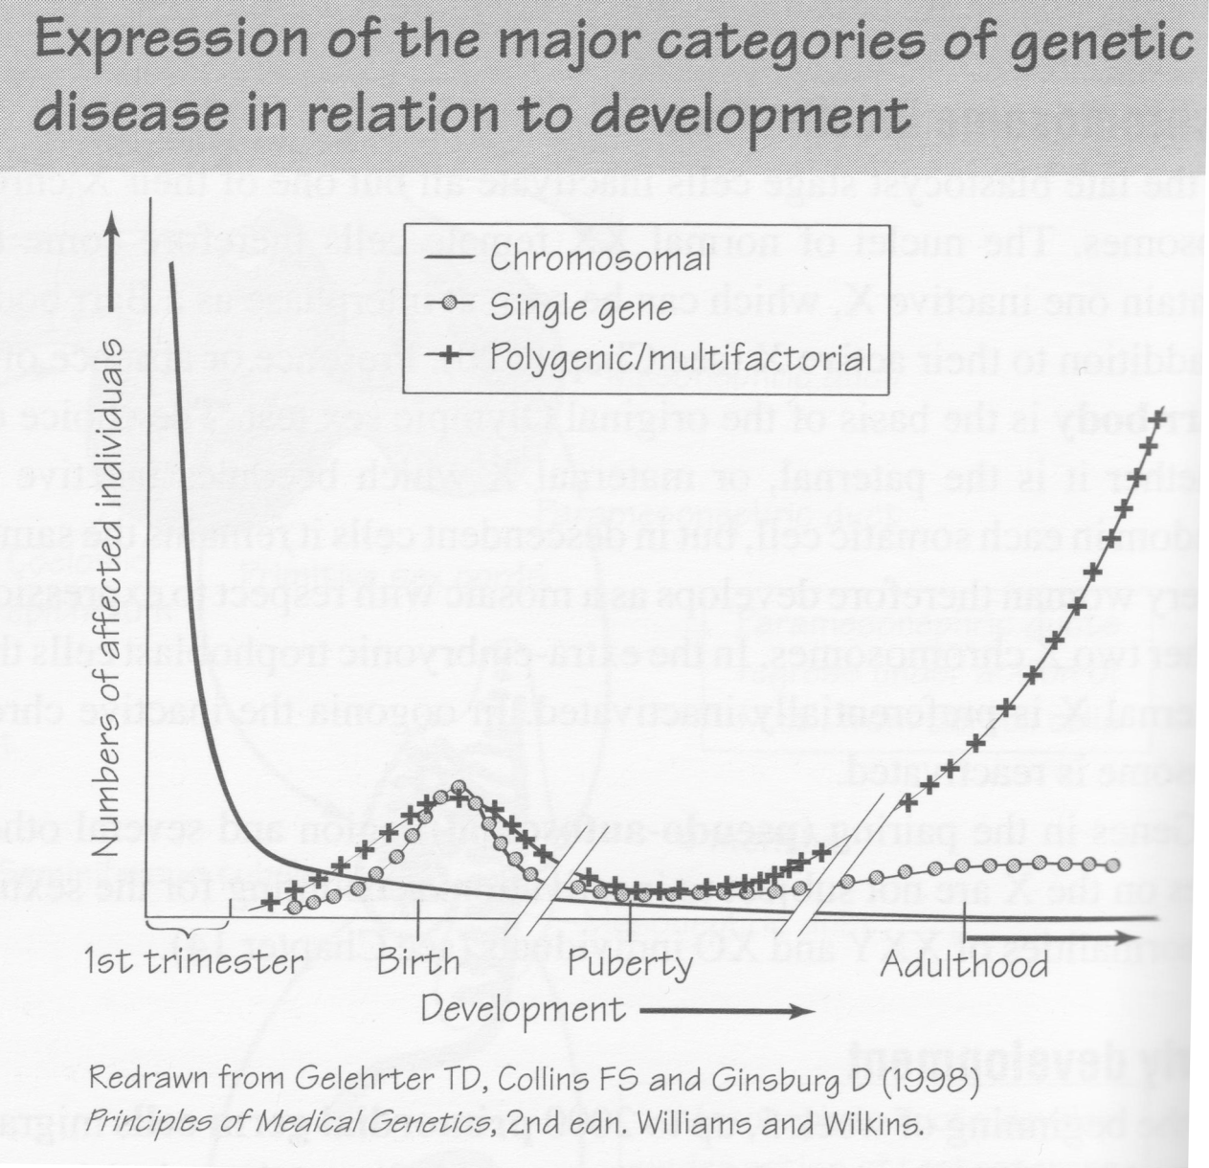
When to Use Exome Sequencing in Ataxia?
Most Ataxia Patients, Often Sporadic
Often Familial
20-40%*
40-50%*
*Patients with negative work-up for acquired causes and common genetic causes
Pritchard DJ & Korf BR 2003 Medical Genetics at a Glance

Slide 22
Types of Next-Generation Genetic Testing
Whole Exome (sometimes called a “Clinical Exome”)
  Most complete test, covers all ~20,000 genes in the genome
  Most expensive overall (~$5-10K) but least expensive per gene
Next-Generation Panels
(sometimes called “Exome Panels” or even a “Clinical Exome”)
  Less expensive per gene than traditional Sanger panels
  Includes only a few to hundreds of genes depending on the test
  Some laboratories may offer reflex option to whole exome if negative
REMEMBER!
  Different laboratories may analyze and/or report results differently
  Method does not detect repeat expansion disorders
  Not every sequence change causes disease
Notes:
Useful for diseases where many different mutations throughout the gene are known to cause disease

Slide 23
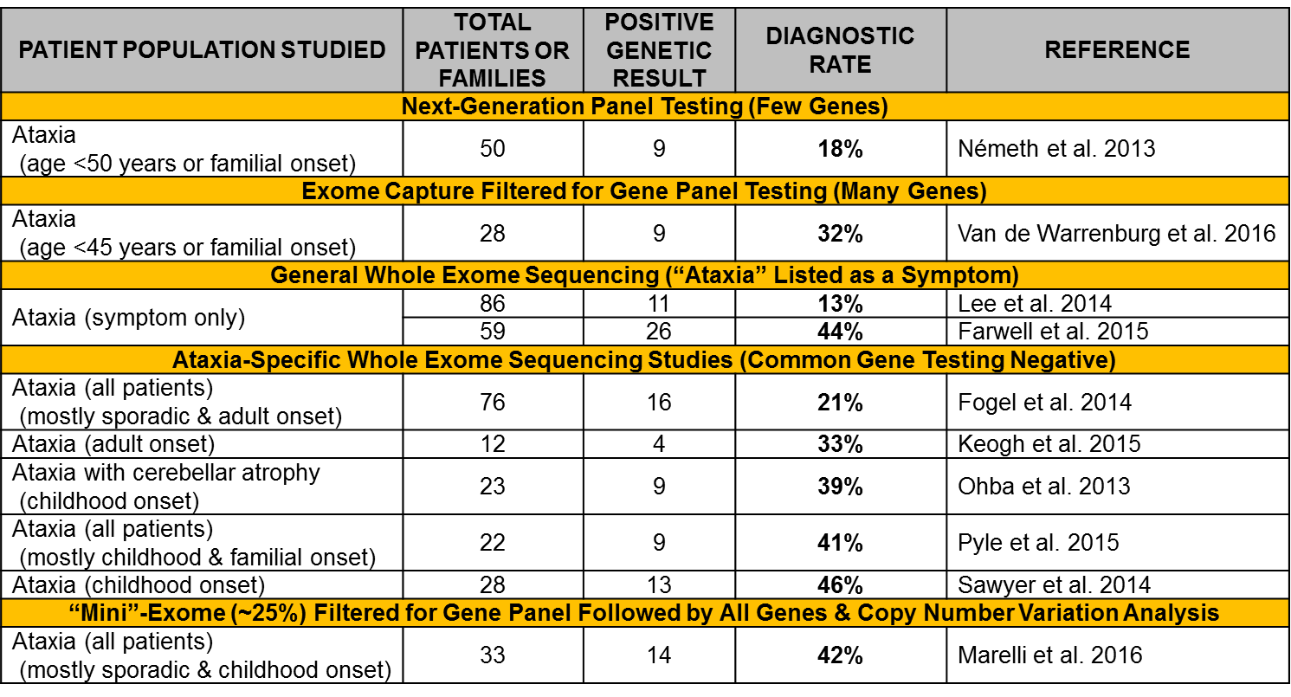
Which Type of Next-Gen Sequencing Test is Best for Ataxia?

Slide 24
Redefining Phenotypes to Improve Diagnosis
Hereditary Spastic Paraplegia (HSP)
Class of disorders characterized by progressive weakness and spasticity of the legs
Prevalence roughly equal to Spinocerebellar Ataxia worldwide
Genes designated as Spastic Paraplegia (SPG), now up to SPG77
SPG7
Causes up to 12% of all recessive HSPs worldwide
SPG7 has been identified in ataxia patients in several whole exome studies
39% (12/31) families in study of spastic ataxia in Canada (Choquet et al. 2015)
PNPLA6/SPG39
Identified in 2008 in patients with spastic paraplegia
In 2014 the SPG39 gene was found to cause forms of cerebellar ataxia
including syndromes with visual and/or hormonal problems (Synofzik et al. 2014)
- Boucher-Neuhäuser syndrome
- Gordon Holmes syndrome
- Laurence-Moon syndrome

Slide 25
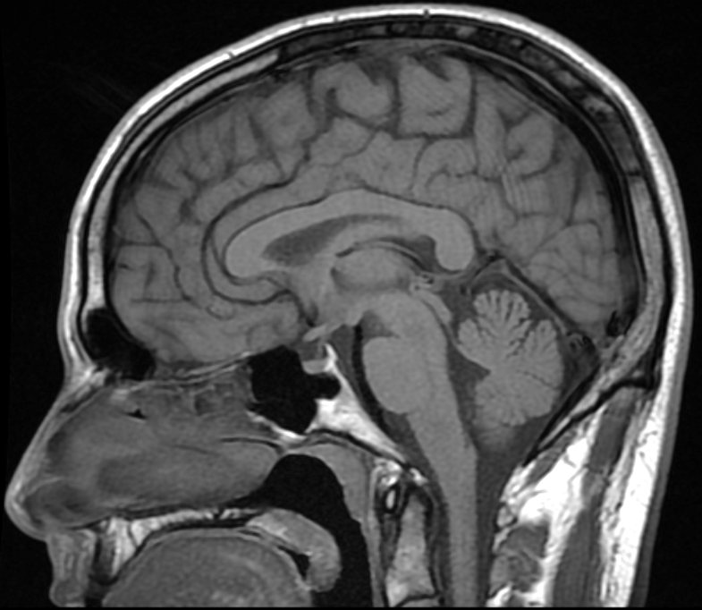
Discovering New Genetic Disorders
40 year old white man of European ancestry
2 years progressive imbalance and ataxic gait
Negative evaluation for acquired causes of ataxia
MRI with mild cerebellar vermian atrophy
No family history but estranged from paternal side
Sagittal T1 magnetic resonance imaging of the brain shows very mild atrophy of the cerebellar vermis (arrow) with no brainstem involvement.

Slide 26
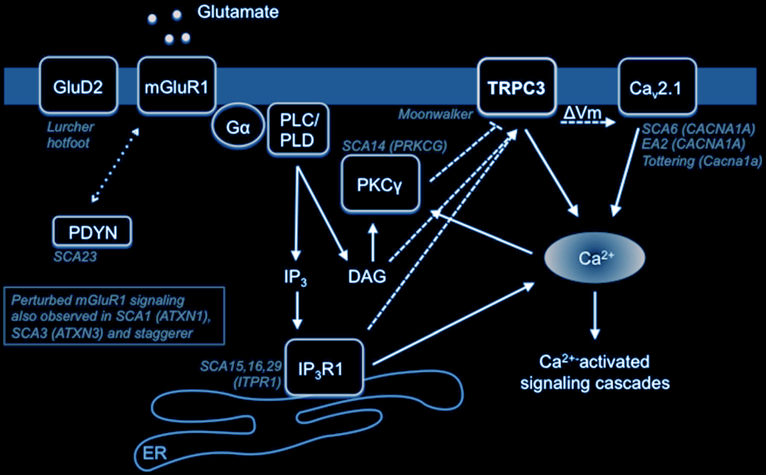
TRPC3
TRPC3 is a non-selective cation channel linked to key signaling pathways affected in cerebellar ataxia
SCA41
Role of TRPC3 in the mGluR1 signaling pathway essential for Purkinje cell function.
Loss of any component in the depicted signaling cascade results in cerebellar ataxia in humans and/or mice.
Figure reproduced from Becker EB. Cerebellum 2015.

Slide 27
Rapid Identification of Treatable Patients
Clinical History
9 year old Lebanese girl with progressive balance problem since age 2 years
Gait & limb ataxia, sensory neuropathy, areflexia and upgoing toes
Scoliosis but no skin, cardiac, or muscle involvement
Detailed genetic testing negative
Exome sequencing identified homozygous mutations in SLC52A2
SLC52A2 encodes a membrane-bound riboflavin transport protein
Mutation of SLC52A2 causes Brown-Vialetto-Van Laere syndrome (juvenile-onset motor neuron disease, deafness, ataxia)
Disease is typically fatal in 1st decade of life
Identical mutation reported in classic BVVLS in 2 families (one from Lebanon)

Slide 28
Rapid Identification of Treatable Patients
Follow-Up
Patient diagnosed with Brown-Vialetto-Van Laere syndrome
Riboflavin transporter is defective but not absent, therefore could potentially drive uptake with high dose intake of riboflavin
Treatment started immediately and symptoms stabilized.
Exercise and physical therapy led to marked improvements.
Now stabile for over 4 years.
Mildly clumsy but playing volleyball, dancing, karate, running long distance.
SHE IS ESSENTIALLY CURED.

Slide 29
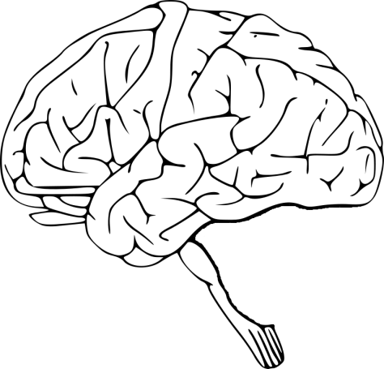
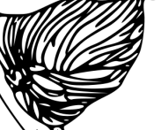
Clinical Evaluation
Detailed History of Symptoms
Comprehensive Neurological Examination
Complete Family History
MRI of the Brain
Most common etiologies
Diagnostic Evaluation
Screen for Acquired Causes of Ataxia
Genetic etiologies
Common Genes:
Estimated 40-50%
of Genetic Ataxia
Basic Diagnostic: Initial Genetic Screening
Single Gene Testing*
Repeat Expansion Disorders
Dominant: SCA1, SCA2, SCA3, SCA6, SCA7
Recessive: FRDA
If negative
Rare Genes:
Estimated <1%
of Genetic Ataxia
Advanced Diagnostic: Clinical Exome Sequencing
If onset prior to age 20 years or suspected recessive
inheritance consider simultaneous evaluation of parents.

Slide 30
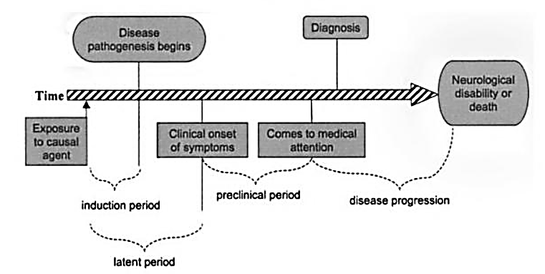
Reasons to Diagnose Neurogenetic Disease
Can be decades (or never) for rare diseases
Disease Pathogenesis
Begins
Diagnosis
Time to Diagnosis
Neurological
Disability
or Death
Time
Causal
Agent
Clinical Onset of
Symptoms
Comes to Medical
Attention
Induction Period
Preclinical Period
Disease Progression
Latent Period
Disease or its comorbidities
may be modifiable
Genetic counseling
Establishing a genetic cause stops
nonproductive search for other causes
Modified from Nelson, Tanner, Van Den Eeden, McGuire eds: Neuroepidemiology, 2004

Slide 31
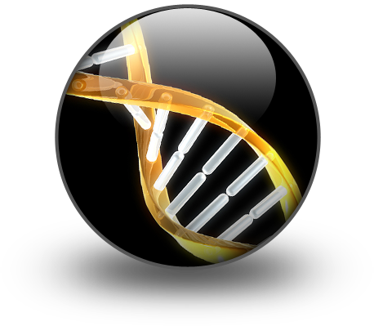
^{Present}
The Future of Clinical Genetic Testing
Clinical Exome Sequencing is an unbiased form of genomic testing that assesses all 20,000 genes in the human genome simultaneously (cheap and efficient)
Clinical Exome Sequencing improves diagnosis of clinically heterogeneous neurogenetic phenotypes (broad application)
Clinical Exome Sequencing can lead to diagnoses that directly affect and improve patient management (clinically meaningful)
Clinical Exome Sequencing reduces time to diagnosis sparing patients an extensive diagnostic odyssey (and sparing payers the subsequent costs)
Clinical Exome Sequencing should compliment, not
replace, a systematic patient evaluation (including
high yield genetic testing if appropriate)
Because results are not typically “positive” or “negative”
physicians must receive training in the proper use and
interpretation of clinical exome sequencing
(disease-specific interpretation)

Slide 32

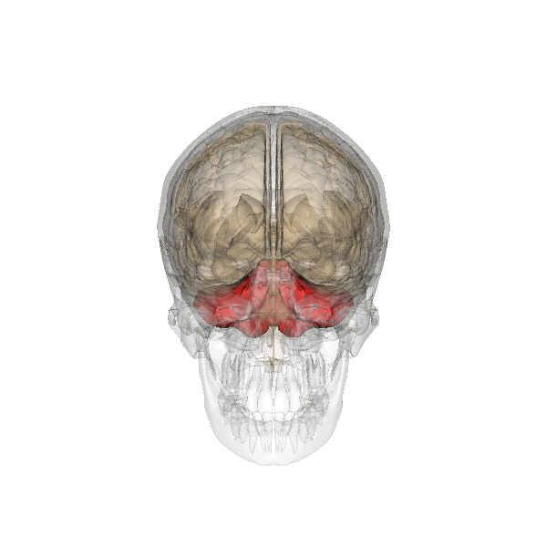
Acknowledgements
Our Patients and their Families
UCLA Neurology
UCLA Neurogenetics
UCLA Molecular Diagnostics Laboratory
National Institutes of Health
National Ataxia Foundation
Questions?
Web: http://fogellab.neurology.ucla.edu/
Twitter: @fogellab
Image from Anatomography maintained by Life Science Databases(LSDB).
From http://commons.wikimedia.org/wiki/File:Cerebellum_small.gif

