Slide 1

General Exercise Recommendations for People Living with Ataxia
Julie Walker PT, DPT, NCS

Slide 2
*Disclaimer*
Please consult with your primary care provider, neurologist, or other health care provider about any advice, exercise, therapies, medication, treatment, nutritional supplement, or regimen that may have been mentioned as part of any presentation

Slide 3
Objectives
By the end of the session the learner should be able to:
  Discuss common challenges to function
  Discuss the benefits of exercise
  Identify current literature
  Identify available PT resources

Slide 4
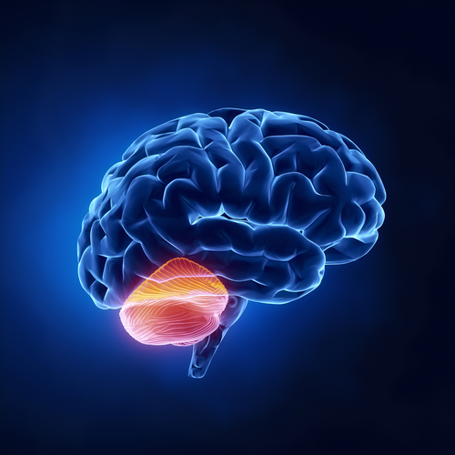
What is the role of the Cerebellum?
Center for Balance, Coordination, and Learning
Controls all Motor behavior
Limb Movements
Trunk Movements
Eye Movements
Speech

Slide 5
Ataxia Symptoms
Impaired Coordination
  Difficulty with reaching for objects or writing
Decreased balance
  Impairments with postural adjustments and control of balance
Difficulty Walking
  Varied step placement due to trouble with leg coordination
Trouble controlling eye movements
Slurring of speech
NO WEAKNESS
  Feel “weak” due to impaired motor control

Slide 6
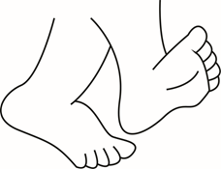

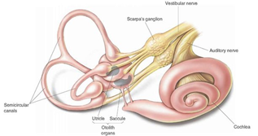
Balance Systems
Vision
Somatosensory
Vestibular

Slide 7


Slide 8
What about Walking?
Decreased Coordination in Legs and Trunk
+
Impaired Balance
=
Variability of steps
Increased Falls
Fatigue

Slide 9
What is a better predictor of improved quality of walking?
A: Leg Placement (coordination)
B: Balance
Answer: Balance
(Morton and Bastian 2003)
Notes:
Amy Bastian from KKI did a study in 2003 where they took 20 controls, 20 cerebellar patients. They measured a dynamic balance weight shifting task then also measured a leg placement task with visually guided stepping.
After measuring those they looked at fast gait speed. They found that overall gait function was predicted by the severity of imbalance and not leg incoordination
So Balance dysfunction predicts cerebellar gait ataxia not just incoordination.

Slide 10
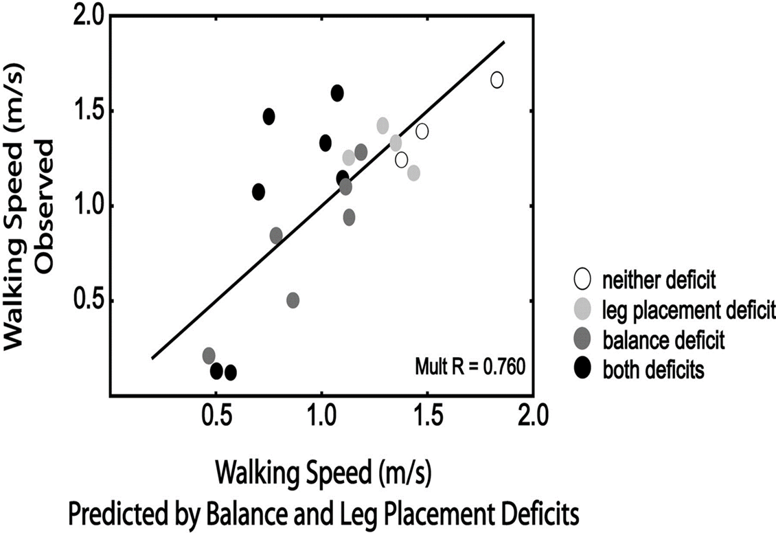
(Morton and Bastian 2003)

Slide 11


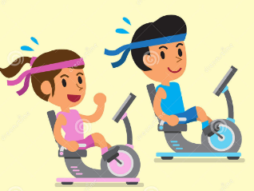

American College of Sports Medicine
Exercise Recommendations

Slide 12

ACSM: Aerobic Exercise
  Frequency: >5 days a week of moderate exercise, or >3 days a week of vigorous exercise
  Intensity: Moderate and/or Vigorous Intensity
  Duration: 30-60 minutes a day, total 150 minutes a week of purposeful moderate exercise
  Mode: Regular, purposeful exercise that involves major muscle groups and is continuous and rhythmic in nature
  Exercise may be performed in one continuous session per day or in multiple sessions of more than 10 minutes to accumulate the desired duration and volume of exercise per day

Slide 13

ACSM: Resistance Exercise
  Frequency: Each major muscle group should be trained 2-3 days a week
  Intensity: 60-70% of the 1 repetition max
  Repetitions: 8-12 repetitions
  Sets: 2-4 sets to improve strength and power
  Rest: Rest >48 hours between sessions for any single muscle group
  Decrease intensity and increase repetitions to improve muscular endurance

Slide 14
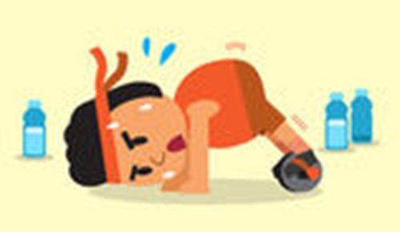
ACSM: Flexibility Exercise
  Frequency: >2-3 days a week
  Intensity: Stretch to the point of feeling tightness or slight discomfort
  Duration: Hold a static stretch for 30-60 seconds
  Mode: Series of flexibility exercises for each of the major muscle-tendon units
  Flexibility exercise is most effective when the muscle is warmed through light to moderate aerobic activity or passively through external methods such as moist heat packs.

Slide 15
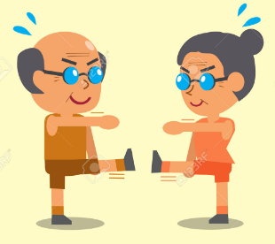
ACSM: Neuromotor Exercise
Frequency: >2-3 days a week
Intensity: Unknown
Duration: >20-30 minutes per day
Mode: balance, agility, coordination, gait
Methods for optimal progression are not known

Slide 16

Evidence in the Literature
Why is Exercise so Important?
What can it help me be able to do?
How can I start exercising and what should I do for exercise?

Slide 17
Can Exercise slow Disease Progression?
Exercise may help regain functional performance of one or more years of the disease progression (miyai, ilg)
SARA scores may worsen 0.4 to 2.2 points per year depending on type of ataxia (Jacobi 2011)
Intensive Coordination Therapy studies have shown SARA Scores improve up to 5.2 points = Gaining 2 or More YEARS of disease progression (Miyai, Ilg 2009)

Slide 18
What are your goals?
Infrequent Faller
Improve Dynamic balance
Decrease falls risk
Prevent need for an assistive device
Playing sports etc.
Frequent Faller
Improve task specific skills
Transfer training
Improve Static Balance
Decrease Falls
Set and establish goals with help of a Physical Therapist

Slide 19
Examples of goals:
Infrequent Faller
Frequent Faller
Talk to family while walking
Walk and carry something without spilling it
Negotiate a curb safely
Be able to play catch with my son
Be able to transfer from the bed to a chair without help
Stand in the kitchen and talk to family without having to hold onto the counter
Use the regular chair at a restaurant instead of my wheelchair

Slide 20
Benefits of Balance Training
Improved Quality of Walking
  Decreased Variability of steps
  Decreased Variability of sway
  Improved Walking Speed
Reduces Risk of Falls
Improves Motor Planning
Ilg 2009, 2015; Bastian and Keller 2014

Slide 21
Intensive Coordinative Training Improves Motor Performance in Degenerative Cerebellar Disease Ilg et al. 2009
Patients
  16 patients
  10 with Cerebellar Ataxia
  6 with Sensory Ataxia
Intervention
  4 weeks of Intensive therapy with a therapist
  3x a week for 1 hour sessions
Results
  Decline of average of 5.2 points on SARA
  Increased Gait Speed
  Less Variability of step placement
  All equal less risk for falls!

Slide 22
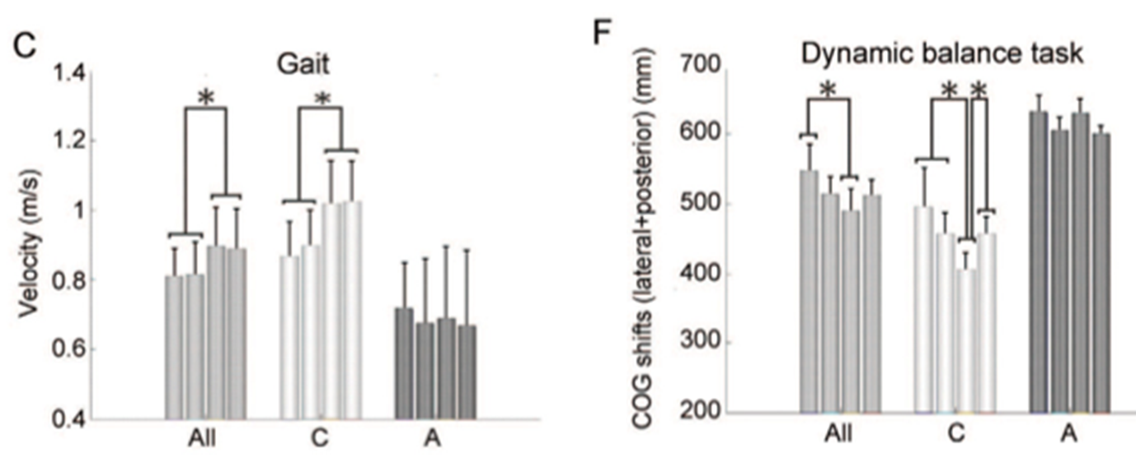

Slide 23
What did they do for Exercise?
Static Balance Exercises
Dynamic Balance Exercises
Standing with varied feet position
Sitting on varied surfaces
Kneeling with arm movement
Stepping while standing
Climbing stairs
Side stepping
Walking on uneven ground

Slide 24
Exercises to prevent Falls
Stepping in multiple directions
External perturbations by the therapist while standing or moving
Quadruped (on all 4s) and practice of floor transfers
Squatting and standing back up

Slide 25
6 week home exercise study for people with cerebellar damage (Keller, Bastian 2014)
Patients
  14 patients with cerebellar ataxia
Assessments
  Walking speed
  Walking balance tests
Intervention
  Home Physical Therapy
Notes:
Key Take Home Point: How much effort the patients were putting in Not about more and easy it is about quality and challenge level

Slide 26
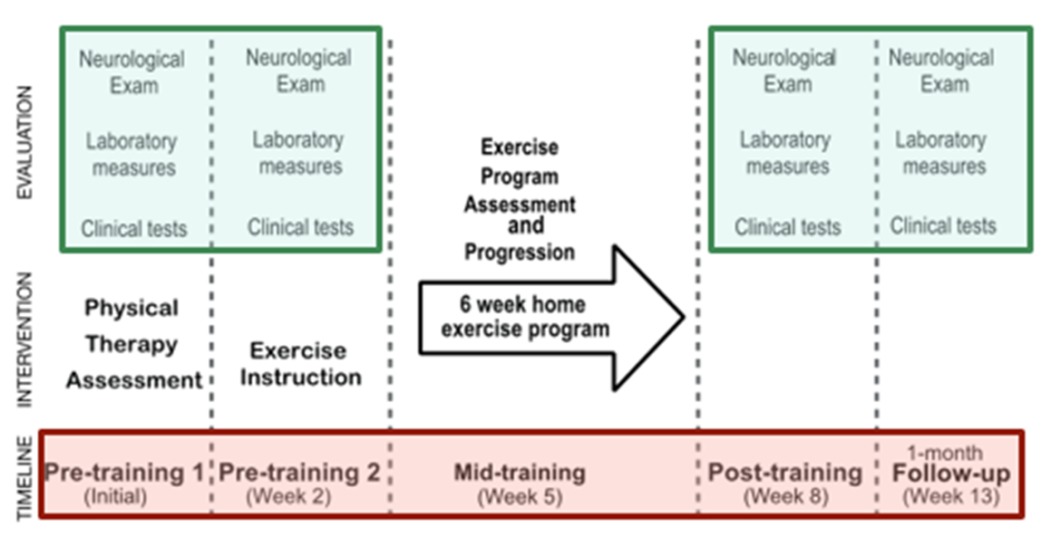

Slide 27
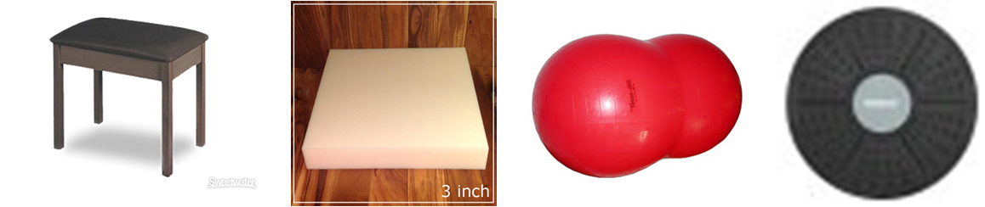
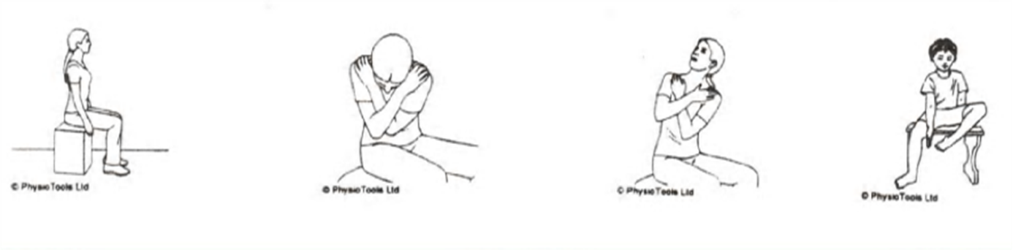
Sitting Balance Exercises
Movement on Varied Support Surfaces
Adapted from Jennifer Keller

Slide 28
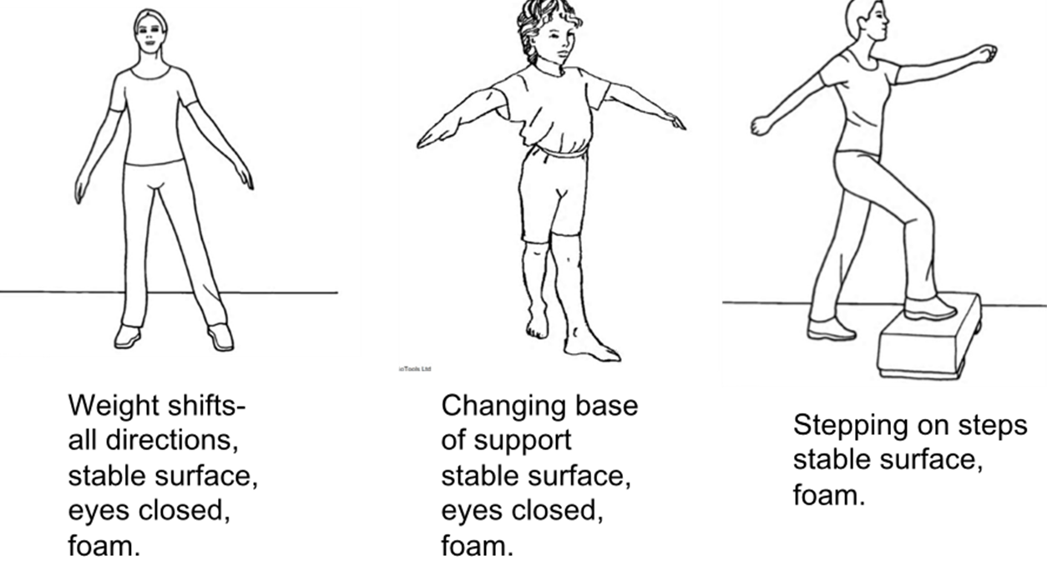
Standing Balance Exercises
Adapted from Jennifer Keller

Slide 29
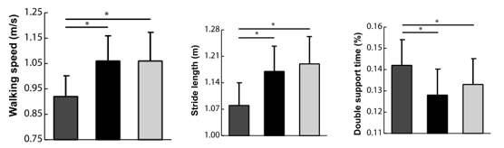
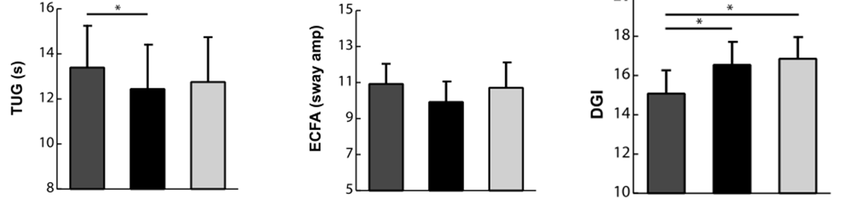
Results
Tests that were not directly part of the training improved!
Adapted from Jennifer Keller
Notes:
Other parts of the brain that can do learning—not motor adaptation but the reinforcement based learning-- --Finding out that the specific feedback is not as good but more general feedback is better.

Slide 30
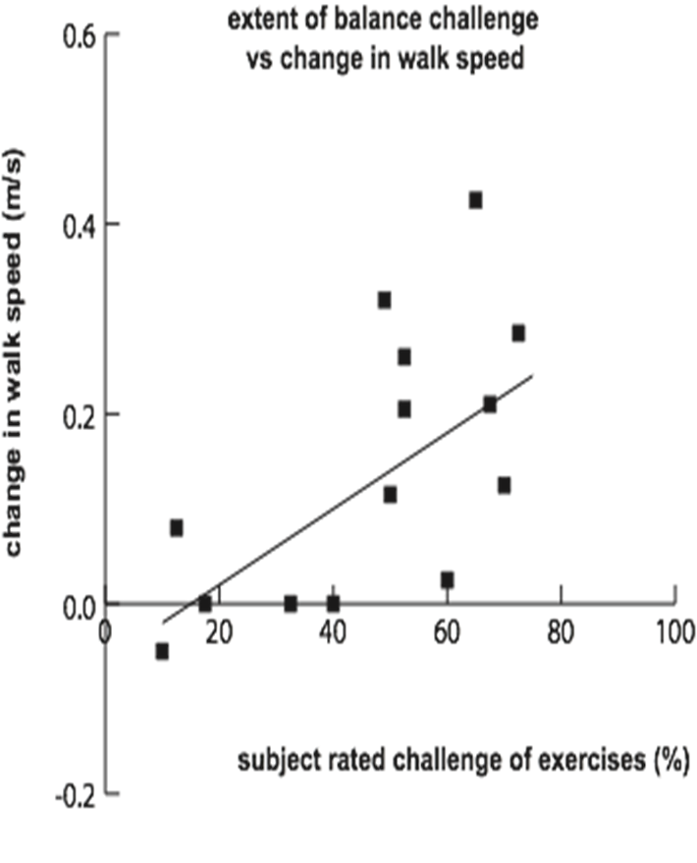
What was the Key to Improvement?
Participants who rated the exercises as more challenging improved the most (Bastian Keller 2014)

Slide 31
What is the Key for Exercise?
Exercise needs to be CHALLENGING enough to be beneficial
  Periodically review your home program with your PT
Exercise needs to be SAFE to prevent falls
  Exercise with advice from a Neuro PT
Motor Learning is achieved with REPETITION and reinforcement (Therrian 2016)
Notes:
Challenging but challenging to a point---Challenging but yet appropriate.

Slide 32
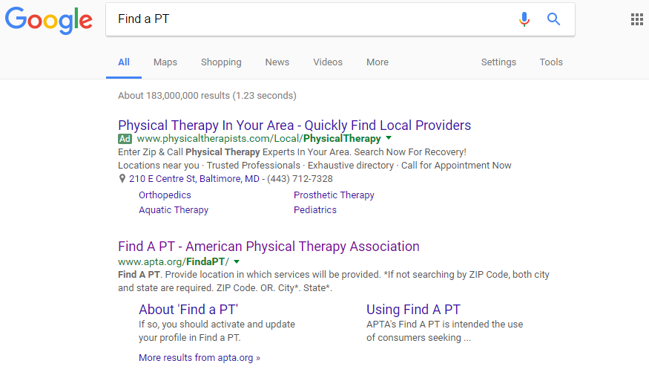
How do you Find a Neuro PT??
Google: Find a PT Near Me

Slide 33
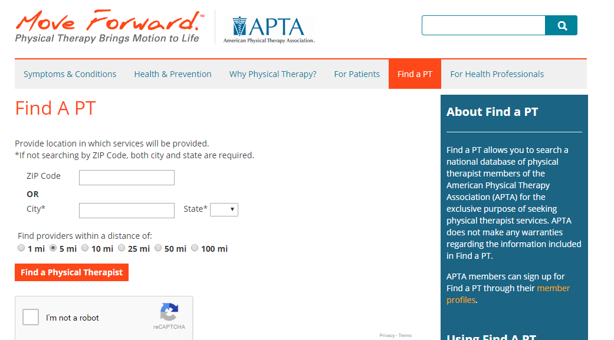

Slide 34
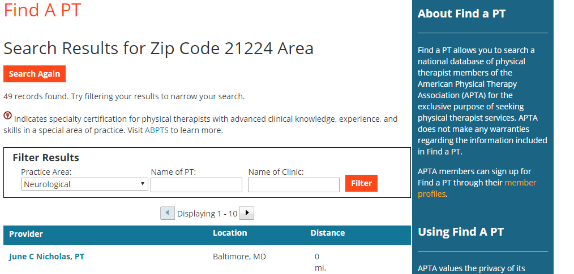

Slide 35

Questions?

Slide 36
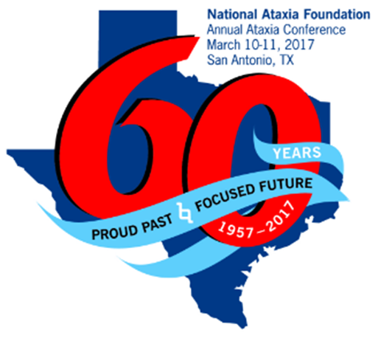
Special Thanks To:
Jennifer Keller
Jennifer Millar
Amy Bastian
The Johns Hopkins Ataxia Clinic

Slide 37
References
Bastian AJ. Learning to predict the future: the cerebellum adapts feedforward movement control. Curr Opin Neurobiol 2006, 16(6): 645-649.
Fonteyn EM, Physiotherapy in Degenerative Cerebellar Ataxias: Utilization, Patient Satisfaction, and Professional Expertise. Cerebellum (2013) 12:841–847
Ilg W, Synofzik M, Brotz D, Burkard S, Giese MA, Schols L. Intensive coordinative training improves motor performance in degenerative cerebellar disease. Neurol 2009; 79 (20):2056-2060.
Ilg W, Schatton C, Schicks J, Giese M, Schols L, Synofzik M. Video game based coordinative training improves ataxia in children with degenerative ataxia. Neurology. 2012; 79: 2056-2060.
Keller JL, Bastian AJ. A home balance exercise program improves walking in people with cerebellar ataxia. Neurorehabilitation and Neural Repair. 2014; 28(8): 770-778.
Morton SM, Bastian AJ. Relative contributions of balance and voluntary leg-coordination deficits to cerebellar gait ataxia. J Neurophysiol 2003; 89(4): 1844-1856.
Morton SM, Bastian AJ. Cerebellar control of balance and locomotion. Neuroscientist 2004; June (10): 247-59.
Morton SM, Bastian AJ. Cerebellar contributions to locomotor adaptations during splitbelt treadmill walking. J Neurosci 2006, 26(36): 9107-9116.
Synofzik M, Ilg W, Motor Training in Degenerative Spinocerebellar Disease: Ataxia-Specific Improvements by Intensive Physiotherapy and Exergames. BioMed Research International 2014 Review Article ID 583507
Therrien AS, Wolpert DM, Bastian AJ. Effective reinforcement learning following cerebellar damage requires a balance between exploration and motor noise. Brain 2016, 139(1):101-14.

