Slide 1

My Journey with Ataxia
Michael Cammer
Downingtown, PA

Slide 2

Disclaimer
The information provided by speakers in any presentation made as part of the 2015 NAF Annual Membership Meeting is for informational use only.
NAF encourages all attendees to consult with their primary care provider, neurologist, or other health care provider about any advice, exercise, therapies, medication, treatment, nutritional supplement, or regimen that may have been mentioned as part of any presentation.
Products or services mentioned during these presentations does not imply endorsement by NAF.

Slide 3
Presenter Disclosures
Michael Cammer
The following personal financial relationships with commercial interests relevant to this presentation existed during the past 12 months:
No relationships to disclose or list

Slide 4
My Journey with Ataxia
When I was first asked to talk about my journey, I started thinking about my timeline, I didn’t realize I had been on the “Ataxia Cab” for 25 years now!
Just one person can make a difference!
DON’T BE SHY!!!

Slide 5
Sunny days ahead! Life before Ataxia
Life up to 1989 was pretty good!
High school/college
Athletics and outdoors
Navy
Community college/2nd job
Triathlons
Assistant wrestling coach
Just about everything I did was to prepare to return to school

Slide 6
Getting Cloudy
1990 - 1992
Returned to college and started competing again
What was happening to me? !!!!!!!
1ST noticeable loss of balance
Had two good seasons and led the team with 20+ wins and was Team Captain at Mansfield University
Did not return to Nationals, but maybe more rewarding – I was named 1st Team Academic All-American twice and 3 time PSAC Scholar Athlete

Slide 7
Dark Days
1993 - 2006
Confusion/the unknown- thought I was hiding symptoms
Quit playing softball – could not see ball anymore, loss of pursuit and developed double vision
Stopped entering triathlons – could not run or ride bike anymore
Worried about my job in law enforcement
Visited neurologist on 2002 for 1st time, couldn’t find out why so he sent me to PT, PT ask me to squeeze tennis ball???
Some light –
Met my wife
Got married and started a family
Became Head Coach of Coatesville HS wrestling team

Slide 8
Stormy Dark Days
Got an MRI in 2006 for painful shoulder, was told nothing wrong with shoulder, BUT…
Sent to neurologist
Diagnosed with spino-cerebellar degeneration
First time I heard the word Ataxia and other vocabulary words
Not a good experience with neurologist
Overwhelming feeling of fear
Really noticed speech after phone message

Slide 9
Hurricane Season
Anger/resentment
Periods of depression/helplessness
Loss of identity
Sold my H-D Sportster
Embarrassment about being handicapped
Gave up coaching for family/personal safety

Slide 10
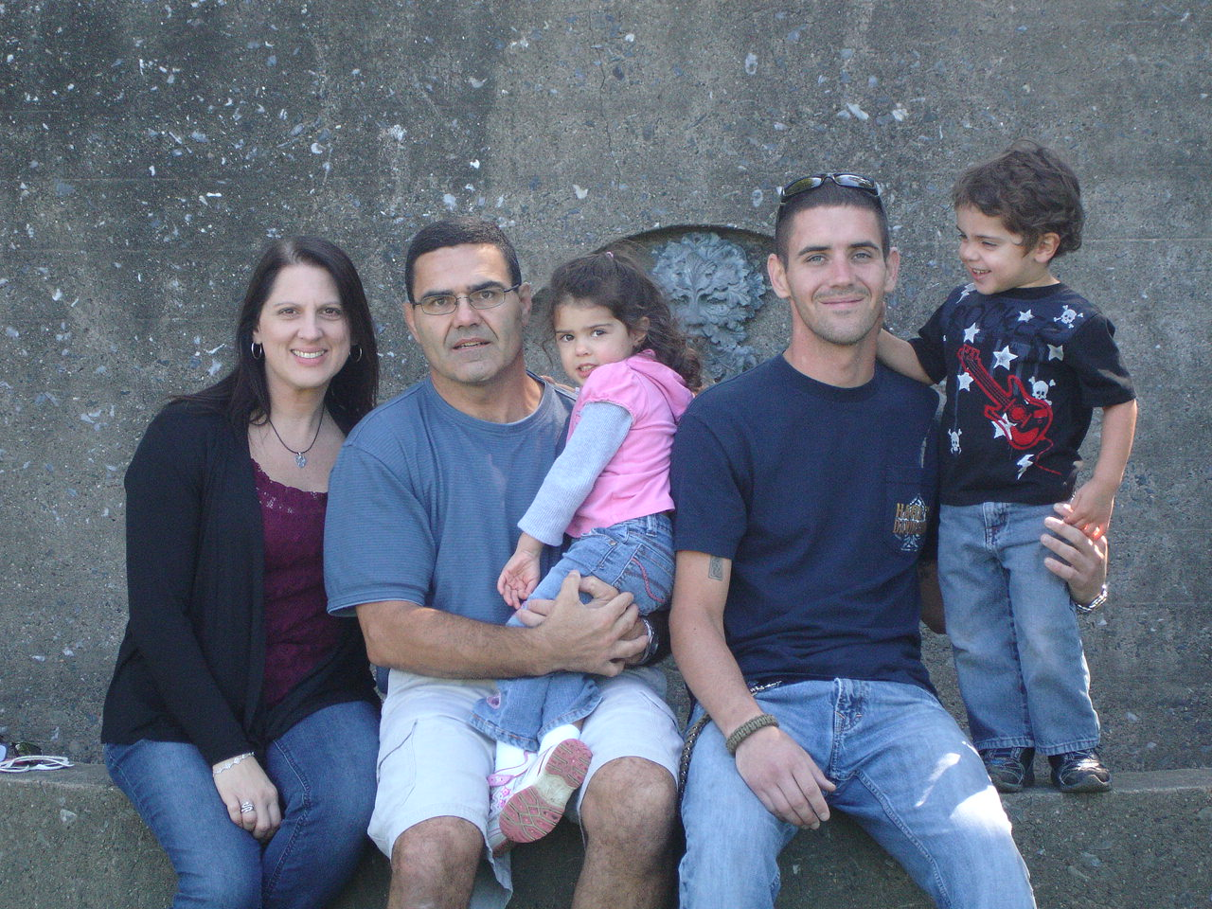
My Family!

Slide 11
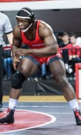
Michael Boykin 197 lb at NC State

Slide 12
How Wrestling has helped
Tenacity and determination
Quickly change direction
Don’t reach when you fall
Unless it is to protect head/face!
TUCK AND ROLL
This may be against all instincts
There are many challenges still!
Stairs, cabinets, doorways, buttons and other small objects

Slide 13
Sunshine after the storm
Found NAF!
Accepted Ataxia by self naming diagnosis –
Shoulder Shrug Ataxia
The hardest door I ever opened was the one to acceptance!
New purpose in life
Became involved with support group
Do research when available
Fundraiser at Boscov’s
Ataxia Awareness table in “Times Square” area of VA hospital I work at

Slide 14
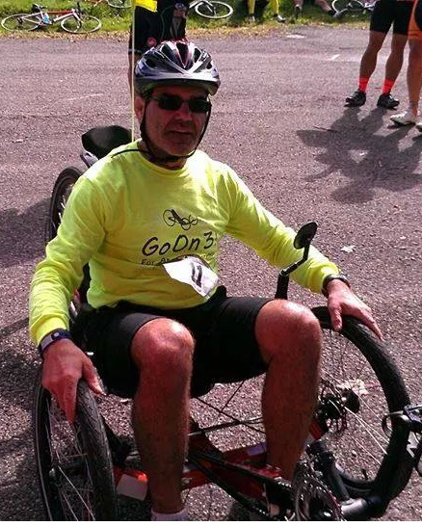
The re-discovery of wheels!
1st recumbent trike demo at 2012 DE/PA “Walk, Run n’ Roll”
June 2014 - Got my trike!

Slide 15
Ride, Ride, Ride and Go On 3!
Found “National Bike Challenge” website
https://nationalbikechallenge.org/
I was #6678 out of 47,592 registered riders!
Got local paper from hometown announcing the 16th Annual Tour de Shunk
My “Go on 3! for Ataxia Awareness” fundraiser was born!
Raised just under $2,000 for NAF and around $300 for the “ThinkBig Pediatric Cancer Fund”
Mission complete for awareness!!! 102.5 mile ride was finished and Ataxia was the buzz word at the “Tour de Shunk” and in the Sullivan Review!
Expand “Go On 3! for Ataxia Awareness

Slide 16
Observations about Internet and Social Media
It is a great thing for finding information about Ataxia, research and staying connected, BUT
It can also be bad, very bad!
By not knowing I was pulling in several different diagnosis’s and some of it was not pretty
It can reach out, but isolate! There are many awesome Facebook pages out there relating to Ataxia to stay connected, but we don’t need to spread awareness amongst ourselves. Get out and verbally tell at least one person a day
REPEAT! Become involved with support group, don’t just be in the support group, BE THE SUPPORT!

Slide 17
Educate, Educate, Educate!
Just remember one thing:
“Every expert was once a beginner!”
There has to be a beginning and we need to use this for ataxia awareness and educate!
Tell at least one person a day about Ataxia!
Brain Health Fair in Washington DC on April 18th

Slide 18
We are not alone!
Ataxian’s fall down enough on our own, we cannot let it keep us down!!!
Ataxia is something that we have been dealt. It is a burden we must learn to carry and overcome. We choose to make a difference!
You are not alone – There are an estimated 150,000 of us, not including family and caregivers, Researchers and of course the NAF. Use this network for support, to build friendships and spread ataxia awareness.
You have all taken the first steps just by being here!

Slide 19
MAINTAIN FITNESS!!!
Work-out daily!
Walk the dog!
Get a trike!
Check out adaptive sports.
I encourage and challenge you all to get strong and be strong for yourself, your family and friends and for the Ataxia community. If we are strong together we can find an answer and cheat Ataxia.
I was told at Kennedy-Krieger Movement Clinic that I was an unfair patient because I’ve maintained my fitness and she had to come up with ways to make things more challenging!

Slide 20
My Journey with Ataxia
In closing, I would like to rephrase a famous presidential quote by JFK:
Ask not what Ataxia has done to you, ask what you can do for research and to spread Ataxia Awareness!
YOU CAN MAKE A DIFFERENCE!!!

Slide 21
My Journey with Ataxia
CONTACT INFO:
Michael Cammer
Downingtown, PA
michael.cammer62@hotmail.com

