Slide 1
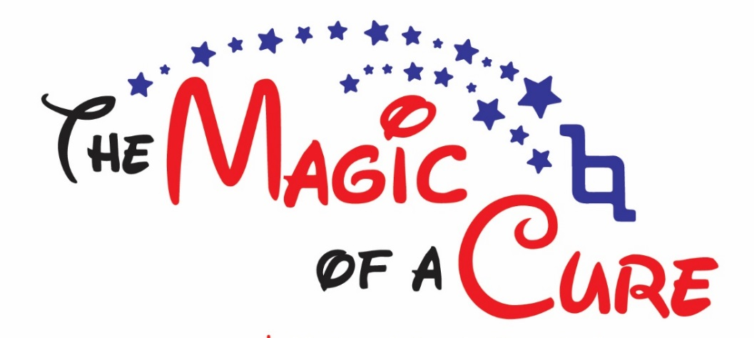
National Ataxia Foundation 59th Annual Ataxia Conference
Mike Parent, Executive Director
Hosted by the SouthEast Region
Dream It.
Hope It.

Slide 2
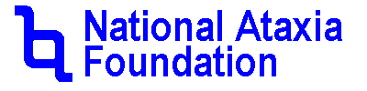
Disclaimer
 The information provided by speakers in any presentation made as part of the 2016 NAF Annual Ataxia Conference is for informational use only.
 NAF encourages all attendees to consult with their primary care provider, neurologist, or other health care provider about any advice, exercise, therapies, medication, treatment, nutritional supplement, or regimen that may have been mentioned as part of any presentation.
 or services mentioned during these presentations does not imply endorsement by NAF.
Presenter Disclosures
 No relationships to disclose or list

Slide 3



Slide 4
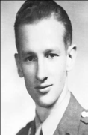
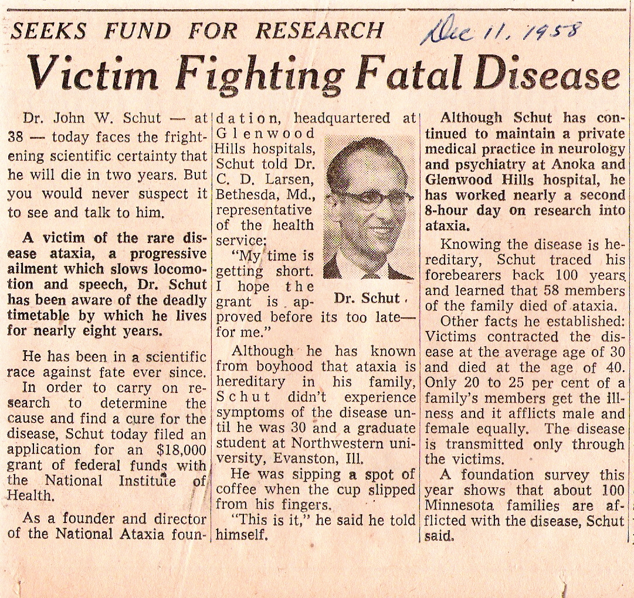
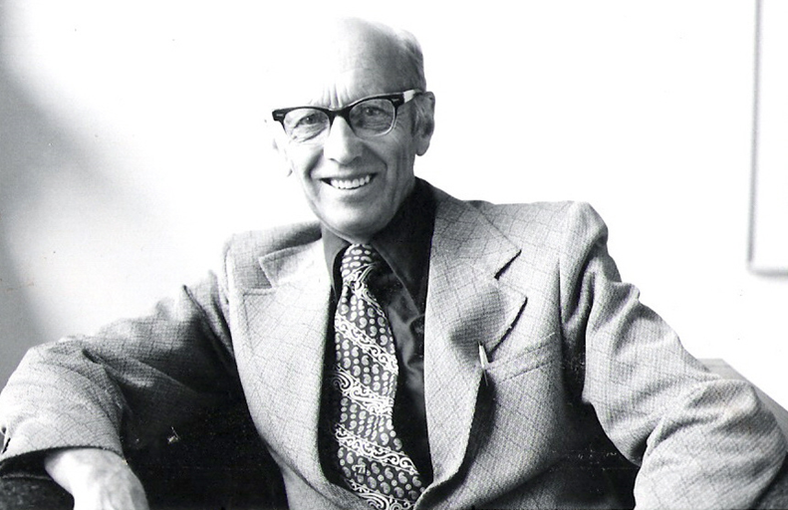
The National Ataxia Foundation
The National Ataxia Foundation is entering its 59th year in serving ataxia families.
The main focus and purpose of the Foundation as envisioned by its founders remain the same :
Fostering promising Ataxia research and helping those with Ataxia and their families.

Slide 5
History
Many rare disease groups organizations are formed by those who have been impacted by a particular disease. The National Ataxia Foundation (NAF) was no exception and was established by a family affected by Ataxia. NAF was founded in 1957 by two brothers, Dr. John W. Schut and Henry Schut, along with other family members and friends, on the belief that by working together, ataxia families, clinicians, researchers, and others can accomplish great things.
Although the road the organization has traveled throughout its history has been challenging, its mission has always been clear.

Slide 6
Here is our journey:

Slide 7
The first officers included President Ellis J. Sherman,
Vice President and Secretary Henry Schut and
Treasurer Robert Van Hauer.
Dr, John W. Schut was appointed as the first Medical Director
1957
Thirteen attend the organizational meeting of the National Ataxia Foundation on April 8, 1957.

Slide 8
1958
When NAF first began, a membership was only given after the application was reviewed at the annual meeting. It was not until the 1970’s when open memberships were accepted.
The 1st annual membership meeting was held April 16, 1958 in Minnesota. Nine of the thirteen members attended. Three more were elected to membership

Slide 9
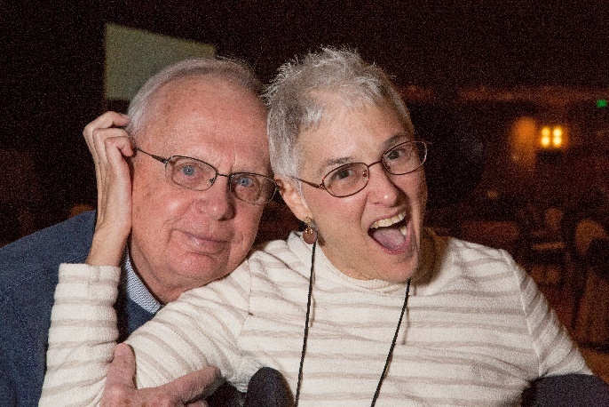
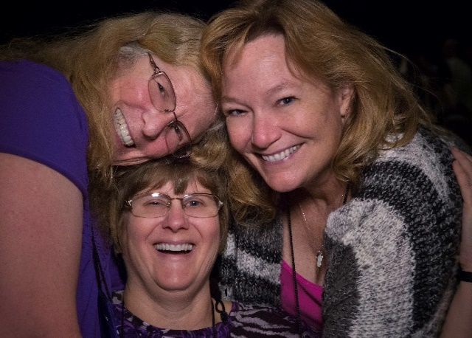
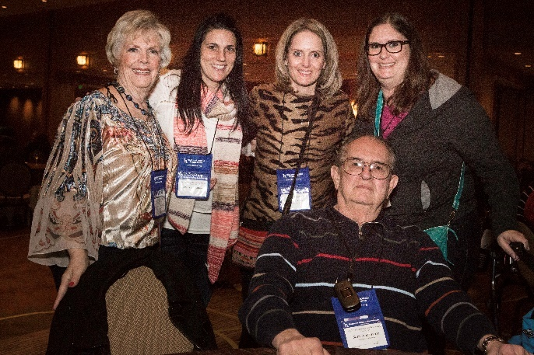
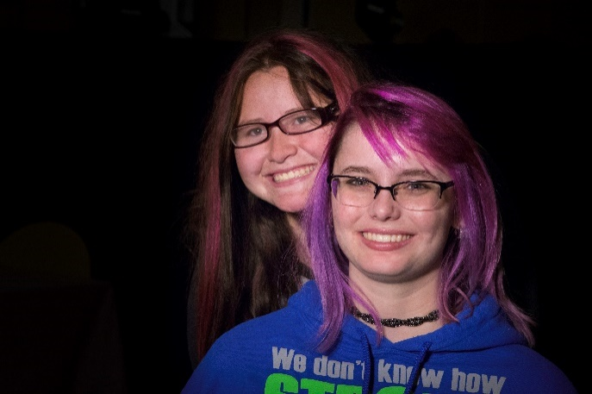
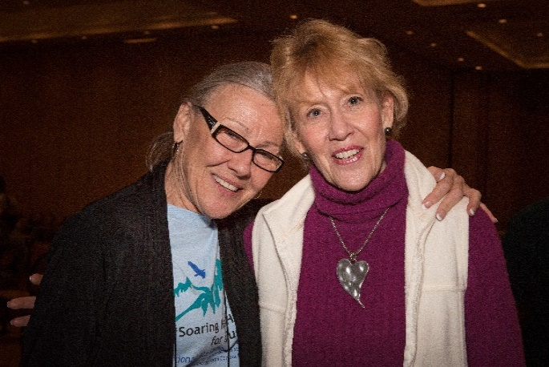
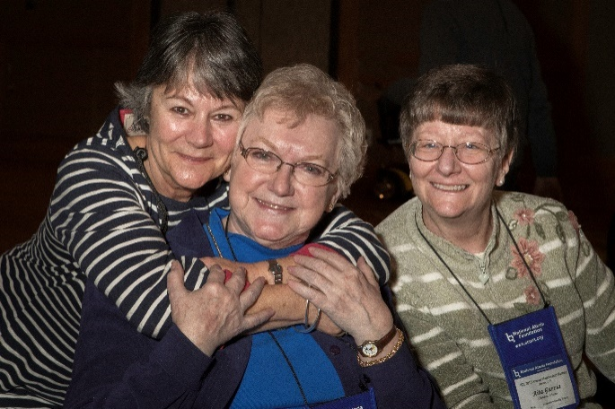
Today the NAF Annual Ataxia Conference attendance ranges between 400-700 people from the United States and other countries. The conference is now held in various cities throughout the United States.

Slide 10
1970
The National Ataxia Foundation struggled in the early years in terms of funding and ataxia awareness. However, in 1970 the NAF offered its first ataxia clinic. Drs. Roger Rosenberg, Larry Schut, and William Nyhan participated in this first ataxia clinic in Sioux Falls, South Dakota on December 13, 1970. There were 95 people attending this clinic and 33 were examined.

Slide 11
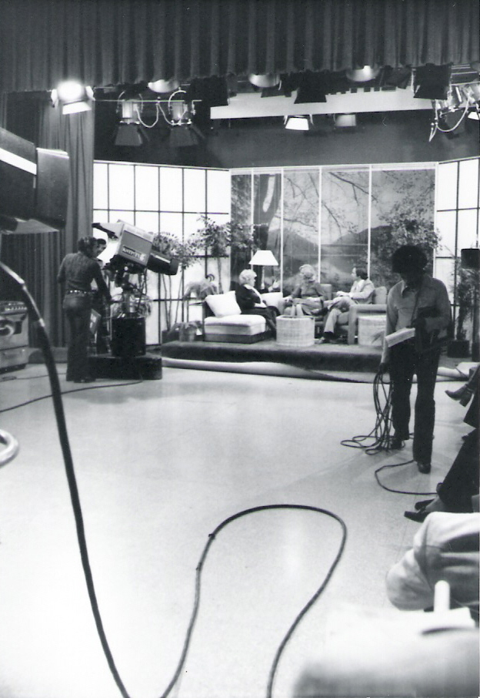
WCCO-TV, based in Minneapolis, Minnesota, covered the clinic and aired a story about ataxia. The three doctors were invited to New York City for a press conference which was attended by Time, Life, and Associated Press. Time published an article on January 25, 1971 which resulted in letters from ataxia families across the country. NAF continued to sponsored ataxia clinics, free of charge to patients, throughout the 1970 and 1980s. This multidisciplinary approach to ataxia clinics was a model for others to follow years later.

Slide 12
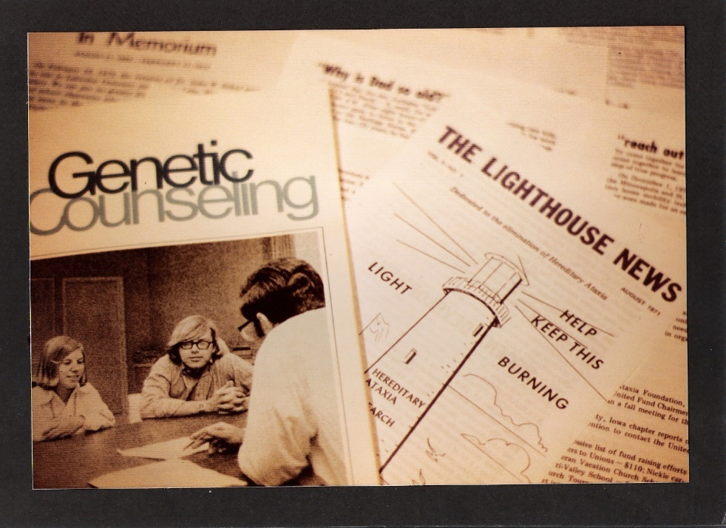
1971
There was a re-structuring and formation of the Medical and Research Advisory Board. This advisory board totaled 7 members. Today this international roster of world leading ataxia clinicians and scientists totals more than 25 members. NAF introduced its first newsletter, “Light House News” which became a quarterly newsletter in 1974. Today the four page “Light House News” has been replaced by the 48-page quarterly news publication “Generations.” Also, in 1974, NAF offered its first brochure on ataxia. Today the Foundation is a world leader in providing current and accurate information through its many publications, books, and website.

Slide 13
1972
On February 19, 1972 the 15th Annual Membership Meeting was held in Minneapolis, Minnesota. There were 38 members who attended the annual membership meeting. Dr. John W. Schut’s funeral was the same day. He was one of the original founders of the Foundation.
Dr. Schut was a brilliant neurologist and researcher who had also inherited the ataxia gene.

Slide 14
1975
NAF’s first ataxia research symposium was held in Minneapolis on November 24, 1975, bringing researchers together to help accelerate ataxia research. These research symposiums continued throughout the 1970s, 80s and 90s and was the foundation for the establishment of NAF’s International Ataxia Investigators Meetings (AIM) which are offered every other year and brings together 140 - 160 leading ataxia clinicians and scientists from around the world to help accelerate world-wide ataxia research.

Slide 15
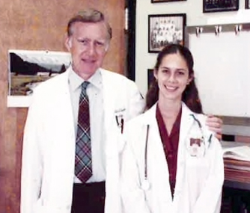
1976
Funding challenges continued to face NAF with total contributions in 1976 of $41,350 compared to $6,537 in 1972. In 1978 the first ataxia research grant awarded by NAF was given to Dr. Robert Currier from Mississippi in the amount of $5,000. Two research grants were awarded in 1979, one grant to Dr. Currier in the amount of $3,250 and the other research grant to Dr. Kark in the amount of $2,500. Today, the Foundation offers five research programs and has funded nearly $3 million over the past 3 years to more than 70 promising ataxia research studies.
Dr. Robert Currier and his daughter
Dr. Mary Currier 1983

Slide 16
1982
On February 20, 1982, the 25th Annual Membership meeting was held in Jackson, Mississippi. This was the first time the meeting was held outside of Minnesota. Since that time, the annual membership meetings have been held in various cities throughout the United States.
The National Ataxia Foundation is able to continue to support promising ataxia research and offer meaningful programs and services for ataxia families because of the kindness and generosity of our donors and volunteers. We gratefully acknowledge their tremendous contributions to these efforts. The vision of our original founders has been our guiding path as we journey forward to end ataxia.

Slide 17


1991
The NAF was approved to be included in the Combined Federal Campaign (CFC). Since that time, government workers have donated more than $500,000 to help support the NAF’s mission.
#10752
1995
The NAF is on the internet for the first time.

Slide 18

NAF Offers Five Research Programs
Research Grant: 1-year $15,000-30,000 “seed-money” grants for early or pilot phases of studies and ongoing investigations
Young Investigator Award: 1-year $35,000 grants to encourage young investigators to pursue a career in the field of any form of ataxia research
Young Investigator Award for SCA Research: 1-year grants of $50,000 awarded to encourage young investigators to pursue a career in Spinocerebellar Ataxia (SCA) research

Slide 19
Research Post-Doc Fellowship Award: 1-year $35,000 grants to post-docs who have shown a commitment to research in the field of ataxia
Pioneer SCA Translational Research Award: 1-year grants of $100,000 focusing on research investigation that will facilitate the development of treatments for the Spinocerebellar Ataxias (SCAs)

Slide 20
NAF Supported Research
The first direct research funding made by NAF occurred in 1978 to Dr. Robert Currier, University of Mississippi in the amount of $5,000.
In 1985, three researchers in the United States received funding totaling $25,000.
In 1995, six researchers from the United States received funding totaling $40,500.
In 2015, NAF received more than 100 research applications from around the world. Lead by Drs. Orr and Ranum, 62 peer reviewers were assigned selected research applications to review with a total of 212 individual reviews.
In 2015, NAF supported 22 ataxia research studies in six countries with funding support of nearly $1 million.

Slide 21
Ataxia Investigators Meeting (AIM)
The 6th Ataxia Investigators Meeting (AIM) is being held this week. AIM 2016 focuses on the most recent scientific advances and emerging translational approaches toward therapy with four primary goals: 1) Identify common disease mechanisms; 2) Explore therapeutic strategies; 3) Help establish the future leaders of ataxia research; and 4) Bring trainees (graduate students and postdocs) into contact with Ataxia families.
This is the largest attended AIM with more than 160 ataxia investigators, industry, and patient advocacy groups attending this scientific conference on Ataxia.
The five prior AIM conferences have been instrumental in advancing ataxia research and in bringing young investigators into the field of ataxia research.

Slide 22
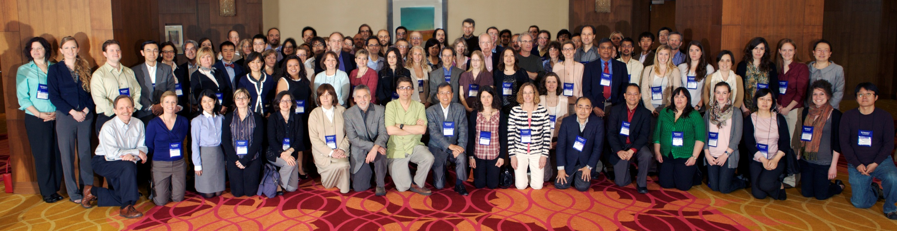
The NAF’s 4th Ataxia Investigators Meeting (AIM 2012-San Antonio)

Slide 23
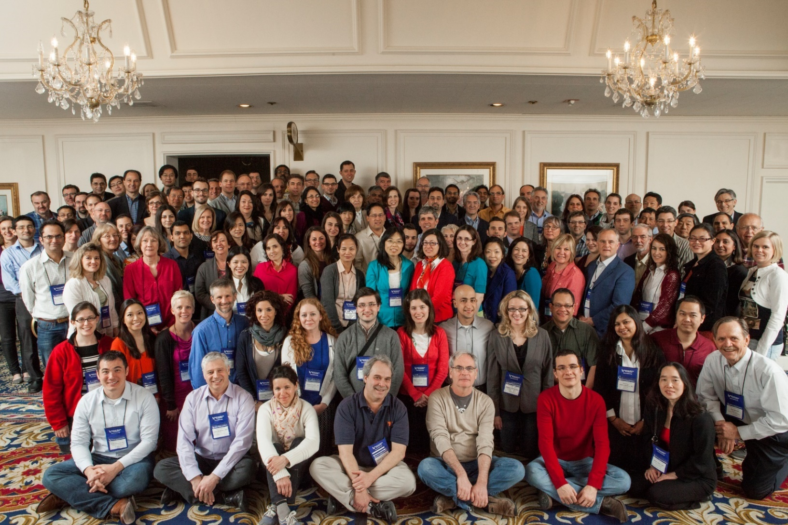
The NAF’s 5th Ataxia Investigators Meeting (AIM 2014-Las Vegas)

Slide 24
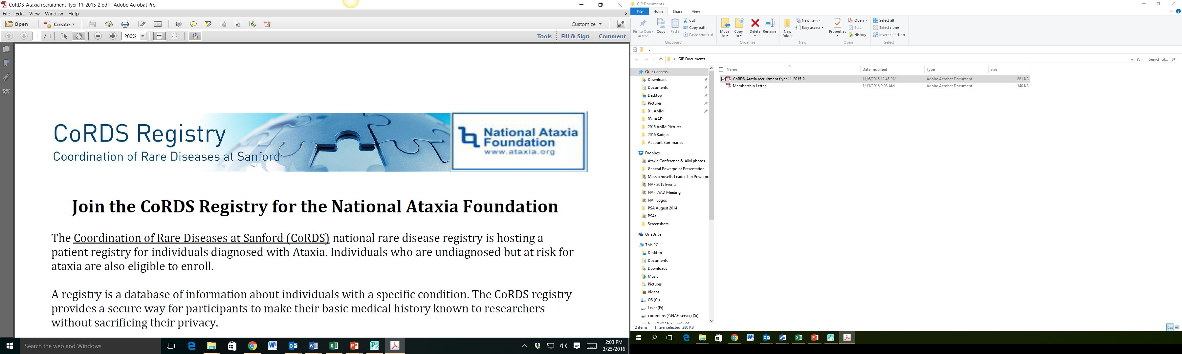

CoRDS–NAF Ataxia Patient Registry: An International Disease-specific Registry for Individuals with Ataxia (Information provided by CoRDS)
What is the CoRDS–NAF Ataxia Patient Registry?
Collaboration between Sanford Research’s Coordination of Rare Disease at Sanford (CoRDS) and the NAF to create a registry that collects and organizes information from individuals with Ataxia (established 2013)
Researchers are able to review de-identified data
Participants may be notified of research studies for which they are eligible
Currently the CoRDS-NAF registry includes:
925 fully enrolled participants
64 participants in screening
Participants have enrolled from:
49 United States
28 Countries

Slide 25

CoRDS-NAF Enrollment
Age of Enrollment
81-90
71-80
61-70
51-60
41-50
31-40
21-30
11-20
0-10
Total:
9
93
222
223
163
98
50
49
18
925
1%
10.1%
24%
24.1%
17.6%
10.6%
5.4%
5.3%
1.9%
100%
Gender Breakdown
Females 51%
Males 49%

Slide 26
How Patients and Families Can Get Involved
Participants that enroll can contribute information to the CoRDS-NAF registry by filling out a brief questionnaire
Enrollment involves reading the consent form and completing the questionnaire
Participants may learn about research opportunities for which they are eligible
When notified about research opportunities, you have the ability to decide whether or not to participate

Slide 27

Why Should You Participate?
Provides participants an opportunity to be informed of research studies and clinical trials for which they are eligible
Provides researchers with a central resource for the identification and more rapid recruitment of potential research participants
Provides the potential to accelerate research into Ataxia
No financial cost to you with easy and quick enrollment

Slide 28
Enroll at the Conference
Informed Consent Form and CoRDS-NAF questionnaire available
Read the Informed Consent & complete the questionnaire and return to CoRDS table
The questionnaire is brief and takes about 30 minutes to complete

Slide 29


Other Enrollment Options
Online enrollment on the CoRDS website: sanfordresearch.org/cords/
Mail-based enrollment
In-person enrollment at the Conference
Become Fully Enrolled
To be fully enrolled, you must fill out both the screening form AND the questionnaire. Speak to a CoRDS team member about finishing enrollment today!

Slide 30
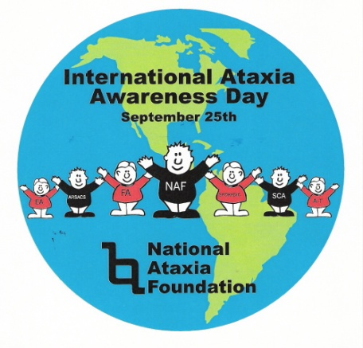
Awareness
In 1982, NAF and members wrote to Dear Abby asking her to print a letter about ataxia in her column. From those efforts, a letter in “Dear Abby” appeared resulting in over 3,400 letters to NAF.
In 1994, ABC’s 20/20 aired a news program about ataxia and NAF that was filmed at the NAF offices.
The first International Ataxia Awareness Day (IAAD) occurred on September 25, 2000. This was the first time that ataxia organizations throughout the world declared and recognized September 25th as IAAD.

Slide 31
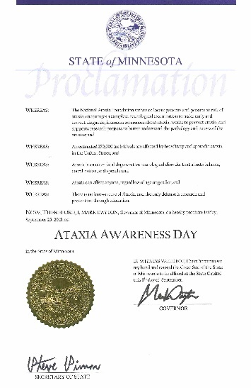
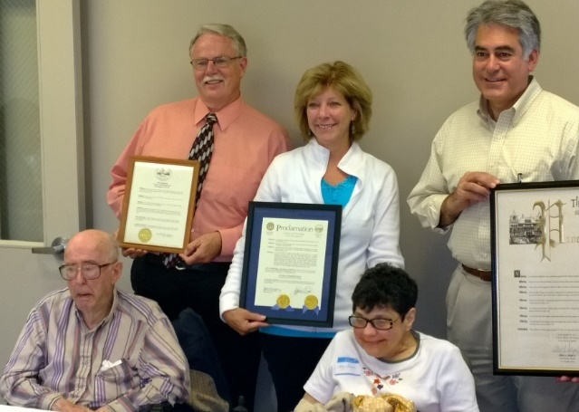
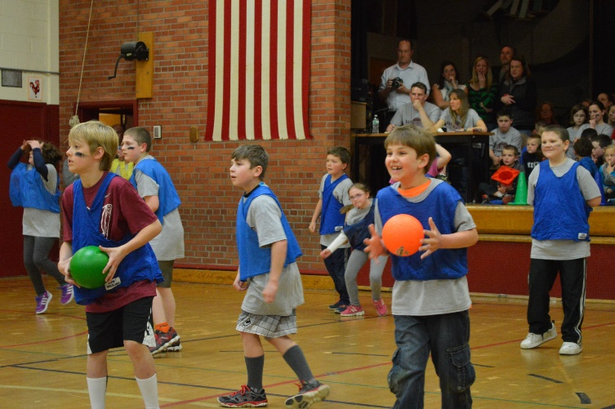

NAF members throughout the US responded to IAAD by informing
their local communities about ataxia through events, proclamations
and media attention.
In 2002, NAF received $20,000 from the game show “Weakest Link.” The male super models, the Carlson twins, Lane and Kyle, were featured on an episode called “Super Male Model Edition” and selected NAF as their charity.

Slide 32
In 2015, NAF’s website received 200,995 visitors from 185 countries: 111,639 from a desktop, 62,765 from a mobile device, and 26,592 through tablets.
NAF’s E-Blast list has now grown to more than 8,500 subscribers. In 2015, 96 E-Blasts were sent out regarding events, research updates, support group meetings, and other activities.
Through awareness events such as the Walk n’ Rolls for Ataxia, media coverage, social media, government proclamations, information booths at Abilities Expos, CFC events, American Brain Foundation Brain Health Fair, as well as medical/research conferences, ataxia awareness events and NAF’s website, the word “Ataxia” is getting out.

Slide 33
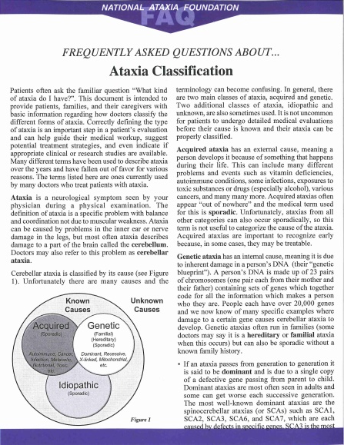
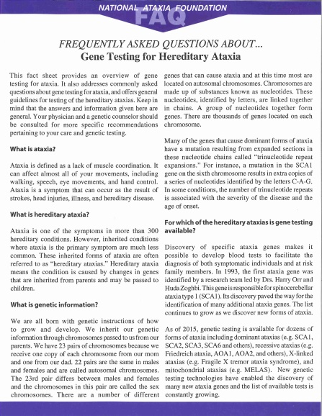
Education
The National Ataxia Foundation now offers more than 20 Frequently Asked Questions (FAQs) Fact Sheets as well as the quarterly newsletter Generations. In addition, NAF offers books and other publications on ataxia. In 2015 fact sheets that were updated included Episodic Ataxia, Gene Testing for Hereditary Ataxia, Sporadic and Multiple Systems Atrophy and Medications for Ataxia Symptoms. In 2015 more than 5,000 paper copies of the NAF fact sheets were distributed and thousands more were downloaded. In addition, the second edition of “Children with Ataxia” was introduced.

Slide 34
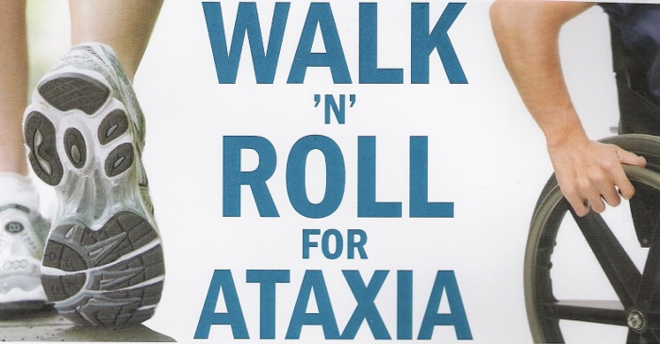
In 2007, Walk n’ Rolls for Ataxia
first began adding another
layer of ataxia awareness.
The first NAF Walk n’ Roll for Ataxia was held in September, 2007 in San Diego, California hosted by the San Diego Ataxia Support Group. Since that time, NAF Walk n’ Roll for Ataxia have continued to grow nationwide from California to Georgia from Massachusetts to Denver from Minnesota to Utah and beyond.

Slide 35
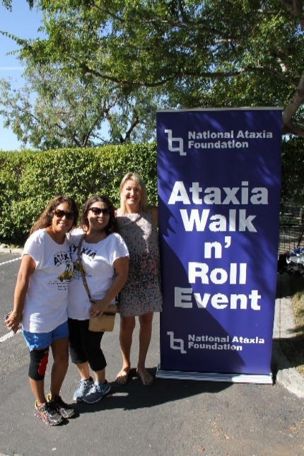
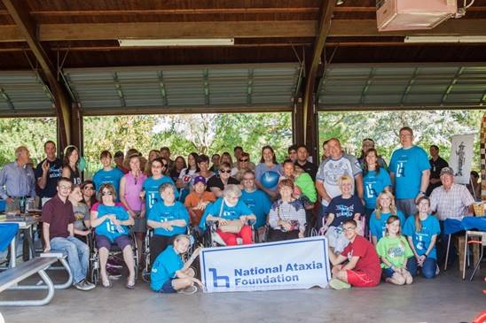
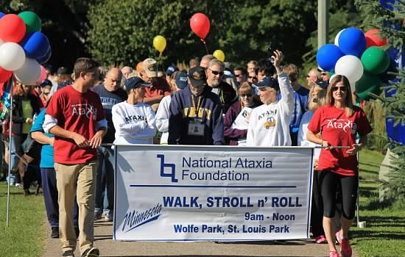
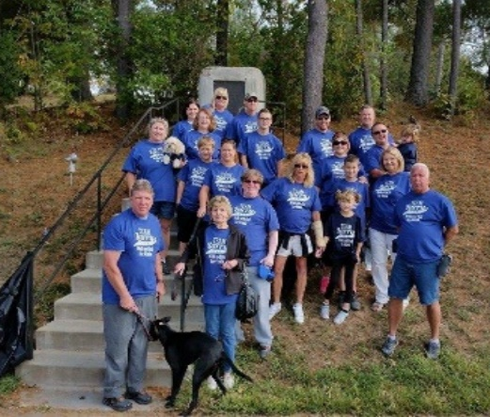
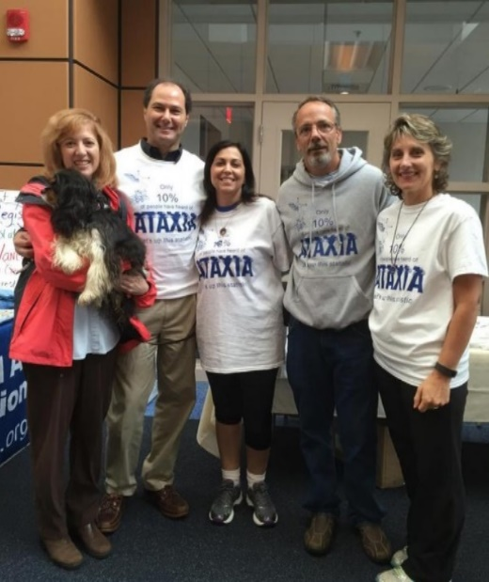
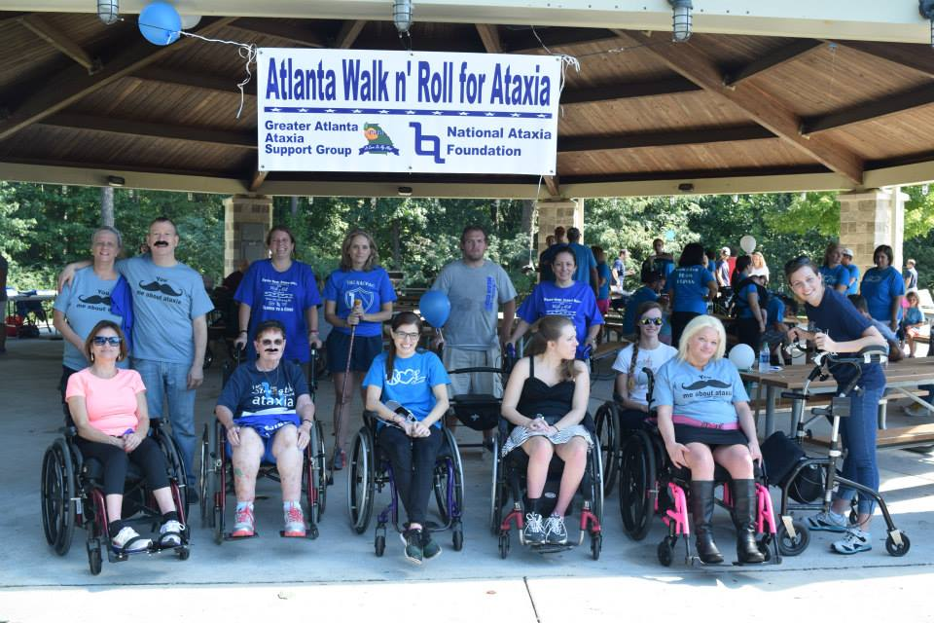
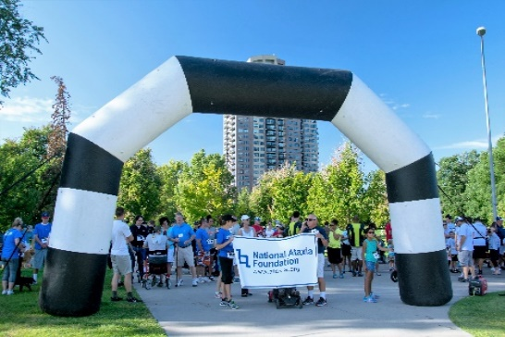
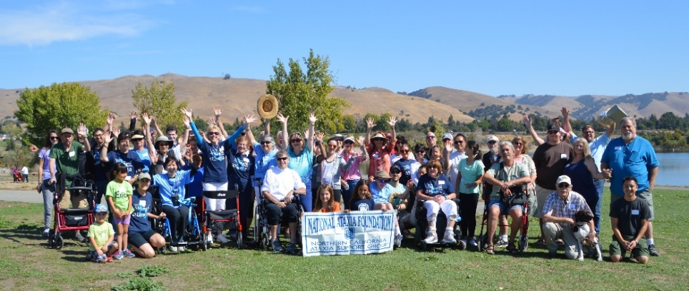
In 2015, twelve Walk n’ Rolls for Ataxia were held throughout the United States raising more than $285,000 with more than 1,600 participants and tens of thousands more being informed about Ataxia.

Slide 36
Why Walk n’ Rolls?
Walk n’ Roll for Ataxia’s primary objectives are to have FUN, raise awareness and funds to support the mission of NAF. Families, friends, co-workers, neighbors, and communities come together each year to honor those with Ataxia. Each Walk n’ Roll is unique, but all provide a setting of fun, sharing, and caring.
Get Involved!
Support groups, families, and individuals have all conducted Walk n’ Rolls for Ataxia. Join them in hosting your own NAF Walk n’ Roll for Ataxia or participate in a Walk n’ Roll near you. For more information or to start a Walk n’ Roll in your community, please contact NAF. Together, we can continue to grow this event!
A heartfelt thank you to the organizers, participants, donors, sponsors, and volunteers…you are all amazing!!!

Slide 37




Social Media
NAF continues to reach the ataxia community through various social media platforms:
2014 2015
NAF Bulletin Board - Members 68,388 71,213
Forum Discussions 9 9
Topics Posted 2,202 3,162
NAF Facebook Group - Members 4,443 5,112
NAF Facebook Page - Likes 3,137 3,755
NAF Twitter Page - Follows 886 1,132
- Tweets 951 1,335
YouTube Channel - Subscribers 98 152
Video Views 8,127 28,246

Slide 38

Here is one example:

Slide 39
Sources of Support
Chapters/Support Groups Fund Raising Events Planned Giving
Combined Federal Campaign Gifts of Stock/Assets Recurring Gifts
Corporate Support Group/Family/Individuals Research Drive
Deferred Giving/Estates IAAD Events Social Networking
Employer Matching Gifts Membership Support Special Projects
Endowment Funds Memorials/Honor Of United Ways
Family Fund Raisers Online Shopping Portals Vehicle Donations
Foundation Support Partnerships Walk n’ Rolls

Slide 40
The National Ataxia Foundation gratefully acknowledges each of our donors. Every donor plays an essential role in fulfilling our mission to serve ataxia families. In addition, our amazing volunteers not only give of their precious time and extraordinary talents, but also significantly help in reducing the cost of NAF expenses, so more funds may be used to support promising research and important programs.

Slide 41
How are Funds Spent?
In 2015, Charity Navigator, America’s premier charity evaluator, gave the National Ataxia Foundation a four out of four star rating. This is the third consecutive year NAF has received this four-star rating. Charity Navigator has awarded this to only 14% of their charities.
According to Charity Navigator, “Receiving four out of a possible four stars indicates that your organization adheres to good governance and other best practices that minimize the chance of unethical activities and consistently executes its mission in a fiscally responsible way.”

Slide 42
While the 2015 annual audited financial statements will be soon available, the 2014 CPA annual audit reflects fundraising costs were 3% of total expenditures and administrative costs were 5% of total expenditures. Program Services for 2014 totaled 92% of total expenditures. In other words, 92 cents out of every dollar spent was used to support research and programs. In the Program Services area, the highest expenditure was research totaling 61.5% of all expenditures for fiscal year 2014.

Slide 43
NAF Chapters, Support Groups, and Ambassadors
Through NAF Chapters, Support Groups, and Ambassadors, NAF has a network of volunteers who bring local ataxia families together to share, learn, and network. Support Group Leaders, Chapter Presidents, and Ambassadors help identify local resources and offer support and information to local ataxia families. These leaders also help coordinate Ataxia awareness campaigns and events in their area.
To help leaders with their important work, a regional concept is being developed in which a Regional Coordinator would be assigned a region to work with leaders in that area to enhance communications and heighten support for Ambassadors, Support Groups and Chapters located within their region. These Regional Coordinators would be a focal point within each region for communications, fund raising and improved interaction.

Slide 44
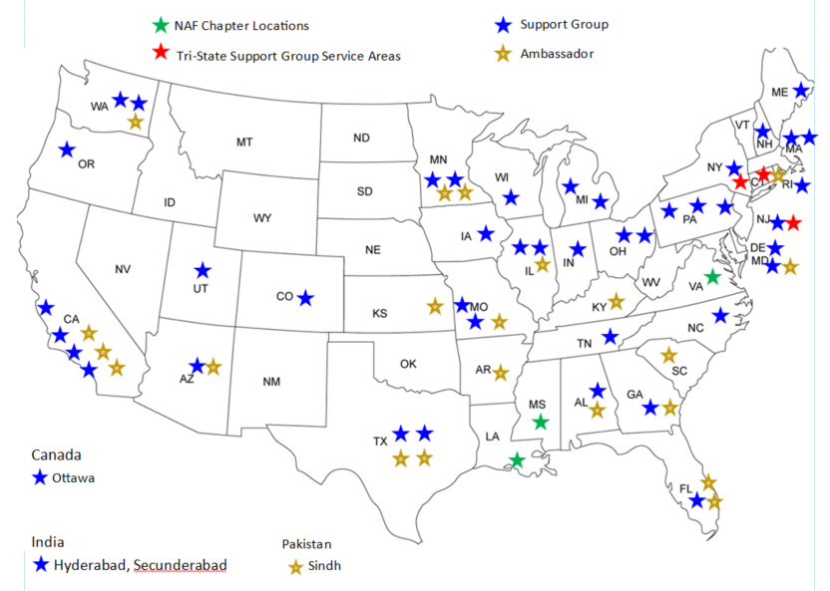
In 2015, there were 3 NAF Chapters, 41 Support Groups, and 23 Ambassadors serving their local communities. These all give local ataxia families hope and understanding. Thank you for all that you do!

Slide 45
Strategic Plan
NAF’s Strategic Goals
The Board of Directors of the National Ataxia Foundation held a two-day strategic planning session in November, 2015. A major outcome of this meeting was the establishment of five bold goals which provide the foundation for a formal strategic plan that will act as NAF’s roadmap for the next three to five years.

Slide 46
NAF’s Five Bold Goals
Increasing revenues to fuel the organization’s growth and enable it to build on its history and past successes to become a stronger, more vital organization.
Increasing awareness and recognition of Ataxia and NAF to strengthen and grow support for NAF’s mission.
Becoming “clinical trial research ready” thus enhancing NAF’s role within the Ataxia community.
Building internal capacity through technology to increase NAF’s organizational efficiency and effectiveness as well as create new opportunities.
Understanding of the importance of having a strategic plan not only to guide the organization, but to provide a mechanism by which NAF’s progress and success may be measured and evaluated.

Slide 47
We expect that the strategic plan to be completed and in place by mid-2016. A very special thank you to all the NAF members who have participated in this strategic planning process. Your input has been invaluable!

Slide 48
The Future
A promise for a brighter future
Enhancing of fundraising capacity
Accelerating ataxia awareness campaigns
Strengthening clinical readiness
Expanding worldwide ataxia research
Collaborating with industry and ataxia organizations
With the dedication and commitment of NAF volunteers, donors and our partners, together we can end Ataxia.

Slide 49
Thank You!

