Slide 1
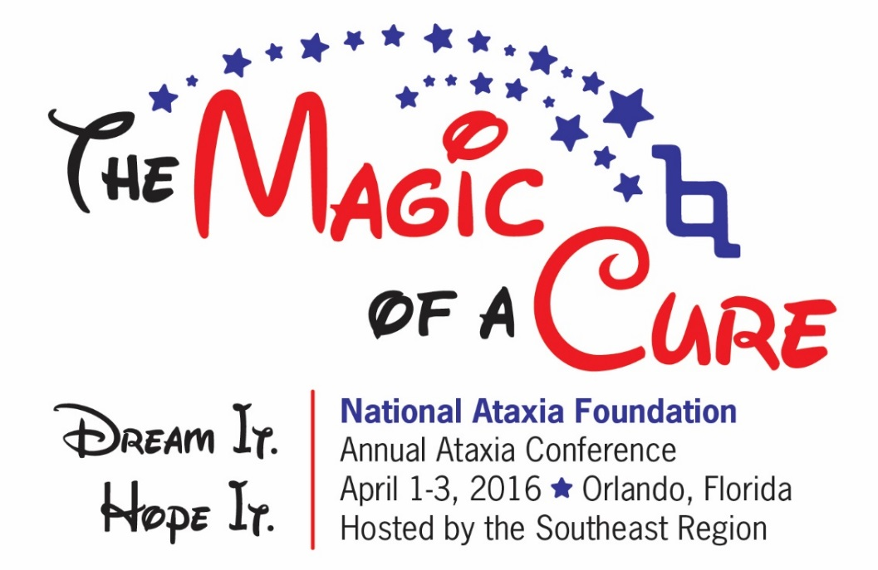
NAF SUPPORTED ResEarch Funding Update
Harry T. Orr, PhD, University of Minnesota

Slide 2

Disclaimer
The information provided by speakers in any presentation made as part of the 2016 NAF Annual Ataxia Conference is for informational use only.
NAF encourages all attendees to consult with their primary care provider, neurologist, or other health care provider about any advice, exercise, therapies, medication, treatment, nutritional supplement, or regimen that may have been mentioned as part of any presentation.
Products or services mentioned during these presentations does not imply endorsement by NAF.

Slide 3
Presenter Disclosures
No relationships to disclose or list

Slide 4
NAF Funded Research – Mission
Bring new investigators into ataxia research
(Seed grants, Young Investigator. Post-doc grants)
Foster development of treatments for ataxias
(All grants – SCA Translational Grants, anonymous donor)

Slide 5
NAF Funded Research – The Big Picture
2015 - $1,067,595
2016 - $876,496

Slide 6
NAF Funded Research – 2015, Seed Grants
($10,000-$30,000)
SCA3, SCA1, SCA36, AOA2, Sleep-Ataxia, Ataxia Database
Rossoll, WilfrSCA31ied, Ph.D., Emory University School of Medicine, Atlanta
Wojcikiewicz, Richard Ph.D., SUNY-Upstate Medical University, Syracuse
Teixeira-Castro, Andreia, Ph.D., University of Minho, Braga, Portugal
Manley, James L., Ph.D., Columbia University, New York
Kim, Do-Hyung, Ph.D., U of MN, Minneapolis ( Funded by BAARC)
Hampe, Christiane S., Ph.D., University of Washington, Seattle
Lim, Janghoo, Ph.D. Yale University, New Haven
Perlman, Susan, M.D. University of California, Los Angeles
Schmahmann, Jeremy D., M.D. Massachusetts General Hospital

Slide 7
NAF Funded Research – 2015, SCA Pioneer Grants
($70,000-$100,000)
Potential Therapies – SCAs, SCA1, SCA3/MJD, SCA8
Ismael Al-Ramahi, Ph.D. Baylor College of Medicine, Houston
Beverly Davidson Beverly, Ph.D. Children’s Hospital of Philadelphia (Partnered with BAARC)
Laura Ranum, Ph.D. University of Florida, Gainesville
Thorsten Schmidt, Ph.D. University of Tubingen, Germany

Slide 8
NAF Funded Research – 2015, Young Investigators
($32,000-$50,000)
Friedreoch’s, SCA3/MJD, SCA1, SCA7
YOUNG INVESTIGATOR AWARD
Donatello, Simona, Ph.D. Université Libre de Bruxelles, Brussels,
POST-DOC FELLOWSHIP AWARDS
Marife Arancillo, Ph.D. Baylor College of Medicine, Houston
Angela Bhalla, Ph.D. University of Alabama at Birmingham
Gautam Rajpal, Ph.D. University of Michigan, Ann Arbor,
Carlos R CastilloHernandez, Ph.D. Universidad Nacional Autonoma de Mexico
Tommaso Vannocci, Ph.D. King’s College, London
Yu Miyazaki, M.D., Ph.D. University of Chicago,
YOUNG INVESTIGATOR - SCA AWARDS
Maria do Carmo Pereira Costa, Ph.D. University of Michigan
Miao Zhang, Ph.D. Virginia Commonwealth University, Richmond
Marija Cvetanovic, Ph.D. University of Minnesota, Minneapolis

Slide 9
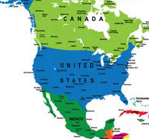
RESEARCH GRANTS (SEED) - 2016
Michael Downey, Ph.D University of Ottawa, Canada, “Ataxia 7 as a regulator of substrate selection by KAT2a acetyltransferase.”
Brent L. Fogel, M.D., Ph.D. & Esther
B. E. Becker, Ph.D. UCLA & University of Oxford, UK Development of Cellular Model for Characterization of SCA41 Mutations
Paul Rosenberg, M.D., Duke University Med Center, “Contribution of store-operated calcium entry to calcium dysregulation in SCAs.”
Susan Perlman, M.D.
UCLA, “Ataxia Data Base.”

Slide 10
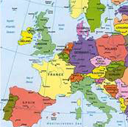
RESEARCH GRANTS (SEED) - 2016
Manolis Fanto, Ph.D. King's College London, RBfox proteins as critical determinants for cell toxicity in DRPLA and other Spinocerebellar Ataxias
Liliana Simões Mendonça, PharmD, Ph.D. University of Coimbra, Portugal “Transplantation of induced pluripotent stem cells-derived neural stem cells in Machado-Joseph disease.”
Katia Aquilano, Ph.D. University of Rome, “Lipid dysmetabolism in the pathogenesis of Friedreich's ataxia”

Slide 11
YOUNG INVESTIGATOR RESEARCH AWARDS - 2016
Ricardo Mouro Pinto, Ph.D. Mass General, Harvard Medical School, “Identification of genetic modifiers of somatic GAA instability in Friedreich Ataxia by in vivo CRISPR-Cas9 genome editing.”
Patricia Richard, Ph.D., Columbia University, New York “Role of the SETX/CHD3 interaction in the DNA damage response and its connection to AOA2”
Percy Tumbale, Ph.D. National Institute Environmental Health Sciences, NIH, Research Triangle Park, NC “Expanded Roles for Aprataxin Mutations in Ataxia Oculomotor Apraxia 1 (AOA1)”

Slide 12
POST-DOC FELLOWSHIP AWARDS - 2016
Rachael L. Cohen, DVM Johns Hopkins University School of Medicine, Baltimore, “Molecular Pathogenesis of SCA 12.”
Su Yang, Ph.D. Emory University, Atlanta,
“Developing the MANF-based therapeutic approach for SCA 17.”

Slide 13
POST-DOC FELLOWSHIP AWARDS - 2016
Pankaj Kumar Singh, Ph.D.
Translational Medicine and Neurogenetics, IGBMC, Ellkirch-Strasbourg, France, “Unravelling pathomechanism of muscle dysfunction in an autosomal recessive cerebellar ataxia 2 (ARCA2) mice model.”
Magda Matos Santana, PharmD, Ph.D.
Center Neuroscience & Cell Biology, Coimbra, Portugal, “Advanced Induced Pluripotent Stem Cell-based Models of Machado-Joseph disease

Slide 14
PIONEER SCA TRANSLATIONAL AWARDS - 2016
Laura Ranum, Ph.D.
Univ of Florida,“ASO targeting
of bidirectional transcripts
& RAN translation in SCA8.”
Wendy Raskind, M.D., Ph.D.
University of Washington,
Seattle, “Oligonucleotide-based Therapy in BAC-Mouse Models
of SCA14..”

Slide 15
YOUNG INVESTIGATOR SCA RESEARCH AWARDS - 2016
Kenneth Scaglione, Ph.D.
Medical College of Wisconsin, Milwaukee,
“Investigation into polyglutamine in Dictyostelium.”
Giorgio Grasselli, Ph.D., University of Chicago, “Role of SK channels in
cerebellar Purkinje
cells in Pathophysiology of
SCA.”
Wei-Ling Tsou, Ph.D. Wayne State University School of Medicine, Detroit,
“Mechanisms of Neuroprotection by DnaJ-1 in SCA6.”
Sarah C. Goetz, Ph.D.
Duke University, Durham, NC
“Exploring the Role of Primary Cilia in SCA11 Pathogenesis.”

Slide 16
THANK YOU FOR
YOUR SUPPORT OF
THE RESEARCH

