Slide 1
Update on NAF Funded Research Laura Ranum, Ph.D. Professor of Molecular Genetics and Microbiology Director Center for NeuroGenetics University of Florida

Slide 2
Goals and Impact of NAF Funding
Birds-Eye View of Funding Portfolio
Making scientific connections between diseases
Encouraging young investigators to pursue ataxia research
Some Examples
Genetics 101-2015
Four Pioneer Awards
Therapeutic strategies to fight ataxia
Connections between scientists, diseases, NIH and Industry

Slide 3
NAF Seed Grant Recipients in 2014
RESEARCH SEED
MONEY AWARDS
Hampe, Christiane S., Ph.D.
University of Washington, Seattle, WA
Glutamate Decarboxylase in Cerebellar Ataxia
Kim, Do-Hyung, Ph.D. (in Partnership with the Bob Allison Ataxia Research Center)
University of Minnesota, Minneapolis, MN
Pathological and therapeutic roles of immunoproteasomes in SCA1
Lim, Janghoo, Ph.D.
Yale University, New Haven, CT
Molecular pathogenesis studies of spinocerebellar ataxia type 1
Manley, James L. Ph.D.
Columbia University, New York, NY
Functions of Senataxin, product of the AOA2 target gene SETX, in autophagy and lysosome function.
Perlman, Susan, M.D.
University of California Los Angeles, CA
National Ataxia Database
Rossoll, Wilfried, Ph.D.
Emory University School of Medicine, Atlanta GA
SCA36 patient stem cell-derived neurons to study disease mechanisms and develop novel therapeutic strategies
Schmahmann, Jeremy, M.D.
Massachusetts General Hospital, Boston, MA
The Nature and Impact of Sleep Dysfunction in Cerebellar Ataxias
Teixeira-Castro, Andreia, Ph.D.
University of Minho, Braga, Portugal
Determinants of neuron-specific pathogenesis: study in a C. elegans model of SCA3
Wojcikiewicz, Richard, Ph.D.
SUNY-Upstate Medical University, Syracuse, NY
Molecular Mechanism of Autosomal Dominant Sensory Ataxia
SCA1
AOA2
Glutamate
Database
SCA36
Sleep
SCA3
AD sensory ataxia

Slide 4
NAF Grant Recipients Young Investigators in 2014
POST-DOC FELLOWSHIP AWARDS
Arancillo, Marife, Ph.D.
Baylor College of Medicine, Houston, TX
Neural Mechanisms of Cerebellar Function In Ataxia
Bhalla, Angela, Ph.D.
University of Alabama at Birmingham, AL
Defining the role of mitochondrial DNA mutations in neuronal degeneration in Friedreich’s ataxia
Hernandez, Carlos R Castillo, Ph.D.
Universidad Nacional Autonoma de Mexico
Longitudinal study of neuropathology of spinocerebellar ataxia type 7 using fMRI
Miyazaki, Yu, M.D., Ph.D.
University of Chicago, IL
Developing the novel microRNA-mediated therapeutic approach for spinocerebellar ataxia type 6.
Rajpal, Gautam, Ph.D.
University of Michigan, Ann Arbor, MI
Antisense Oligonucleotide (ASO) treatment for Spinocerebellar Ataxia 3 (SCA3)
Vannocci, Tommaso, Ph.D.
King’s College, London, England
Understanding disease development in Friedreich’s ataxia in a time-resolved way: a new cellular model
INVESTING IN THE NEXT GENERATION
OF ATAXIA RESEARCHERS
Brain Function
Mitochondria in Friedreich’s Ataxia
SCA7 fMRI
miRNA SCA6
ASO SCA3
Friedreich’s over time
Chemical pathways in Friedreich’s
Pathways for polyQ regulation SCA3
Microglia in SCA1
Drugs for channels in SCA
YOUNG INVESTIGATOR AWARD
Donatello, Simona, Ph.D.
Université Libre de Bruxelles, Brussels, Belgium
The role of mTOR in Friedreich’s ataxia and identification of new pathways for therapeutic intervention.
YOUNG INVESTIGATOR FOR SCA RESEARCH AWARDS
Costa, Maria do Carmo Pereira, Ph.D.
University of Michigan, Ann Arbor, MI
Defining pathways that regulate levels of polyglutamine disease protein in MJD/SCA3
Cvetanovic, Marija, Ph.D. (in Partnership with the Bob Allison Ataxia Research Center)
University of Minnesota, Minneapolis, MN
Role of Microglia in SCA1 pathogenesis
Zhang, Miao, Ph.D.
Chapman University School of Pharmacy, Irvine, CA
Structural insights for drug discovery targeting SK2/3 channels for SCA

Slide 5

NAF Grant Recipients in 2014
Al-Ramahi, Ismael, Ph.D.
Baylor College of Medicine, Houston, TX
Identification of druggable targets that modulate the levels of SCA-causing proteins in vivo
Davidson, Beverly, Ph.D. (in Partnership with the Bob Allison Ataxia Research Center)
Children’s Hospital of Philadelphia, PA
Translating RNAi therapy for Spinocerebellar Ataxia 1 (SCA1) to the clinic
Ranum, Laura, Ph.D.
University of Florida, Gainesville, FL
ASO targeting of bidirectional transcripts and RAN translation in SCA8
Schmidt, Thorsten, Ph.D.
University of Tubingen, Tubingen, Germany
Targeting the intracellular localization of ataxin-3 as novel treatment strategy for Spinocerebellar Ataxia Type 3 (SCA3)
PIONEER SCA TRANSLATIONAL
RESEARCH AWARDS
Moving towards therapies
DNA
RNA
Protein

Slide 6
Genetics 101

Slide 7
The DNA Double Helix
Sugar phosphate backbone
Base pair
Bases
Adenine (A)
Thymine (T)
Cytosine (C)
Guanine (G)
ASCO
Notes:
3
Basic Genetics
ASCO Curriculum: Cancer Genetics & Cancer Predisposition Testing

Slide 8
Overview Chromosomes, DNA, Genes, Proteins
Gene
Nucleus
Cell
Chromosomes
Protein
Adapted from Understanding Gene Testing, NIH, 1995
ASCO
Notes:
2
Basic Genetics
ASCO Curriculum: Cancer Genetics & Cancer Predisposition Testing
10 to 100 trillion

Slide 9
Central Dogma
DNA
RNA
Protein
Notes:
Turn back the clock to discovery of bidirectional transcription and RAN translation

Slide 10
GENOMIC SOFTWARE “The Code”

Slide 11
DNA → RNA CODONS→Protein
Genomic DNA THYBIGRYDDOGRANOUT
Messenger RNA THEBIGREDDOGRANOUT
Translated Message THE BIG RED DOG RAN OUT
Notes:
16
Basic Genetics
ASCO Curriculum: Cancer Genetics & Cancer Predisposition Testing

Slide 12
Organization of a Gene
Promoter
EXON
EXON
3’ UTR
DNA
Intron
Transcription
RNA
Translation
PROTEIN
Post-Translational Modification

Slide 13
Genetics of Disease

Slide 14
Disease-Associated Mutations
A mutation is a change in the normal base pair sequence
Commonly used to define DNA sequence changes that alter protein function
ASCO
Notes:
12
Basic Genetics
ASCO Curriculum: Cancer Genetics & Cancer Predisposition Testing

Slide 15
Disease-Associated Mutations Can Alter Protein Function
Functional protein
Nonfunctional or missing protein
ASCO
Notes:
14
Basic Genetics
ASCO Curriculum: Cancer Genetics & Cancer Predisposition Testing

Slide 16
Point Mutations
Normal
Missense
Nonsense
Frameshift (deletion)
Frameshift (insertion)
THE BIG RED DOG RAN OUT.
THE BIG RAD DOG RAN OUT.
THE BIG RED.
THE BRE DDO GRA.
THE BIG RED ZDO GRA.
Point mutation: a change in a single base pair
Notes:
16
Basic Genetics
ASCO Curriculum: Cancer Genetics & Cancer Predisposition Testing

Slide 17
Autosomal Dominant Inheritance
Each child has 50% chance of inheriting the mutation
Equally transmitted by men and women
Normal
Affected
Notes:
30
Basic Genetics
ASCO Curriculum: Cancer Genetics & Cancer Predisposition Testing

Slide 18
Autosomal Recessive Inheritance
Carrier
Affected
Normal
Notes:
2
Basic Genetics
ASCO Curriculum: Cancer Genetics & Cancer Predisposition Testing

Slide 19

Drinking from a hydrant

Slide 20
Genetics 101 2015

Slide 21
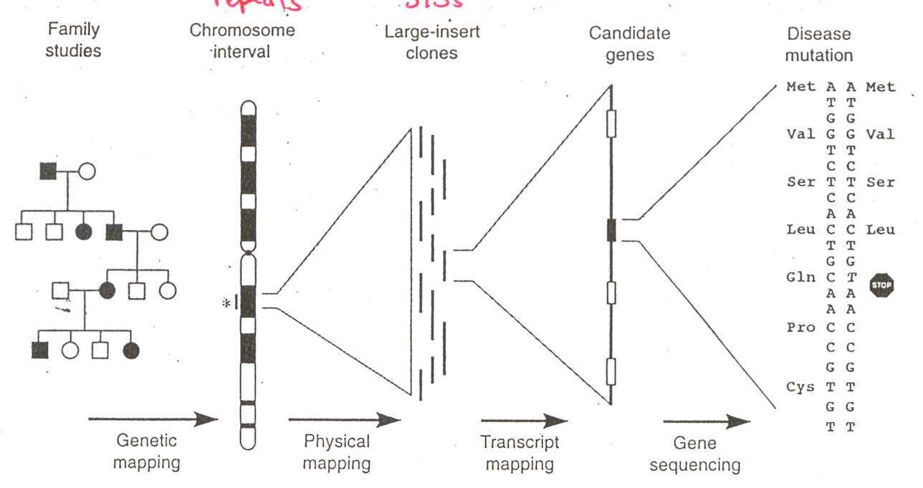
Positional cloning overview
Collins, Nat Genet. 1992 1:3-6

Slide 22
Disease mutations can be repeat expansions 1990s

Slide 23
SCA1 Gene – Repeat Length Changes Protein
(CAG)n
41-83 Affected
6-39 Unaffected
2.4 Kb
10.6 Kb

Slide 24
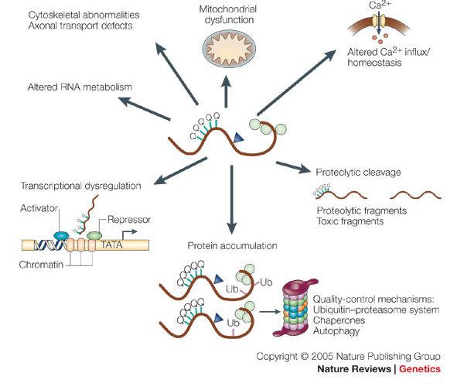
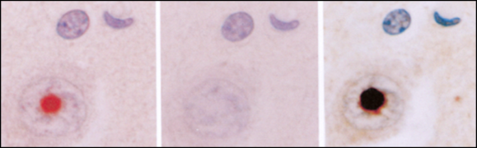
Polyglutamine Protein Aggregates in Patient Cells Cause Cellular Problems.
Modified from Gatchel &Zoghbi, Nature Reviews Genetics, 2005

Slide 25
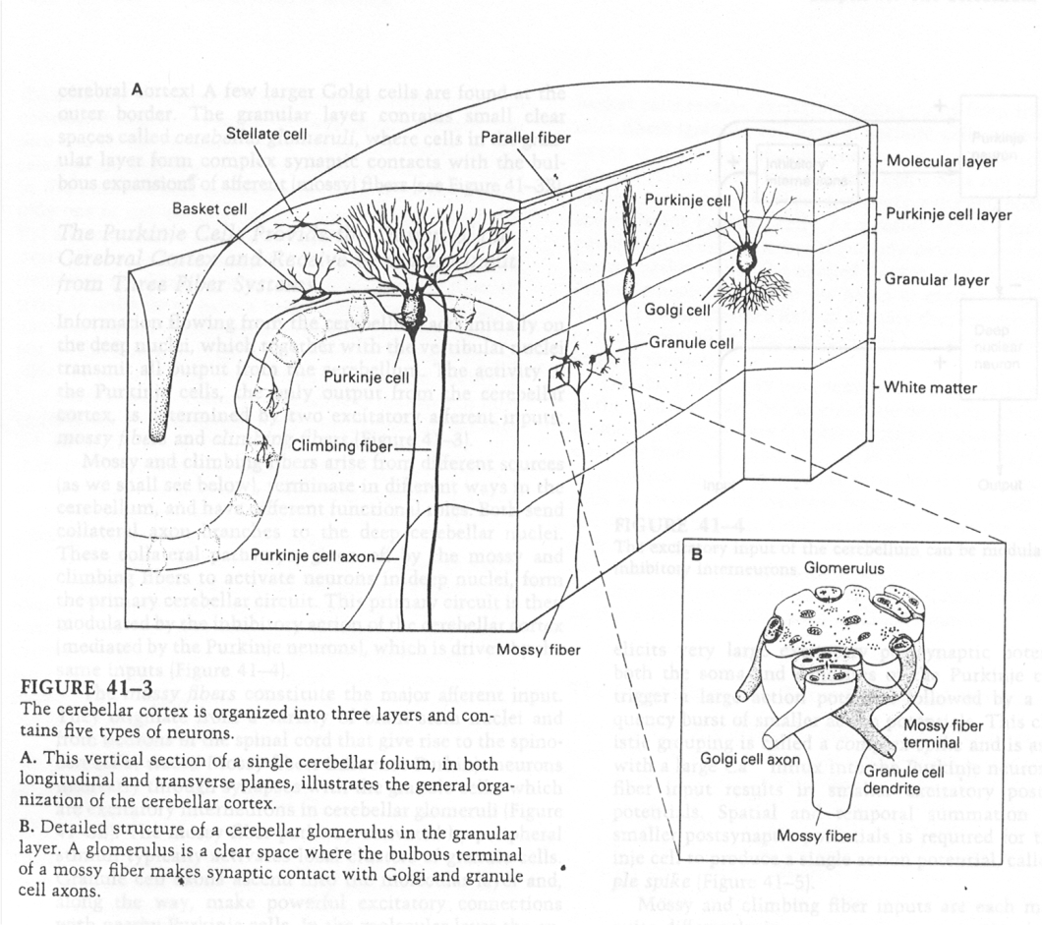
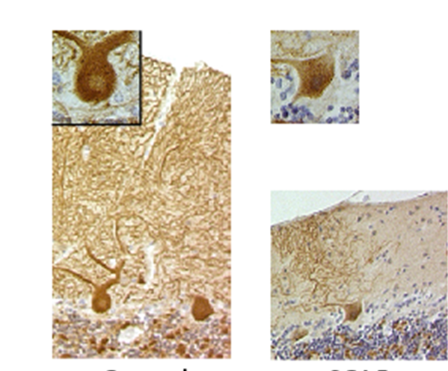
Purkinje Cell Degeneration
Control Ataxia
Ikeda et al., Nat Genet. 2006;38:184-90
Purkinje cells degenerate in most ataxias

Slide 26
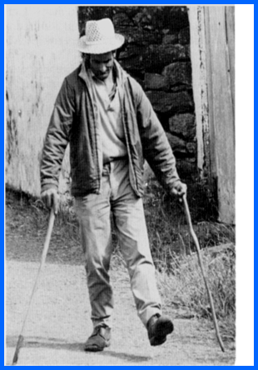
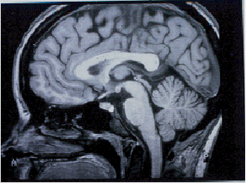
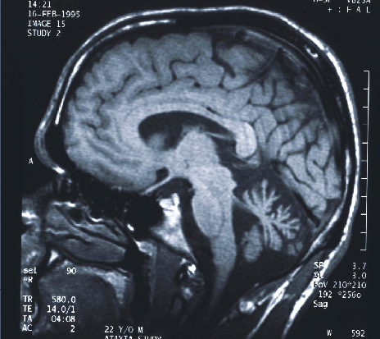
Clinical Features of Ataxia
Limb and gait incoordination
Eye movement abnormalities
Slurred speech
Babinski signs
Rapidly or slowly progressive
Cerebellar/brain stem atrophy
Control
Affected

Slide 27
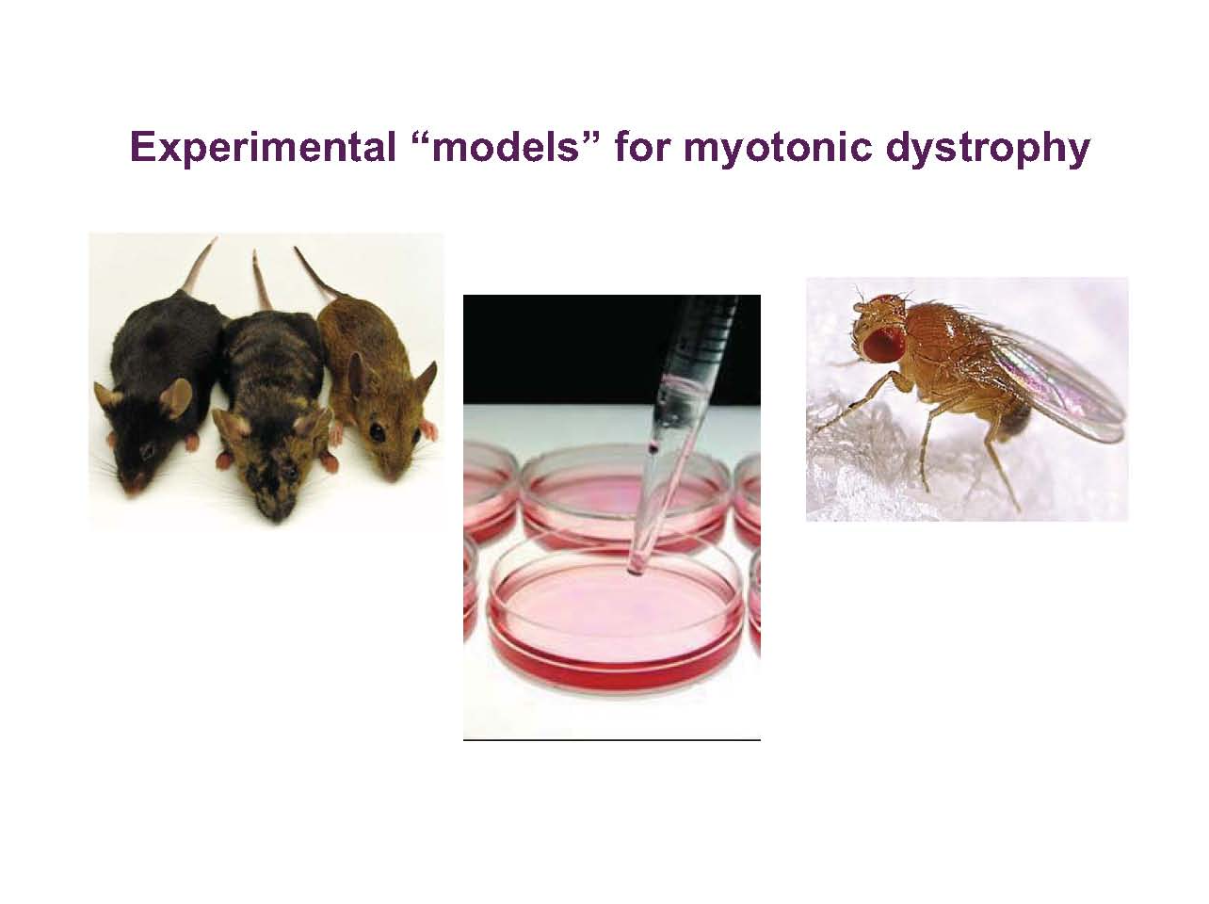

Slide 28
RNA interference (RNAi) “Shooting the messenger”
Mutant Gene
Davidson, Beverly, Ph.D. (in Partnership with the Bob Allison Ataxia Research Center)
Children’s Hospital of Philadelphia, PA
Translating RNAi therapy for Spinocerebellar Ataxia 1 (SCA1) to the clinic
X
mRNA
“Toxic” Protein
Brain Dysfunction

Slide 29
Reduce mutant protein
Mutant Gene
Al-Ramahi, Ismael, Ph.D.
Baylor College of Medicine, Houston, TX
Identification of druggable targets that modulate the levels of SCA-causing proteins in vivo
Schmidt, Thorsten, Ph.D.
University of Tubingen, Tubingen, Germany
Targeting the intracellular localization of ataxin-3 as novel treatment strategy for Spinocerebellar Ataxia Type 3 (SCA3)
mRNA
X
“Toxic” Protein
Brain Dysfunction

Slide 30





Slide 31
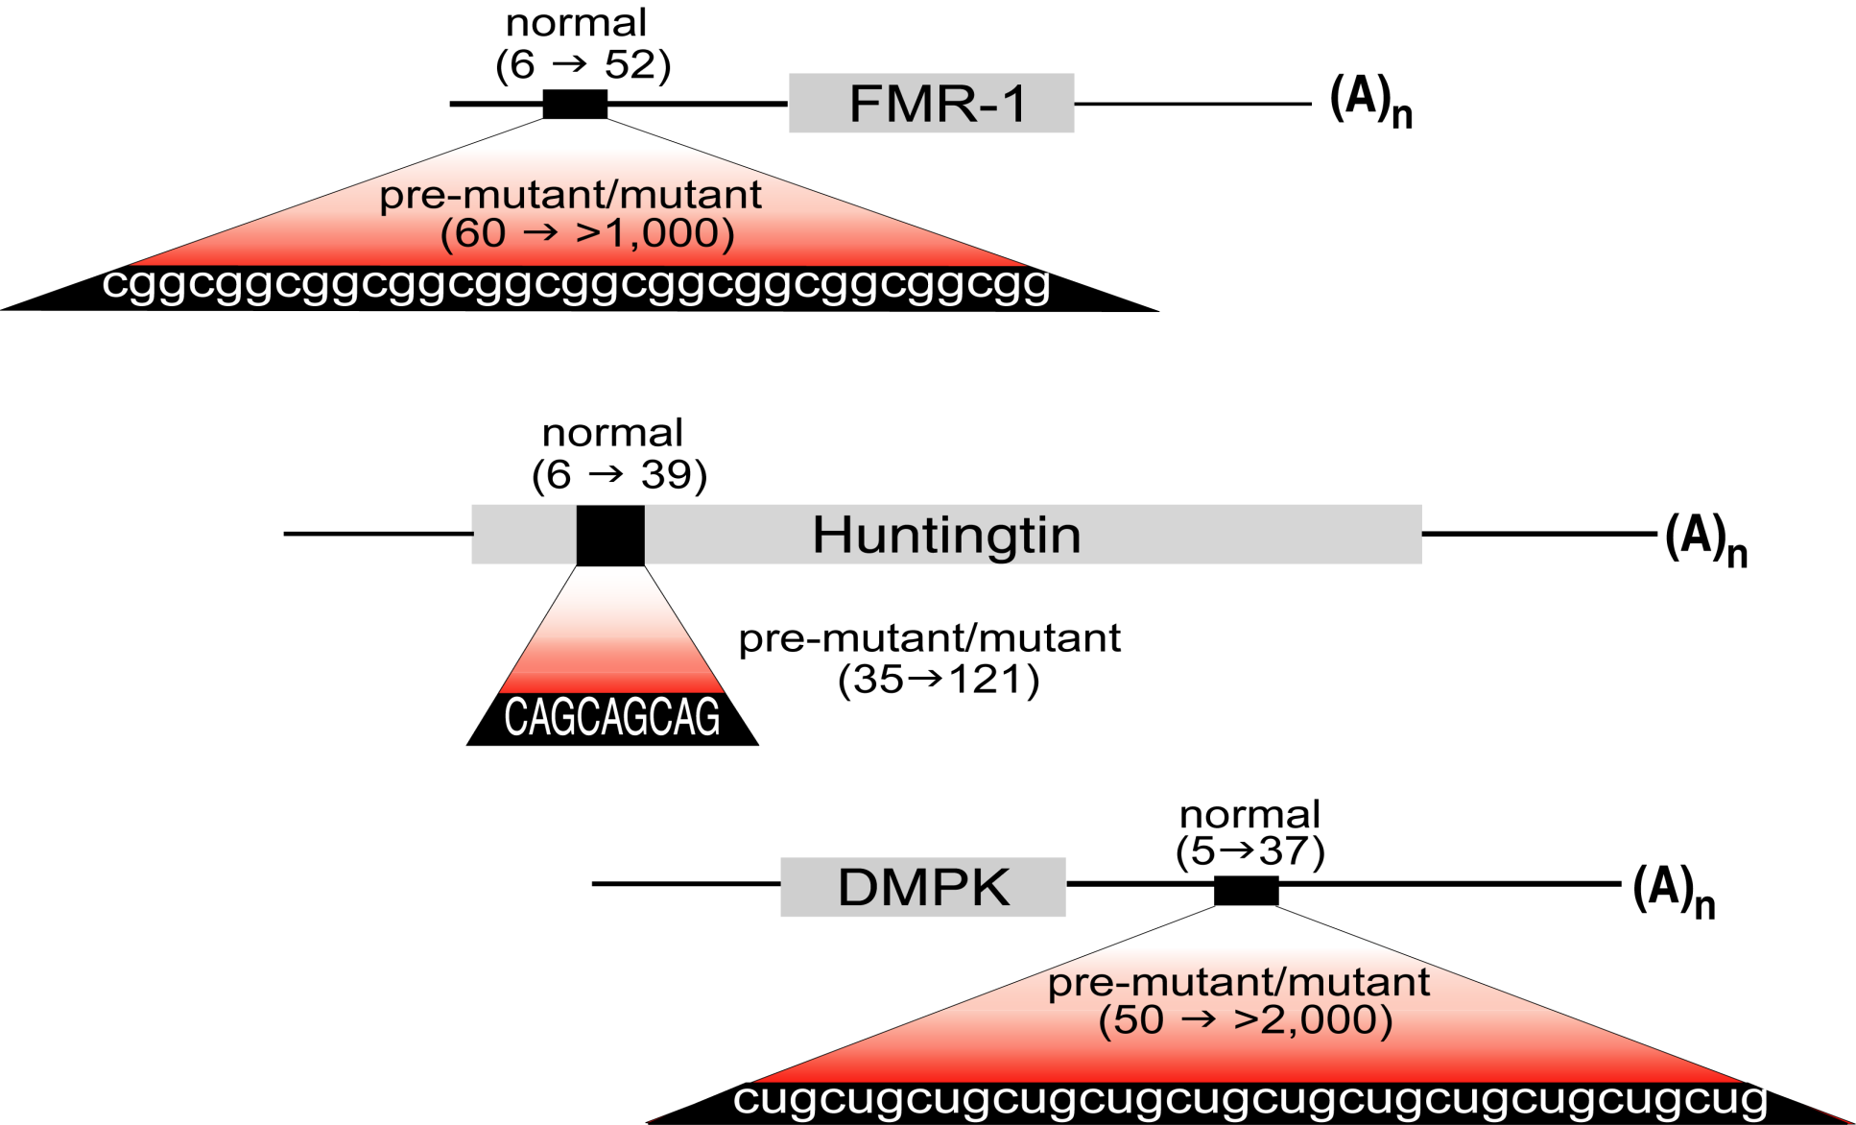
Microsatellite Expansion Diseases
Fragile X
Syndrome
Protein Loss
Protein Gain
RNA Gain
Huntington
Disease
ATG
ATG
Myotonic
Dystrophy

Slide 32

DNA → RNA CODONS→Protein
Genomic DNA THYBIGRYDDOGRANOUT
Messenger RNA THEBIGREDDOGRANOUT
Translated Message THE BIG RED DOG RAN OUT
The code is read three letters at a time and the ATG sets the reading frame
Notes:
16
Basic Genetics
ASCO Curriculum: Cancer Genetics & Cancer Predisposition Testing

Slide 33
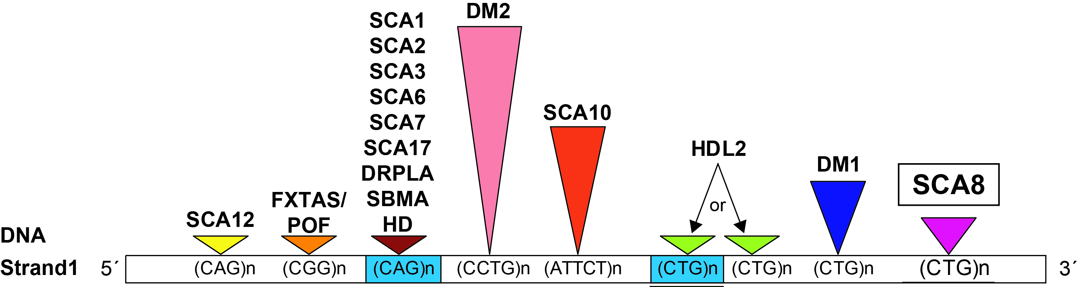
Protein coding and non-coding expansion disorders ~2005
FMR1
HMolGenet
Fillipova, 2007
HDL2
SCA7
(Margolis)
Neurosci. Meeting 2006
(Yang) WBC 2007
(La Spada)
ASHG Meeting 2008
(Moseley/Ranum)
Nature Genetics 2006
(Fillipova/Tapscott)
Mol Cell. 2005 20(3):483-9

Slide 34
Spinocerebellar Ataxia Type 8 SCA8

Slide 35
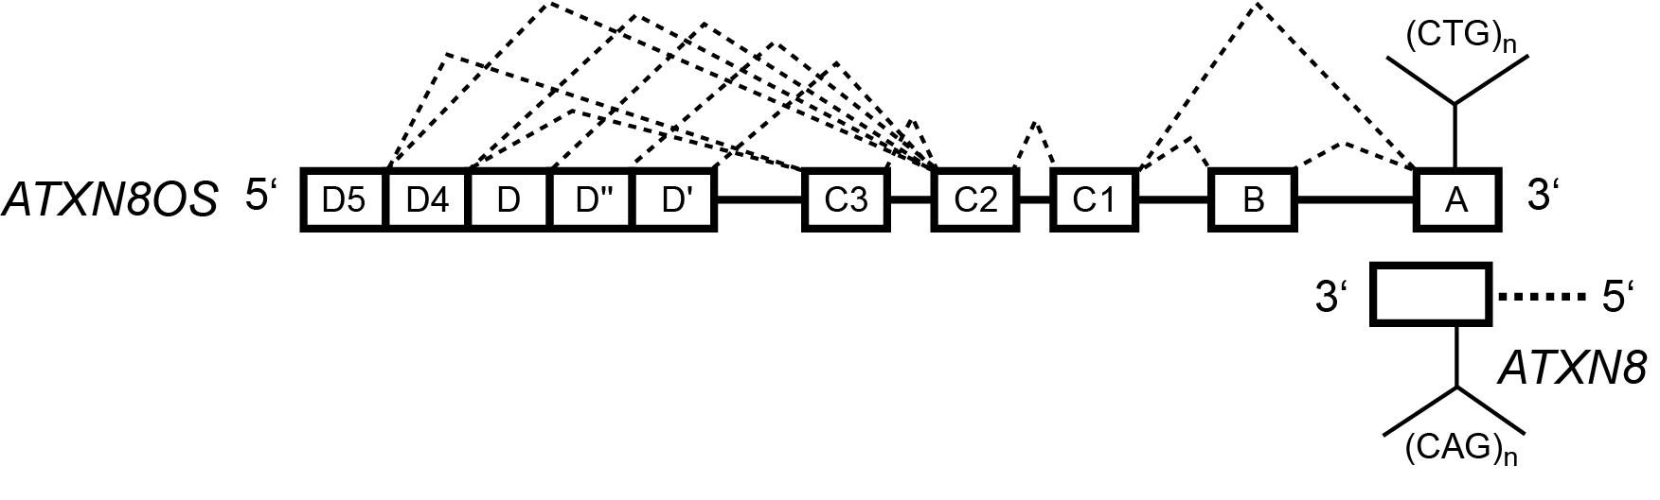
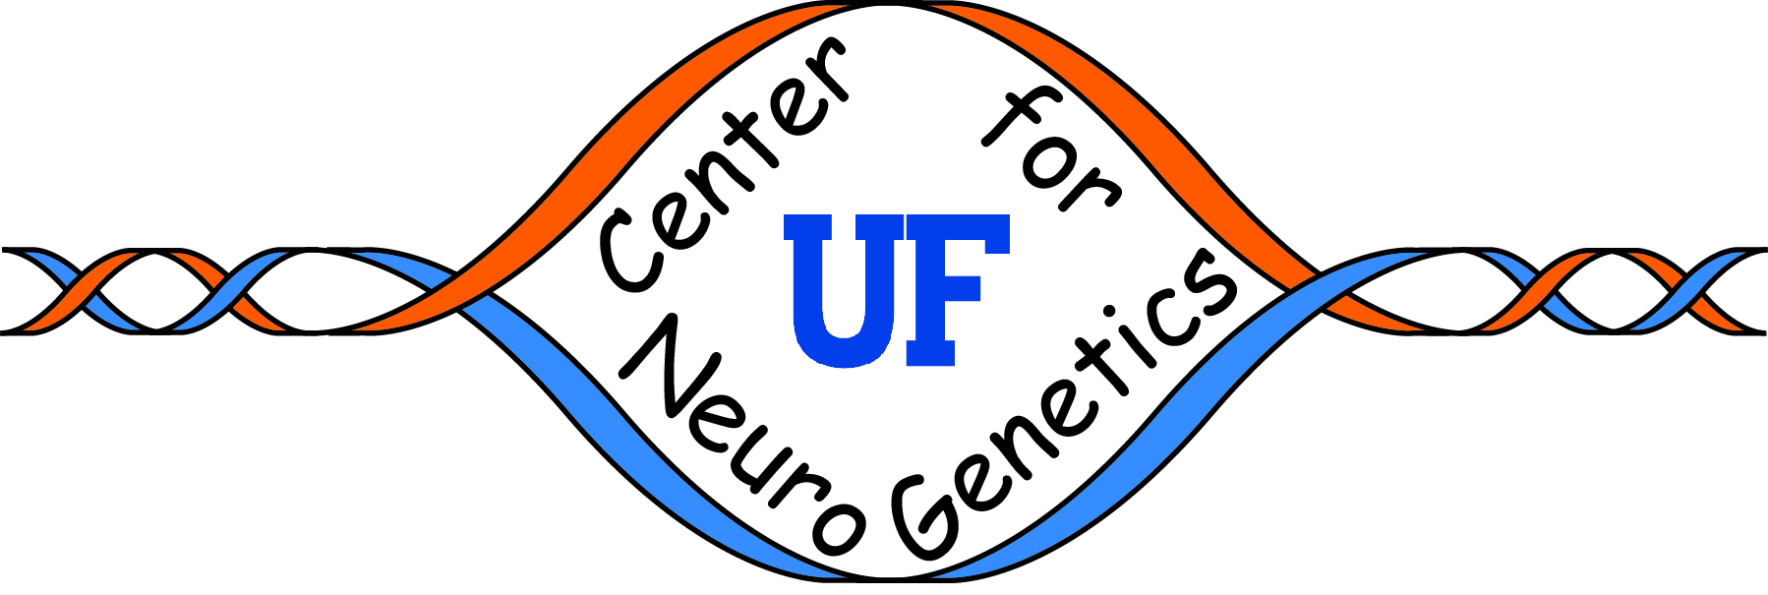
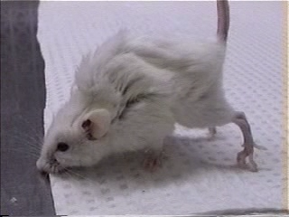
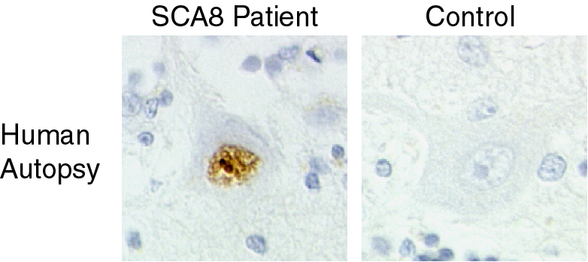
SCA8 transgenic mice
Nuclear polyGln inclusions in humans and mice
detected with 1C2 antibody
Moseley et al. Nature Genetics 2006

Slide 36

SCA8: one mutation two genes
Toxic RNA
Mechanism
CUG_{EXP}
Daughters et al. 2009
PLoS Genetics
(CTG)n
Exon B
Exon A
Exon 1
(CAG)n
CAG_{EXP}
Toxic PolyQ
Mechanism?
5’
Moseley et al., 2006
Nature Genetics
5’
TAAAAAATG(CAG)₁₀₃CGG(CAG)₇CGG(CAG)₅TAGTAGTAGTAAACG
* M(Q)₁₀₃R(Q)₇R(Q)_{5****}

Slide 37
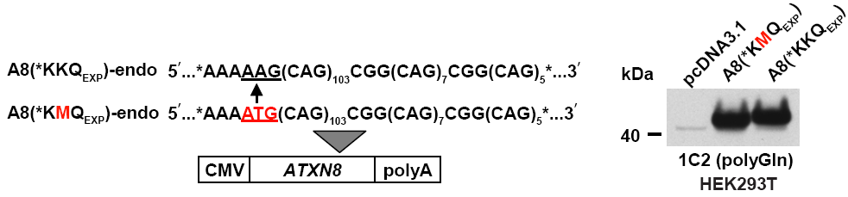
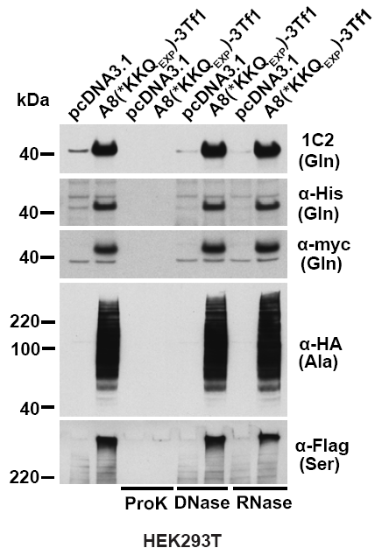
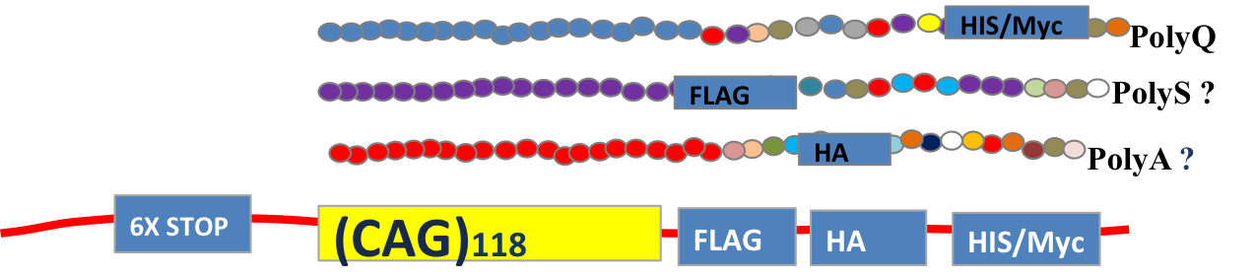
Discovery of Repeat-Associated Non-ATG Translation (RAN translation)
Tao Zu
Frame | Codon | Amino Acid
1 | CAG | Glutamine(Q)
2 | AGC | Serine(S)
3 | GCA | Alanine(A)
CAGCAGCAGCAGCAGCAGCAGCAG
Zu et al., PNAS 2011

Slide 38
DNA → RNA → Protein
Genomic DNA THYBIGRYDDOGRANOUT
Messenger RNA THEBIGREDDOGRANOUT
Translated Message THE BIG RED DOG RAN OUT
HEB IGR EDD OGR ANO UTT
EBI GRE DDO GRA NOU TTH
Repeat Associated Non-ATG (RAN) translation
Notes:
16
Basic Genetics
ASCO Curriculum: Cancer Genetics & Cancer Predisposition Testing

Slide 39
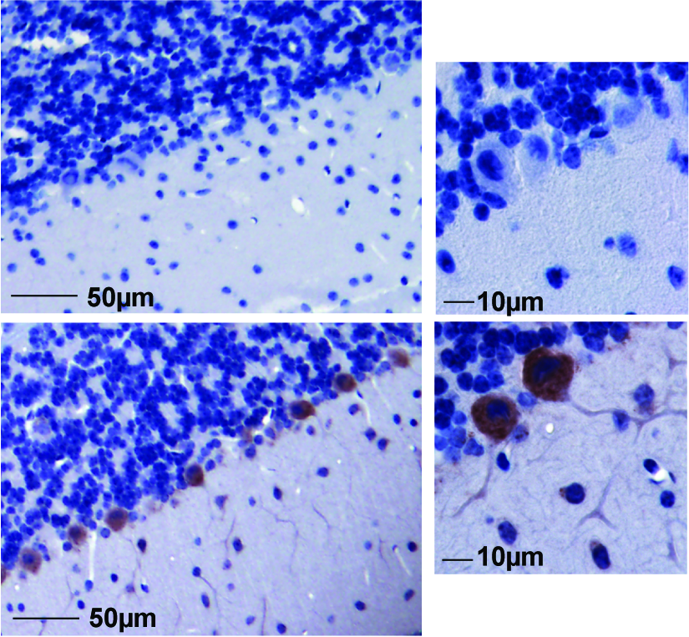
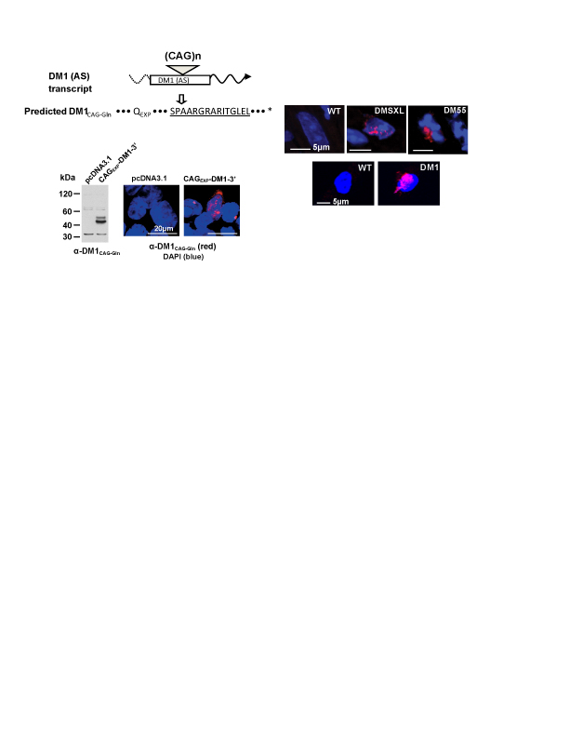
RAN Translation in vivo: SCA8
α-SCA8 poly-GCA-Ala
α-DM1 poly-CAG-Gln
WT
SCA8
Mouse Cerebellum
Human Myoblasts
Zu et al., PNAS 2011

Slide 40
SCA8: one mutation two genes up to six proteins
Toxic RNA
Mechanism
CUG_{EXP}
Daughters et al. 2009
PLoS Genetics
(CTG)n
Exon B
Exon A
Exon 1
(CAG)n
CAG_{EXP}
Toxic PolyQ
Mechanism?
5’
Moseley et al., 2006
Nature Genetics

Slide 41
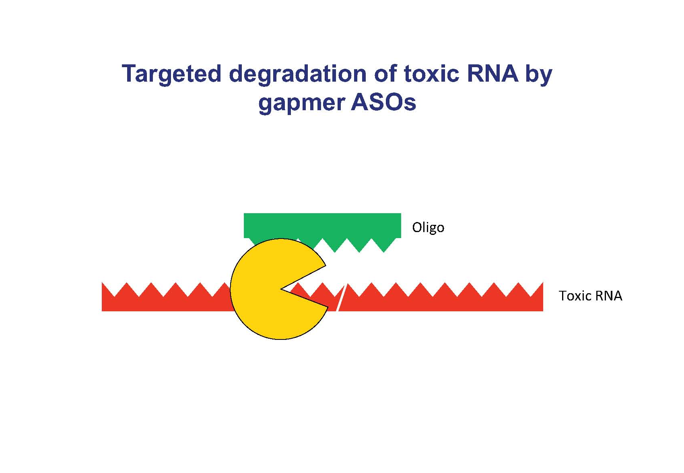

Slide 42


Target both RNAs
Toxic
RNA & RAN
Proteins
CUG_{EXP}
(CTG)n
Exon B
Exon A
Exon 1
(CAG)n
CAG_{EXP}
Toxic PolyQ
& RAN protein
5’

Slide 43
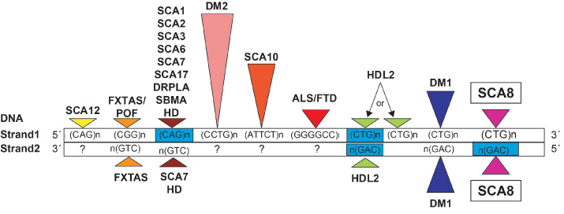
New view of expansion disorders
polyGly
GP/GR/GA/PA/PR/GP
RAN Translation
MpolyGln
RAN Translation
polyGln
polyAla
Framework for understanding disease mutations has changed
Bidirectional expression is common
Repeats express unexpected proteins
Impact on strategies to treat these diseases
RAN Translation

Slide 44
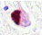

Conclusions
THANK YOU!!!!!!
NAF funding critically important for understanding the causes of ataxia and developing treatments
Therapeutic efforts to target RNA and protein pathways are underway.
Lessons from one disease connect to other diseases

Slide 45










Acknowledgements
University of Florida
Maurice Swanson
Tetsuo Ashizawa
S.H. Subramony
Anthony Yachnis
Johns Hopkins
Jeffrey Rothstein
Juan Troncoso
Lyle Ostrow
Washington University
Tim Miller
University of Florida
Ranum Lab
Tao Zu
Yuanjing Liu
John Cleary
Monica Bañez Coronel
Tammy Reid
Fatma Ayhan
David Deal
Amrutha Pattamatta
Barbara Perez
Alex Tarabochia
Solaleh Tusi
University of Minnesota
Tim Ebner
Brent Clark
Mathew Stone
Todd Markowski
Stephen Schmechel
Nik Somia
Walter Low
Peter Bitterman
Mark Peterson
INSERM France
Genevieve Gourdon
Mario Gomes-Pereira
Aline Huguet

Slide 46
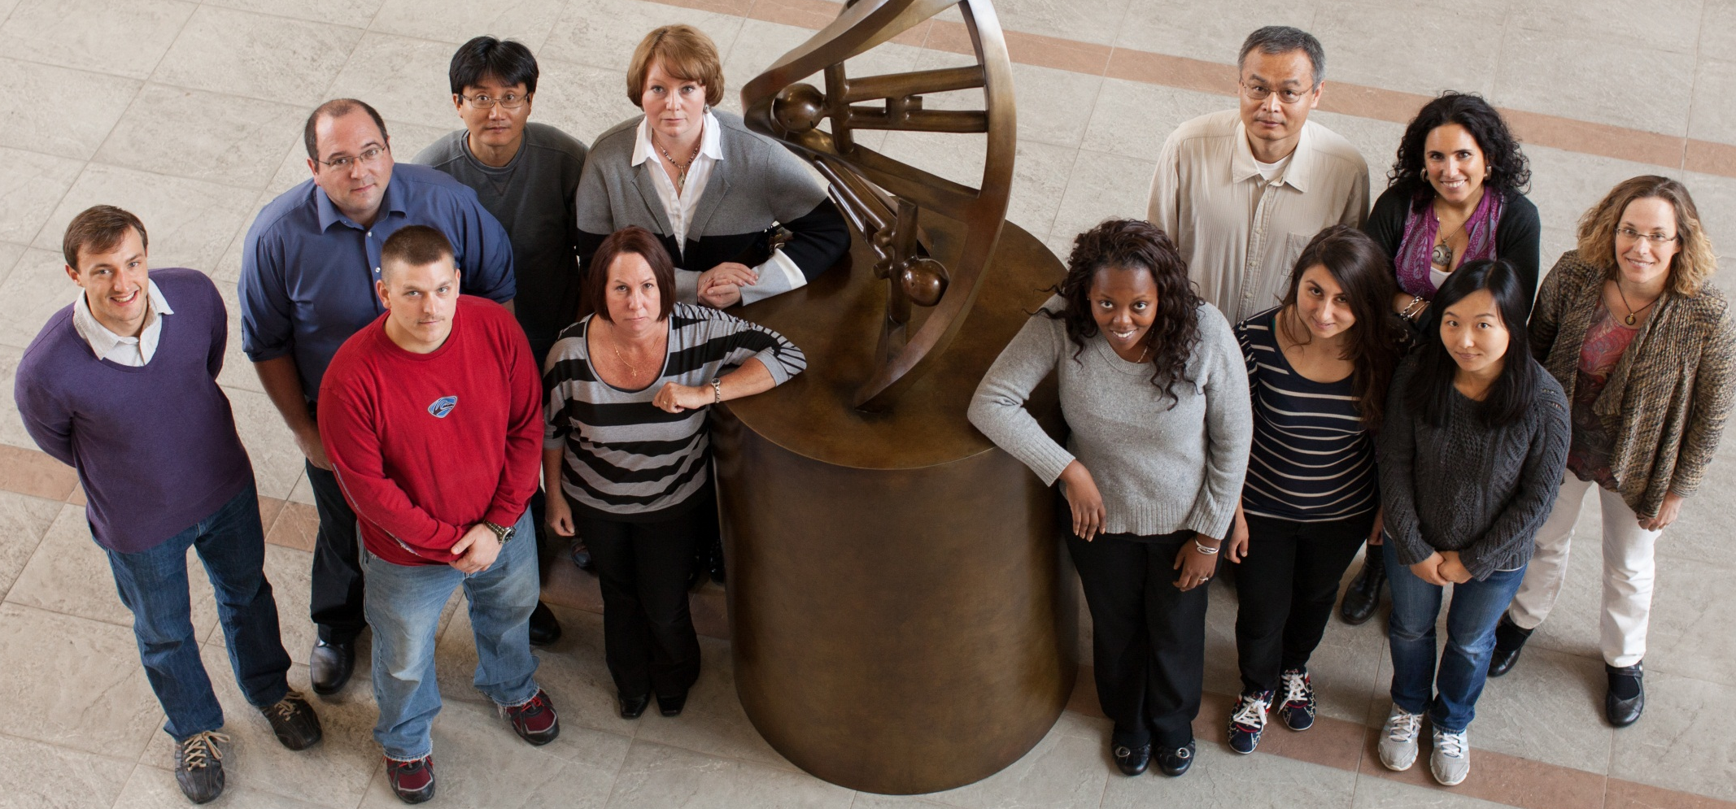
THANK YOU

Slide 47
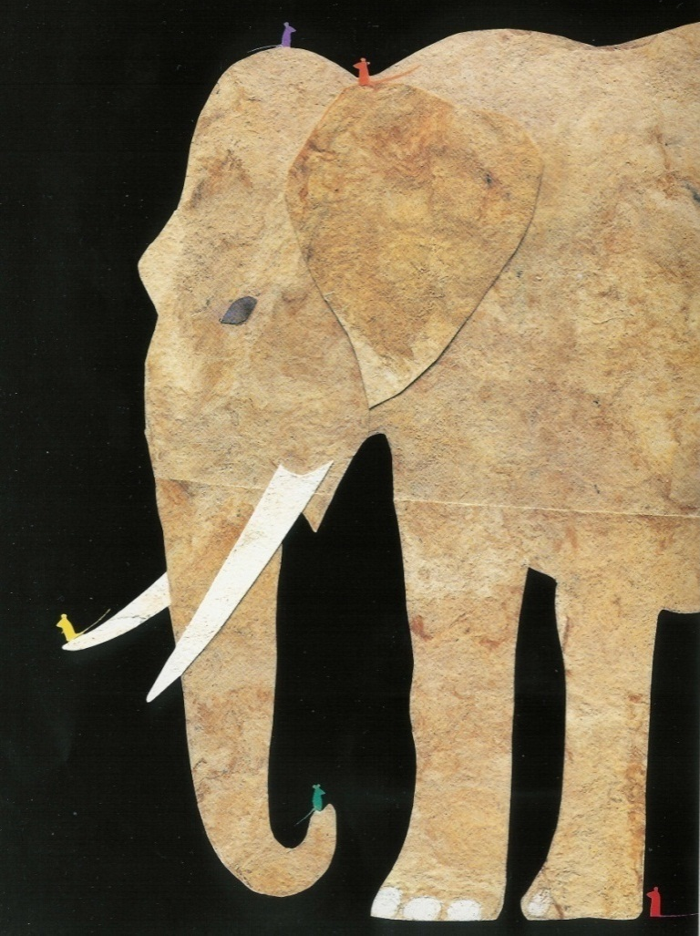
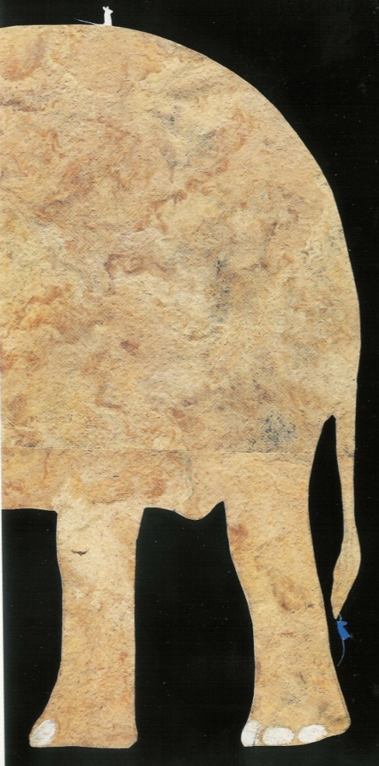

Discoveries of how genes work in SCA8
Story about an Elephant:
Ed Young: Seven Blind Mice
Notes:
Holy grail of understanding neurodegneration is to understand all of the different aspects and common pathways. Too often we are like blind mice in this picture book exploring a small piece of the elephant and reporting back completely different findings
We have pursued the identification which are hard to relate to each other. With that transition I am going to move on to gene #2
Segway – clearly d

Slide 48
Microsatellite Expansion Diseases
Fragile X
Syndrome
Protein Loss
Protein Gain
RNA Gain
Huntington
Disease
ATG
ATG
Myotonic
Dystrophy

Slide 49
Protein coding and non-coding expansion disorders ~2005
FMR1
HMolGenet
Fillipova, 2007
HDL2
SCA7
(Margolis)
Neurosci. Meeting 2006
(Yang) WBC 2007
(La Spada)
ASHG Meeting 2008
(Moseley/Ranum)
Nature Genetics 2006
(Fillipova/Tapscott)
Mol Cell. 2005 20(3):483-9

Slide 50
DNA → RNA CODONS→Protein
Genomic DNA THYBIGRYD(RYD)60DOGRANOUT
Messenger RNA THEBIGRED(RED)60DOGRANOUT
Translated Message THE BIG RED (RED)60 DOG RAN OUT
The code is read three letters at a time and the ATG sets the reading frame
Notes:
16
Basic Genetics
ASCO Curriculum: Cancer Genetics & Cancer Predisposition Testing

Slide 52
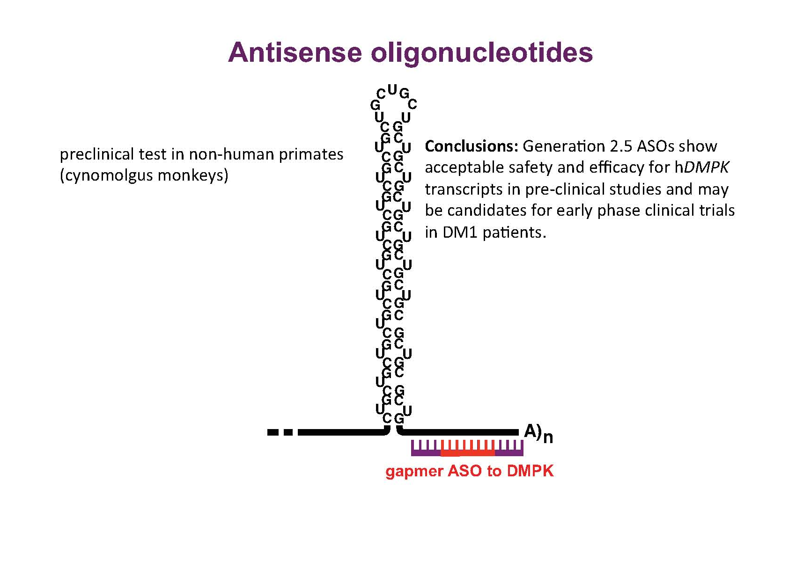

Slide 53
