Slide 1

Medical Marijuana
A role in the Ataxias?
Terry D. Fife, MD, FAAN
Director, Balance Disorders & Otoneurology
Barrow Neurological Institute
Associate Professor of Neurology
University of Arizona College of Medicine

Slide 2
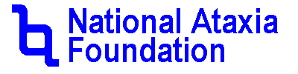
Disclaimer
The information provided by speakers in any presentation made as part of the 2015 NAF Annual Membership Meeting is for informational use only.
NAF encourages all attendees to consult with their primary care provider, neurologist, or other health care provider about any advice, exercise, therapies, medication, treatment, nutritional supplement, or regimen that may have been mentioned as part of any presentation.
Products or services mentioned during these presentations does not imply endorsement by NAF.

Slide 3
Presenter Disclosures
Dr. Fife has no financial relationship with any manufacturer of any commercial product and/or provider of commercial services discussed in this CME activity.
Dr. Fife will discuss the evidence of cannabinoid use in neurological conditions for which there is not an FDA-designated indication.

Slide 4
Objectives
Be familiar with formulations of cannabinoids
Develop a reasonable understanding of the evidence regarding use of various cannabinoids in neurological diseases and ataxia syndromes
Be aware of a few of the legal issues associated with use of cannabinoids in medical care

Slide 5
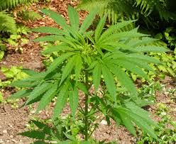
The plant: Cannabis sativa
Many active chemical constituents: THC (psychoactive), and cannabidiol (not psychoactive)
Hemp is fiber made from the stem of the plant and used for clothing and paper but has no medicinal value.

Slide 6
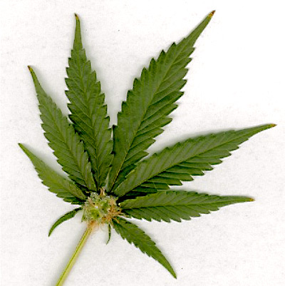
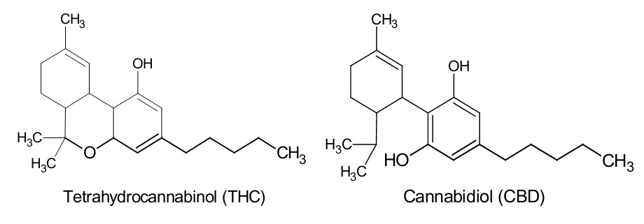

Slide 7
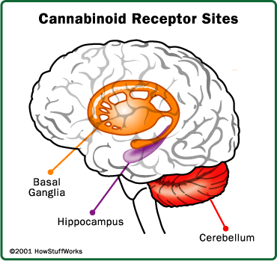
Brain has endocannabioids
which are our body’s own molecules that bind to cannabinoid receptors (named CB1 and CB2).
CB1 – in CNS mainly hippocampus and cerebellum, basal ganglia, limbic system, prefrontal cortex.
CB2 – located on immune cells

Slide 8
Controversies of Medical Marijuana
Accounts for 75% of illegal drug use in U.S.
Two cannabinoids approved by FDA in 1985:
Marinol® (Schedule III) and Cesamet™ (Schedule II).
Herbal (plant) marijuana remains illegal
FDA Schedule I drug since President Nixon signed the Controlled Substance Act in 1970 as a prelude to the “war on drugs” declaration.

Slide 9
Federal Law on Marijuana
Controlled Substances Act (CSA) which was signed into law as the Comprehensive Drug Abuse Prevention and Control Act of 1970 placed marijuana and its derivatives as Schedule I.
Notes:
9

Slide 10
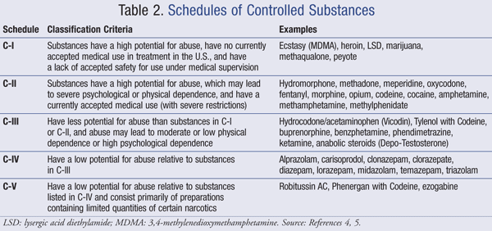

Slide 11
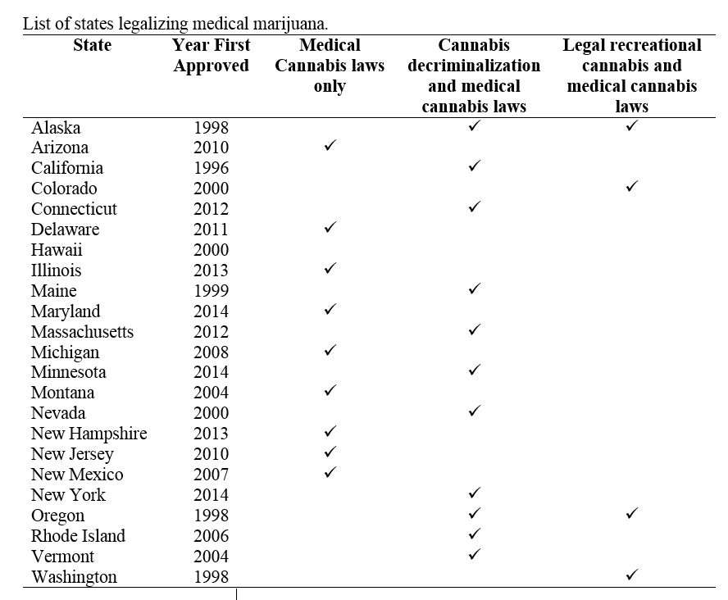

Slide 12
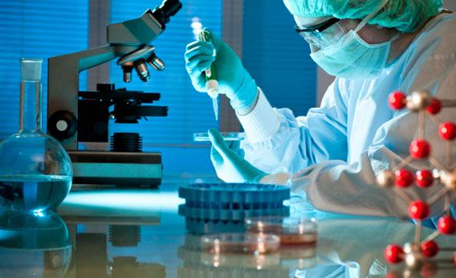

So what does the science tell us?

Slide 13
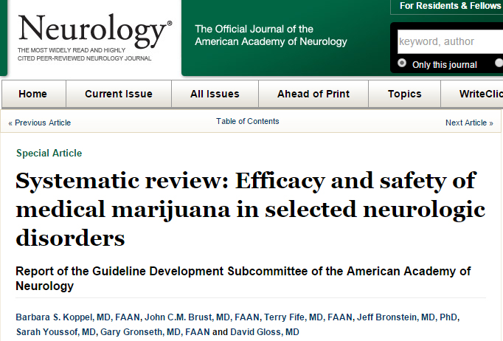
Notes:
13

Slide 14
Methods
A systematic review of published literature broadly related to neurological conditions, 1947-2013
1590 Articles, 61 relevant, 23 were RCT meeting criteria, 9 were Class I
Literature Classified on the basis of potential for bias (RTC), only Class I, II and III considered.
Notes:
14

Slide 15
Questions to Answer
What is the efficacy of cannabinoids in relieving spasticity in patients with MS?
What is their efficacy in relieving central pain and painful spasms in MS?
What is their efficacy in alleviating bladder dysfunction in MS?
What is their efficacy in controlling involuntary movements including tremor in MS?
What is their efficacy in reducing dyskinesias of Huntington’s disease, levodopa-induced dyskinesias of Parkinson’s disease, and tics of Tourette’s syndrome?
What is their efficacy in reducing seizure frequency in epilepsy?
Notes:
15

Slide 16
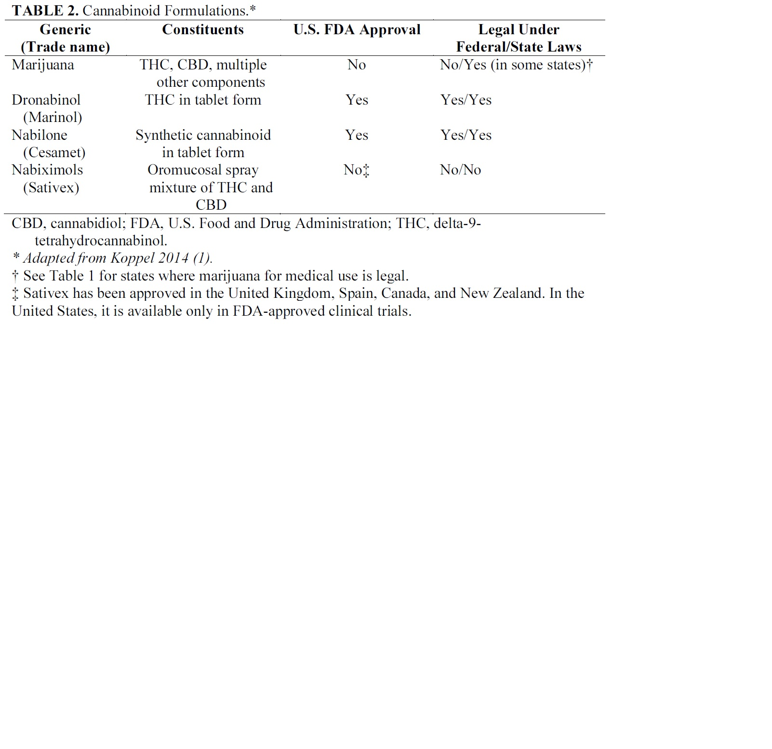

Slide 17
Spasticity from MS
Cannabis extract/THC and Sativex probably effective in patient-reported (VAS/NAS) spasticity (4 Class I studies)
Cannabis extract/THC probable ineffective for physician-assessed (Ashworth scale) spasticity (3 Class I studies)
Smoked marijuana is of uncertain benefit in MS related spasticity (2 conflicting Class III studies).

Slide 18
Spasticity from MS
Oral cannabis is established as effective to reduce patient-reported symptoms of spasticity over six weeks (Level A).
Sativex® and THC are probably effective in reducing patient reported symptoms of spasticity over six weeks (Level B).
Inhaled marijuana is of uncertain effect in reducing spasticity (Level U).

Slide 19
Medically refractory central pain in MS
Based on 5 Class I studies, 3 Class II studies:
Oral cannabis extract is established as effective to reduce central pain of MS that has failed standard therapy (2 Class I studies), (Level A).
THC or nabiximols are probably effective to reduce central pain or painful spasms of MS that has failed standard therapy (1 Class I study each), (Level B).

Slide 20
Bladder symptoms in MS
Based on 4 Class I studies, 1 Class II studies:
Nabiximols probably effective decreasing number of bladder voids at 10 weeks (Level B).
THC / oral Cannabis probably ineffective in reducing bladder complains (Level B).
Nabiximols of uncertain effectiveness for overall bladder symptoms (Level U).

Slide 21
MS-related tremor
Based on secondary outcome measures in 2 Class I studies, 2 Class II studies:
No benefit in tremor reduction, possibly worsens
THC / oral cannabis extract should not be offered for MS-related tremor (Level B).

Slide 22
Involuntary movements
Huntington’s chorea: 2 Class I studies using CBD but with different rating scales, underpowered. Benefit with secondary outcome of chorea (1 study), behavioral features (1 study). Possible modest benefit in chorea (Level B)
Levodopa-dyskinesias in PD: 1 Class I study using THC was ineffective (Level B)
Tourette’s syndrome: 1 Class I, 1 Class II study, conflicting data that is overall insufficient evidence of CBD in reducing tics (Level U)

Slide 23
Seizure frequency in epilepsy
No Class I-III studies using cannabinoids for seizure frequency in epilepsy. All studies Class IV. No recommendation for use (Level U)

Slide 24
Answers to Questions
Refractory spasticity in patients with MS? Subjective improvement – YES
Objective improvement – NO
Refractory central pain and painful spasms in MS? YES
Bladder dysfunction in MS? NO (mostly)
Tremor in MS? NO
Dyskinesias of HD, dopa-dyskinesia in PD, Tics in Tourette’s syndrome? MOSTLY NO (possible modest reduction of chorea in HD)
Seizure frequency in epilepsy? Unknown
Notes:
24

Slide 25
So where does that leave us?
Answer: in need of more study.
So why is it taking so long?
Answer: politics, opinions, ideologies

Slide 26
Some Thoughts
Disclaimer: We do not have answers to very many questions so these are my thoughts for what they are worth…
When you might consider marijuana or cannabinoids:
Pain that has failed all conventional therapies
Excessive weight loss or loss of appetite
Nausea or motion sensitivity failing other Tx
Anxiety, extreme emotional distress failing other Tx
Excessive spasticity or muscle tone failing other Tx
Oscillopsia (jittery vision) from nystagmus

Slide 27
When you might want to avoid marijuana or cannabinoids
if you have:
Memory or cognitive dysfunction
Ataxia – it might worsen balance, speech
Periods of confusion, hallucinations, disorientation
Consider the following healthful approaches:
Minimize sedating and non-essential drugs
Well-balance diet, hunger is permitted
Exercise – how to achieve depends on health
Engage with others socially, intellectually

Slide 28
