Slide 1

Relationships & Sexuality
Theresa M. Chase, MA, ND, RN
Assistant Professor, Nursing-Mental Health
Colorado Mesa University

Slide 2

Disclaimer
The information provided by speakers in any presentation made as part of the 2015 NAF Annual Membership Meeting is for informational use only.
NAF encourages all attendees to consult with their primary care provider, neurologist, or other health care provider about any advice, exercise, therapies, medication, treatment, nutritional supplement, or regimen that may have been mentioned as part of any presentation.
Products or services mentioned during these presentations does not imply endorsement by NAF.

Slide 3
Presenter Disclosures
Theresa M. Chase
The following personal financial relationships with commercial interests relevant to this presentation existed during the past 12 months:
No relationships to disclose or list

Slide 4
My intentions for this session….
To assist and support your growth as a human being in the area of relationship and sexuality
To provide a fun, interactive and experiential learning opportunity.
To provide you with food for thought, resources to gain and a new level of comfort with this topic.

Slide 5
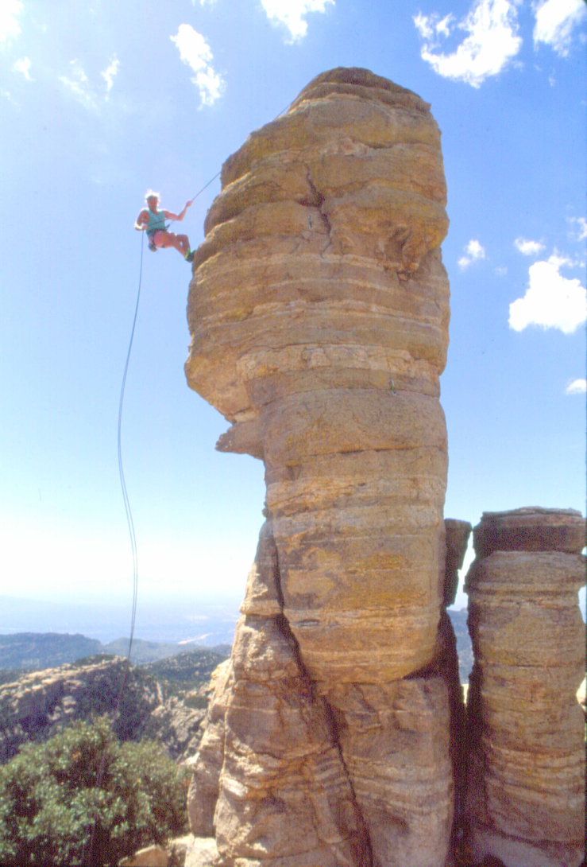
How This Session is Different….
“Out of the Box” approach
Not the usual route
I am nervous
Your participation is essential
That is not really me on the rock☺

Slide 6
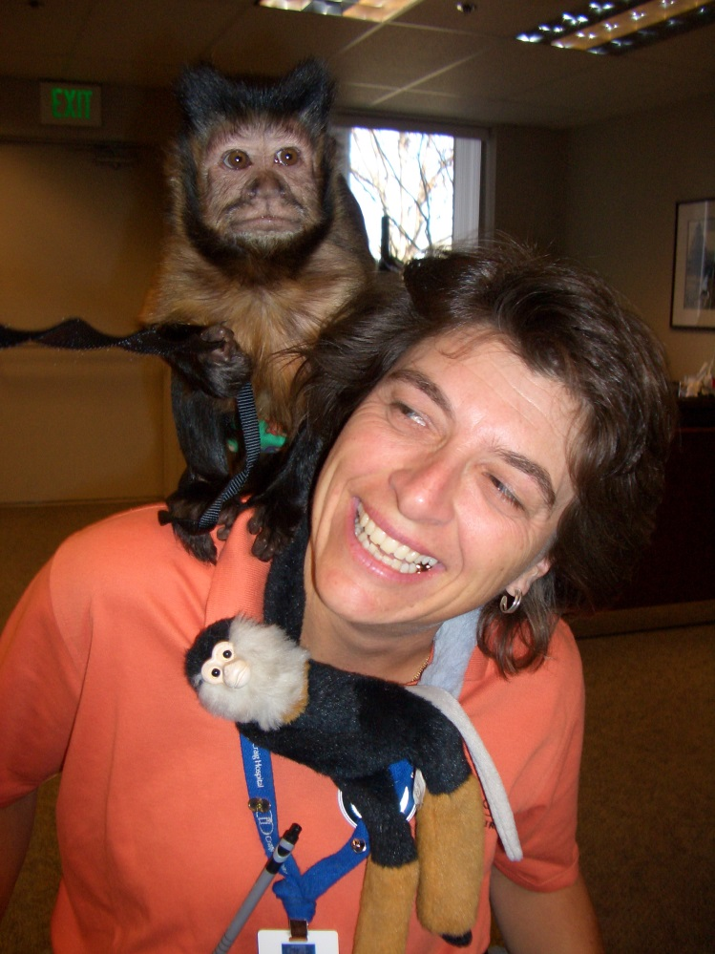
Why Me?
Background
Educator
Counselor
Nurse
Experience
35+ years/educator
200+ presentations
18 years w/ new patients
Training
Nursing
Education
Health Promotion
Communication
Mental Health

Slide 7
Why You?
Are you a human being?
Do you have an interest in relationship & sexuality?
What do you want in your life?

Slide 8
Are You a Human Being?
If so, then you are a sexual being….
Needs & desires
Sexual expression
Relationship
Curiosity
Growth

Slide 9
Human Sexuality
In the the broadest sense, human sexuality represents a natural extension of affection, tenderness and companionship between two people.
It is the integration of somatic, emotional, intellectual, and social aspects of well-being.
Having the ability to enjoy and control sexual reproduction and behavior without fear, guilt and shame.
Firestone, Firestone & Catlett, 2008

Slide 10
Relationship
The human heart yearns for contact---above all it yearns for genuine dialogue.
Dialogue is at the heart of the human.
To be seen, heard and met by another…..recognized in our uniqueness, fullness, vulnerability.
Hycner & Jacobs, 1995

Slide 11
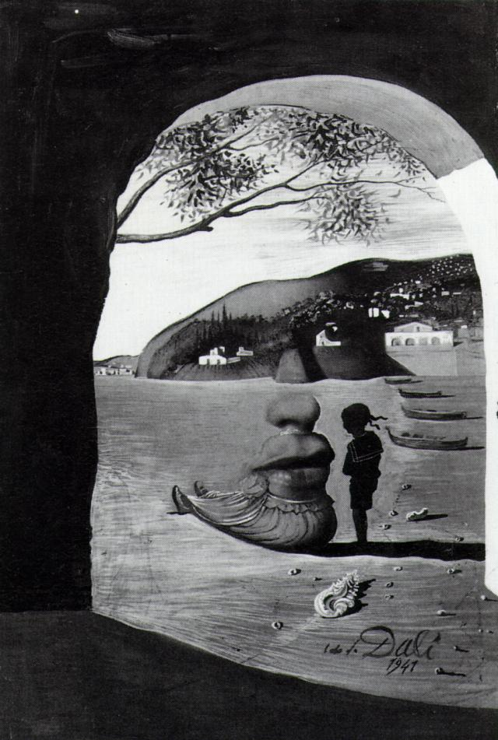
Talking about Sex
No common vocabulary
Not easy to talk sex
Media portrayal of sex
Values, family, religion and culture influence
Judgment of sexuality
No one to listen…..

Slide 12
How do You Choose to Live?
Love and sex is about promoting good feelings and enhancing a capacity for play. Ability to feel good, top play and to enjoy loving sexuality entwined with all aspects of life….
Physical health
Emotional and Mental well-being
Loving relationships
Spiritual connection.
Resnick 2012.

Slide 13
Barriers to Getting what you want
Other’s ideas about sexuality & you….
Your own ideas about sexuality & you…..
Interference of the disability issues
Changes in roles, relationship, daily life….
Who’s there? Single, partner, marriage, no one.
Time, assistance, function
Body Hatred & Body Image Issues

Slide 14
Expanding Your Views: Learning from Others
People with Spinal Cord Injury Reported….
Increased sexual imagination
Knowledge & creativity
Discovered new erogenous zones
Explored new positions
Changed time of day routine
Planned sex was OK
Spasms enhanced sexual pleasure
Let go of the expectation of orgasm
Experienced pleasure and orgasm in new and different ways.
Liddiard 2014.

Slide 15
Body-Mind Basics
Name 3 qualities you would like more in your emotional life with your partner.
..
..
..
Name 3 qualities you would like more of in your sexual life with your partner.
..
..
..
How would you and your partner have to grow to make those changes?

Slide 16
Waking Up Your Senses Breathing Exercises
Belly Rolls
Belly Breathing
The Complete Breath
Taking Felt-Sense Inventory

Slide 17
What Dampens Desire?
Obvious Risk Factors
Stress
Pressures of daily life
Money tensions
Pessimism, fear, blame, power struggles
Depression and Anxiety
Despair and apprehension wipe out anything pleasurable
Depressed people are locked in the past
Trauma
Unresolved emotional effects of abuse
Emotional, physical, sexual abuse and trauma linger in the body/mind

Slide 18
Other Issues…..
Desire Dampeners…
Partner Infidelity
Caregiver role
Daily Proximity
Health declines
Desire-Dampening Physical Conditions
Functional changes
Hormone deficiencies
Side effects of medications
Illness, fatigue, limited energy

Slide 19
Falling in Love: The 1st time or Again….
Falling in Love & Commitment involves brain chemistry
Falling in Love” stimulates dopamine & norepinephrine
Generates feelings of euphoria, triggers testosterone
“Commitment” stimulates oxytocin & vasopressin
Sedating effects and inhibit testosterone

Slide 20
Experiments in Relationship
1 Minute Mindful Hug
Say What You Love
Have Fun Together
Holding & Breathing
Empathic Touch
Making Eye Contact

Slide 21
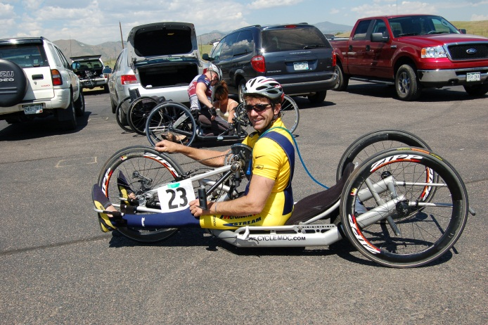

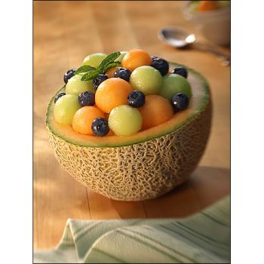
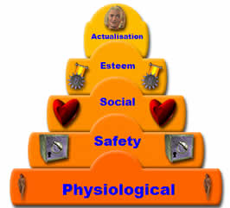
Healthy Body, Healthy Mind

Slide 22
What is Truly Great Sex?
Being present, focused and embodied
Extraordinary communication and heightened empathy
Authenticity and transparency
Freedom to be genuinely honest
Feeling no self-consciousness with partner
Fun and Play….Sense of Humor…Laughing Together
Allowing oneself to be vulnerable and surrender

Slide 23
Practice Safe Sex
Safer sex means sexual contact that:
Shows respect
Is pleasurable
Freely consented by both partners
Reduces the risks of passing on STDs
Reduces the risks of unwanted pregnancy
Is safe emotionally
Sex is never an obligation –

Slide 24

Safer sex activities
Involve NO exchange of body fluids:
Massage, hugging, touching
Self-stimulation
Social kissing
Rubbing against each other
Fantasy, thinking about sex
Kissing the body
Saying NO to things you do not feel comfortable about

Slide 25
Truly Great Sex?
Focusing on sexual performance for those with sexual concerns is counterproductive, because truly great sex and relationship is about “being in the experience” enjoying the connection, letting it unfold rather than achieving any particular sexual goals.
Kleinplatz, 2009

Slide 26
You are a Sexual Being……
There is no rush….
It’s up to you….
What do YOU want?
Who do YOU want to be with?
What do YOU need?

Slide 27

“The real voyage of discovery rests not in seeking new landscapes, but in having new eyes.”
--Marcel Proust
Notes:
Old Hasidic Tale--
pg 15-Omega

Slide 28
References
American Psychological Association (2011). The guidelines for psychological practice with lesbian gay, and bisexual clients. www.apa.org.
Firestone RW, Firestone CA, Catlett J. (2008). Sex & Love in Intimate Relationships.
Hycner R, Jacob . 1995). The Healing Relationship in Gestalt Therapy.
Klienplatz PJ, Menard AD, Paquet MP, et al. (2009). The components of optimal sexuality: A portrait of great sex. Canadian Journal of Human Sexuality, 18 (1-2), 1-13.
Liddiard K. (Spring, 2014). Sex, love & disability: Experiencing sensuality and intimacy. Abilities.
Resnick, S. (2012) The heart of desire: Keys to the pleasure of love. John Wiley & Sons: New Jersey.

