Slide 1

Reprodutive Strategies and wrap-up
Chip Wilmot, MD, PhD

Slide 2
Disclaimer
The information provided by speakers in any presentation made as part of the 2017 NAF Annual Ataxia Conference is for informational use only.
The NAF encourages all attendees to consult with their primary care provider, neurologist, or other health care provider about any advice, exercise, therapies, medication, treatment, nutritional supplement, or regimen that may have been mentioned as part of any presentation.
Products or services mentioned during these presentations does not imply endorsement by the NAF.

Slide 3
Presenter Disclosures
No relationships to disclose or list

Slide 4

Presenter Disclosures
No relationships to disclose or list
Sex will be mentioned

Slide 5
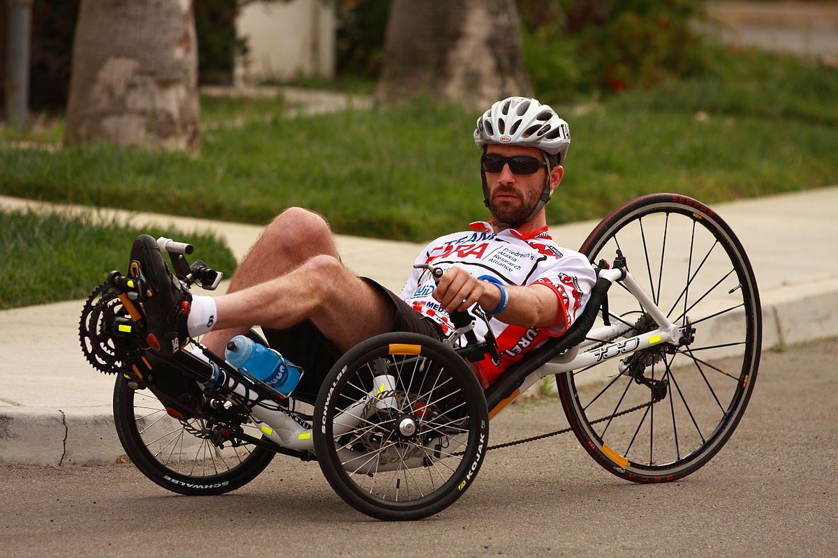
Strategies to Defeat Ataxia
Live Well, Fight Hard … aka the “Kyle Bryant Method”
  www.kyleabryant.com

Slide 6
Strategies to Defeat Ataxia
Live Well, Fight Hard … aka the “Kyle Bryant Method”
Develop Treatments

Slide 7
Strategies to Defeat Ataxia
Live Well, Fight Hard … aka the “Kyle Bryant Method”
Develop Treatments
  Understand Disease Mechanism
  Develop rational therapeutic strategies
    “preclinical” lab science
  Develop testing methods
    Establish measures of disease, trial network
  Conduct trials
    Mostly with companies
  Provide treatment
    FDA approval
    Insurance coverage

Slide 8
Strategies to Defeat Ataxia
Live Well, Fight Hard … aka the “Kyle Bryant Method”
Develop Treatments
  Helpful for an affected individual
Banish the Disease
  Helpful for others

Slide 9
Strategies to Defeat Ataxia
Live Well, Fight Hard … aka the “Kyle Bryant Method”
Develop Treatments
  Helpful for an affected individual
Banish the Disease
  Helpful for others
  Only works for genetic ataxias
  No Mutated Gene ==== > No Disease
  Most helpful for Dominantly inherited ataxias

Slide 10
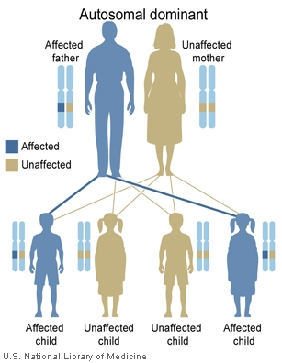
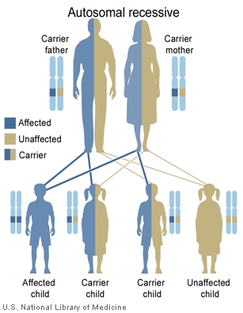

Slide 11
Strategies to Defeat Ataxia
Banish the Disease

Slide 12
Strategies to Defeat Ataxia
Banish the Mutant Gene

Slide 13
Strategies to Defeat Ataxia
Banish the Mutant Gene
  Don’t ever have sex -- abstinence

Slide 14
Strategies to Defeat Ataxia
Banish the Mutant Gene
  Don’t ever have sex -- abstinence
  Have “protected” sex -- birth control

Slide 15
Strategies to Defeat Ataxia
Banish the Mutant Gene
  Don’t ever have sex -- abstinence
  Have “protected” sex -- birth control
  What if you want to have children?

Slide 16
Strategies to Defeat Ataxia
How to have a child

Slide 17
Strategies to Defeat Ataxia
How to have a child without passing on the bad gene

Slide 18
Strategies to Defeat Ataxia
How to have a child without passing on the bad gene
  Borrow your neighbors child

Slide 19
Strategies to Defeat Ataxia
How to have a child without passing on the bad gene
  Borrow your neighbors child
  Get a spouse who already has kids (the stepkid solution)

Slide 20
Strategies to Defeat Ataxia
How to have a child without passing on the bad gene
  Adopt
  Unaffected Sperm Donor (for affected males)
  Unaffected Egg Donor (for affected females)
    In vitro fertilization (you become pregnant)
    Surrogate pregnancy (another woman becomes pregnant)

Slide 21
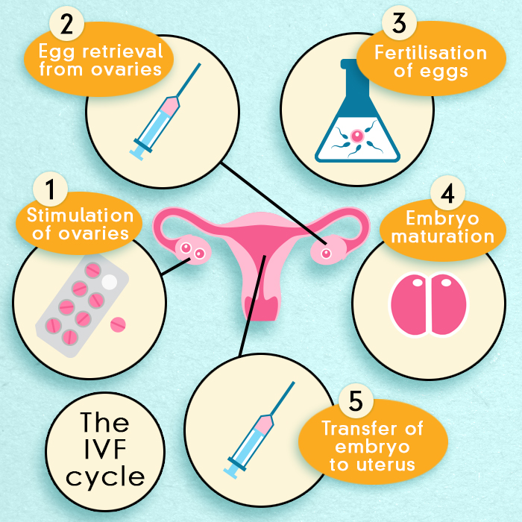
In vitro fertilization

Slide 22
Strategies to Defeat Ataxia
How to have a child without passing on the bad gene (that is 100% genetically related)
  Test after usual pregnancy has started
    Amniocentesis, chorionic villous sampling
    Terminate the pregnancy if the fetus has the disease
  Test before unusual pregnancy has started
    Preimplantation Genetic Diagnosis (PGD)

Slide 23
Strategies to Defeat Ataxia
Preimplantation Genetic Diagnosis (PGD)
  Allows the selection of unaffected embryos
  Children are 100% genetically related to parents
  IVF ➔ test young embryos for the mutation ➔ implant unaffected embryos

Slide 24
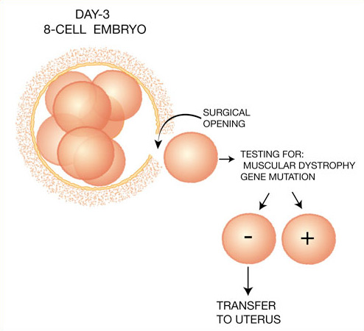
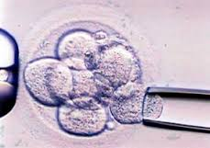
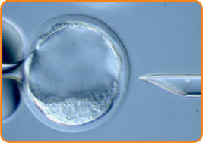
Strategies to Defeat Ataxia
Pre-implantation Genetic Diagnosis (PGD)

Slide 25
Strategies to Defeat Ataxia
Pre-implantation Genetic Diagnosis (PGD)
  Considerations:
    Ethical/moral/religious
    Cost $10-15,000
    Hassle
    Efficiency ~50%

Slide 26
Strategies to Defeat Ataxia
Pre-implantation Genetic Diagnosis (PGD)
  CAN be done in at-risk parents who don’t want testing
  If you are interested:
    Talk to your physician
    See a genetic counselor or geneticist
    Find a fertility clinic

Slide 27
Wrap-up
Camille Daglio and Joel Sutherland
  NAF is 60!!!
  NAF 6 consecutive 4-star ratings by Charity Navigator
  “Money buys research, … “

Slide 28
Wrap-up
Camille Daglio and Joel Sutherland
  NAF is 60!!!
  NAF 6 consecutive 4-star ratings by Charity Navigator
  “Money buys research, Research buys answers“
  “Think big, but its still one step at a time”
  “The only thing you can’t do is nothing”
  60 for 60
  NAF new look

Slide 29
Wrap-up
Pravin Khemani
  Types of ataxia
  Multidisciplinary care
  Team approach
  Seek out experienced neurologist

Slide 30
Wrap-up
Jason Wolfer
  Glimpse of what it means to have ataxia
  “Everyone has a number. I wanted one too.”
  SCA 24-7
  Experiences with neurologists
    (Note to self – don’t underestimate patients!!!)
  Importance of meeting people and support
  ” The hammer that shatters the glass is the same hammer that shapes the metal”
  Denial, Isolation, Acceptance, Support
  “My life had been invaded by a very stubborn guy sho wasn’t going away soon”

Slide 31
Wrap-up
Huda Zoghbi
  SCA1 mouse models
    polyQ expansion makes it more stable
    S776 phosphorylation in needed for toxicity
    Strategy: lowering ataxin-1 levels
      Antisense Oligonucleotides (ASO)
        help mice, esp. lifespan
        Works in humans in other diseases (Spinal Muscular Atrophy)
        Need to prove target engagement
        Need to dose properly to make it safe (might affect other genes like Capicua)
      Find genes that lower ATXN1 levels (MSK1 … which phosphorylates S776)

Slide 32
Wrap-up
Henry Paulson
  Clinical Trial Readiness
  Finding genes
    “ Can’t find answers unless you toil in the lab”
  Common Mechanisms
    DNA repair
    Chennel dysfunction
    Bioenergentics
    polyQ toxicity
    Protein homeostasis
    Repeat expansions

Slide 33
Wrap-up
Brent Vogel
  Genes! Genes! SCA43, SCAR24
  Types of testing -
    Single genes, gene panels. Whole Exome Sequencing
  Identifying new genes
  9 yo girl found to have a treatable condition (high dose riboflavin)
  Benefits of testing
    Stop unnecessary treatment
    Get an answer
    Prognosis
    Treatment (of course)

Slide 34
Wrap-up
Terri Alessi
  Caregiver for husband and son with SCA2
  You have to proactive in letting your needs known, accept help
  Financial impact
  Love for her family and such poise!
  “Walk for Dave”

Slide 35
Wrap-up
Laura Ranum
  NAF research grants
  Many applications (102 covering many diseases), many reviewers, conference calls etc.
  $1.1 million for 27 projects (26%)
  Pioneer SCA Translation Research awards described in more detail
  Gene discovery ➔ Gene based therapies
    Mutation types
    Genetics 2017 - RAN translation
    Gene Editing and targeting possibilities

Slide 36
THANK YOU!!!
  Patients
  NAF
  FARA
  nurse coordinators - Becky McMurray, Cathy Wood -Siverio, Betty Robinson, Sue Gronka
  Industry partners – Reata, Biohaven, Shire, Santhera

