Slide 1

Update on NAF Research
Laura Ranum, Ph.D.
Professor and Director Center for NeuroGenetics
University of Florida

Slide 2
Disclaimer
The information provided by speakers in any presentation made as part of the 2017 NAF Annual Ataxia Conference is for informational use only.
The NAF encourages all attendees to consult with their primary care provider, neurologist, or other health care provider about any advice, exercise, therapies, medication, treatment, nutritional supplement, or regimen that may have been mentioned as part of any presentation.
Products or services mentioned during these presentations does not imply endorsement by the NAF.

Slide 3
Goals and Impact of NAF Funding
Birds-Eye View of Funding Portfolio
  Making scientific connections between diseases
  Encouraging young investigators to pursue ataxia research
Some Examples
  Genetics 101-2015
  Four Pioneer Awards
  Therapeutic strategies to fight ataxia
  Connections between scientists, diseases, NIH and Industry

Slide 4
NAF’s Research Programs
Research Seed-Money Grants – Seed monies in early or pilot phases of studies and ongoing investigations that demonstrate need to attract future funding from other sources.
Post-Doc Fellowship Awards – Intended for researcher to spend a 3rd year in a post-doc position to increase their chance of establishing an independent ataxia research program

Slide 5
NAF’s Research Programs
Young Investigator and Young Investigator SCA Awards - Awarded to encourage young investigators to pursue a career in the field of ataxia
Pioneer SCA Translational Awards - This grant is intended for research investigations that will facilitate the development of treatments for the spinocerebellar ataxias (SCAs).

Slide 6
Research Applications Received
33 Seed-money grant applications were received
22 Post-Doc Fellowship Applications received
15 Young Investigator (non-SCA) applications received
14 Pioneer SCA Translational Research Applications received
18 Young Investigator SCA Applications received
TOTAL of 102 Applications were submitted

Slide 7
13 Countries represented
United States
United Kingdom
Brazil
The Netherlands
Germany
Portugal
Australia
Canada
Spain
France
Italy
Cyprus
Mexico

Slide 8
Types of ataxia
SCAs
Friedreich Ataxia
Gordon Holmes Syndrome
Joubert Syndrome
Mitochondrial
FXTAS
A-T
Episodic Ataxia
ARSACS
Spastic ataxia
AOA
SCAN
Sporadic

Slide 9
Review Process
Reviewers are assigned by Dr. Harry Orr and Dr. Laura Ranum
All applications are peer-reviewed by 2 reviewers
Pioneer applications peer-reviewed by 3 reviewers
More than 60 reviewers worldwide
Conference calls are attended by a sub-group of NAF Medical Research Advisory Board members to make funding recommendations
NAF Board of Directors make the final funding decisions

Slide 10
NAF Funded Research
27 Research Projects were Funded totaling more than
$1.1 million of research
9 Seed Money Research Grants
4 Young Investigator Awards
7 Post-doc Fellowship Awards
4 Young Investigator-SCA Awards
3 Pioneer Translational SCA Awards
26% of submitted grants were funded
Success rate is substantially higher than the NIH

Slide 11
Vogel, Adam, PhD
Centre for Neuroscience of Speech Parkville, Victoria, Australia
Intensive home based speech rehabilitation for adults with degenerative ataxia
Simões, Ana, PharmD, PhD
University of Coimbra, Portugal
Calpain-mediated proteolysis in Machado-Joseph disease
Karnebeek, Clara, MD, PhD
University of British Columbia, Vancouver, BC, Canada
Whole Exome Sequencing in the Diagnosis and Management of Atypical Childhood Hereditary Ataxia Conditions
He, Fang, PhD
Texas A&M University, Kingsville, TX
Development of a Drosophila model for Spinocerebellar Ataxia type 36 (SCA36)
Oz, Gulin, PhD
University of Minnesota, Minneapolis, MN
Launching the US-Europe Neuroimaging Partnership in SCA
Burmeister, Margit, PhD
University of Michigan, Ann Arbor, MI
Role of VPS13D in Ataxia
Lavin, Martin, PhD
University of Queensland Centre for Clinical Research (UQCCR) Australia
Assessing the role of senataxin in cellular inflammation, gene regulation, and innate immunity in Setx-/- mice and a human neuronal model
Ribeiro, Sandra, PhD
Instituto de Biologia Molecular e Celular Porto, Portugal
New therapeutic approaches for Machado-Joseph Disease: Chaperoning protein self-assembly
Perlman, Susan, M.D.
University of California Los Angeles, Los Angeles, CA
Web-based National Ataxia Database
RESEARCH SEED
GRANTS 2016
Speech Rehabilitation
SCA3
Gene discovery
SCA36
Brain Imaging
Inflammation in Setx
Ataxia Database

Slide 12
NAF Grant Recipients
Young Investigators in 2016
Yao, Bing, PhD
Emory University, Atlanta, GA
Epigenetic Modulation Mediated by RNA-Binding Proteins in Neurodegeneration
Schmidt, Jana, PhD
University of Tuebingen, Germany
Alleviation of proteasomal inhibition as a therapeutic approach for SCA3
Butler, Jill Sergesketter, PhD
University of Alabama at Birmingham, AL
Reduced expression of mitochondrial aldehyde dehydrogenases contributes to metabolic stress in Friedreich’s ataxia
Ben-Johny, Manu, PhD
Johns Hopkins University, Baltimore, MD
Aberrant Regulation of Voltage-gated Na channels in the Pathophysiology of Spinocerebellar Ataxia 27
Cvetanovic, Marija, PhD
University of Minnesota, Minneapolis, MN
Role of astrocyte calcium signaling in the pathogenesis of SCA1
Nageshwaran, Sathiji, MD
Harvard University, Boston, MA
Transcriptional activation using CRISPR/Cas mutant proteins as a novel therapy for Frataxin gene silencing
Khurana, Vikram, MD, PhD
Brigham and Women’s Hospital and Harvard Stem Cell Institute, Boston, MA
Systematic edgotyping of ataxin proteins in cellular systems from yeast to patient neurons.
Gennarino, Vincenzo, PhD
Baylor College of Medicine, Houston, TX
PUMILIO1 deficiency: understanding a new ataxia gene and its role in cerebellar dysfunction in mice and humans
INVESTING IN THE NEXT GENERATION
OF ATAXIA RESEARCHERS
Gene Regulation
Removal of toxic proteins in SCA3
Friedreich’s – mitochondrial stress
Cell-Cell communication SCA27
Astrocyte signaling in SCA1
Turning up Frataxin with Crispr/Cas
ASO SCA3
Chemical pathways in Friedreich’s
Pathways for polyQ regulation SCA3
Protein networks in ataxia
PUMILIO1 – a new ataxia gene

Slide 13
NAF Grant Recipients
POSTDOCTORAL FELLOWSHIPS 2016
INVESTING IN THE NEXT GENERATION
OF ATAXIA RESEARCHERS
Anderson, Collin J., PhD
University of Utah, Salt Lake City, UT
Development and mechanistic study of deep brain stimulation of dentate nucleus for the treatment of degenerative ataxia.
Orengo, James, MD, PhD
Baylor College of Medicine, Houston, TX
Unraveling the mechanisms of motor neuron degeneration in Spinocerebellar Ataxia, type1
Chen, Jonathan, PhD
Scripps Florida, Jupiter, FL
Rapid structure-based lead optimization of a small molecule drug that target r(CAG)exp
Bott, Laura C., PhD
Northwestern University, Evanston, IL
Transcellular regulation of the proteostasis network in Spinocerebellar ataxia type 3
Chopra, Ravi, PhD
University of Michigan, Ann Arbor, MI
Identifying Dendro-Protective Ion Channels in Cerebellar Ataxia
Seminara, Stephanie, MD
Massachusetts General Hospital, Boston, MA
Ataxia with hypogonadotropic hypogonadism due to ubiquitin ligase dysregulation
Brain Structure
Small Molecule Drugs
Motor Neuron Degeneration
RNA Degradation of CAG repeats
Cell-cell communication and protection
Protein dysregulation

Slide 14
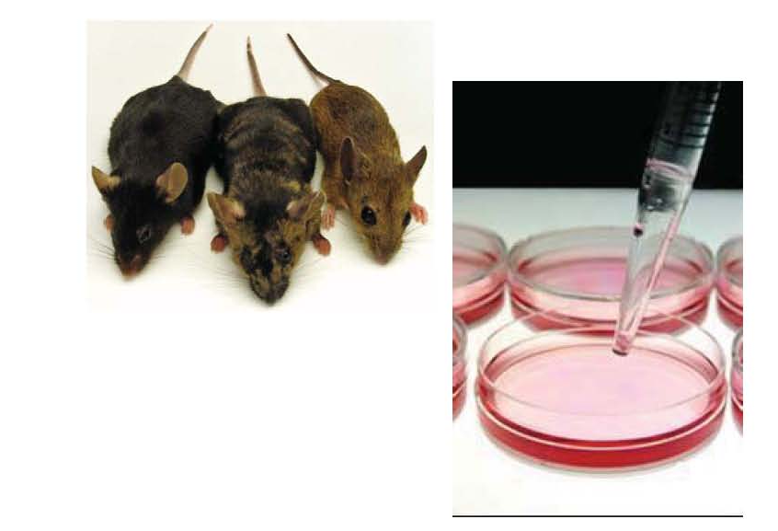

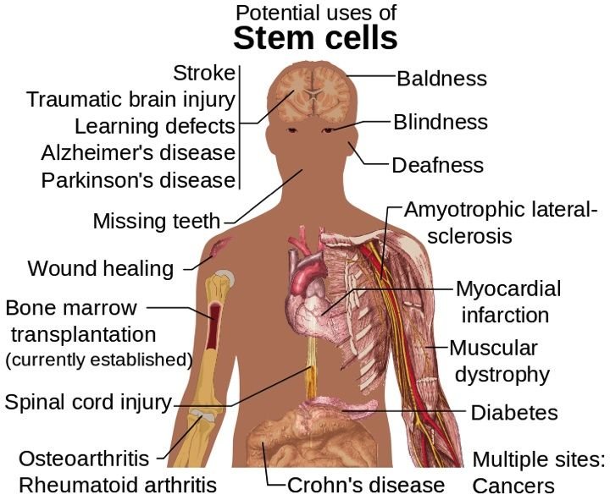
NAF Grant Recipients in 2016
PIONEER SCA TRANSLATIONAL
RESEARCH AWARDS
BASIC RESEARCH STEM CELLS
Maciel, Patrícia, PhD
University of Minho, Braga, Portugal
Testing the therapeutic potential of Mesenchymal Stem Cells and their secretome in an animal model of spinocerebellar ataxia type 3
Moving towards therapies
DNA
Orr, Harry, PhD
University of Minnesota, Minneapolis, MN
Towards an ASO Therapy for Spinocerebellar Ataxia Type 1
Roon-Mom, Willeke M.C. van, PhD
Leiden University Medical Center, The Netherlands
Advancing the therapeutic potential of exon skipping
for Spinocerebellar ataxia type 3
RNA
Protein
Notes:
Mesenchymal stem cells are cells derived from several tissues (including the bone marrow) which have been shown to have a great regenerative potential, and which are being put forward as biological therapy agents against neurodegenerative diseases. While the effect of the cells has been studied in several neurodegenerative diseases, including ataxias, with promising results, no pre-clinical studies exist in spinocerebellar ataxia type 3 (SCA3), also known as Machado-Joseph disease (MJD). The goal of this project to study the utility of using either mesenchymal stem cells or biological products derived from these cells to treat SCA3/MJD. For this, we will assess of the short and long term effect of these treatments on the motor impairments of a mouse model of this disease, using tests that address balance, strength, and movement coordination; we will also look at effects on neuronal death in different regions of the nervous system of these mice, six months after the administration of the stem cells or their biological products. We will compare different protocols, including different injection sites, to define the one with a higher effect. This should provide relevant proof-of-concept information for future clinical studies of MSCs in patients with SCA3
Advancing the therapeutic potential of exon skipping for Spinocerebellar ataxia type 3
Willeke M.C. van Roon-Mom, PhD
She may be contacted at w.vanroon@lumc.nl
Removal of the toxic protein region
In our group we make use of molecules called antisense oligonucleotides (AONs). AONs can be used to remove specific regions of proteins within cells. We implement AONs to remove the toxic polyglutamine repeat from the ataxin-3 protein. In this manner, we are able to directly remove the cause of SCA3, without reducing the amount of ataxin-3 protein. Since ataxin-3 is likely an important protein for normal brain function, this is a key advantage over other AON based strategies for SCA3 that aim to lower the levels of ataxin-3 protein.
Preliminary results
We have shown that our AON approach in cell and animal models of SCA3 can indeed achieve removal of the polyglutamine repeat. Injection of the AON in the brains of mice led to removal of the polyglutamine repeat from the ataxin-3 protein throughout the brain. The treatment was well tolerated by the mice, and the treatment effect was observed for at least 2.5 months after injection. These results are very promising, and we wish to further pursue this approach to optimize the clinical potential.
Proposed research
In order to advance our AON approach for SCA3 to the clinic, we want to systematically screen a range of different AON sequences to determine the most effective molecule. We will perform these tests in SCA3 mice which have the mutated human ATXN3 gene. Furthermore, we will use human neuronal cell cultures of SCA3 to carefully assess ataxin-3 protein functioning in patient-relevant cell models to ensure safety of the treatment.
Harry Orr, PhD
Towards an ASO Therapy for Spinocerebellar Ataxia Type 1
Spinocerebellar ataxia type 1 (SCA1) is a fatal inherited form of ataxia for which there is currently no effective treatment. Studies using mouse models of SCA1 demonstrate that reducing expression of the SCA1 gene is able to reduce SCA1-like symptoms including motor dysfunction and premature death. We propose to further our proof-of-concept studies that an antisense oligonucleotide (ASO) approach to reduce total Sca1 gene expression, including the mutant gene is effective in relieving SCA1-like symptoms in the Sca1154Q/2Q knockin mouse model of SCA1. Assessing whether therapies impact the progression of neurodegeneration using only clinical scales is challenging due to slow progression and phenotypic variability, necessitating long clinical trials with large sample sizes.
Therefore, we will focus on monitoring ASO therapy in Sca1154Q/2Q mice using advanced MRS-based neuroimaging to address an unmet need relevant for translating ASO therapy to patients with SCA1

Slide 15
GENE DISCOVERY TO GENE BASED THERAPIES

Slide 16
The DNA Double Helix
Sugar phosphate backbone
Base pair
Bases
Adenine (A)
Thymine (T)
Cytosine (C)
Guanine (G)
ASCO
Notes:
3
Basic Genetics
ASCO Curriculum: Cancer Genetics & Cancer Predisposition Testing

Slide 17
Overview
Chromosomes, DNA, Genes, Proteins
Gene
Nucleus
Cell
Chromosomes
Protein
Adapted from Understanding Gene Testing, NIH, 1995
ASCO
Notes:
2
Basic Genetics
ASCO Curriculum: Cancer Genetics & Cancer Predisposition Testing
10 to 100 trillion

Slide 18
Central Dogma
DNA
RNA
Protein
Notes:
Turn back the clock to discovery of bidirectional transcription and RAN translation

Slide 19
GENOMIC SOFTWARE
“The Code”

Slide 20
DNA → RNA CODONS→Protein
Genomic DNA THYBIGRYDDOGRANOUT
Messenger RNA THEBIGREDDOGRANOUT
Translated Message THE BIG RED DOG RAN OUT
Notes:
16
Basic Genetics
ASCO Curriculum: Cancer Genetics & Cancer Predisposition Testing

Slide 21
Genetics of Disease

Slide 22
Disease-Associated Mutations
A mutation is a change in the normal base pair sequence
Commonly used to define DNA sequence changes that alter protein function
Notes:
12
Basic Genetics
ASCO Curriculum: Cancer Genetics & Cancer Predisposition Testing

Slide 23
Disease-Associated Mutations Can Alter Protein Function
Functional protein
Nonfunctional or missing protein
ASCO
Notes:
14
Basic Genetics
ASCO Curriculum: Cancer Genetics & Cancer Predisposition Testing

Slide 24
Point Mutations
Normal
Missense
Nonsense
Frameshift (deletion)
Frameshift (insertion)
THE BIG RED DOG RAN OUT.
THE BIG RAD DOG RAN OUT.
THE BIG RED.
THE BRE DDO GRA.
THE BIG RED ZDO GRA.
Point mutation: a change in a single base pair
Notes:
16
Basic Genetics
ASCO Curriculum: Cancer Genetics & Cancer Predisposition Testing

Slide 25
Autosomal Dominant Inheritance
Each child has 50% chance of inheriting the mutation
Equally transmitted by men and women
Normal
Affected
Notes:
30
Basic Genetics
ASCO Curriculum: Cancer Genetics & Cancer Predisposition Testing

Slide 26
Autosomal Recessive Inheritance
Carrier
Affected
Normal
Notes:
2
Basic Genetics
ASCO Curriculum: Cancer Genetics & Cancer Predisposition Testing

Slide 27
Genetics 101 2017

Slide 28
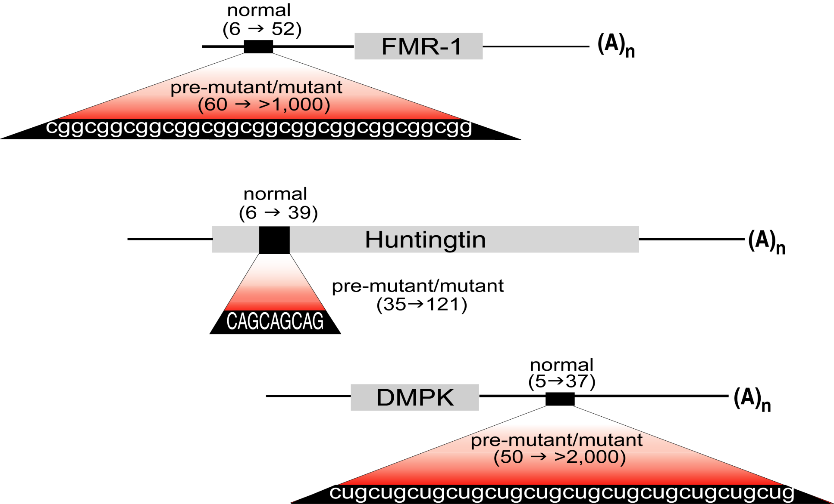

Repeat Expansion Diseases
Fragile X
Syndrome
Protein Loss
Protein Gain
RNA Gain
Huntington
Disease
ATG
ATG
Myotonic
Dystrophy

Slide 29
DNA → RNA CODONS→Protein
Genomic DNA THYBIGRYDDOGRANOUT
Messenger RNA THEBIGREDDOGRANOUT
Translated Message THE BIG RED DOG RAN OUT
The code is read three letters at a time and the ATG sets the reading frame
Notes:
16
Basic Genetics
ASCO Curriculum: Cancer Genetics & Cancer Predisposition Testing

Slide 30
DNA → RNA → Protein
Genomic DNA THYBIGRYDRYDRYDRYDDOGRANOUT
Messenger RNA THEBIGREDREDREDREDDOGRANOUT
Translated Message THE BIG RED RED RED RED DOG RAN OUT
Notes:
16
Basic Genetics
ASCO Curriculum: Cancer Genetics & Cancer Predisposition Testing

Slide 31
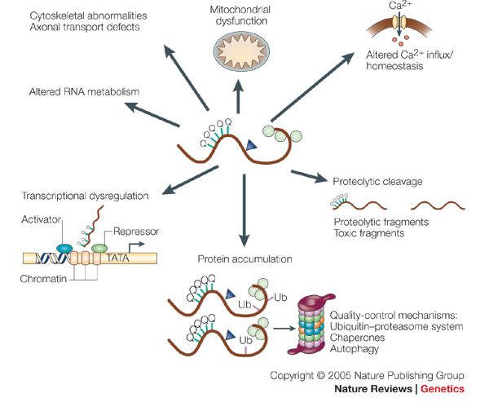
PolyQ Protein Problems
Gatchel &Zoghbi, Nature Reviews Genetics, 2005

Slide 32
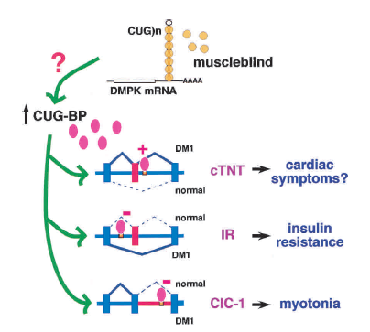

Mutant RNA problems – myotonic dystrophy
CELF
100-1000s of targets
CLIP, RNA sequencing
Hu et al. Nat Struct Mol Biol 2010
Batra, et al. Molecular Cell, 2014
DM1, DM2, SCA8, FXTAS
TDP43, FUS/TLS, Nova,
C9orf72
Ranum and Cooper Ann Rev Neurosci, 29:259; 2006

Slide 33
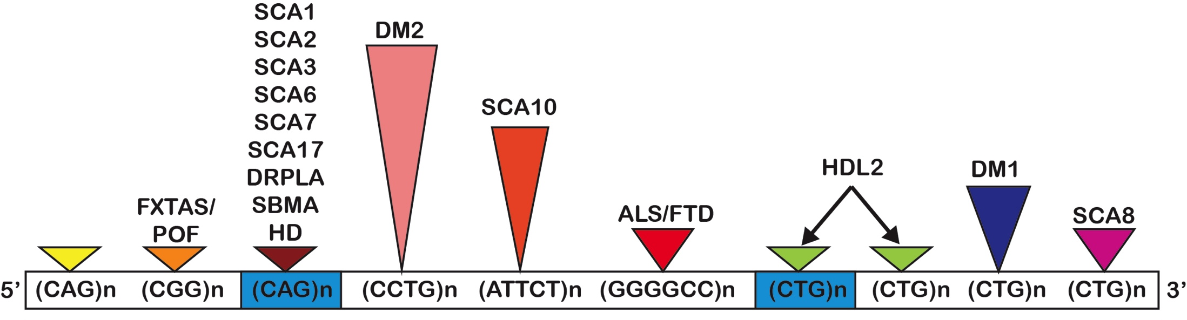
Repeat Expansion Mutations in Neurologic Disease
SCA12
ATG
(Q)_{EXP}
Protein Loss / Protein Gain / RNA Gain of Function
Bidirectional Expression
Repeat Associated Non-ATG (RAN) translation
Expansion mutations produce unexpected proteins in multiple frames

Slide 34
Spinocerebellar Ataxia Type 8
SCA8

Slide 35
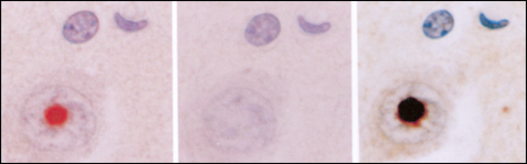
SCA8: one mutation two genes
Toxic RNA
Mechanism
CUG_{EXP}
Daughters et al. 2009
PLoS Genetics
(CTG)n
Exon B
Exon A
Exon 1
(CAG)n
CAG_{EXP}
Toxic PolyQ
Mechanism?
5’
Moseley et al., 2006
Nature Genetics
*AAAATG(CAG)_{EXP}***

Slide 36
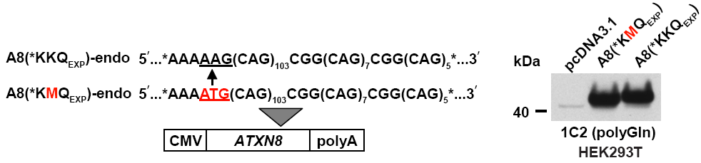
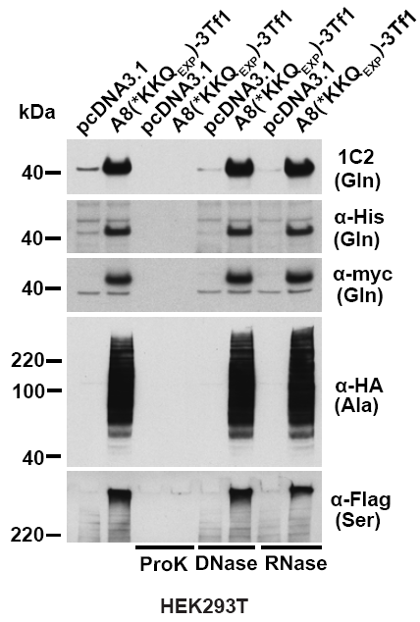
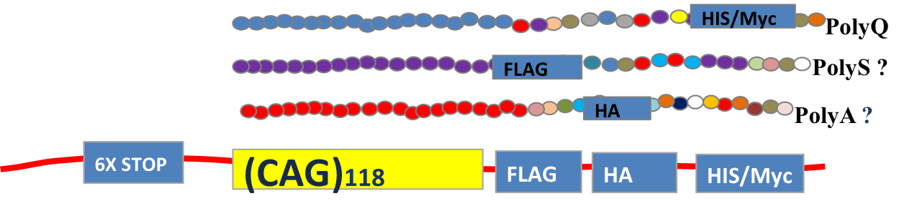
Discovery of Repeat-Associated Non-ATG Translation (RAN translation)
Tao Zu
Frame | Codon | Amino Acid
1 | CAG | Glutamine(Q)
2 | AGC | Serine(S)
3 | GCA | Alanine(A)
CAGCAGCAGCAGCAGCAGCAGCAG
Zu et al., PNAS 2011

Slide 37
DNA → RNA → Protein
Genomic DNA THYBIGRYDRYDRYDRYDDOGRANOUT
Messenger RNA THEBIGREDREDREDREDDOGRANOUT
Translated Message THE BIG RED RED RED RED DOG RAN OUT
RED RED RED RED DOG RAN OUT
EDR EDR EDR EDD OGR ANO UT
DRE DRE DRE DDO GRA NOU T
Repeat Associated Non-ATG (RAN) translation
Notes:
16
Basic Genetics
ASCO Curriculum: Cancer Genetics & Cancer Predisposition Testing

Slide 38
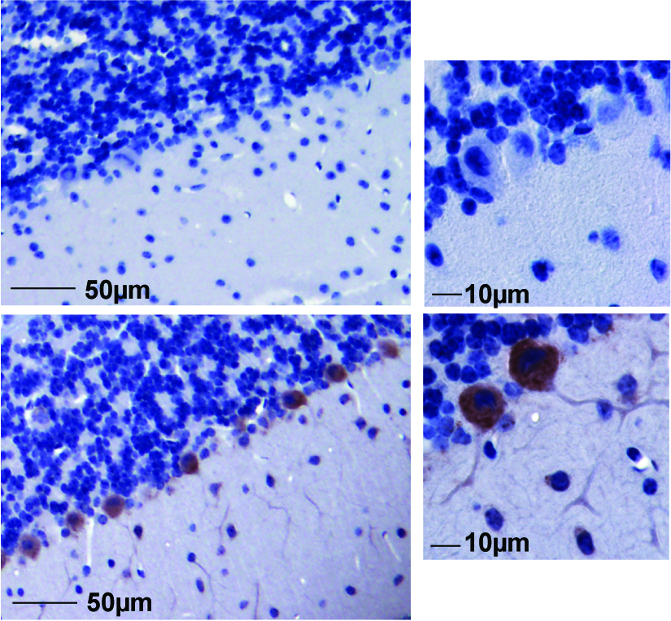
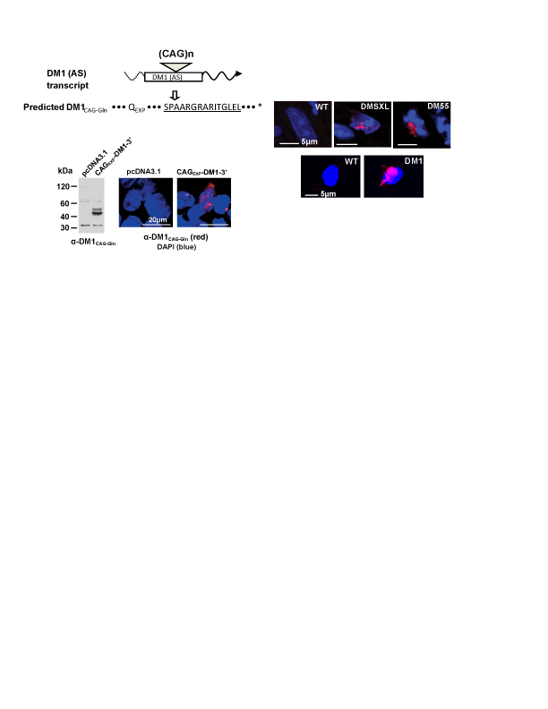
RAN Translation in vivo: SCA8 and myotonic dystrophy
α-SCA8 poly-GCA-Ala
α-DM1 poly-CAG-Gln
WT
SCA8
Mouse Cerebellum
Human Myoblasts
Zu et al., PNAS 2011

Slide 39
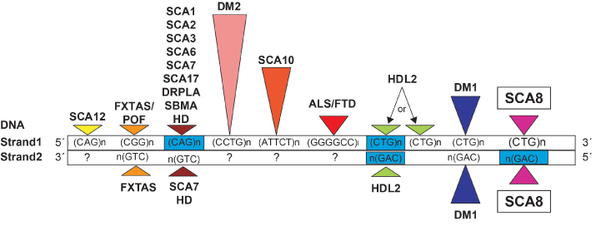
Growing trends in many expansion diseases
RAN
polySer
polyAla
polyCys
polyLeu
polyGly
GP/GR/GA/PA/PR/GP
RAN
MpolyGln
RAN
polyGln
polyAla
RAN
RAN
  Framework for understanding disease mutations needs revision.
  Bidirectional expression is common
  Repeats express unexpected proteins
  RAN proteins now found in RNA and “polyQ” diseases

Slide 40

RAN Proteins in Huntington’s Disease
HD mutation
CAG
HTT
RAN
DNA
CAGCAGCAG…
…GTCGTCGTC
CUG
polyGlutamine mHTT
polyCysteine
polyAlanine
polySerine
polyLeucine
HD pathogenesis
WHAT ABOUT THE POLY-Q ATAXIAS?

Slide 41
Therapy development
New Genetic Tools
Gene Editing
RNA Targeting

Slide 42
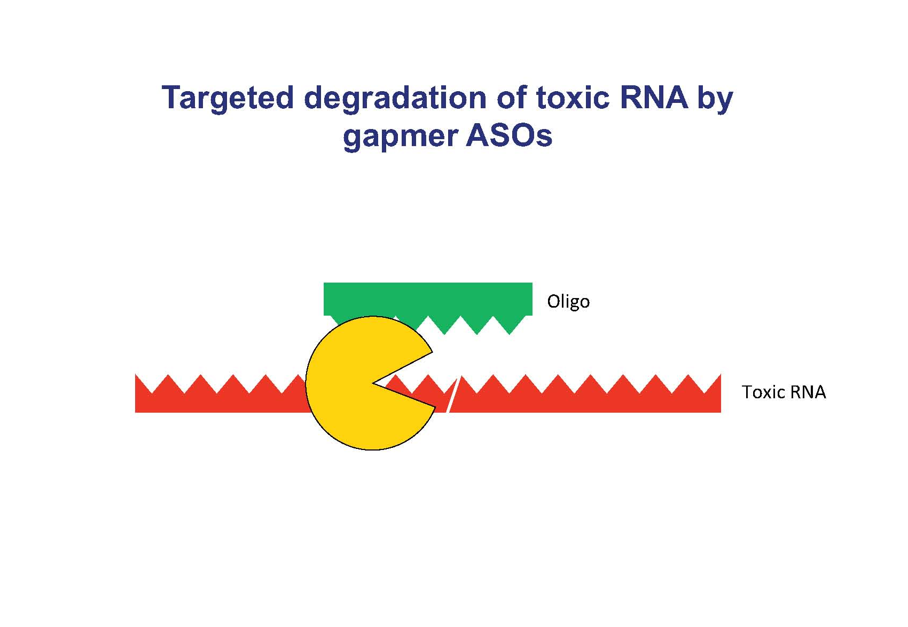
Targeting the RNA

Slide 43

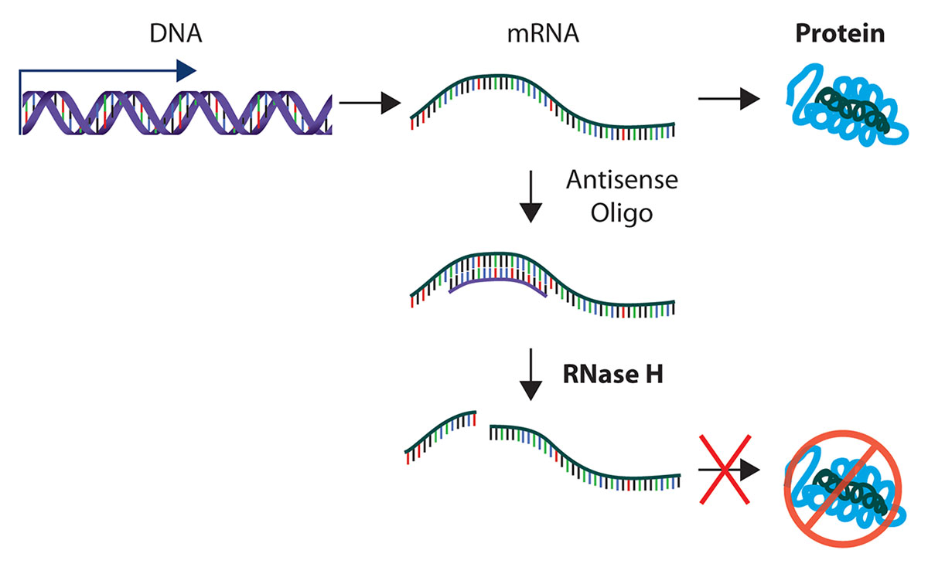
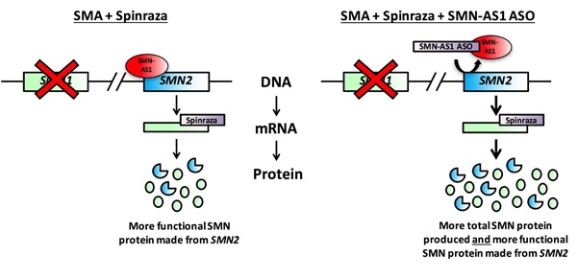
ANTISENSE OLIGONUCLEOTIDE THERAPY
FDA approval for Biogen and Ionis Pharmaceuticals – Spinaraza
Spinal Muscular Atrophy
SIMILAR DRUGS CAN REMOVE RNA
DRUG WAKES UP A SLEEPING GENE

Slide 44


SCA8 targeting the problems: one or both RNAs?
Toxic
RNA
& RAN
Proteins
CAG_{EXP}
(CAG)n
CAG
CTG
(CTG)n
CUG_{EXP}
Toxic RNA
& RAN proteins
5’
Similar strategies being applied for many of the SCAs including SCA1 and SCA3

Slide 45
GENE DISCOVERY
HOW GENETIC MUTATIONS CAUSE DISEASE
THERAPY DEVELOPMENT
PARTNERING WITH YOU

Slide 46
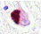

Conclusions
THANK YOU!!!!!!
NAF funding critically important for understanding the causes of ataxia and developing treatments
Therapeutic efforts to target RNA and protein pathways and to repair genes are underway.
Lessons from one disease connect to other diseases
  How mutations cause disease
  Therapy development

