Slide 1

Safe Mobility Strategies and Adaptive Equipment
Julie Walker
PT, DPT, NCS
Marlena Casey
OTR/L, CLT

Slide 2
Disclaimer/ Disclosure
Please consult with an Occupational Therapist, Physical Therapist, Primary Care Provider, or another health care provider prior to purchasing equipment.
The Presenters have no disclosures or ties to any of the companies or products presented in the following presentation.

Slide 3
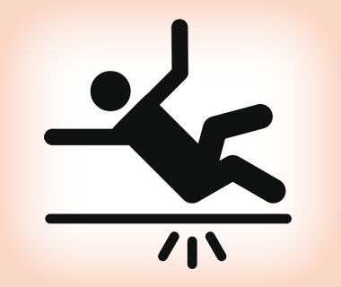
Why does safety Matter?

Slide 4
What percent of patients with Cerebellar Ataxia fall per year?
A: 57%
B: 74%
C: 46%
D: 83%
Answer:
B: 74%
Ella et al 2010

Slide 5
Safe Strategies for Mobility
Change Something!!!
  With Yourself
  With the Strategy you use
  With the Environment you are in

Slide 6


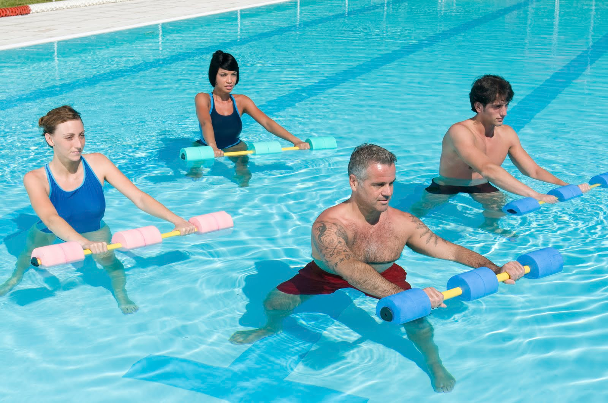
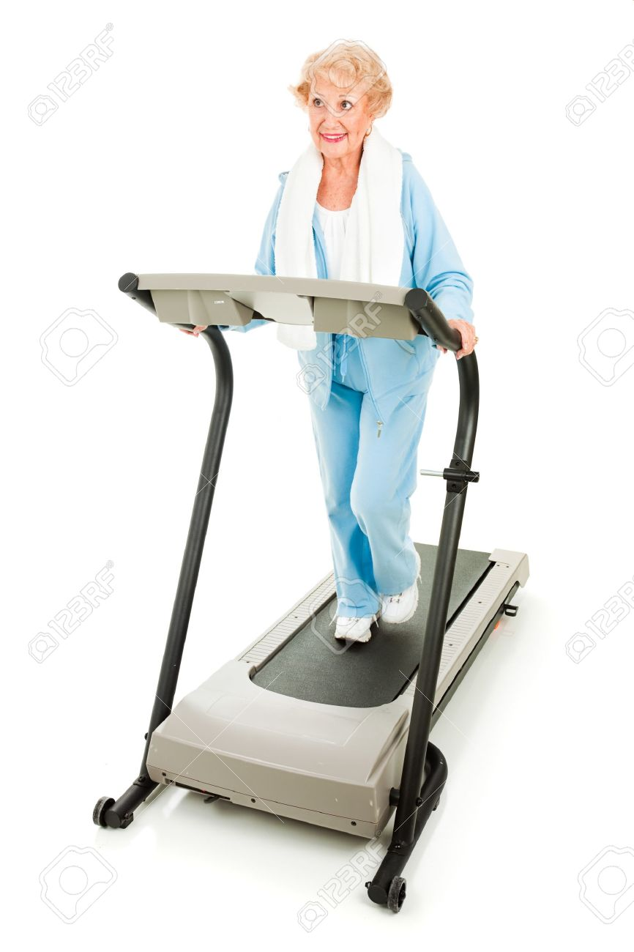
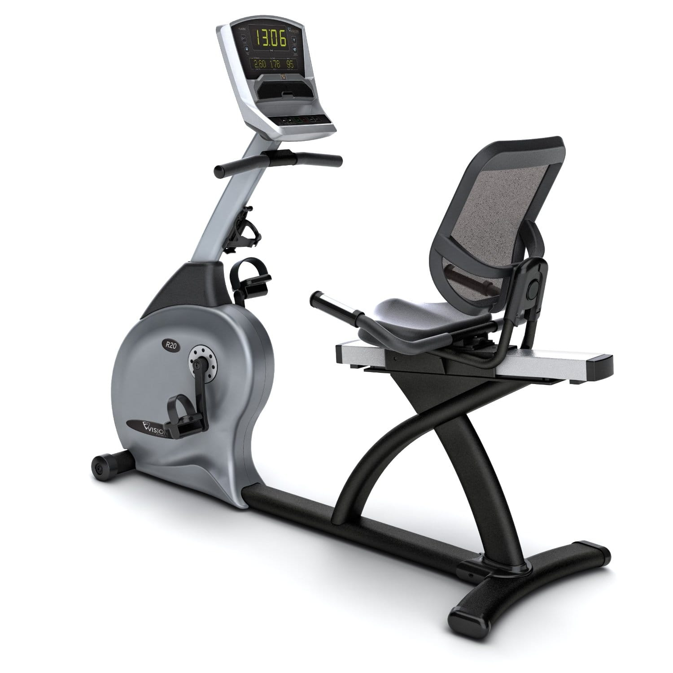
What can you change about Yourself?
EXERCISE!
Swimming
Walking
Stationary Bike

Slide 7

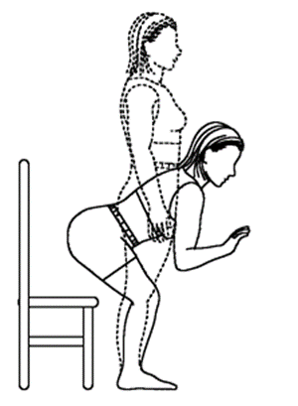

What can you change about the Strategy?
Plan out your movements
Avoid Multitasking
Quality of Movement not Speed!
Every time you stand up, stop and get your balance before moving

Slide 8
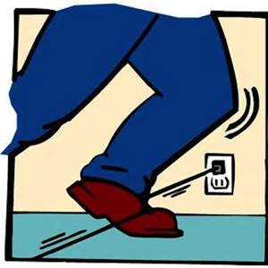
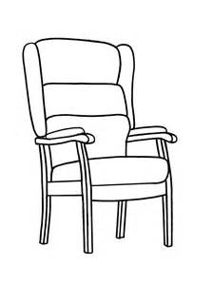

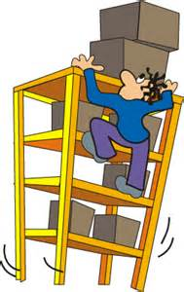
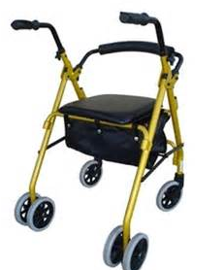
What can you change about the Environment?
Choose to sit in chairs you know you can get out of
Assess fall hazards
YES
NO
Keep an assistive device available
Store frequently used items at waist level

Slide 9


Slide 10
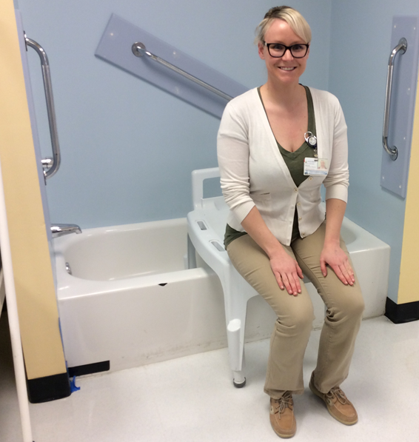
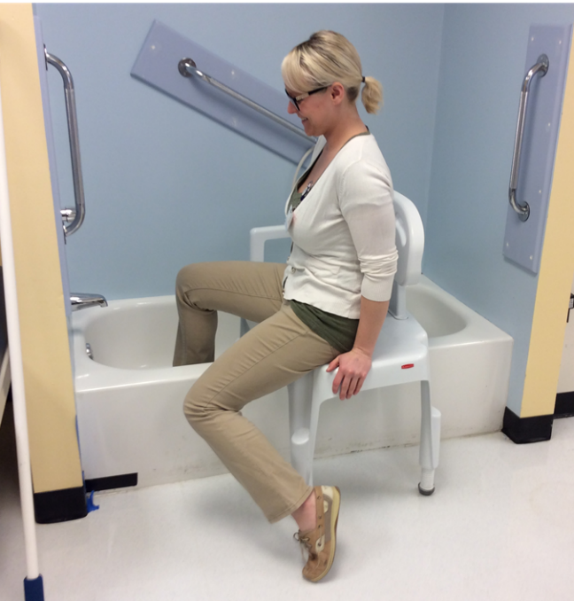
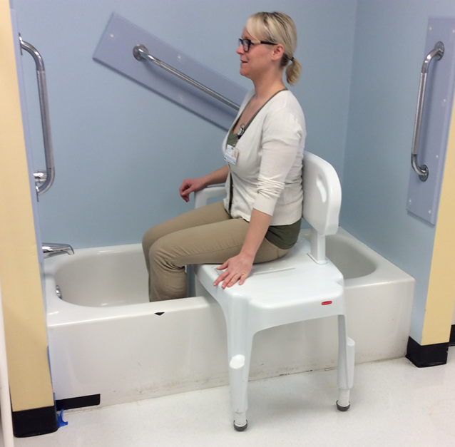
TUB TRANSFERS
Step 1
Step 2
Step 3

Slide 11
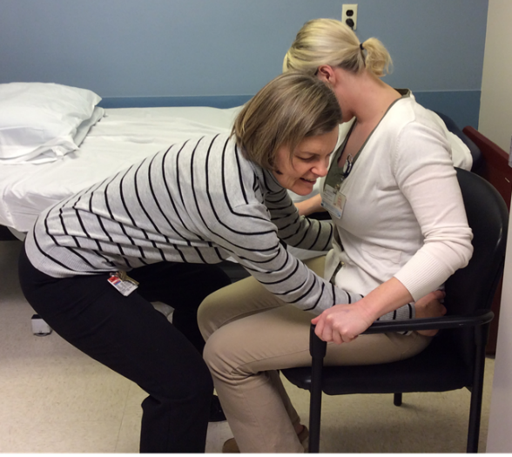
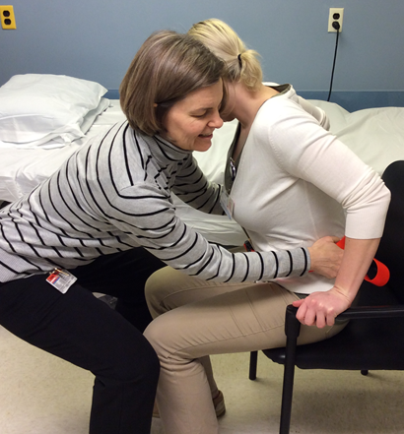
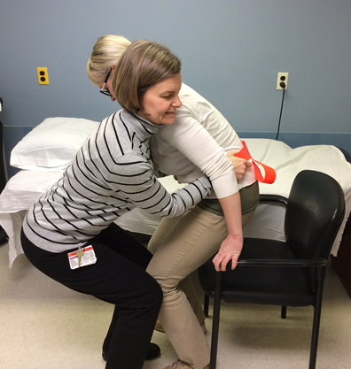
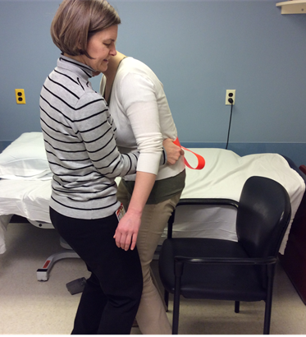
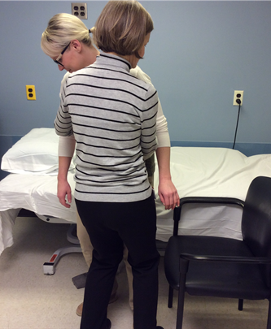
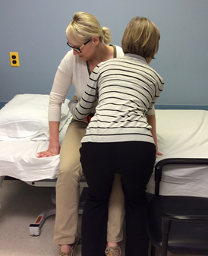
ASSISTED STAND PIVOT TRANSFERS
Step 1
Step 2
Step 3
Step 4
Step 5
Step 6

Slide 12
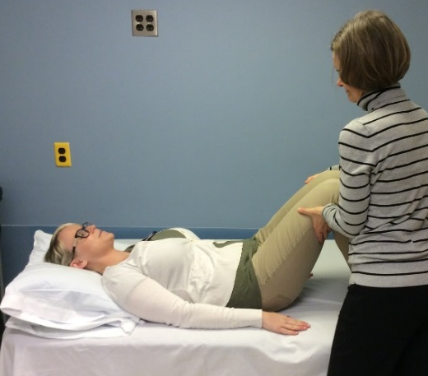
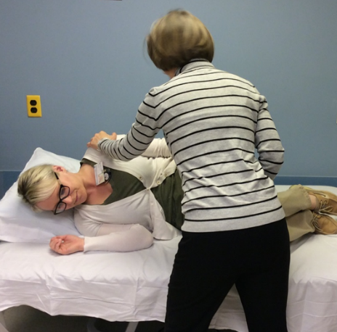
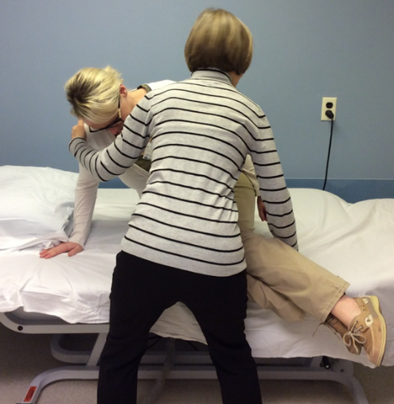
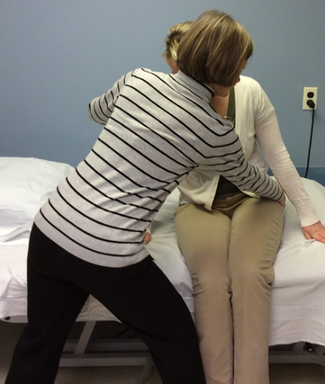
ASSISTED BED MOBILITY
Step 1
Step 2
Step 3
Step 4

Slide 13
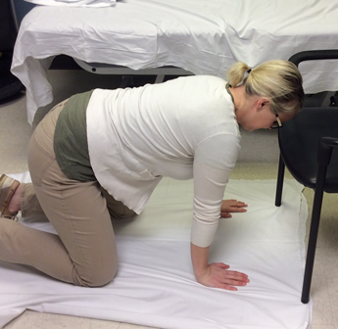
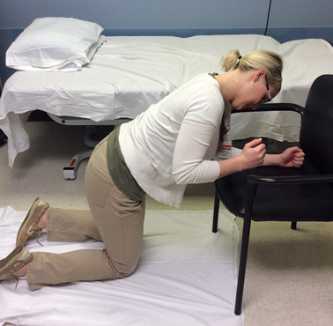
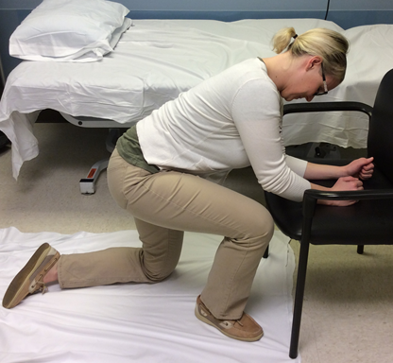
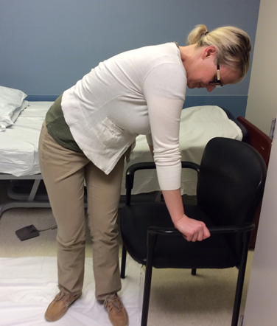
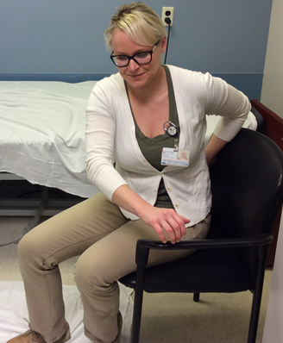
TRANSFERS FROM FLOOR
Step 1
Step 3
Step 2
Step 4
Step 5

Slide 14
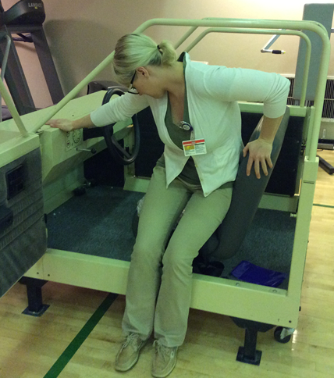
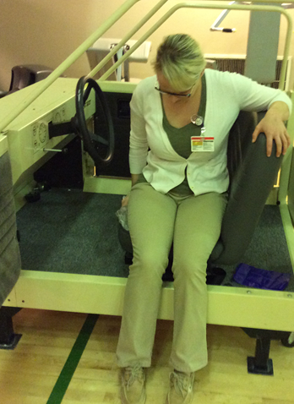
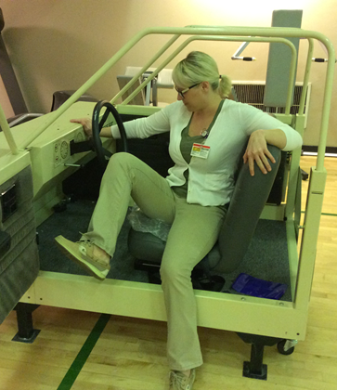
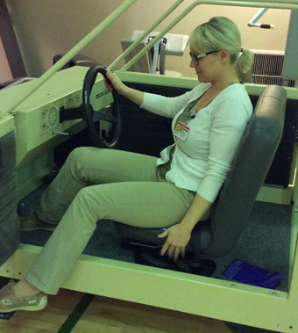
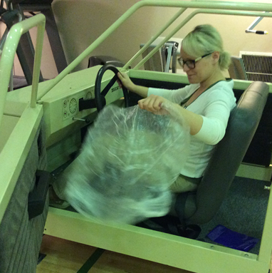
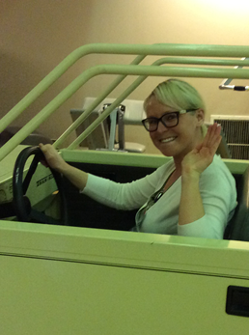
TRANSFERS IN AND OUT OF CAR
Step 1
Step 2
Step 3
Step 4
Step 5
Step 6

Slide 15
“Interventions were not aimed at changing underlying movement capabilities but instead were focused on devising strategies to integrate available movement and control in the most effective and efficient manner possible.” (Gillen 2002)

Slide 16
Adaptive Equipment
Adaptive Devices:
  Stabilize
  Control Degrees of Freedom
  Decrease falls risk
  Energy Conservation
Assistive Technology:
  Tremor dampening
  Communication Devices

Slide 17
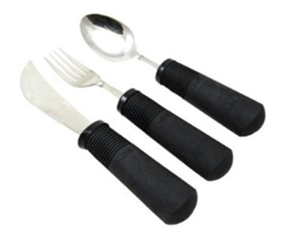
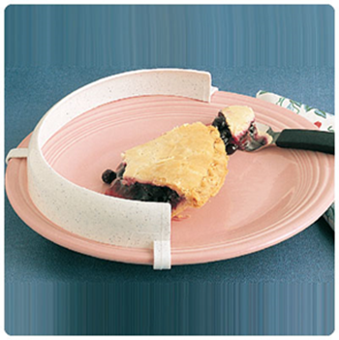
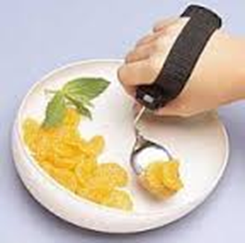
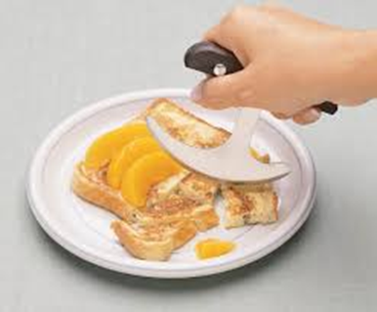
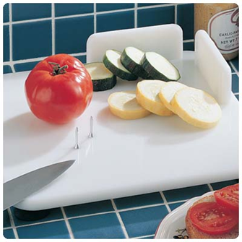
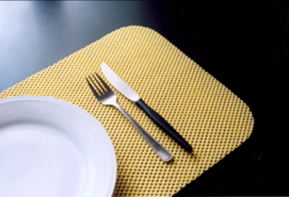
Eating
Weighted Utensils
Plate Guard
Cuff Silverware
Dycem
Rocker Knife
Adapted Cutting Board

Slide 18
Eating
1. Weighted Utensils
2. Plate Guard
3. Cuff Silverware
4. Dycem
5. Rocker Knife
6. Adapted Cutting Board

Slide 19
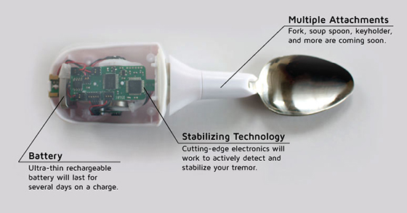
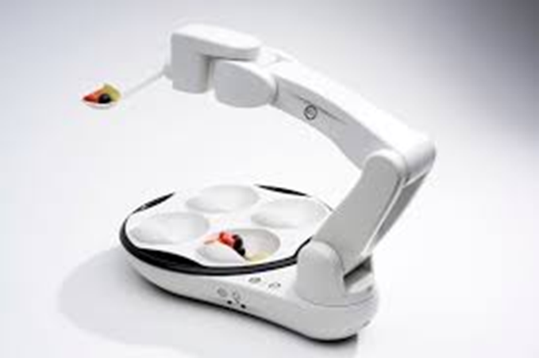
Assistive Technology Eating equipment
Obi Robotic Feeding Device
https//meetobi.com
Liftware Spoon
Active Cancellation of Tremor technology to stabilize an eating utensil
(Pathak et al 2014) www.liftware.com

Slide 20
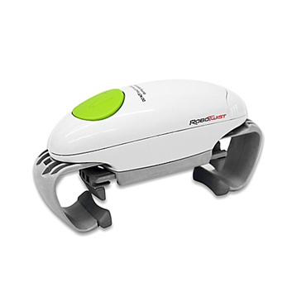
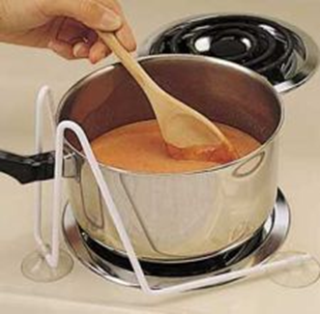
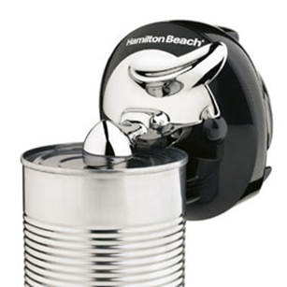
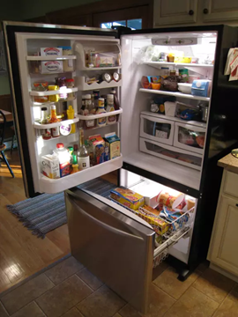
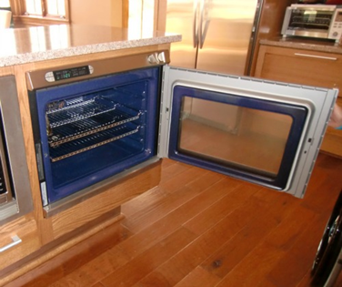
Kitchen Devices
Robotwist Hands Free Jar Opener
Pot/Pan Stabilizer
Cordless Can Opener
Side Hinge Oven Door
Bottom-Drawer Freezer Refrigerator

Slide 21
Kitchen Devices
1. Robotwist Hands Free Jar Opener
2. Pot/Pan Stabilizer
3. Cordless Can Opener
4. Bottom-Drawer Freezer Style Refigerator
5. Side Hinge Oven Door

Slide 22
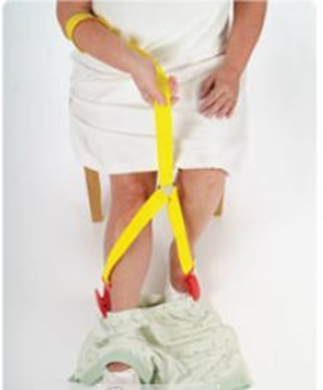
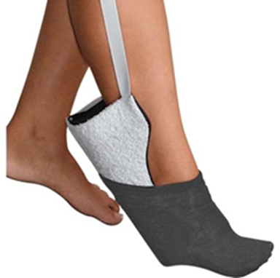
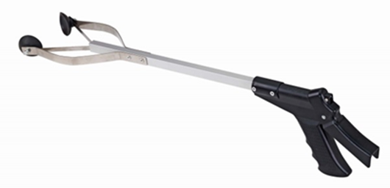
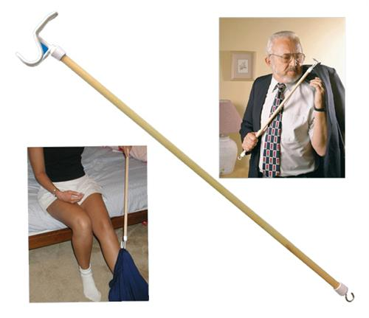


Lower Body Dressing
Reacher
Clip and Pull Dressing Aid
Sock Aide
Elastic Shoelaces/Coilers
Dressing Stick
Long Handled Shoe Horn

Slide 23
Lower Body Dressing
1. Sock Aide
2. Reacher
3. Clip and Pull Dressing Aid
4. Elastic shoelaces/coilers
5. Dressing Stick
6. Long Handled Shoe Horn

Slide 24




Upper Body Dressing
Button Hook
One Arm Dressing Technique
Zipper Pull
Front Latching Bra

Slide 25
Upper Body Dressing
1. Button Hook
2. One arm dressing technique
3. Zipper Pull
4. Front Latching Bra

Slide 26






Bathing
Foot Brush
Wash Mitt
Soap on a Rope
Long Handled Sponge
Removable Shower Head
Shower Chair

Slide 27
Bathing
1. Soap on a Rope
2. Foot Brush
3. Wash Mitt
4. Long Handled Sponge
5. Removable Shower Head
6. Shower Chair

Slide 28






Grooming
Weighted Razor and Toothbrush
Electric Toothbrush
One Handed Nail Clippers
Height Adjusted Hair Dryer Stand
Long Handled Brush and Comb
Denture Brush

Slide 29
Grooming
1. Weighted Razor and Toothbrush
2. One Handed Nail Clippers
3. Electric Toothbrush
4. Denture Brush
5. Long handled brush and comb
6. Height adjusted hair dryer stand

Slide 30



Toileting
Tongs
Toilet Buddy
Raised Toilet Seat

Slide 31
Where to Buy things
Amazon
  https://www.amazon.com/
Northern Pharmacy
  https://www.northernpharmacy.com/Durable-Medical-Equipment
NC Medical
  https://www.ncmedical.com/categories/Assistive-Devices-ADL_12839533.html
  Alimed
  http://www.alimed.com/adls/

Slide 32


Questions?

Slide 33
References
Bastian AJ. Learning to predict the future: the cerebellum adapts feedforward movement control. Curr Opin Neurobiol 2006, 16(6): 645-649.
Ilg W, Synofzik M, Brotz D, Burkard S, Giese MA, Schols L. Intensive coordinative training improves motor performance in degenerative cerebellar disease. Neurol 2009; 79 (20):2056-2060.
Keller JL, Bastian AJ. A home balance exercise program improves walking in people with cerebellar ataxia. Neurorehabilitation and Neural Repair. 2014; 28(8): 770-778.
Morton SM, Bastian AJ. Relative contributions of balance and voluntary leg-coordination deficits to cerebellar gait ataxia. J Neurophysiol 2003; 89(4): 1844-1856.
Morton SM, Bastian AJ. Cerebellar control of balance and locomotion. Neuroscientist 2004; June (10): 247-59.
Therrien AS, Wolpert DM, Bastian AJ. Effective reinforcement learning following cerebellar damage requires a balance between exploration and motor noise. Brain 2016, 139(1):101-14.
Pathak A., Redmond JA, Allen M, Chou KL. A Non-Invasive Handheld Assistive Device to Accommodate Essential Tremor: A pilot study. Mov Disord. 2014;29(6):838-842.
Fonteyn et al. Falls in Spinocerebellar Ataxias: Results of the Euro SCA Fall Study. Cerebellum. 2010:9:232-239
Gillen G. Improving Mobility and Community access in an adult with ataxia. American Journal of Occupational Therapy. 2002:56(4)462-466.

