Slide 1
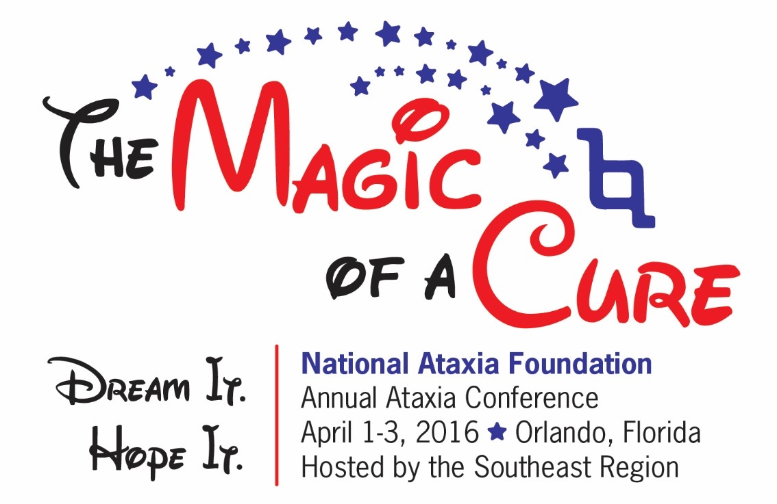
STEM CELLS: FACT, FICTION AND FUTURE
Henry Paulson, MD PhD
Lauren Moore, Neuroscience Graduate Student
University of Michigan

Slide 2

Disclaimer
The information provided by speakers in any presentation made as part of the 2016 NAF Annual Ataxia Conference is for informational use only.
NAF encourages all attendees to consult with their primary care provider, neurologist, or other health care provider about any advice, exercise, therapies, medication, treatment, nutritional supplement, or regimen that may have been mentioned as part of any presentation.
Products or services mentioned during these presentations does not imply endorsement by NAF.

Slide 3
Presenter Disclosures
Henry Paulson:
Research grant from Ionis Pharmaceuticals
Receives research grants from NIH and ALS Association (and in past years, from NAF)
Lauren Moore:
No relationships to disclose or list

Slide 4
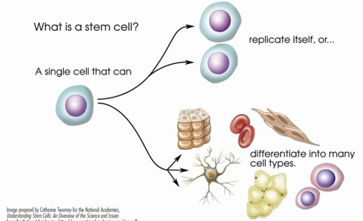
Some FACTs: What is a stem cell?
Undifferentiated cell from a multicellular organism that can give rise, indefinitely, to more cells of the same type, and from which certain other kinds of cells arise by differentiation.
Notes:
“Magic” in stem cells
Totipotent vs. pluripotent - Seed analogy

Slide 5
“Totipotent”? “Pluripotent”? “Multipotent”?
Stem cells can differentiate into many different types of cells
If they can produce all types of cells (and even generate a full organism), they are totipotent.
If they can produce many, but not all, types of cells, they are pluripotent or multipotent

Slide 6
WHAT ARE SOURCES OF stem cells?
Adult mesenchymal stem cells
Found in many tissues (e.g. bone marrow, umbilical cord, adipose tissue, placenta, muscle)
Multipotent cells (i.e. can differentiate into many but not all cell types, and cannot reconstitute an entire organ)
Likely play role in normal tissue repair
Induced pluripotent stem cells
Derived from skin cells or blood cells by providing them with special de-differentiating “factors” (certain gene products)
Embryonic stem cells
Come from early embryos, and are true totipotent cells

Slide 7
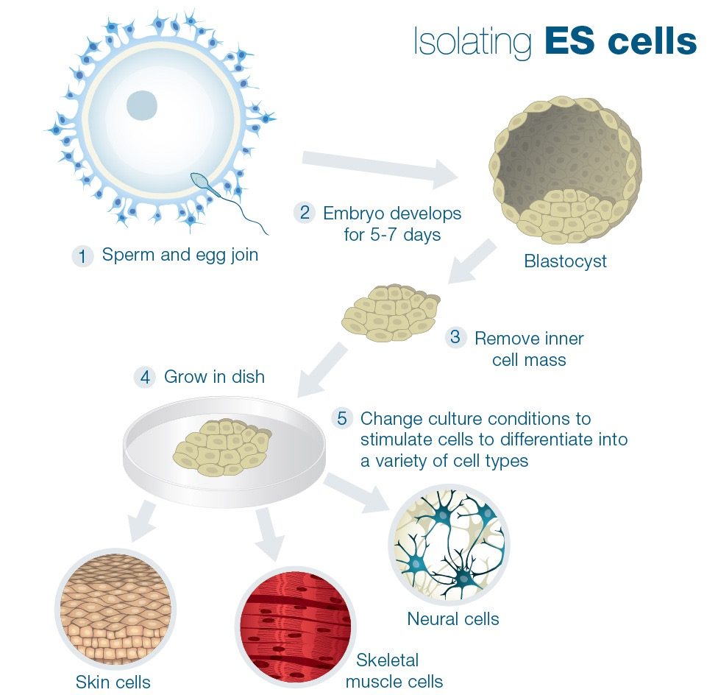
EMBRYONIC stem cells
Benefits:
Totipotent
Differentiate readily into numerous cell types
Limitations:
Ethical considerations
Limited number of disease-specific embryonic stem cell lines available
Can be used in research in U.S., but not in many other countries
http://learn.genetics.utah.edu/content/stemcells/quickref/

Slide 8
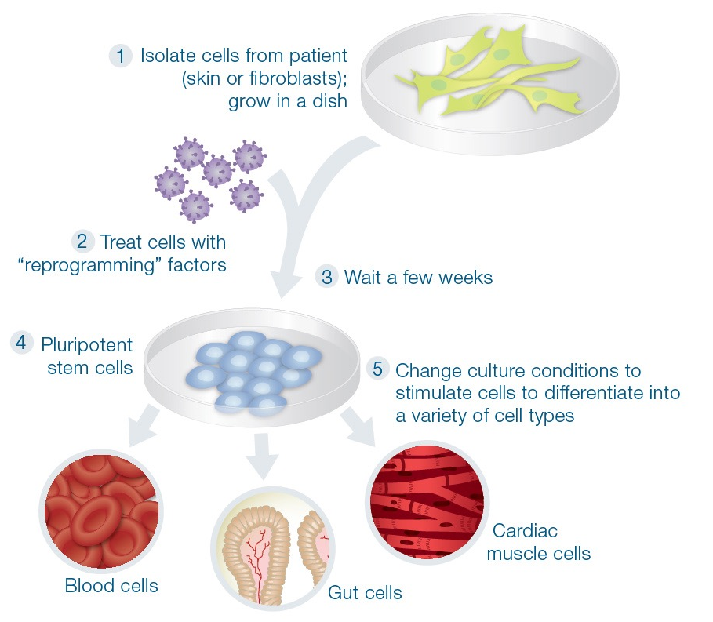
Induced pluripotent stem cells
Benefits:
Can be generated easily from skin biopsy or simple blood draw -- from any person of any age
Widely used already, and have accelerated “disease in a dish” studies
Limitations:
Not totipotent cells
Considerable heterogeneity in lines derived for a given disease
http://learn.genetics.utah.edu/content/stemcells/quickref/

Slide 9
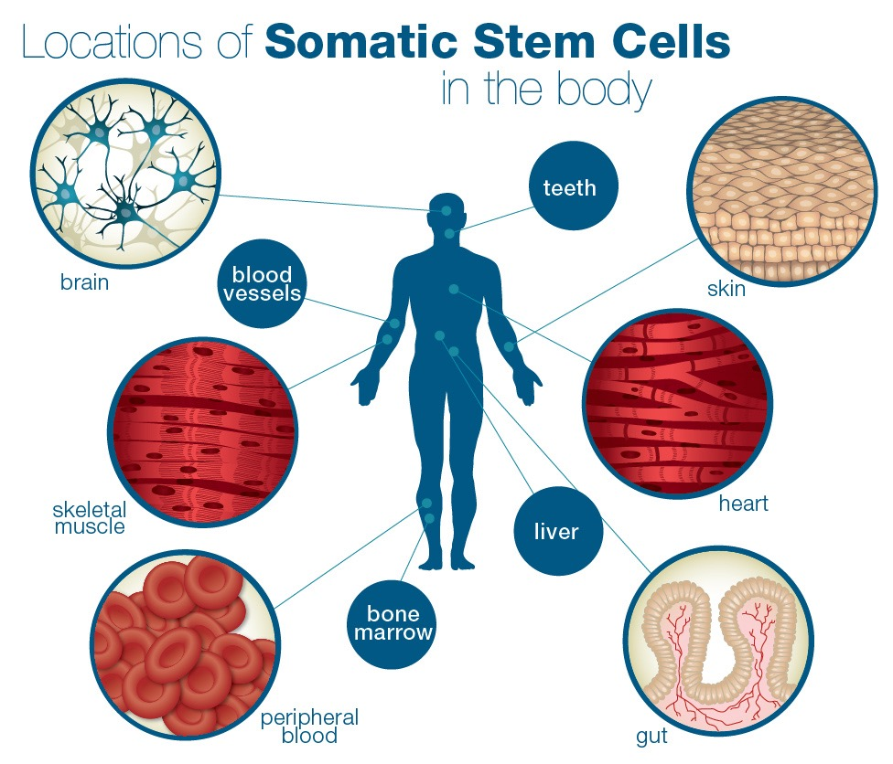
mesenchymal stem cells
adipose
modified and adapted from:
http://learn.genetics.utah.edu/content/stemcells/quickref/

Slide 10
What DO stem cells HAVE TO DO WITH ataxia?
Stem cells are being investigated as a potential therapy for some neurological disorders.
Stem cells can provide new insights into the disease process (“disease in a dish”) that could lead to new approaches to therapy.
Stem cells are a good model system to test novel therapeutic strategies before moving to human clinical trials.

Slide 11
Can stem cells be used as a therapy for ataxia?
Putting stem cells into the brain to restore lost neurons is an unrealized dream… and a very tall order!
To date, no well-controlled trial has shown benefit from stem cell injections in any form of ataxia
Cell transplantation studies in Parkinson disease (PD) – which have been going on for over 30 years - offer some hope, but also provide a cautionary tale
Early claims for success in PD were not matched in placebo controlled clinical trials
Increasing evidence that the number of and type of neurons injected is critical
Some patients who received cell transplantation therapy still seem to have real benefit more than a decade later
PD, which is not ataxia, is arguably a more compelling target for stem cell therapy

Slide 12
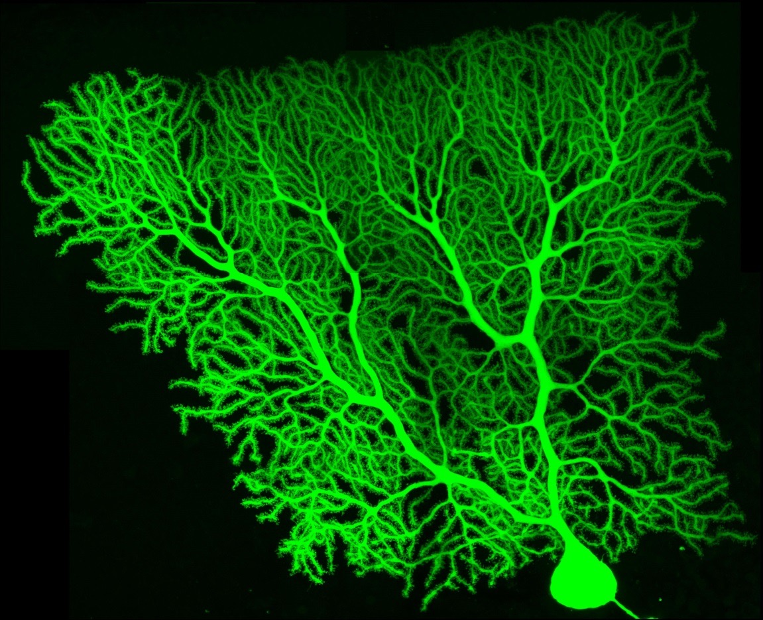
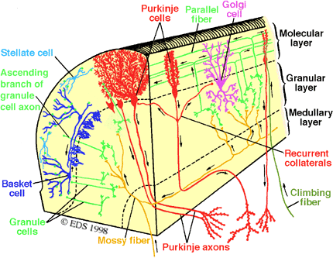
cell replacement in Ataxia: Not as “easy” as PD
Purkinje neuron of cerebellum
Complex cerebellar network
http://www.ibens.ens.fr/IMG/jpg/barbour-purkinje_green.jpg
http://www.tnb.ua.ac.be/models/images/cerebellum.gif

Slide 13
Neurological Studies with mesenchymal stem cells
Over 35 clinical trial reports in past 7 years (traumatic brain injury, spinal cord injury, ALS, stroke, multiple sclerosis… and spinocerebellar ataxia, multiple system atrophy)
Intravenous, intrathecal, or, rarely, intraparenchymal
Most often use autologous cells (from the participant’s own tissue)
Nearly all are open label trials without placebo control
Stem cell injections usually have been well tolerated, and some open label studies have shown positive responses

Slide 14
Example from literature
Dongmei H, et al. Clinical analysis of the treatment of spinocerebellar ataxia and multiple system atrophy-cerebellar type with umbilical cord mesenchymal stromal cells. Cytotherapy (2011)
- Umbilical cord mesenchymal stromal cells (UC-MSC)
- 14 cases of SCA, 10 cases of MSA-C
- Weekly intrathecal injection, four times
- International Cooperative Ataxia Rating Scale (ICARS) and Activity of Daily Living Scale (ADL)
- Follow-up for 6-15 months
- 10 cases remained stable for > half a year, and 14 cases regressed to pretreatment status (on average by 3 months)
Important qualifiers: Open label trial, no placebo control, no carefully defined outcome measures, and a rather heterogeneous group of research participants
Cytotherapy. 2011 13:913-7.

Slide 15
NAF Statement on Stem cell research and therapy
Selected excerpts:
“…deeply concerned that some clinics … are promising stem cell-based treatments for ataxia without oversight and other standard patient protections. They boast stunning rates of cures without scientific evidence to back those claims. In essence the only thing they do provide is cruel health fraud, at an exorbitant price, preying on the desperation that patients and families feel in the face of this untreatable neurological disease.”
“… there is promise for stem cell therapies in some neurologic disease, but for now patients need to know that currently there are no stem cells that can fix the brain, improve ataxia, or prevent the worsening of ataxia.”
“…Stem cells have great potential … but there are no shortcuts. We must use scientific principles that have been proven in the laboratory before we begin putting stem cells into people who are affected with ataxia. We must safeguard patients from unproven treatments that may cause serious harm.”
https://www.ataxia.org/links/ataxia-general-stem-cells.aspx

Slide 16
Should the field of ataxia pursue stem cells as potential therapy?
Yes, but…
... in carefully controlled clinical trials with sound scientific basis, based on compelling preclinical data

Slide 17
What about the future?
In a sense, the future is now
Updates from this week’s Ataxia Investigators Meeting:
“Transplantation of Neural Stem Cells as a therapeutic strategy in Machado-Joseph Disease.”
Rapid advances in stem cell technology have revolutionized “disease in a dish” experiments, leading to new disease insights
New gene editing techniques (e.g. CRISPR/Cas) allow scientists to create models for any genetically based ataxia
Notes:
Thank you for that kind introduction Dr. Paulson. It’s quite a privilege to have the opportunity to speak here with you all today. Like Dr. Paulson said, I am a graduate student conducting research in his lab at the University of Michigan where I study SCA3. In addition, SCA3 happens to run in my family, so I have a highly vested interest in finding a cure for this debilitating disease.

Slide 18
Traditional models of ataxia
Decades of research has primarily used mouse models and non-brain cells to study neurological diseases.
Limitations of these traditional disease models:
Mice are not humans!
Lifespan, brain structure, lack of genetic variation
Potential therapies that appear promising in mice have had little to no success in human clinical trials for neurological disorders.
In many brain disorders, only brain cells are vulnerable to disease, but many current cell models are more similar to skin cells than brain cells.
i.e. trying to figure out what’s wrong with a car engine by checking the tires.
The use of stem cells enable scientists to study ataxia in the types of human cells affected by disease.

Slide 19
My Research Focus
Investigating causes of cell death and testing new therapies for SCA3 using arguably the best available cell model system to study this genetic disease - the first SCA3 human embryonic stem cell line.

Slide 20
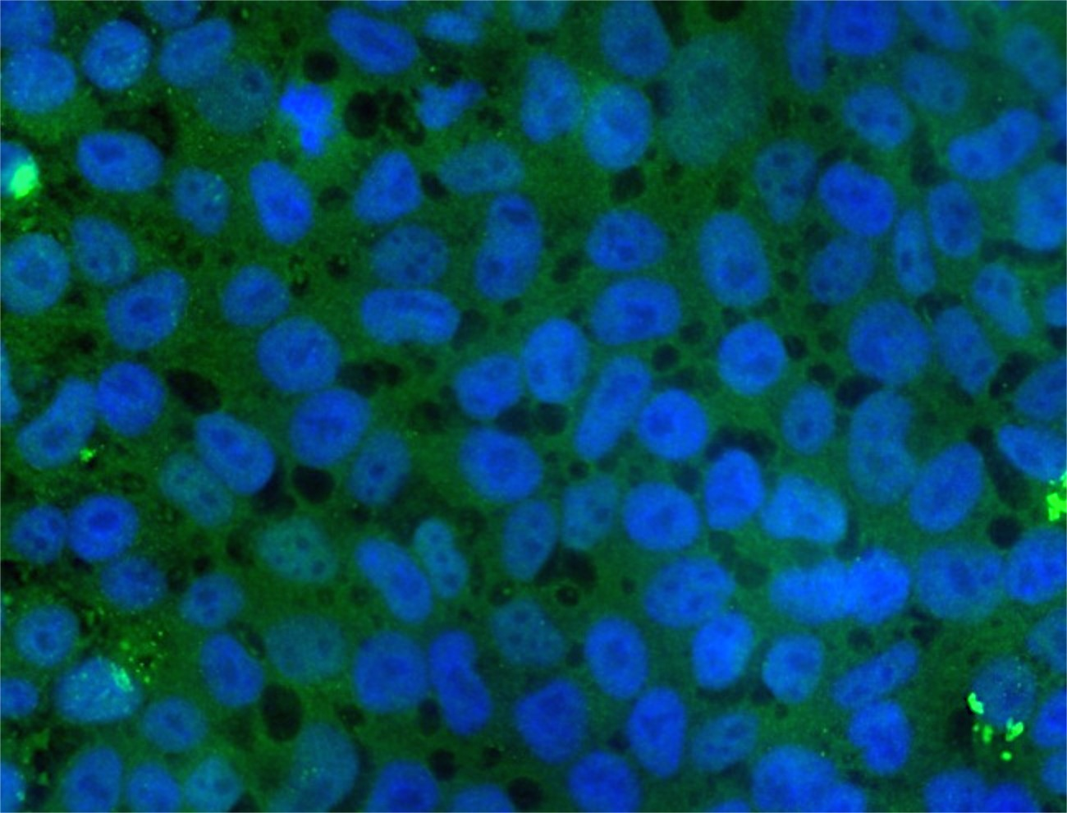
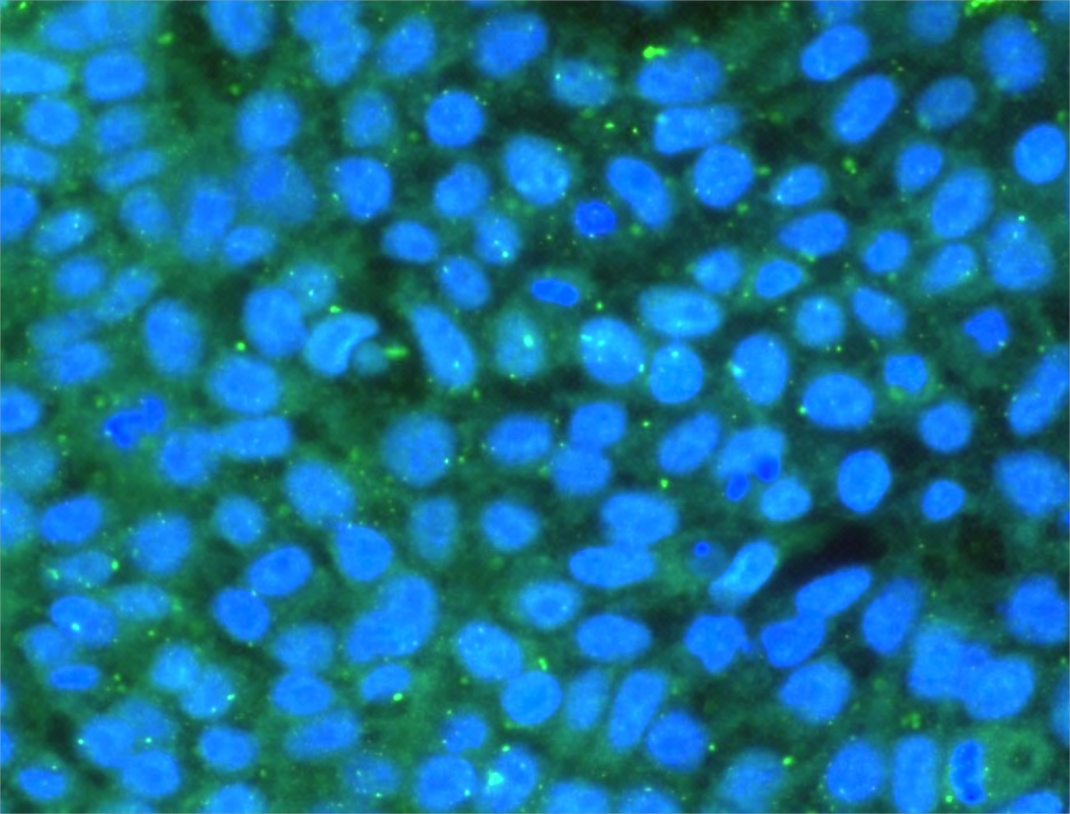
Can stem cells really replicate human disease?
Ataxin-3 + Cell Nucleus
SCA3 stem cells closely replicate important characteristics of human disease.
The disease-causing protein in SCA3, Ataxin-3:
Is dislocated to the nucleus of SCA3 stem cells.
Accumulates into protein aggregates (“trash dumps”) within the cell.
Unaffected
stem cells
SCA3
stem cells

Slide 21
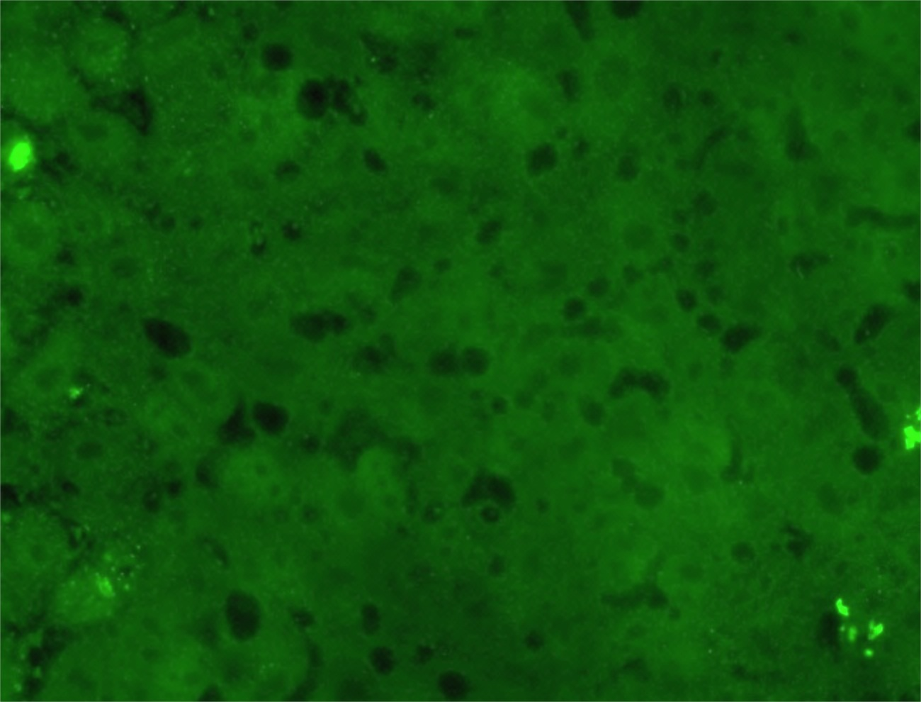
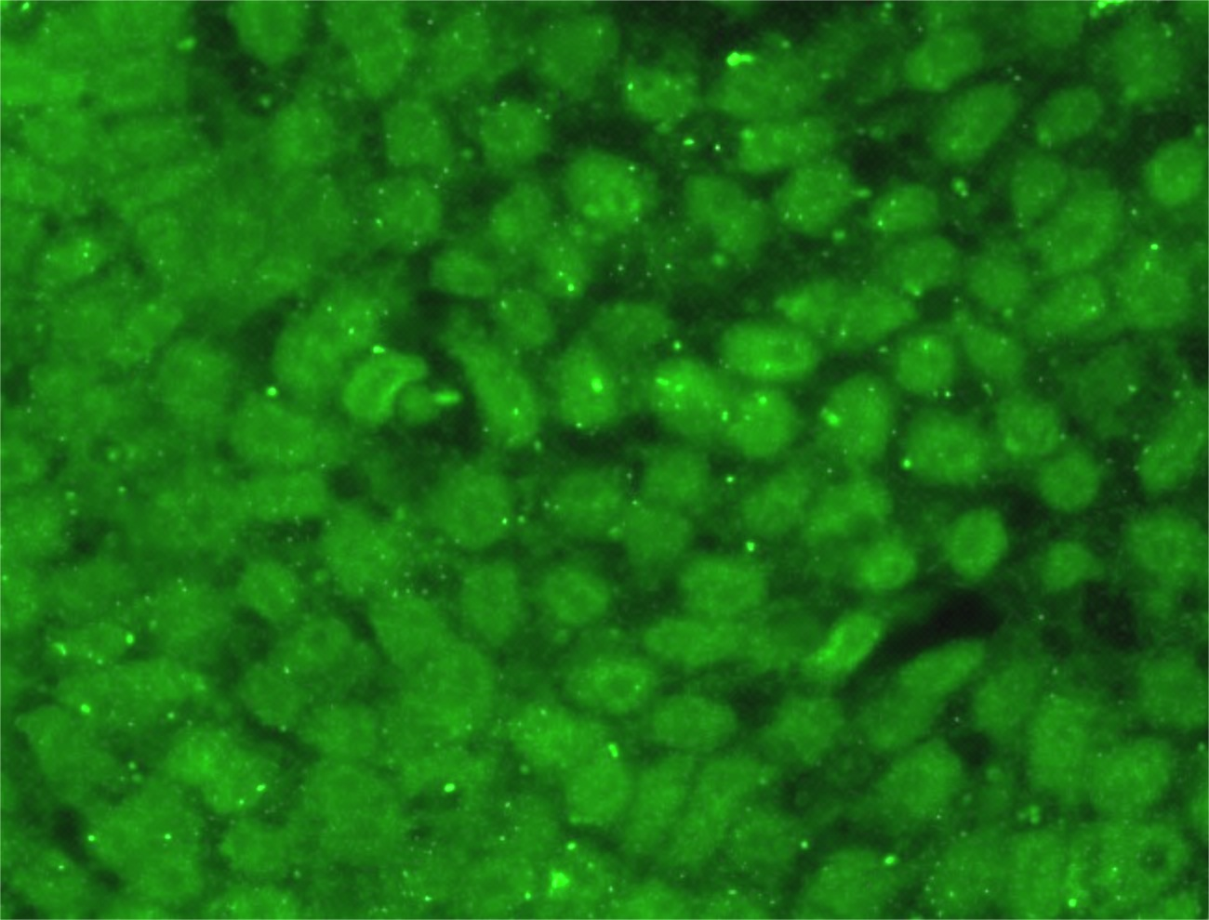
Can stem cells really replicate human disease?
Ataxin-3 + Cell Nucleus
SCA3 stem cells closely replicate important characteristics of human disease.
The disease-causing protein in SCA3, Ataxin-3:
Is dislocated to the nucleus of SCA3 stem cells.
Accumulates into protein aggregates (“trash dumps”) within the cell.
Unaffected
stem cells
SCA3
stem cells

Slide 22
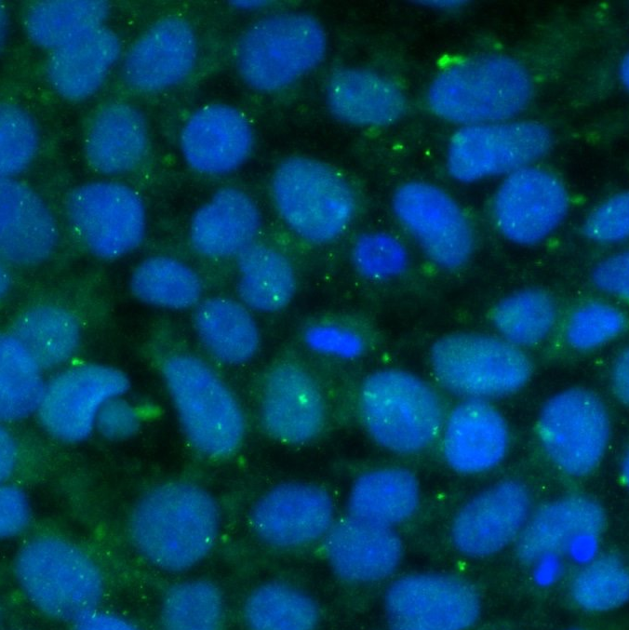
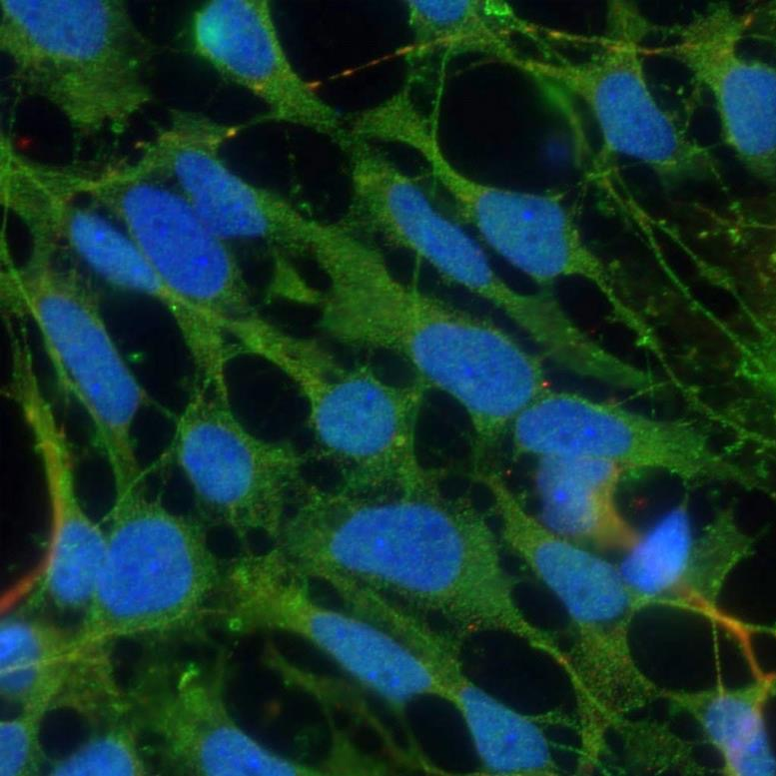
Deriving SCA3 neurons
Mature SCA3 Neurons
(brain cells)
Totipotent SCA3 Stem Cells
Differentiation factors

Slide 23
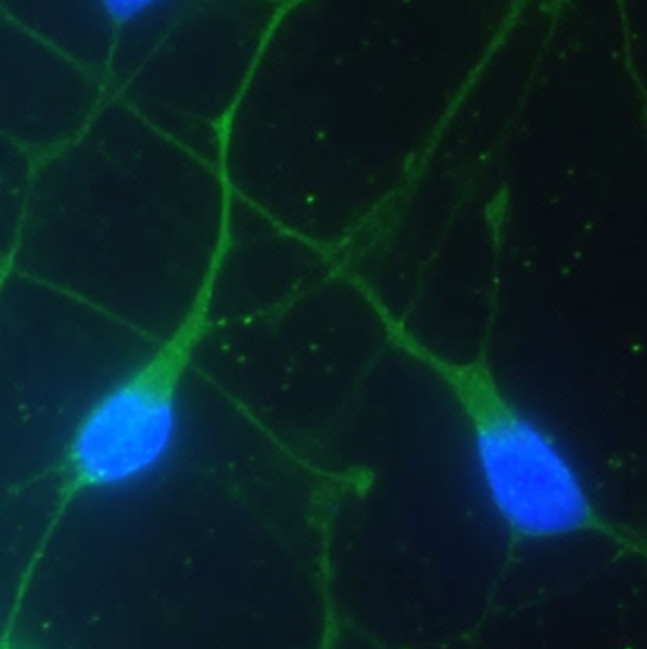
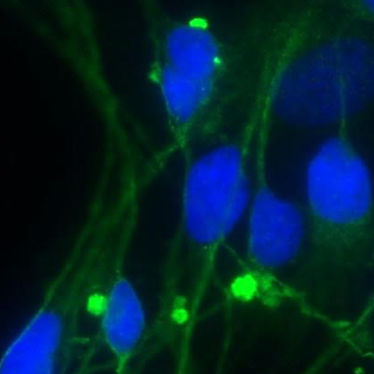
Why do we care?
Identifying novel differences in these cell lines could lead to new therapeutic targets for ataxia.
Unaffected Brain Cells
SCA3 Brain Cells
Vimentin/Nucleus
Notes:
By comparing neurons derived from an SCA3 and an unaffected stem cell line, I have identified previously unidentified differences that may contribute to cell death in SCA3.

Slide 24
Moving closer to a cure
Antisense oligonucleotides (ASOs) - a new therapeutic strategy that can stop genetic diseases at their source by preventing production of the disease-causing toxic protein (“gene silencing”).
ASO therapy for SMA, a fatal genetic motor neuron disorder that mostly affects infants, has advanced to Phase 3 human clinical trials with promising preliminary results.
Therapy is safe and infants that received ASO treatment are demonstrating significant increases in survival and motor abilities.
ASOs are currently in human clinical trials for other neurological diseases including Huntington’s disease, ALS, and genetic forms of Alzheimer’s disease.
Notes:
Many labs presented earlier this week using ASOs in many different genetic ataxias.

Slide 25
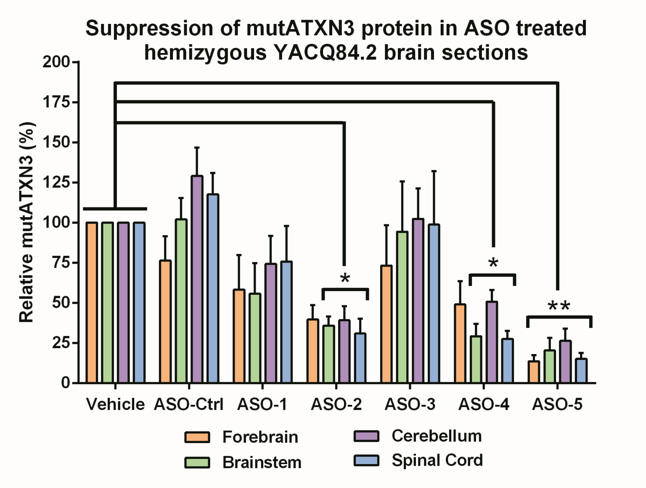
Moving closer to a cure
Amount of SCA3 toxic protein in mouse brain after ASO Treatment
ASOs greatly reduce amount of the toxic SCA3 protein in all brain regions of treated SCA3 mice.
Next step – test ASO therapy in human neurons derived from the SCA3 stem cell line.
Demonstrating that ASOs can reduce toxic protein levels and reverse disease-relevant abnormalities will:
Provide support for moving ASO therapy into a human clinical trial for SCA3
Potentially speed up the “bench-to-bedside” process
Success in stem cells is likely more predictive of success in patients.
% mutant ATXN3 Protein
Lauren Moore, Hayley McLoughlin, Gautam Rajpal (unpublished)

Slide 26
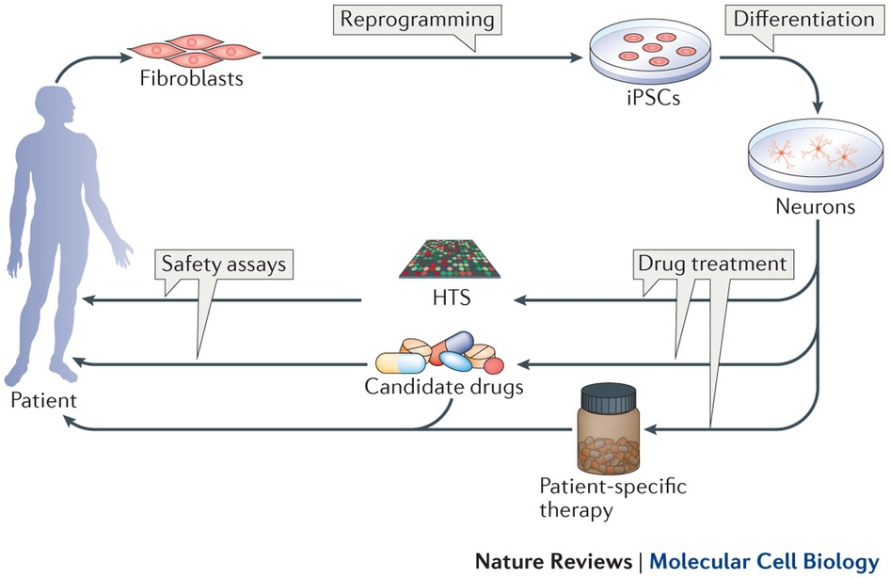
Using induced pluripotent stem cells to test novel therapies
Test thousands of existing FDA approved drugs for “drug repurposing”
By using iPSCs from patients, in the future we may tailor therapies to individual patients

Slide 27
Insights from an ataxia researcher & proud daughter of an ataxia patient.
There is no disease too rare.
The ataxia research community is HUGE.
YOU have advocates in the scientific community.
New discoveries are happening everyday!
Cures are not only possible, but inevitable.
There is a thin line between science and magic!

