Slide 1

Strategies for Living with Ataxia
Bailey Vernon, MPH, CHES
Johns Hopkins Ataxia Center

Slide 2

Disclaimer
The information provided by speakers in any presentation made as part of the 2015 NAF Annual Membership Meeting is for informational use only.
NAF encourages all attendees to consult with their primary care provider, neurologist, or other health care provider about any advice, exercise, therapies, medication, treatment, nutritional supplement, or regimen that may have been mentioned as part of any presentation.
Products or services mentioned during these presentations does not imply endorsement by NAF.

Slide 3
Presenter Disclosures
List Speaker(s)
The following personal financial relationships with commercial interests relevant to this presentation existed during the past 12 months:
No relationships to disclose or list

Slide 4
Strategies
Execute a care plan
Exercise
Eat Well
Education
Effective Communication
Effective Coping
Exploring Options
3. Dunlop (2014)
Notes:
This conference provided us with a lot of great information about ataxia. We have learned that we are working hard towards a cure, but we still have a ways to go. We need to focus on what WE CAN do. E-s for Empowered living with PD, Becky Dunlop. This apply very much to ataxia. They incorporate us taking an active approach and living a healthy lifestyle. We can empower people to have the best outcomes possible.

Slide 5
Strategies
Execute a care plan
Exercise
Eat Well
Education
Effective Communication
Effective Coping
Exploring Options
Notes:
I have added the first step because we need to be active participants in our care. Learned about the individuals involved in providing ataxia care, so we need to create our care plan and look at the network we have.

Slide 6
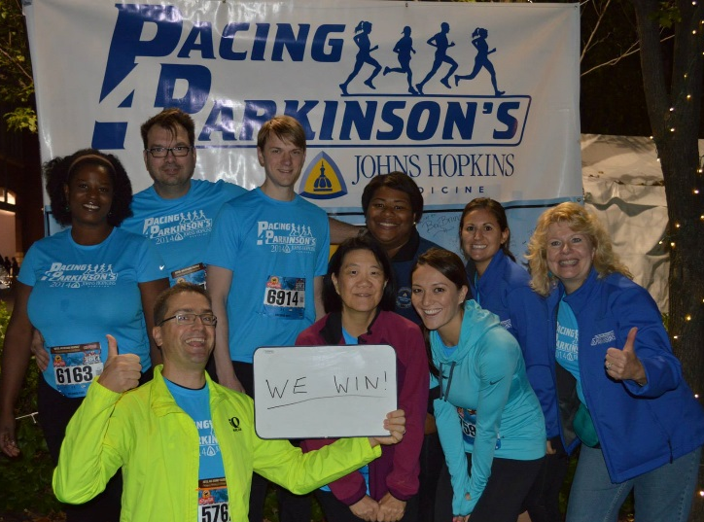
Your Care Plan
Be an ACTIVE participant
Develop a TEAM of individuals dedicated to your care
  Seek care providers you trust ¹
  Build a strong relationship with your physician ²
  Identify your
  care partner(s)
Notes:
As a team you can work together to help manage the symptoms – make you feel in control. Want providers that you can maintain a strong and open relationship with. You can be an active participant by finding providers you feel comfortable with, making the most of your time, be your own advocate, ask for your reports. There are books available that provide tips on how to maintain a strong relationship with your doctor. Simple tips – going in with 3 issues that are most important. It is good to find one main physician that can help supervise our overall care. Dr. Gomez gave a great presentation last year on the benefits of being followed by ataxia center, but accessing a center may not be realistic. Find a physician or neurologist that is interest in learning and helping. Identify those members of your family or your friends that want to be active participants with you.

Slide 7
Build Your Care Team
Patient
Family
Neurologist
Physical
Therapist
Speech
Therapist
Occupational
Therapist
Nurse
Primary
Physician
Dietician
Psychiatrist
Genetic Counselor
Other
Specialists
Support
Groups
3. Dunlop (2014)
4. Reynolds (2009)
Notes:
Patient Centered Care, Ataxia Center – Multidisciplinary Care
Goal is to empower participants to become active participants in their care
Ataxia brings a variety of symptoms, specific to the individual, that can be treated – like sleep disturbances, vision problems, fatigue, anxiety depression, aches/pains, bladder/bowel problems, sexual dysfunction

Slide 8
Strategies
Execute a care plan
Exercise
Eat Well
Education
Effective Communication
Effective Coping
Exploring Options
Notes:
Each AAM meeting has emphasized the importance of exercise.
2014 AAM – Kyle Bryant who shared how he lives with FA and was the founder of Ride Ataxia Founder, rode Trike and personal testified how exercise has helped him, and Mike Cammer
2013 AAM – Wheelchair Yoga
Mid-Atlantic Ataxia Support Group – Dance Therapist & Qi Gong

Slide 9
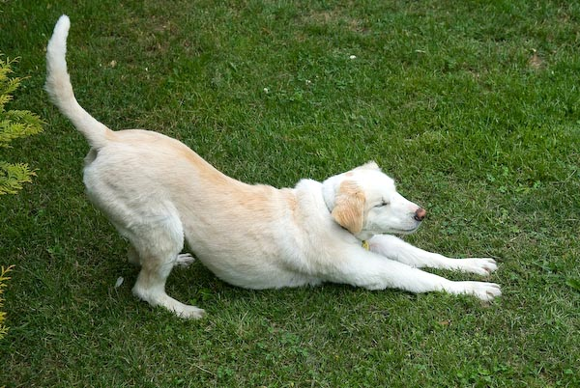
Exercise
Benefits
  Helps with mood
  Improve physical conation
  Maintain function and independence
Important part of the
treatment plan
Notes:
2013 AAM – Wheelchair Yoga
Baltimore Support Group – Dance Therapist & Qi Gong
Balance exercises – only helpful if practice EVERY day

Slide 10

Exercise
Where to start?
  Seek a physical therapist
  Community centers
  Library
What type?
  Incorporate aerobic, strengthening, stretching
  Find exercise that you enjoy and adapt it into your daily routine
Notes:
2013 AAM – Wheelchair Yoga
Baltimore Support Group – Dance Therapist & Qi Gong
Balance exercises – only helpful if practice EVERY day

Slide 11
Strategies
Execute a care plan
Exercise
Eat Well
Education
Effective Communication
Effective Coping
Exploring Options

Slide 12


Eat Well
Balanced nutritious diet
Limit Alcohol
Moderation
Address chewing and swallowing difficulties
Notes:
Eat a diet Full of fruits, vegetables and whole grains; less processed foods, Variety of foods; Eat smaller meals more frequently
Alcohol can intensify balance, speech and walking
All deserve to treat ourselves, but all in modersation
Start with a speech therapist

Slide 13
Strategies
Execute a care plan
Exercise
Eat Well
Education
Effective Communication
Effective Coping
Exploring Options

Slide 14
Educate Yourself
Knowledge is power
Know where to find reliable information
Beware “Information overload”
Notes:
Future Shock – Alvin Toffler’s 1970 book that introduced this concept of information overload

Slide 15
Strategies
Execute a care plan
Exercise
Eat Well
Education
Effective Communication
Effective Coping
Exploring Options

Slide 16
Effective Communication
Knowing the vocabulary of ataxia
Communication between providers
Voice health

Slide 17
Strategies
Execute a care plan
Exercise
Eat Well
Education
Effective Communication
Effective Coping
Exploring Options
Notes:
2013 AAM – Wheelchair Yoga
Baltimore Support Group – Dance Therapist & Qi Gong

Slide 18
Effective Coping
  Anger
  Denial
  Helplessness
  Isolation
  Guilt
  Fear
  Frustration
  Disappointment
  Confusion
  Uncertainty
  Embarrassment
  Anxiety
Notes:
Emotions come with diagnosis and also feel throughout the journey

Slide 19
Effective Coping
Additional stress
  Relationship changes
  Altered communication
  Family conflicts
  Apathy
Disease progression can change emotions
  Loss of independence
  Loss of privacy
  Lowered self-esteem
  Guilt

Slide 20
Effective Coping
Stress management
Find the positive
Develop and maintain your humor
Professional services
Know your limits and make adaptations
Social support
Support groups
Notes:
How do we cope with these emotions?
Ataxia can be very socially isolating and we need to find ways to cope with these emotions, different for everyone
Stress management – stress can worsen symptoms, need to identify your stress and find ways to reduce it (meditation, exercise, hanging with friends, reading); try simplifying your life, slowing down, developing a routine
Find the positive – I have learned from the support group that this plays a huge part in how we live with ataxia; navigate the new normal, gratitude in the small things, what motivates you? Keep moving
Sometimes we just need to laugh!
Professional services – depression and anxiety are VERY Common, seek a social worker, psychologist – Roseanne Dobkins CBT, psychiatrist
Knowing your limits – be creative in still doing the things that you enjoy – find those adaptations, rock climbing
Isolating - having strong friendships can help fight depression
Support Groups

Slide 21
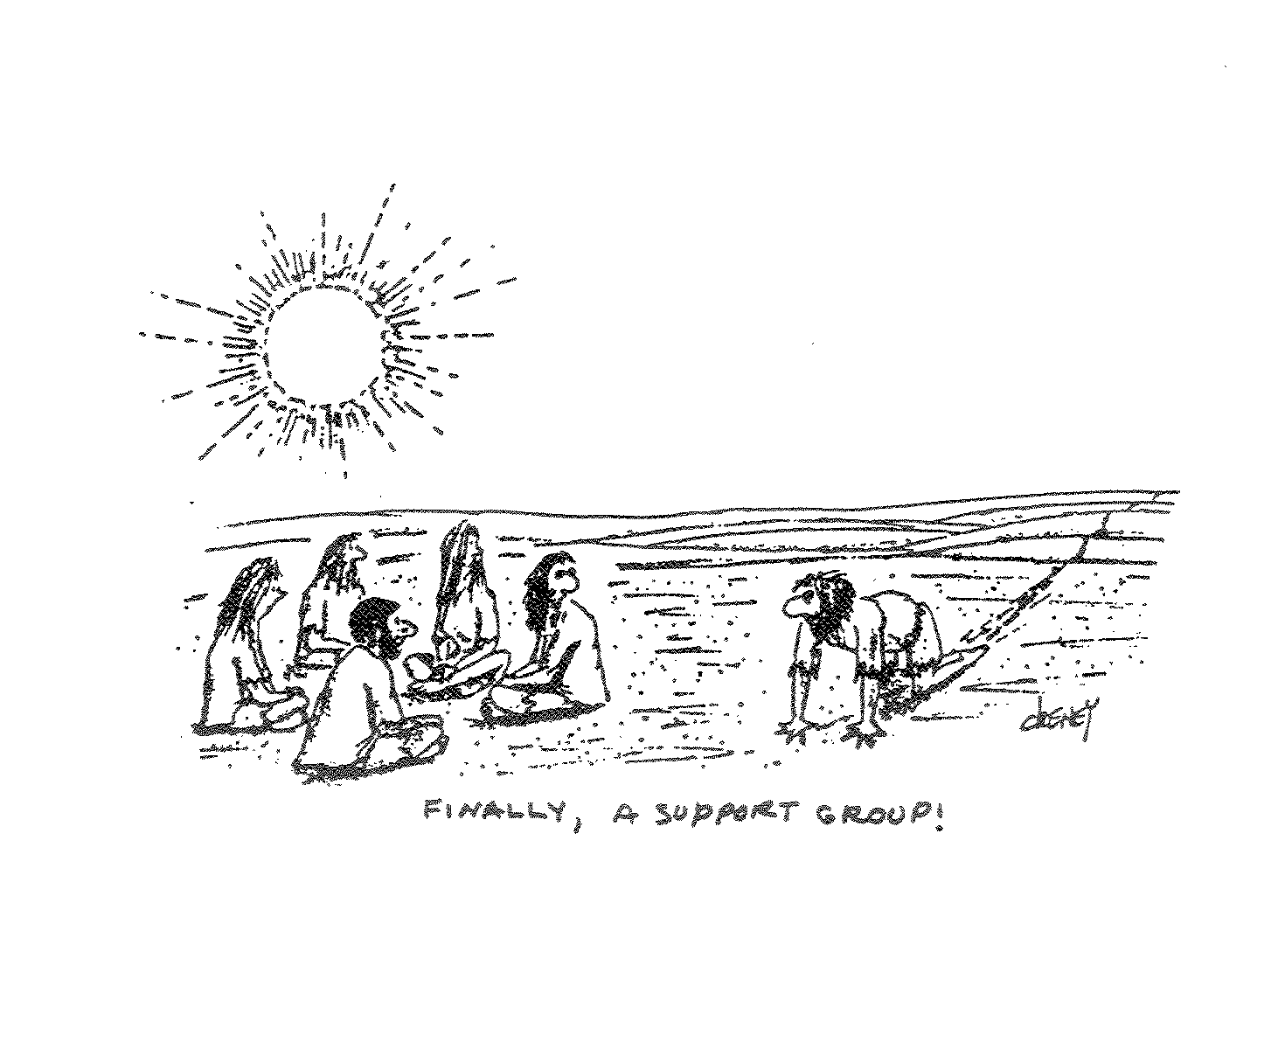
Notes:
Ataxia can be very socially isolating, having strong friendships can help fight depression

Slide 22
Effective Coping
Caregiver Support
  Ataxia impacts entire families and communities
  Prevent caregiver burnout
  Find ways to continuously support one another
  Caregiver health
    Care partner support groups
    Take breaks
    Visit your doctor

Slide 23
Strategies
Execute a care plan
Exercise
Eat Well
Education
Effective Communication
Effective Coping
Exploring Options
Notes:
2013 AAM – Wheelchair Yoga
Baltimore Support Group – Dance Therapist & Qi Gong

Slide 24
Explore Options
Learn what resources are available in your community
  Activity centers
  Wellness programs
  Financial resources
  Future planning
  Case managers
Notes:
Ataxia Wellness Program I am developing with Dr. Rosenthal

Slide 25
“Life consists not in holding good cards but in playing those you hold well”
-Josh Billings

Slide 26
References
1. Gomez, C. M. (2014). Finding the Best Ataxia Care. The University of Chicago.
2. Nance, M. A. (2003). Living with Ataxia. National Ataxia Foundation
3. Dunlop, S. R. (2014). The Parkinson’s Disease Management Plan. Johns Hopkins Parkinson’s Disease and Movement Disorders Center
4. Reynolds, A. (2009). Patient-centered Care. American Society of Radiological Technologists.
    5. Dokin, R. D. (2014). Cognitive Behavorial Therapy. Rutgers University.

