Slide 1

The Ataxia Rollercoaster: How to Have a Smoother Ride with the Ups, Down & Loop-the-Loops of Life
Ellen Sichel, BS

Slide 2
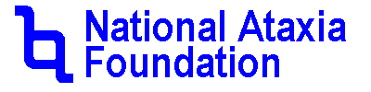
Disclaimer
The information provided by speakers in any presentation made as part of the 2016 NAF Annual Ataxia Conference is for informational use only.
NAF encourages all attendees to consult with their primary care provider, neurologist, or other health care provider about any advice, exercise, therapies, medication, treatment, nutritional supplement, or regimen that may have been mentioned as part of any presentation.
Products or services mentioned during these presentations does not imply endorsement by NAF.

Slide 3
Presenter Disclosures
List Speaker(s)
The following personal financial relationships with commercial interests relevant to this presentation existed during the past 12 months:
No relationships to disclose or list

Slide 4
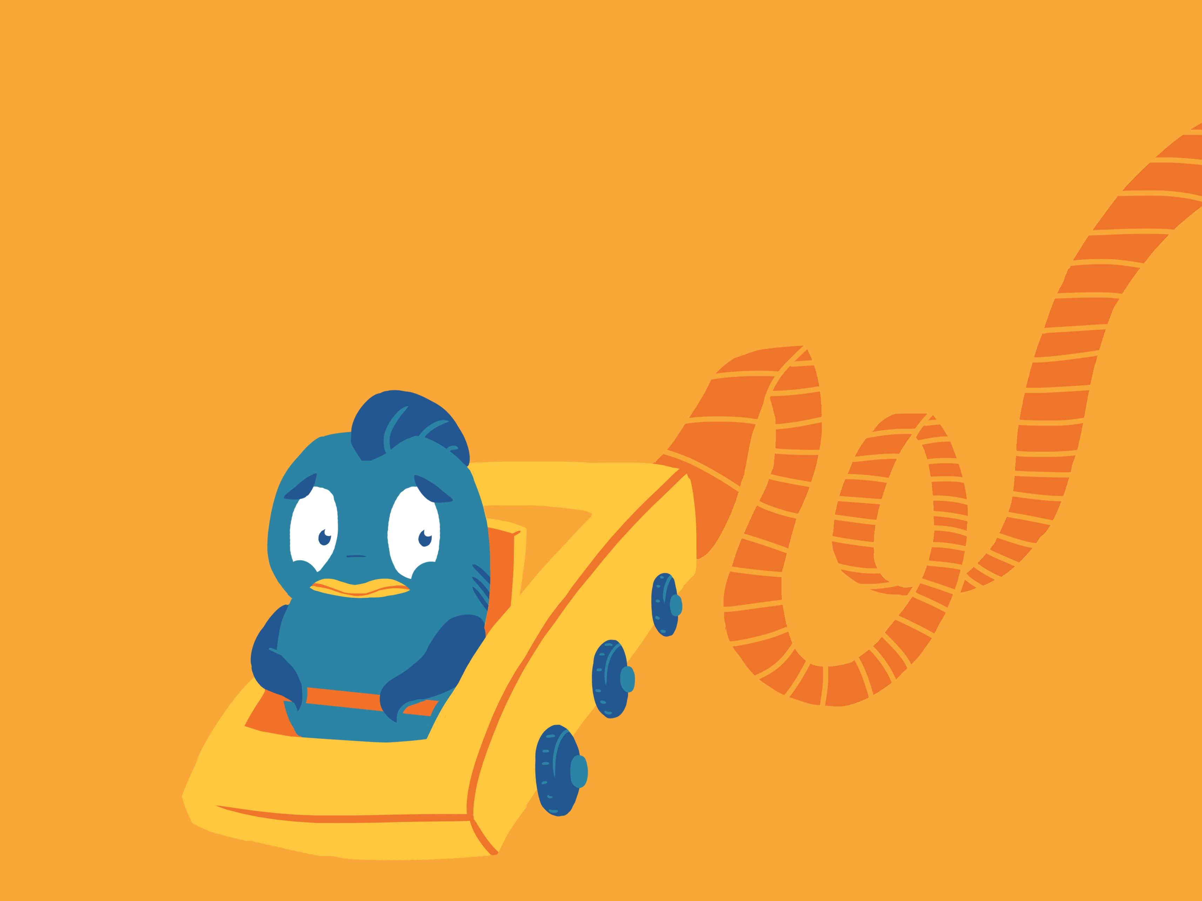
The Ataxia Rollercoaster
How to Have a Smoother Ride with the
Ups, Downs & Loop-the-Loops of Life

Slide 5

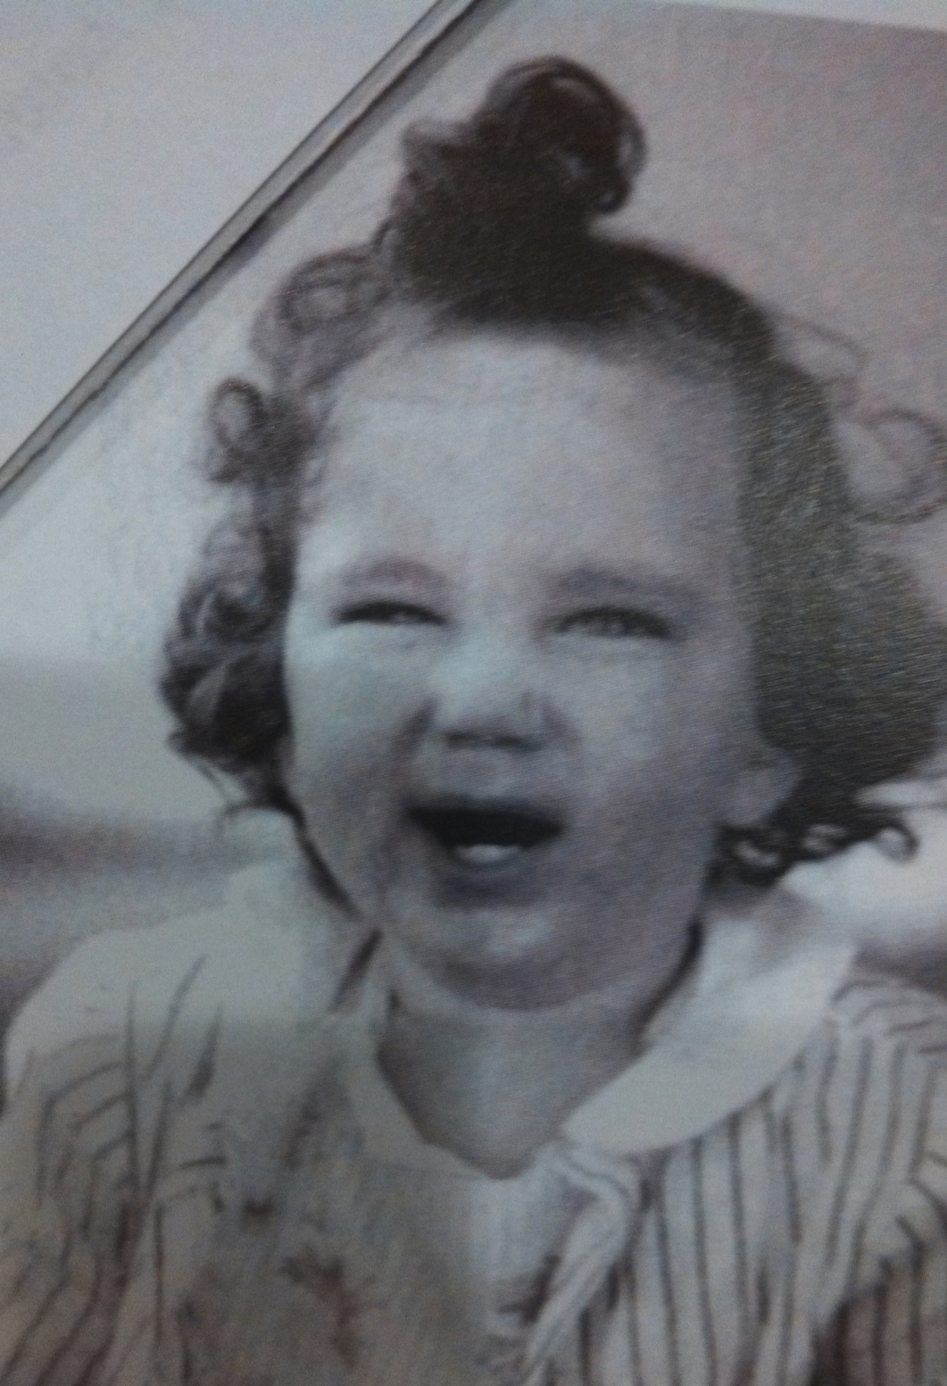
Why I do, what I do…
My stress &
pain began at
a very young age.
(maybe my bun was too tight)

Slide 6

What do you find
stressful?
Remember, stress comes
from both happy and
challenging times.

Slide 7

What do you do
to de-stress?
Vacation Bath
Retirement Yoga class
Exercise A stiff drink!?
Massage Read
It doesn’t last- Why? You take yourself with you!

Slide 8

Your stress comes not from the event, but from your reaction to the event. When you react you are either in the past or future,
not where your feet are planted.

Slide 9
The Culprit is…
Your Mind
40,000 - 80,000 thoughts per day
The mind loves to be entertained
You cannot force thoughts to stop
Tendency to become forgetful, scattered, reactionary

Slide 10
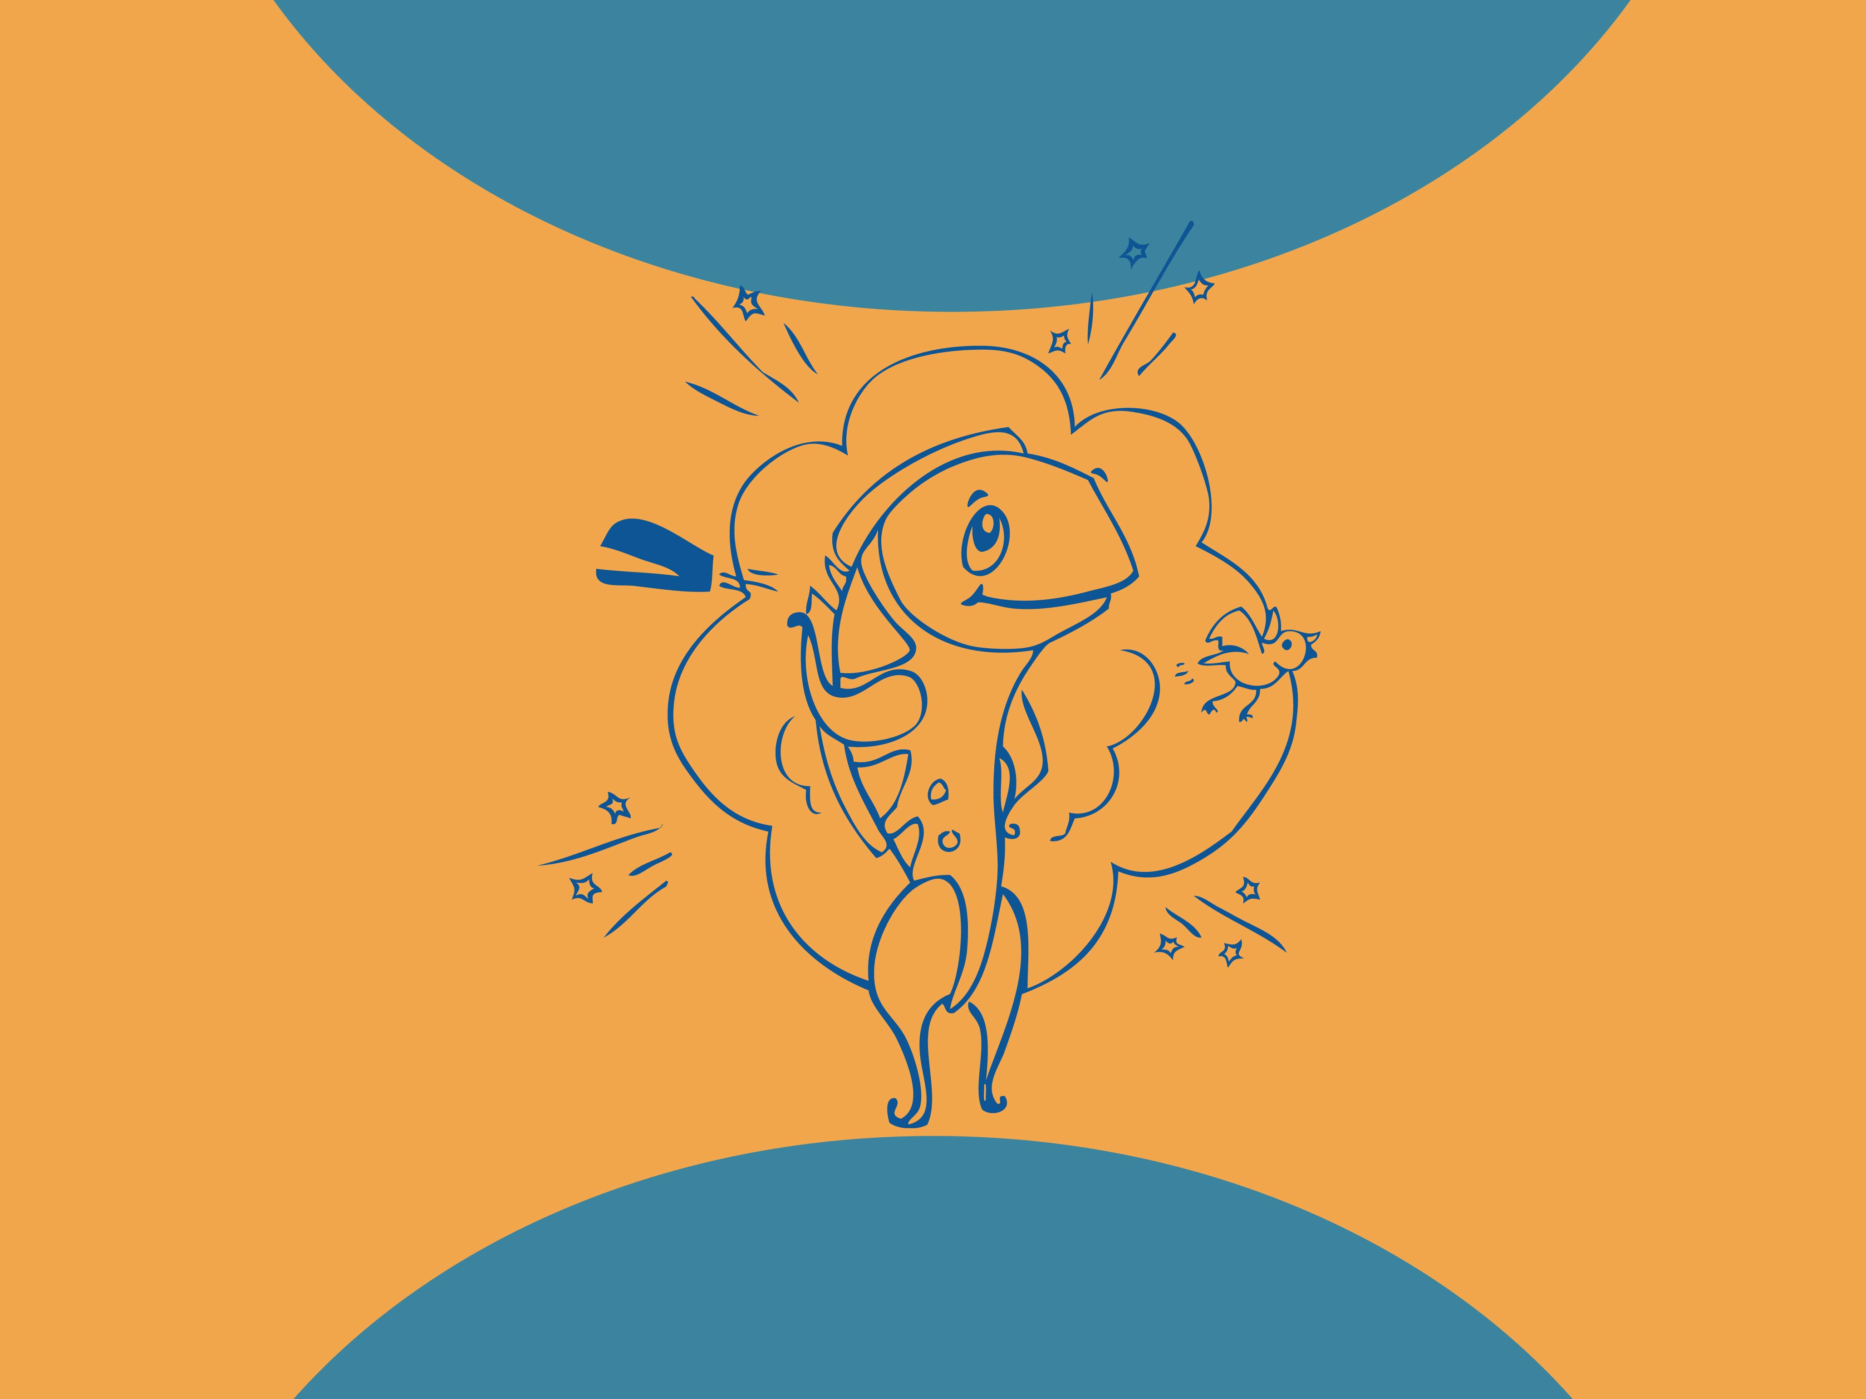
The Solution
Simple? Yes… Easy? No.

Slide 11

Calm your mind
Meditation
Paying attention,
focusing your mind
What is Mindfulness?
Cultivating non-judgmental awareness of the present moment. Observation without judgment
Embracing all that is in any given moment.

Slide 12

Benefits of
Mindfulness
Calm the mind
Improve coping skills for pain/ emotions
Decrease stress symptoms
Improve quality of life
Increase spiritual well-being

Slide 13
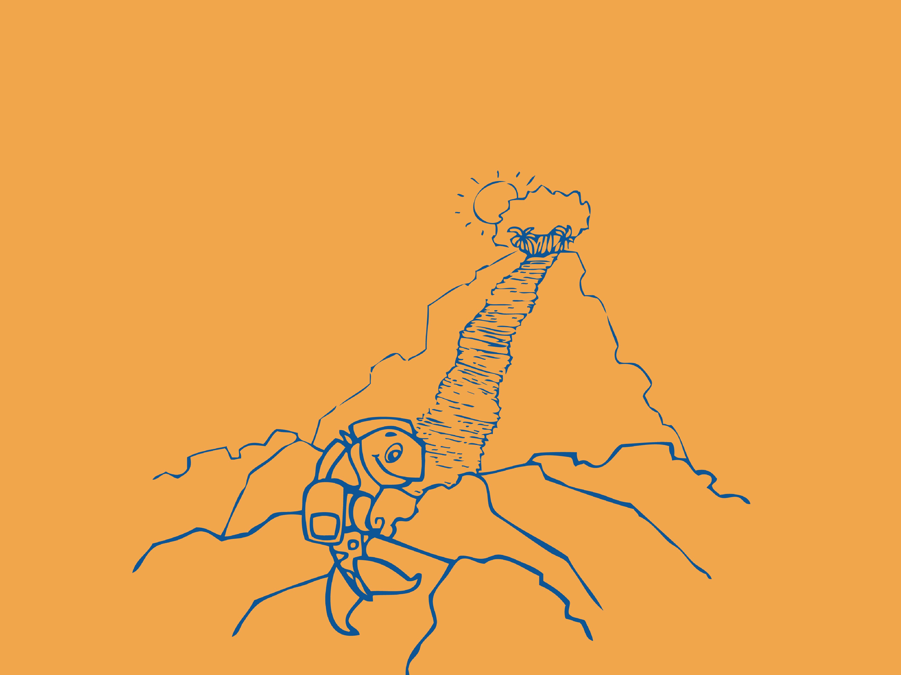
Be where your feet are planted…

Slide 14

How?
Riding the Waves
vs.
Battling the Waves

Slide 15
Riding the Waves
Noticing the wavelike motion, rather than trying to change what is happening, gives you the ability to stay out of reaction
It is what it is, while it is, the way it is,
until it changes – and it will change.

Slide 16

Battling the Waves
Fight or flight response
Habitual pattern of reacting
Adversely affects overall health

Slide 17

Riding the Waves is Effective for…
Pain
Emotions
Thoughts
Fatigue

Slide 18
Let’s experiment
with riding the waves
of breath…
What did you notice?

Slide 19
Benefits of
Breathing Techniques
Physical:
Oxygenates the body Lowers pain
Aids digestion
Eases muscle tension Increases stamina
Improves sleep
Emotional:
Calms the mind
Calms nervous system
Uplifts mood
Improves clarity

Slide 20

Let’s take breath a bit further…
What did you notice?

Slide 21
Remember
You are so Much More Than
a Patient or Caregiver
(iceberg analogy)

Slide 22

Solution Time!
Let’s get a game plan …
Begin each day with a short practice
Each day look for simple ways to
fill up and recharge
What do you enjoy that you no longer do? Can you stay present with your tasks?
Commitment time!

Slide 23
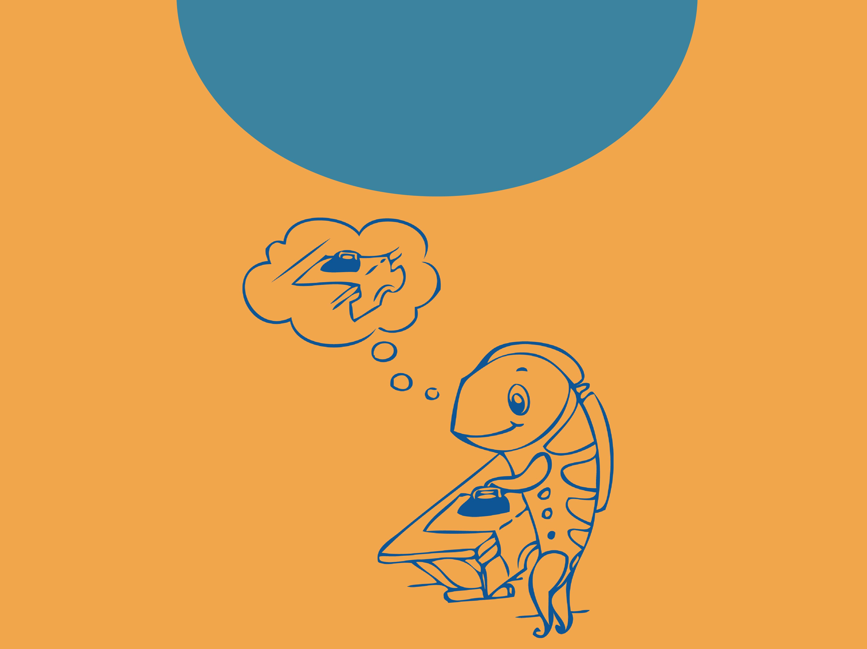
No time? No problem! fill up with daily tasks

Slide 24
Let’s put this all together with a story

Slide 25
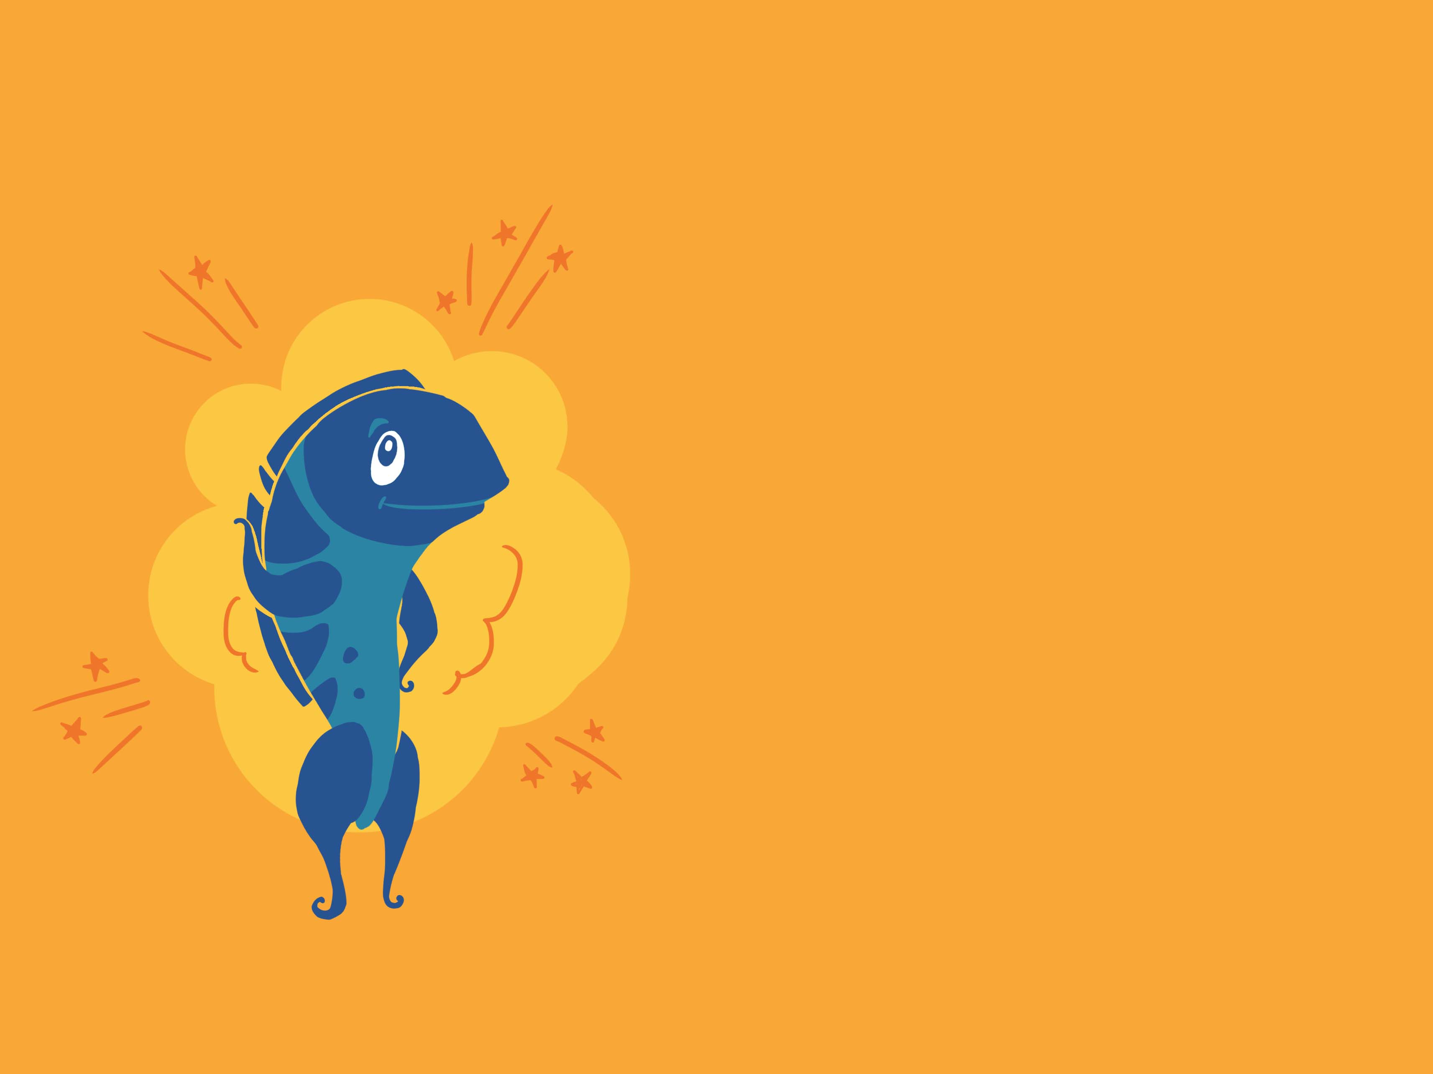


Thank You!
Stay in touch –
ellen@customcalm.com
(770) 313-6162
Book –
Splash into Calm
Virtual No B.S. book club
Custom Calm | contact@customcalm.com | www.customcalm.com

