Slide 1
Friedreich Ataxia: Update
April 1, 2016
David R. Lynch, MD PhD

Slide 2

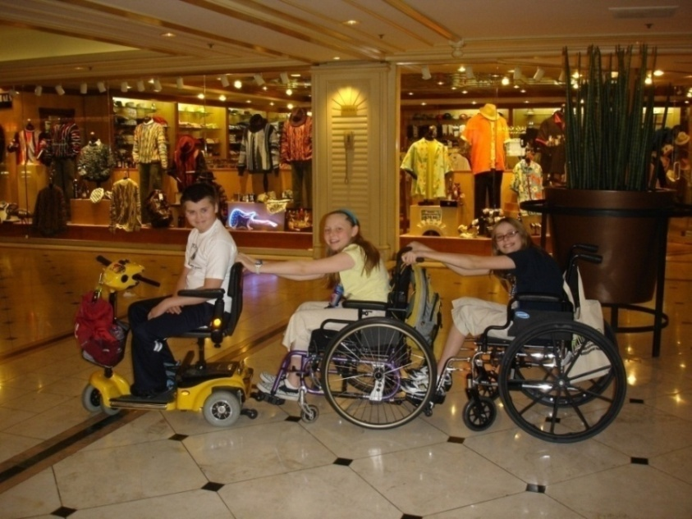
Friedreich Ataxia (FA)
Nicolaus Friedreich first described in 1860’s based on 6 patients from 2 families
A rare, genetic condition that is a progressive degenerative disease of children, adolescents and adults
Affects 1 in 50,000
Estimated 5-6,000 individuals in US and 10-15,000 worldwide
Typically thought of as a neurodegenerative disease as this is the most visible and common symptom; however FA is a multi-system disease

Slide 3
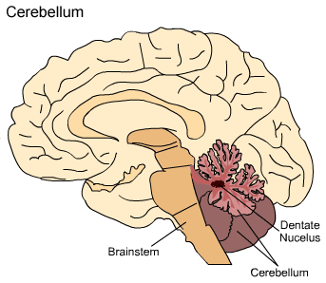
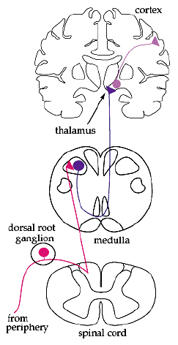
FA – Clinical Features
Clinical features: Neuro
Loss of large sensory neurons - proprioception
Loss of balance and coordination
Loss of reflexes
Loss of spinocerebellar tracts
Loss of balance and coordination
Loss of motor tracts to a lesser degree
Loss of dentate nucleus of the cerebellum
Dysarthria (slurred speech), modest eye movement abnormalities
Loss of a few other specific sites
Vision, hearing loss
Sparing of cerebellar cortex, cerebral cortex
Normal cognition
Overall loss of relatively few neurons, modest number of axonal tracts----MRI scans are normal or almost normal in early disease

Slide 4

FA – Clinical Features
Heart: Cardiomyopathy and arrhythmia
Hypertrophic cardiomyopathy
Later onset of progressive cardiac fibrosis with loss of systolic function
Clinically insignificant EKG abnormality – inverted T waves
Clinically significant arrhythmia
Troponin abnormalities—meaning unclear
ENT:
Hearing loss –subclinically abnormal >70%, clinical dx: 10-15% of patients
Impaired temporal processing
Ophthal: Optic atrophy - present in 10% of pts
Fixation abnormalities common (square wave jerks, ocular flutter)
Loss of retinal ganglion cells; OCT

Slide 5
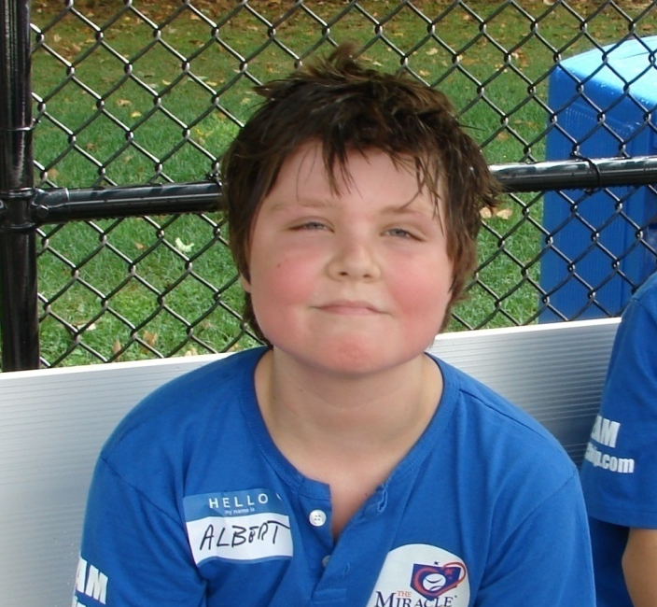
FA – Clinical Features
Endo: Diabetes –10-20%
>65% Insulin resistance
Skeletal: Scoliosis
Corrective surgery required in up to 50% of patients
Pes cavus
GU: Urinary symptoms– 50% of adult patients
Urgency, sphincter dysynergia
Psychiatric: Depression
Fatigue: Nearly all patients experience significant fatigue that impacts quality of life
Cognition: Remains essentially normal

Slide 6
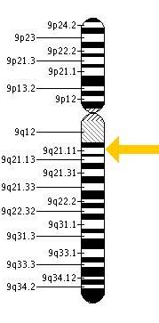
FA – Monogenic condition, Autosomal recessive
1996 – Disease causing gene identified, FXN
GAA
Exon 1
2
3
4
5
GAA repeats
3-33 – normal
34-65 – premutation
66-1700 - abnormal
GAA
L106X
G130V, I154F
Exon 1
2
3
4
5
Primary disease causing mutation is the expansion of a naturally occurring GAA repeat in the noncoding region of the gene for frataxin (FXN) - 95% of abnormal alleles. The other 5% of abnormal alleles are point mutations in the coding regions of the gene.
ONE DOES NOT HAVE TO PUT IN NEW GENE, ONLY TURN THAT WHICH THERE ON
Notes:
6

Slide 7
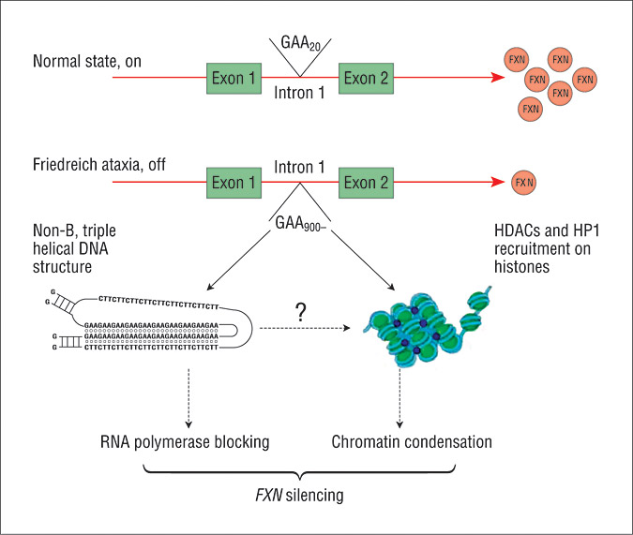

Mechanisms of FXN silencing by the expanded GAA repeat
New concepts:
Other modifications of DNA such as
methylation
Progressive
Potentially reversible by
Small RNA molecules
Pandolfo, M. Arch Neurol 2008;65:1296-1303.
Copyright restrictions may apply.

Slide 8
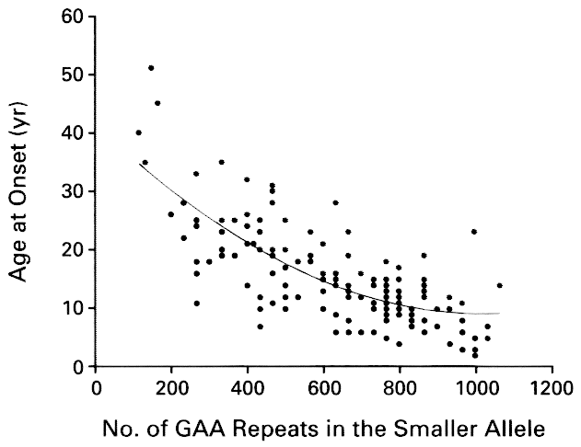
GAA Repeat Size and Age of Onset, Durr et al., NEJM, 1996
GAA repeat expansion sizes correlate with measures of disease severity
GAA repeat expansions decrease, but do not eliminate, frataxin expression
This curve for 1997 looks the same now.

Slide 9

FRDA
Pathophysiology
GAA expansions lead to gene silencing which leads to relative lack of frataxin
Frataxin deficiency leads to mitochondrial dysfunction
Cell selective mitochondrial dysfunction leads to clinical manifestations including neurological features.

Slide 10
FA TREATMENT PIPELINE – MARCH 2016
DISCOVERY
(Finding Potential
Therapies/Drugs)
PRE-CLINICAL
DEVELOPMENT
(Testing in Laboratory)
IND FILED
(Investigational New Drug; FDA filing)
PHASE I
(Human
Safety Trial)
PHASE II
(Human Safety
And Efficacy Trial)
PHASE III
(Definitive Trial)
NDA FILED
(New Drug Application; FDA filing)
AVAILABLE
TO PATIENTS
Decrease
Oxidative Stress
and/or Increase
Mitochondrial
function
EPI-743
Edison
SHP622 (0X1)
Shire
RTA-408 – Nrf2 Activator
Reata
dPufas
Retrotope
Modulation of
Frataxin
Controlled
Metabolic
Pathways
Nutritional approach
University of Pennsylvania (Philadelphia, PA)
Nrf2 Activators
Ixchel Therapeutics
Frataxin
Stabilizers,
Enhancers, and Replacement
Ubiquitin Competitors
University of Rome “Tor Vergata” (Rome, Italy)
Frataxin replacement
Chondrial Therapeutics, BioBlast Pharma, IRB Barcelona (Barcelona, Spain)
HDAC Inhibitors
BioMarin
Increase
FA gene
Expression
Resveratrol
Jupiter Therapeutics & Murdoch Children’s Research Institute, Australia
Nicotinamide
Imperial College (London, UK)
Interferon gamma
Horizon
RNA-based approach
RaNA, ProQR
Gene
Therapy
AAV-based approaches
Voyager, Agilis, Bamboo, Annapurna, 4D Molecular Therapeutics, IGBMC (Strasbourg, France), University of Florida
Epigenetic & FXN expression
Pfizer, Novartis
Drug Discovery
Frataxin mimetics
University of Pennsylvania
Mitochondrial
& Pathways
University of Pennsylvania, University of California Davis, & Arizona State University (Tempe, AZ)
© 2016 Friedreich's Ataxia Research Alliance. All Rights Reserved.

Slide 11
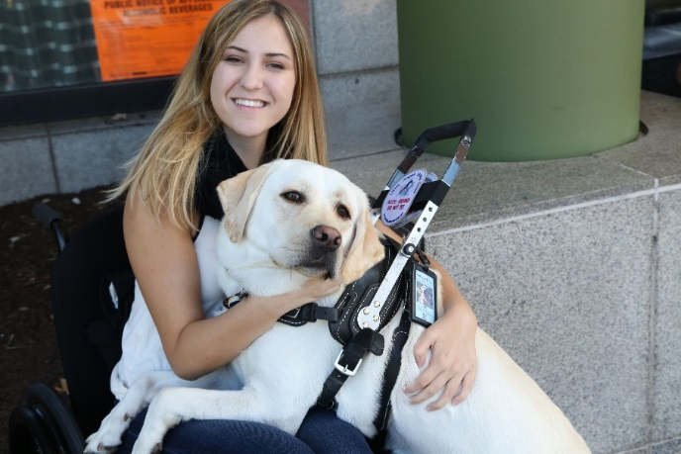
FRDA Therapies
Conceptual approaches to clinical trials:
Improve mitochondrial function/antioxidant
EPI743
SH622
Idebenone,
CoQ
Retrotope RT001
Improve bodies reaction to Mitochondrial dysfunction
Reata RT 408
Make more frataxin

Slide 12

Ways to make more frataxin
Turn gene back on
Inhibit processes turning off—HDAC, methylation
Use small RNA based therapies to turn on
Actimmune
Give exogenous frataxin
TAT frataxin and similar approaches
Put in a new gene
Gene therapy (at least 6 companies)
Cut out the abnormal gene
CRISPR technology and others

Slide 13
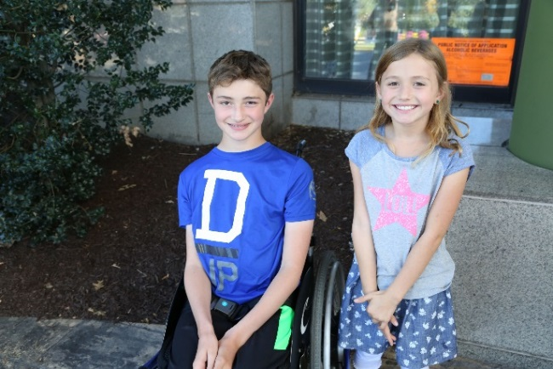
Pathophysiology of FRDA
Pathophysiology
GAA expansions lead to gene silencing which leads to relative lack of frataxin
Frataxin deficiency leads to mitochondrial dysfunction
Cell selective mitochondrial dysfunction leads to clinical manifestations including neurological features
So what else do we need to test a drug neurologically?

Slide 14
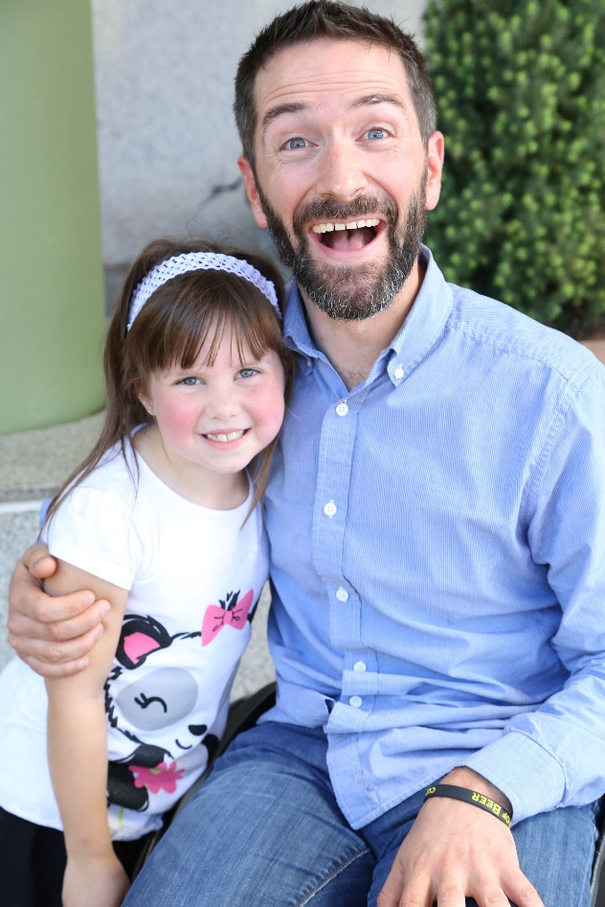
FRDA
Measures
Biomarkers
Natural history data
Way to find patients with specific
features
Funding
Patient advocacy organization
Pharmaceutical company support
CCRN, EFACTS

Slide 15
FA Biorepository (CHOP)
DNA - >750 samples from patients
RNA – 300 patients, 150 carriers, 50 controls
Whole blood - >650 patients, 500 carriers, 200 controls
Frataxin measurement
Plasma – 475 patients, 200 carriers, 80 controls
Serum – 300 patients, 150 carriers, 75 controls
Buccal cells – 700 patients, 500 carriers, 200 controls
Frataxin measurement
Fibroblasts
Expanding fibroblast lines at Coriell
M.Napierala - >40 lines growing and establishing iPS cells
Muscle biopsy

Slide 16
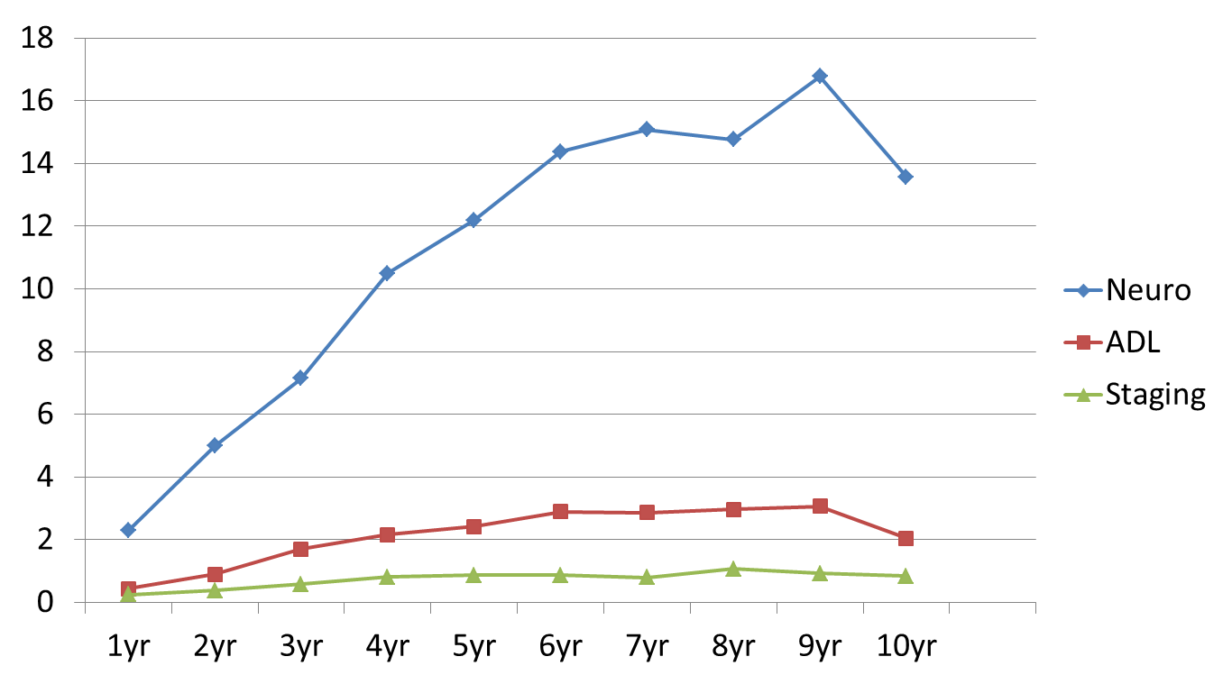
Neurological measure
Friedreich Ataxia Rating Scale
Quantified exam
Rate of change over time
know from natural history study
3. Acceptable to FDA in modified
form
Can compare results from clinical trials to this curve as a control

Slide 17
Typical Anatomically selective measures
Nerve conduction studies
Measure large proprioceptive neurons
Frequently absent in FA patients as soon as symptoms begin
Do not worsen over time if present
Somatosensory evoked potentials
Measure large proprioceptive neurons
Frequently absent in FA patients as soon as symptoms begin
Do not worsen over time if present
MRI scan
Normal brain early in FA
Spinal cord atrophy at presentation (reflecting large proprioceptive neurons)
Conclusion: typical anatomic measures do not work well in FA

Slide 18
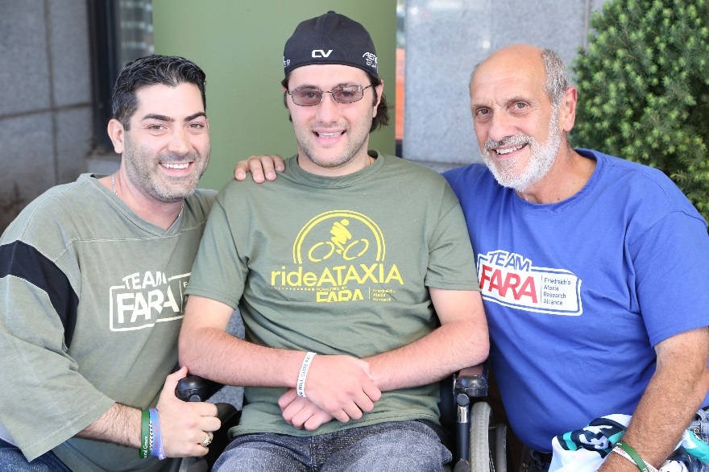
Methodologies for ongoing anatomical evaluation
MRI
Minnesota
Brazil
MRS
Minnesota
Electrophysiological
Motor evoked potentials
Correlate with disease severity in FRDA

Slide 19
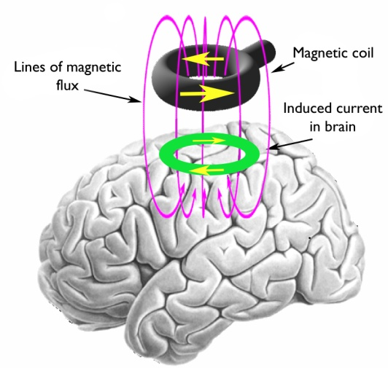
Motor Mapping: Transcranial Magnetic Stimulation
A safe, well tolerated, noninvasive technique which uses electromagnetic fields to induce action potentials in motor neurons
Assess the integrity of central motor pathways
Notes:
TMS: Current is discharged rapidly into a wire coil and produces a magnetic field which can then induce current in the brain underlying the coil. When placed over motor cortex, a stimulus induces action potentials in motor neurons leading to a descending volley in the corticospinal tract, and ultimately a momentary twitch in a target muscle – the motor evoked potential. The MEP is measured using surface EMG electrodes. The MEP amplitude is an estimate of the extent of corticospinal tract and motor neuron activation (upper and lower motor neuron activity).

Slide 20
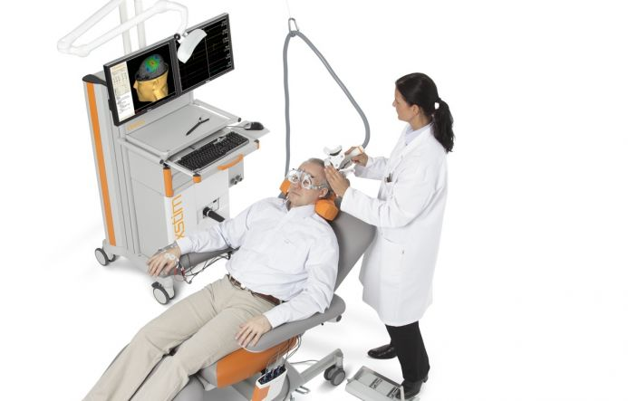
Notes:
The investigator holds a stimulation coil on the head and delivers single pulses of TMS.
Stereotactic navigation system to help guide where to place coil, and to increase precision of stimulation – patient wears trackers (goggles or headband).
Surface electrodes on the target muscles -- in this picture, muscles of the hand.

Slide 21
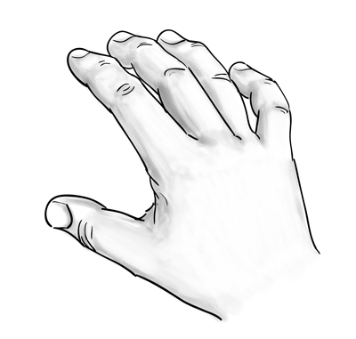

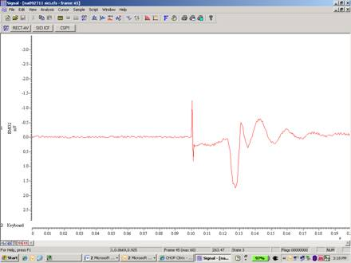
FDI Muscle
TMS pulse artifact
Motor Evoked Potential
Amplitude (mV)
Time (seconds)
Notes:
The motor evoked potential in a g

Slide 22
Conclusions
Many agents coming to clinical trials for FRDA
Need collaboration across all groups to develop novel tests

