Slide 1
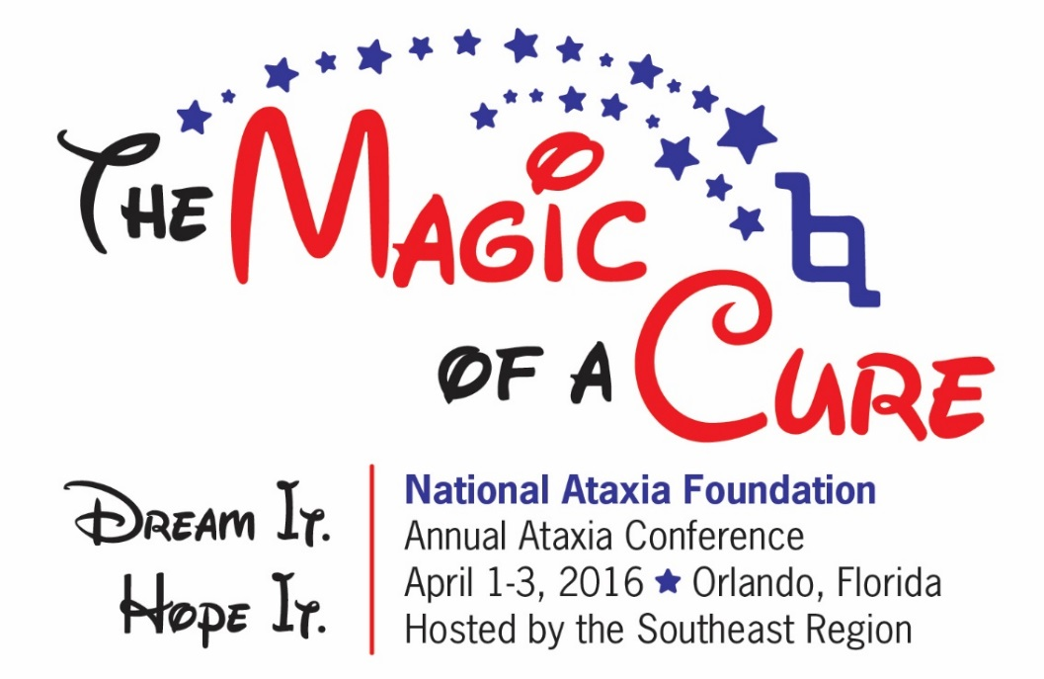
Update on sca Research
George Wilmot, MD, PhD

Slide 2

Disclaimer
The information provided by speakers in any presentation made as part of the 2016 NAF Annual Ataxia Conference is for informational use only.
NAF encourages all attendees to consult with their primary care provider, neurologist, or other health care provider about any advice, exercise, therapies, medication, treatment, nutritional supplement, or regimen that may have been mentioned as part of any presentation.
Products or services mentioned during these presentations does not imply endorsement by NAF.

Slide 3
Presenter Disclosures
George Wilmot, MD, PhD
The following personal financial relationships with commercial interests relevant to this presentation existed during the past 12 months:
Biohaven Pharmaceuticals
Forward Pharma
Santhera Pharmacueticals

Slide 4
Sca update
What is SCA?
SpinoCerebellar Ataxia
Autosomal Dominant ataxia -correct
Any ataxia –incorrect, though used
Three areas of Advancement
Diagnostic
Pre-clinical
Clinical

Slide 5
Diagnostic advances in sca
New ataxias
SCA 41 (gene TRCP3)
SCA 42 (gene CACNA1G)
Italian Spinone dog ataxia (gene ITPR1)

Slide 6
Diagnostic advances in sca
New ataxias
SCA 41 (gene TRCP3)
SCA 42 (gene CACNA1G)
Italian Spinone dog ataxia (gene ITPR1)
Increased availability of Whole Exome Testing

Slide 7
Whole Exome testing
Exome
Concept
Total of all coding portions (“exons”) of all genes
30,000 genes
Coding portions are about 1% of the genome
180,000 exons
30 million base pairs

Slide 8
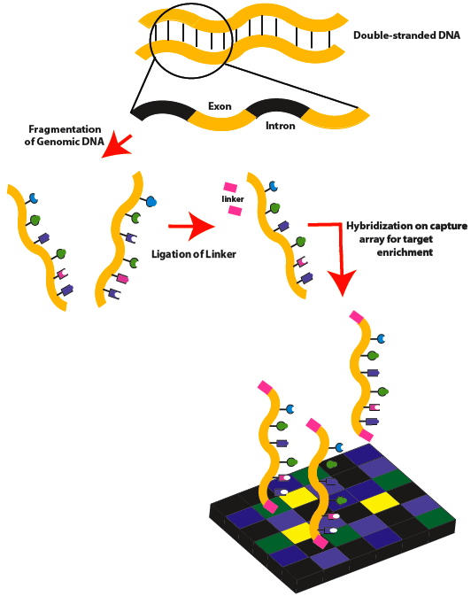
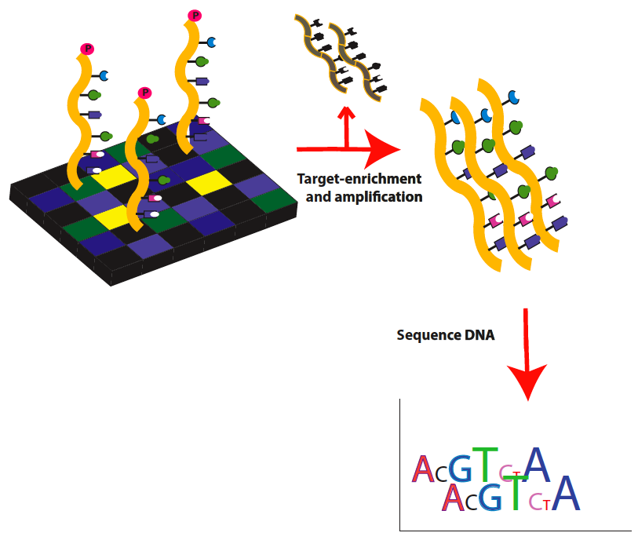
Whole Exome testing

Slide 9
Whole Exome testing
“This example provides proof of concept of the use of whole-exome sequencing as a clinical tool in evaluation of patients with undiagnosed genetic illnesses. These findings further underscore the ability to parse large quantities of sequence data to produce clinically useful information that combines clues from the clinical condition in conjunction with the genetic data to arrive at a correct diagnosis. We can envision a future in which such information will become part of the routine clinical evaluation of patients with suspected genetic diseases in whom the diagnosis is uncertain.”
Choi et al. 2009

Slide 10
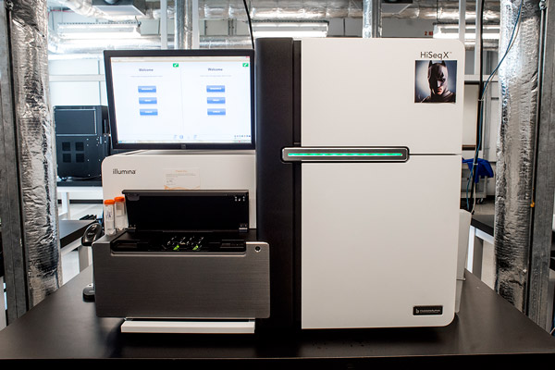
Whole Exome testing
Many exomes per run (1-3 days)
Some machines up to 1.5 Tb per run
Whole Genome (not Exome!!!)
now < $1000 in costs to the lab.

Slide 11
Preclinical Advances
Improved understanding of disease mechanisms
Development of potential therapeutics
Anti-sense Oligonucleotides (ASO’s), siRNA
Gene Therapy (delivery systems)
Stem cells
Small molecules (more traditional)

Slide 12
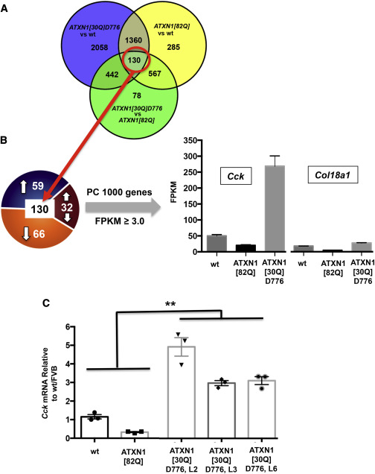
SCA1 mice
-Transcriptome analysis in engineered SCA1 mice
-find co-regulated genes
-CCK elevated in a non-progressive mouse
-without CCK, mice progress
-maybe CCK is neuroprotective
Ingram et al. 2016

Slide 13
Preclinical Advances
Drug Screens
models are important
Now 9 SCA3 mouse models
Lower level models < -------------- > Higher level models
Worms < -------------- > Mice
Efficiency < -------------- > Accuracy

Slide 14
Screen for SCA3
-worms and mice
Teixeira-Castro et al. 2015

Slide 15
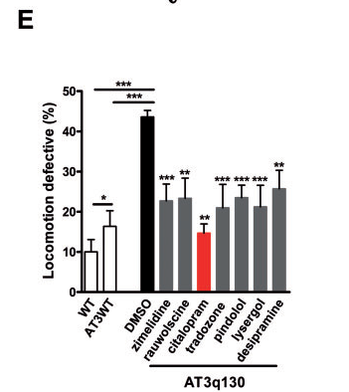
Citalopram improved locomotion and reduced aggregates in worms

Slide 16
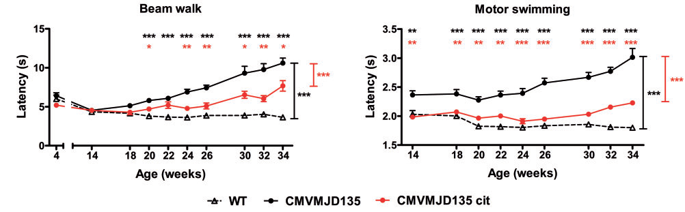
…and had some benefit in mice

Slide 17
Clinical Advances
Longitudinal Studies

Slide 18
Multi-year follow-up of SCA 1,2,3 and 6
Jacobi et al. 2015

Slide 19
How many patients are needed for a 1 year clinical study?

Slide 20
Clinical Advances
Should we use something other than an ataxia scale?
-imaging and other biomarker studies
Do we have therapeutic candidates?
Exercise
Existing medicines that are used for other conditions (riluzole, varenicline, citalopram)
Disease-specific therapies based on disease mechanisms

Slide 21
Clinical Advances
Longitudinal Studies
Possible treatments

Slide 22
Clinical Advances
Riluzole
Used for ALS
Expensive
Liver toxicity
Multiple mechanisms, some of which may be relevant to ataxia

Slide 23
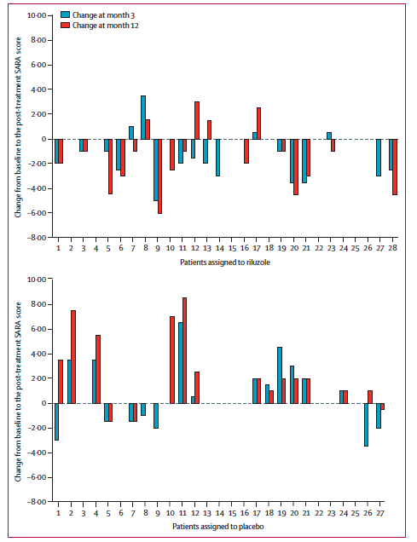
Italian Study 2015
30 patients each
placebo and riluzole
SARA at 3 and 12 months.
Results:
-Indications of benefit
-heterogeneity of subjects a problem
-low numbers of subjects a problem
Romano et al. 2015

Slide 24
So the question you will no doubt have is …
How should I be treated, right now, not in the future, but now?

Slide 25
My best answer: Work it out with your own doctor. But please continue to recognize the imperative nature for rigorous research. If everyone is taking unproven treatments, it may become more difficult to enroll subjects in the upcoming trials.

Slide 26
Future directions
Continue to advance our understanding of known ataxias

Slide 27
Future directions
Continue to advance our understanding of known ataxias
Find new ataxias

Slide 28
Future directions
Continue to advance our understanding of known ataxias
Find new ataxias
Refine therapeutic screens of existing compounds and development of new agents (ASOs etc.)

Slide 29
Future directions
Continue to advance our understanding of known ataxias
Find new ataxias
Refine therapeutic screens of existing compounds and development of new agents (ASOs etc.)
Find biomarkers and better clinical outcome measures

Slide 30
Future directions
Continue to advance our understanding of known ataxias
Find new ataxias
Refine therapeutic screens of existing compounds and development of new agents (ASOs etc.)
Find biomarkers and better clinical outcome measures
Cautiously proceed with clinical studies
Riluzole derivatives
Citalopram
Stem cells
Others

Slide 31
PLEASE do the CoRDS Registry!

Slide 32
Presenter Disclosures
George Wilmot, MD, PhD
The following personal financial relationships with commercial interests relevant to this presentation existed during the past 12 months:
Biohaven Pharmaceuticals
Forward Pharma
Santhera Pharmacueticals

Slide 33
Thanks!!!
Funding - FARA, NIH, NAF
Colleagues
Most of all, my patients

