Slide 1
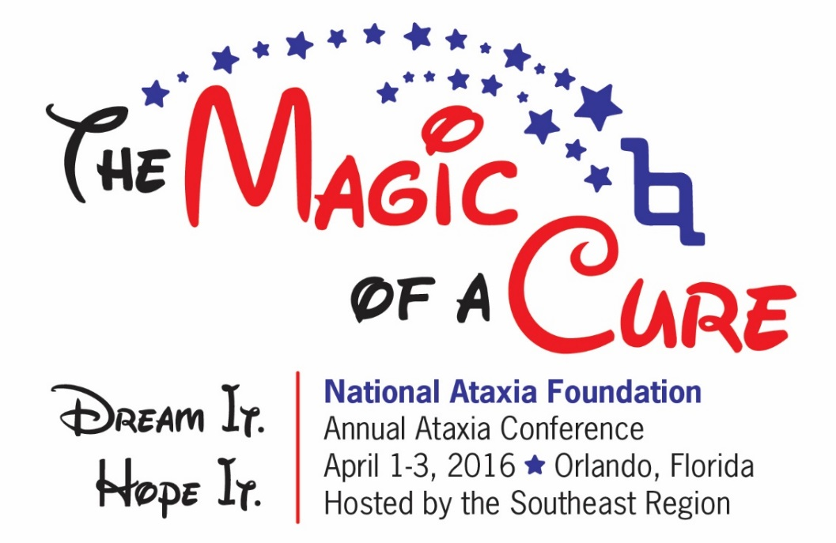
What We Have Learned!
John W. Day, MD, PhD
Professor of Neurology and Pediatrics – Stanford University

Slide 2
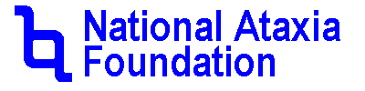
Disclaimer
The information provided by speakers in any presentation made as part of the 2016 NAF Annual Ataxia Conference is for informational use only.
NAF encourages all attendees to consult with their primary care provider, neurologist, or other health care provider about any advice, exercise, therapies, medication, treatment, nutritional supplement, or regimen that may have been mentioned as part of any presentation.
Products or services mentioned during these presentations does not imply endorsement by NAF.

Slide 3
Presenter Disclosures
Athena Diagnostics SCA5
Consultant – Ionis and Biogen
Research support – Ionis and Biogen, NIH, MDA

Slide 4
Finding a cure
Finding a treatment
What do we need to develop a treatment for ataxia?
Organize Patients, Clinicians, Investigators, Pharma
Diagnose it
Understand it
Manage it optimally
Find a treatment
Evaluate treatment biology in patients
Validate treatment’s clinical value
How long will it take?
Phase 1 – 1 year
Phase 2 – 1-2 years
Phase 3 – 2 years
– at least 5 years from tomorrow

Slide 5




Slide 6




But Other Types of Magic Require Skill, Education, and Hard Work

Slide 7

What is needed to make an Ataxia treatment potion?
Real Magic of AtaxiA treatment
Treatment Discovery
Treatment Discovery
Treatment Evaluation
Treatment Evaluation
Management
Management
Disease Characterization
Disease Characterization
Treatment Clinical Validation
Treatment Clinical Validation
Diagnosis
Diagnosis

Slide 8
Is there progress in diagnosis
More and better Diagnoses
Vikram Shakkottai
Increasing ease of dx
Increasing gene discovery
Vikram Khurana
Importance of precise dx
Clinical dx MSA and sporadic Gene dx
David Lynch
Importance of Genetic Dx of FA
Susan Perlman
Chip Wilmot
Improved facility to dx
Tailoring treatment to dx
Focusing research on specific forms of ataxia

Slide 9
Do we understand the biology of ataxia?
clearer mechanisms of ataxia
Henry Paulson and Lauren Moore
Stem cells to understand ataxia
Using stem cells to test treatment
Harry Orr
NAF helps new investigators
NAF promotes new Rx
David Lynch
Effects of frataxin loss on mitochondria and energy prod.
Gülin Öz
160 investigators finding ataxia causes
Clarifying causes in cells, animals and people
Chip Wilmot
Common elements of SCA – protein folding
nerve cell calcium loading
RNA processing
Vikram Khurana
Connection of MSA and PD
Role of protein folding in ataxia

Slide 10
Is there progress in care?
Optimizing ataxia management
Nygel Lenz
Learning to honestly and openly deal with ataxia
Fight ataxia, accept yourself
Nancy Harrington
Novel communication means
Ellen Sichel
Importance of riding the wave
Not letting ataxia have control
Jonathan Rodis and Kathleen Kane
Navigating Disability
SSI, SSDI and not giving up
Susan Perlman
Control what you can control
Sleep
Exercise
Nutrition – value of a feeding tube
Jennifer Millar
The importance of exercise – control balance to control gait

Slide 11
Are there promises of treatments?
real treatments are taking shape
Chip Wilmot
Marked increase in treatment discovery
Increasing ease of dx
Increasing gene discovery
Vikram Khurana
Connection of MSA and PD opens treatment options
Role of protein folding
David Lynch
Gene replacement therapy
Energy production
Hank Paulson and Lauren Moore
Need of research before stem cells can help with ataxia
Power of ASOs
Gülin Öz
International ataxia investigators working together
Many evolving treatments – new and repurposed drugs

Slide 12
Can we tell if treatments work?
Better quantification of ataxia
Chip Wilmot
Role of ataxia scales
Tissue repository
Jennifer Millar
Gait lab to measure ataxia
Quantitating motor function
David Lynch
Clinical scales, biomarkers and tissue repository in FA
Hank Paulson and Lauren Moore
BioBank for BioMarkers
Gülin Öz
MRI measures of brain damage
MRS early measures of disease
Correlating MRI and Neuropsych

Slide 13
Ingredients for AtaxiA magic
Treatment Discovery
Treatment Evaluation
Management
Disease Characterization
Treatment Clinical Validation
Diagnosis
PATIENTS & FAMILIES

Slide 14
Take Home Messages
Yes, Ataxia is Complicated
Ataxia results from a large number of causes
Each type of ataxia has unique damaging effects on nerve cells
Each person with ataxia will need a team of sophisticated clinicians
BUT, There are more reasons than ever to be optimistic
Ataxia diagnosis and management are more standardized than ever
Basic and clinical scientists have teamed-up to conquer ataxia
Promising treatments are in the pipeline
There is a light at the end of the tunnel – join the NAF to work toward

