Slide 1


Cognition, Emotion, and PROM-ataxia
Jeremy D. Schmahmann, MD
Ataxia Center
Massachusetts General Hospital and Harvard Medical School
A Virtual Event
March 17-19, 2022

Slide 2



DISCLAIMER
The information provided by speakers in any presentation made as part of the 2022 NAF Annual Ataxia Conference is for informational use only.
Products or series mentioned during these presentations does not imply endorsement by NAF
NAF encourages all attendees to consult with their primary care provider, neurologist, or other healthcare provider about any advice, exercise, therapies, medication, treatment, nutritional supplement, or regimen that may have been mentioned as part of any presentation.
2022 AAC
A Virtual Event
March 17-19

Slide 3

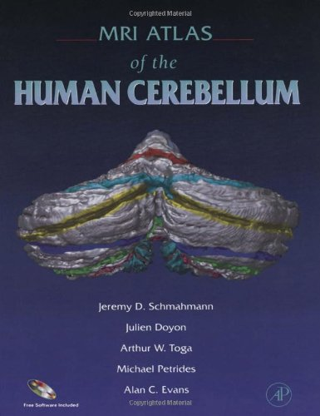
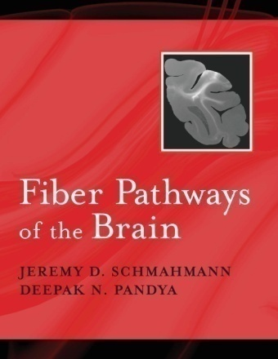


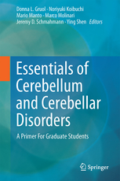


DISCLOSURES
Book Publishers
  Academic Press
  Elsevier
  Oxford University Press
  MacKeith Press
  Springer
Copyright with The General Hospital Corporation
  BARS, BARSc, CCAS/Schmahmann Scale, CNRS, PROM-Ataxia, PROM-Ataxia Short Form
Consulting
  Biogen, Biohaven, Medavante
2022 AAC
A Virtual Event
March 17-19

Slide 4
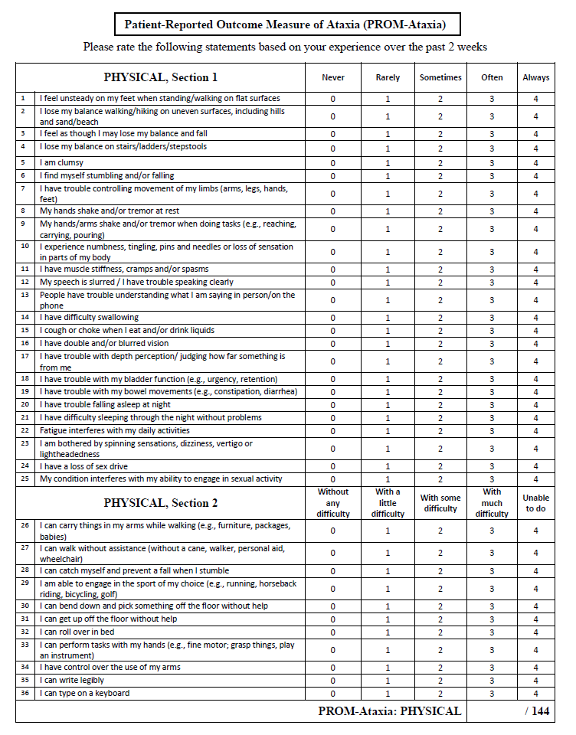
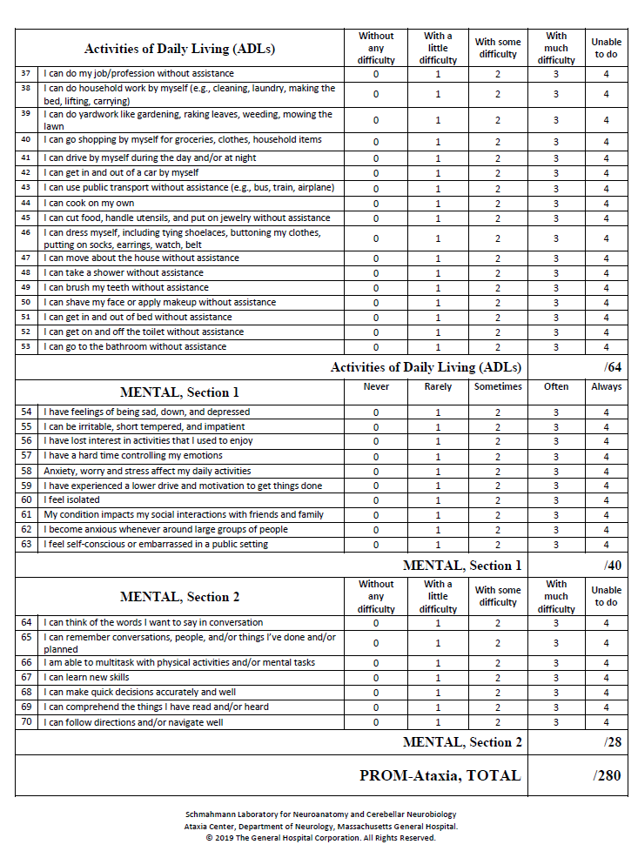
Patient-Reported Outcome Measure of Ataxia (PROM-Ataxia)
2022 AAC
A Virtual Event
March 17-19
Schmahmann, Pierce. MacMore, L’Italien. Movement Disorders, June 2021

Slide 5
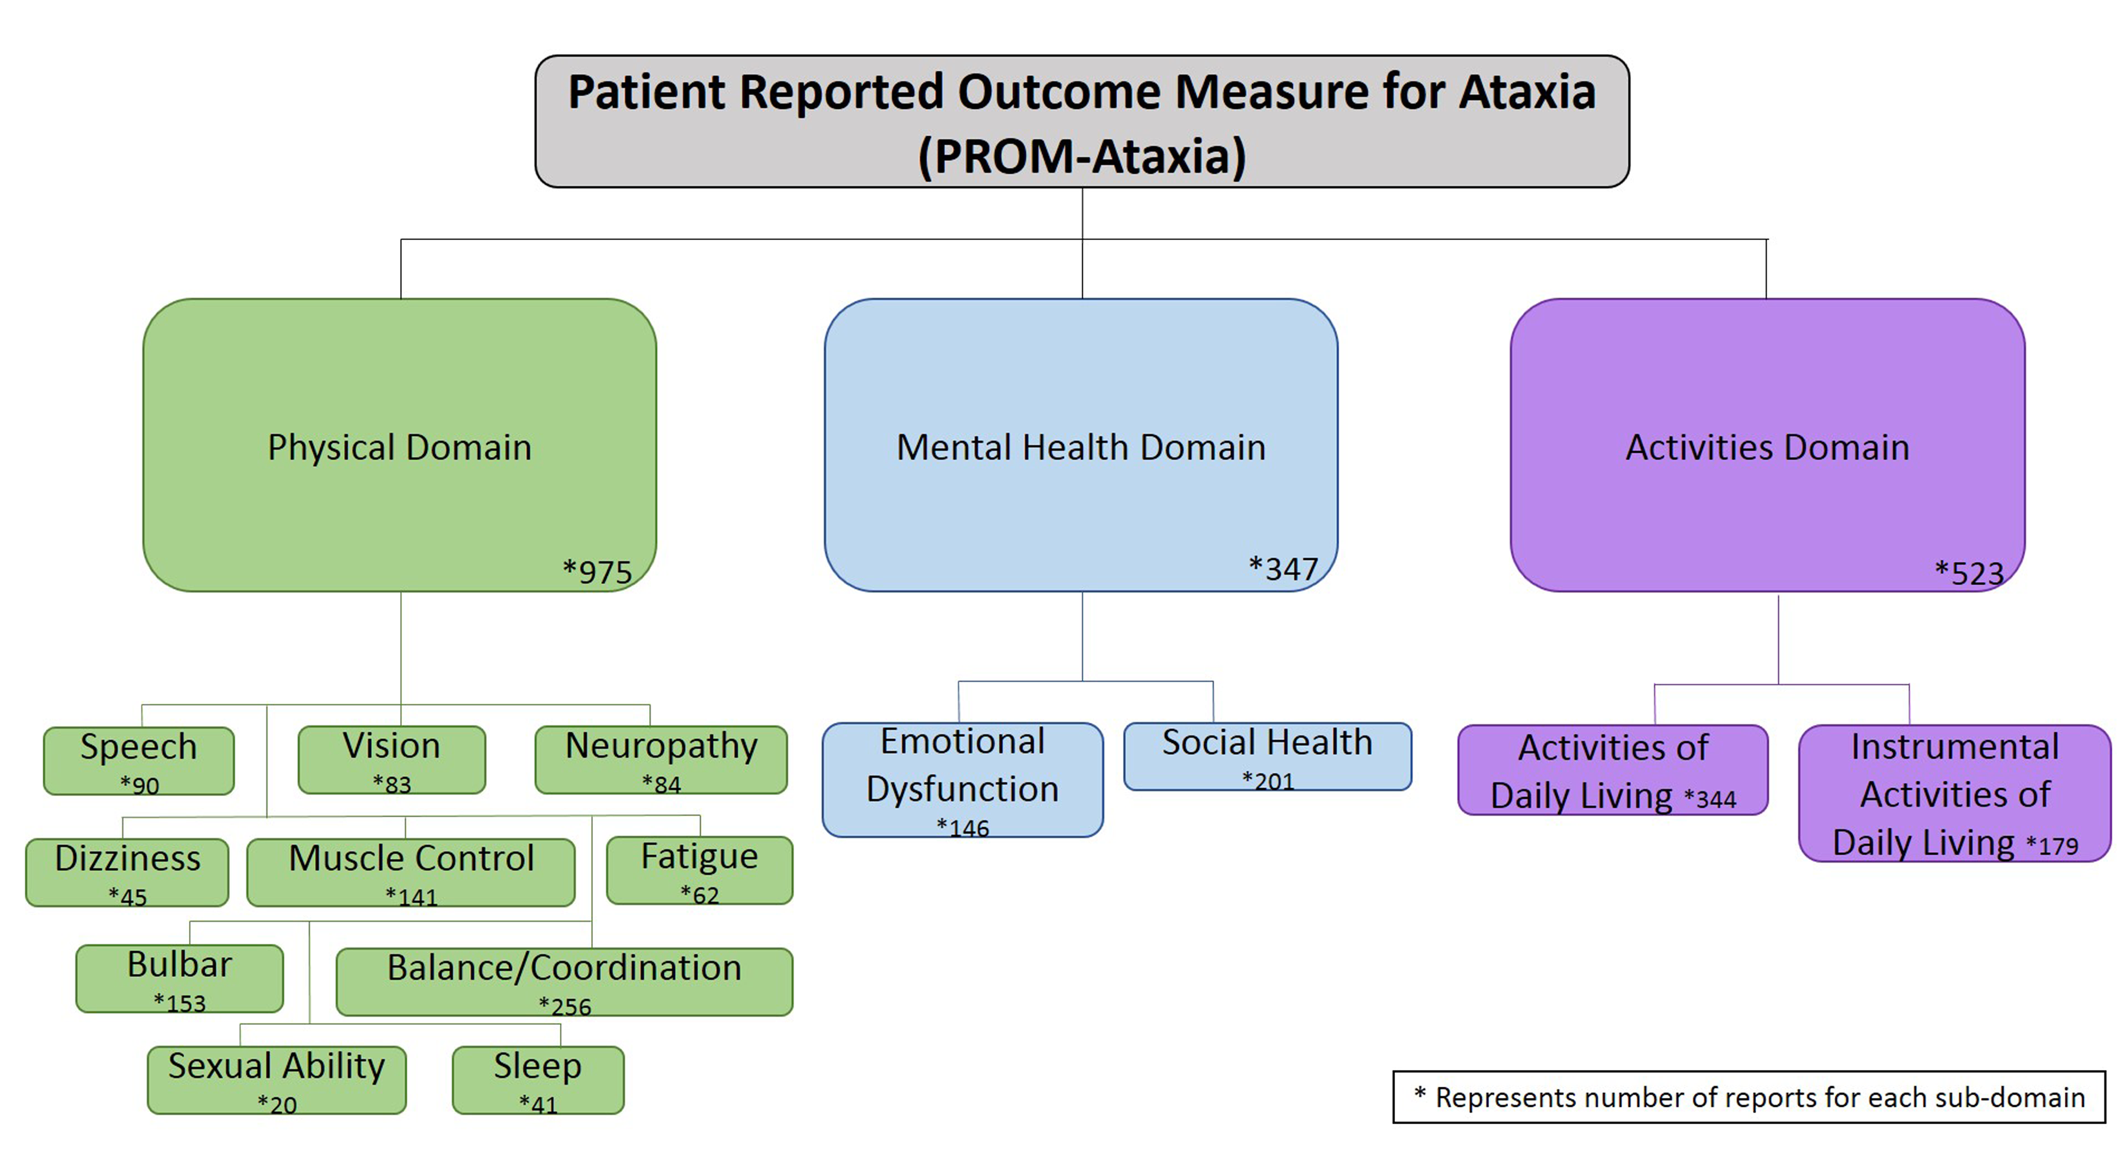
Development of the PROM-Ataxia
2022 AAC
A Virtual Event
March 17-19
The 3 Domains and 14 Subdomains of the PROM-Ataxia.
Numbers = unique items reduced during Phase 1 from the conceptual framework of symptoms
These were the basis of development of the 70 questions subjected to the Cognitive Debrief in Phase 2
Schmahmann JD, Pierce S, MacMore J, L’Italien G, 2020

Slide 6
Development of the PROM-Ataxia
347 of 1,845 items
= 18.8%
2022 AAC
A Virtual Event
March 17-19
The 3 Domains and 14 Subdomains of the PROM-Ataxia.
Numbers = unique items reduced during Phase 1 from the conceptual framework of symptoms
These were the basis of development of the 70 questions subjected to the Cognitive Debrief in Phase 2
Schmahmann JD, Pierce S, MacMore J, L’Italien G, 2020

Slide 7
Patient-Reported Outcome Measure of Ataxia (PROM-Ataxia)
2022 AAC
A Virtual Event
March 17-19

Slide 8
Patient-Reported Outcome Measure of Ataxia (PROM-Ataxia)
2022 AAC
A Virtual Event
March 17-19

Slide 9
Patient-Reported Outcome Measure of Ataxia (PROM-Ataxia)
2022 AAC
A Virtual Event
March 17-19

Slide 10
Patient-Reported Outcome Measure of Ataxia (PROM-Ataxia)
2022 AAC
A Virtual Event
March 17-19

Slide 11
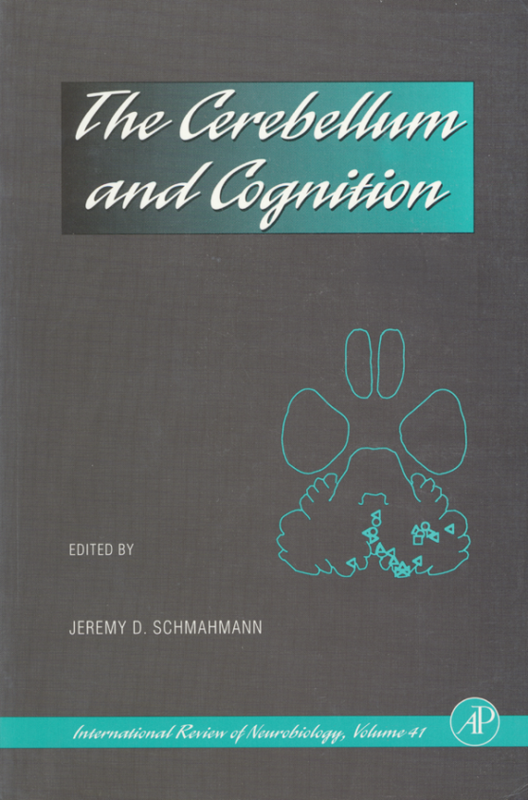
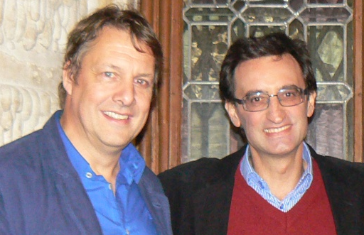
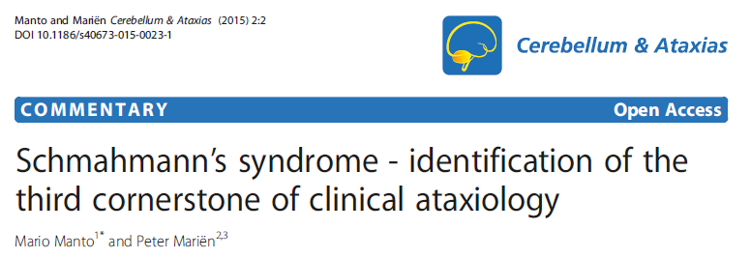
Cerebellar Cognitive Affective Syndrome (CCAS)
Executive Function
Planning, set-shifting, verbal fluency,
abstract reasoning, working memory
Spatial Cognition
Visual spatial organization and memory
Language Deficits
Agrammatism, aprosodia, anomia
Personality Change
Blunting of affect, disinhibited and inappropriate behavior
Schmahmann and Sherman. Brain, 1998
2022 AAC
A Virtual Event
March 17-19
Mario Manto and Peter Mariën. Cerebellum and Ataxias 2015;2:2

Slide 12
Neuropsychiatry of the cerebellum: Insights from the clinic
2022 AAC
A Virtual Event
March 17-19
Schmahmann, Weilburg, Sherman. Cerebellum. 2007;6:254-267

Slide 13
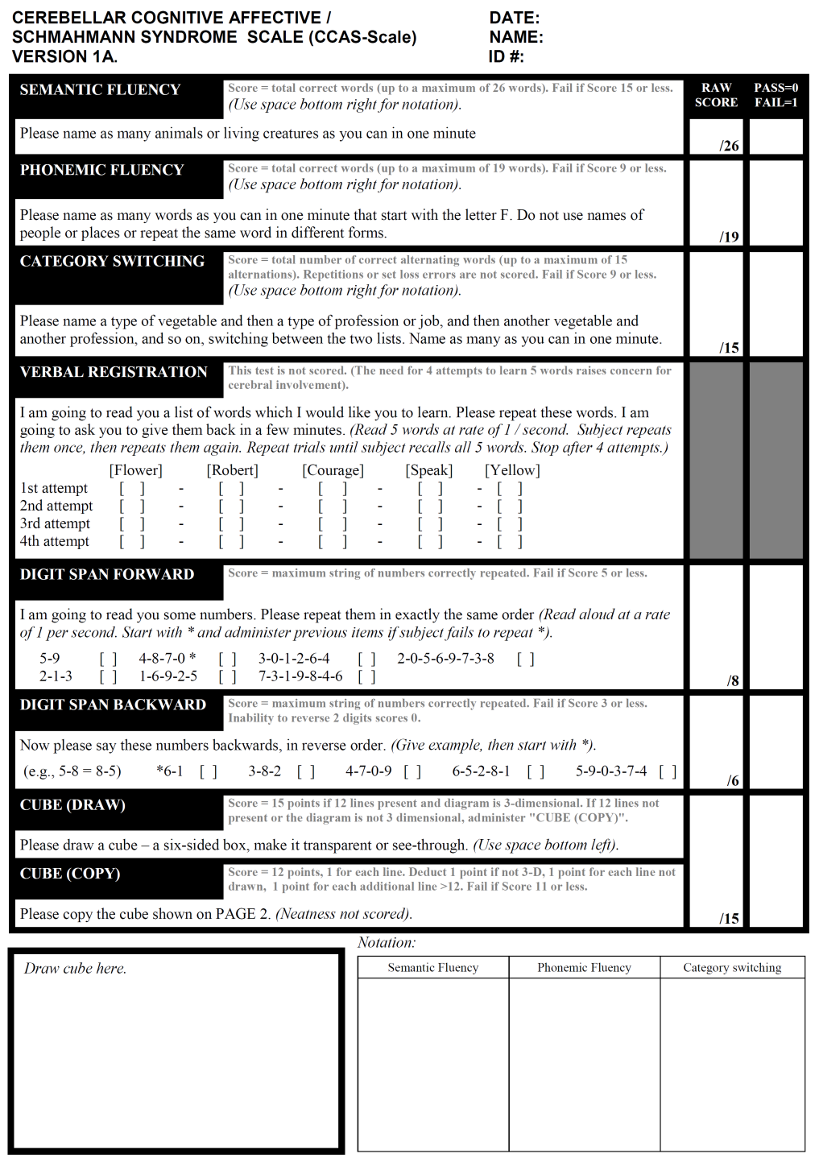
CCAS Scale (Hoche et al., Brian, 2018)
2022 AAC
A Virtual Event
March 17-19

Slide 14
CCAS in SCA (CRC-SCA / READISCA study)
How many individuals met criteria for the CCAS?
SYMPTOMATIC INDIVIDUALS (true positives)
Participant group | Number of participants | Possible CCAS | Probable CCAS | Definite CCAS
All SCAs | 309 | 83.2% | 63.1% | 46.0%
SCA1 | 58 | 89.6% | 75.9% | 58.6%
SCA2 | 52 | 80.8% | 55.8% | 38.5%
SCA3 | 132 | 81.1% | 65.2% | 47.7%
SCA6 | 47 | 85.1% | 48.9% | 29.8%
SCA7 | 11 | 72.7% | 63.6% | 45.5%
SCA8 | 9 | 88.9% | 66.7% | 66.7%
CONTROLS (false positives)
Controls | 37 | 54.1% | 10.8% | 5.4%
2022 AAC
A Virtual Event
March 17-19
Selvadurai, Schmahmann, with CRC-SCA and READISCA (NAF Macklin Foundation project). In preparation

Slide 15
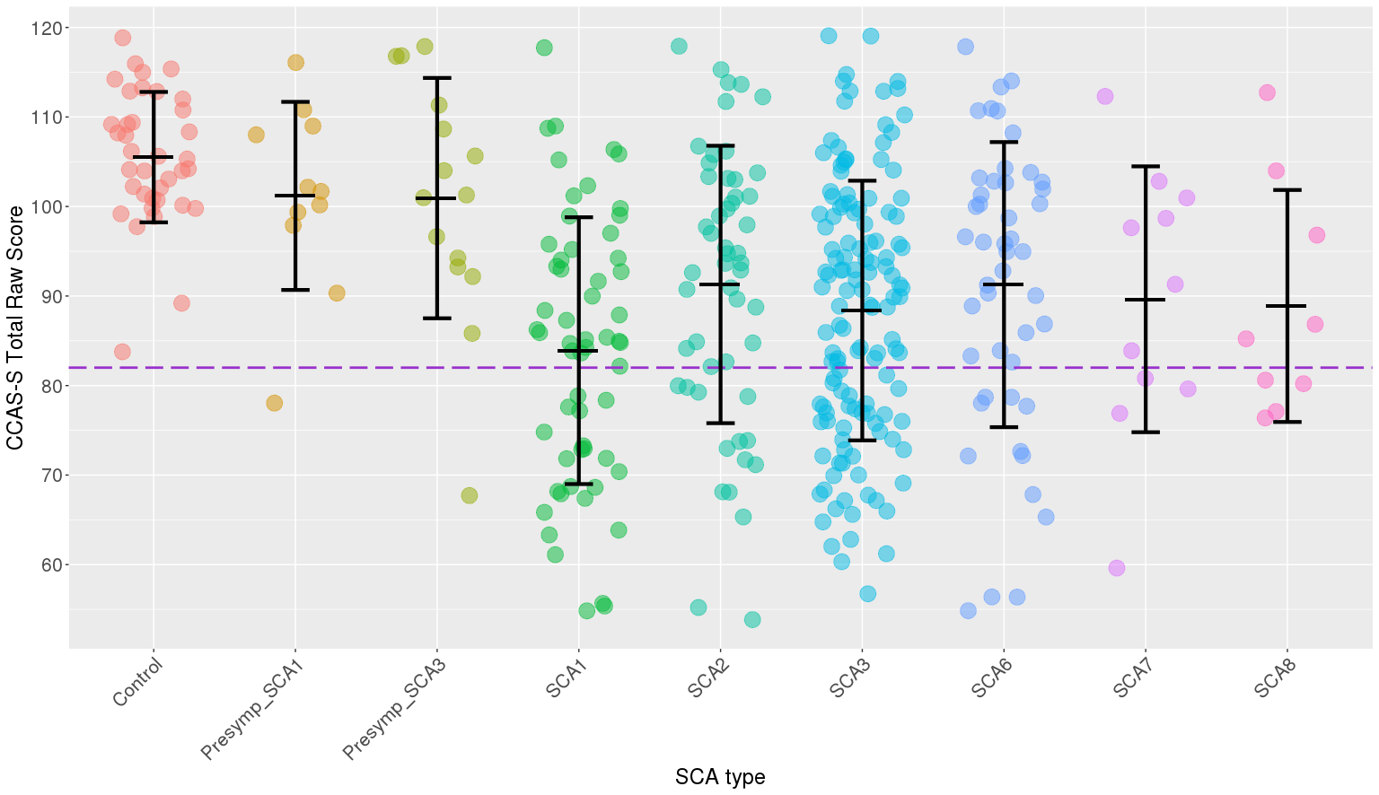
CCAS in SCA (CRC-SCA / READISCA study)
CCAS Scale total raw score by diagnosis
2022 AAC
A Virtual Event
March 17-19
Selvadurai, Schmahmann, with CRC-SCA and READISCA (NAF Macklin Foundation project). In preparation

Slide 16
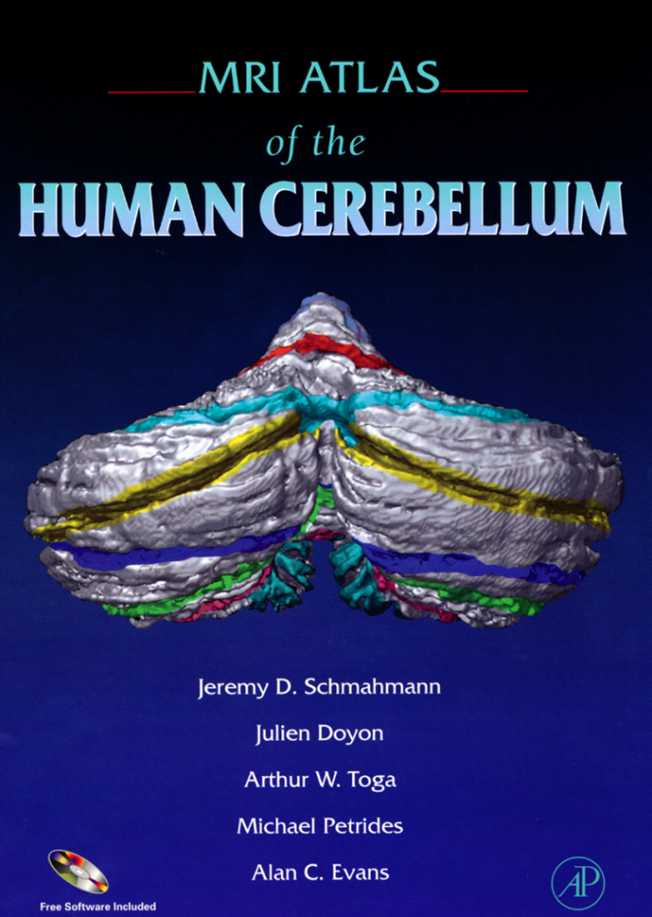
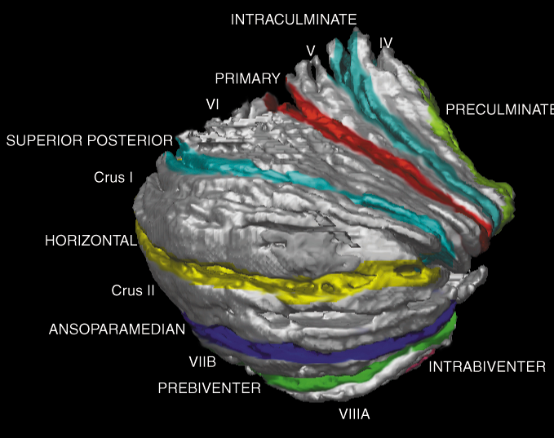
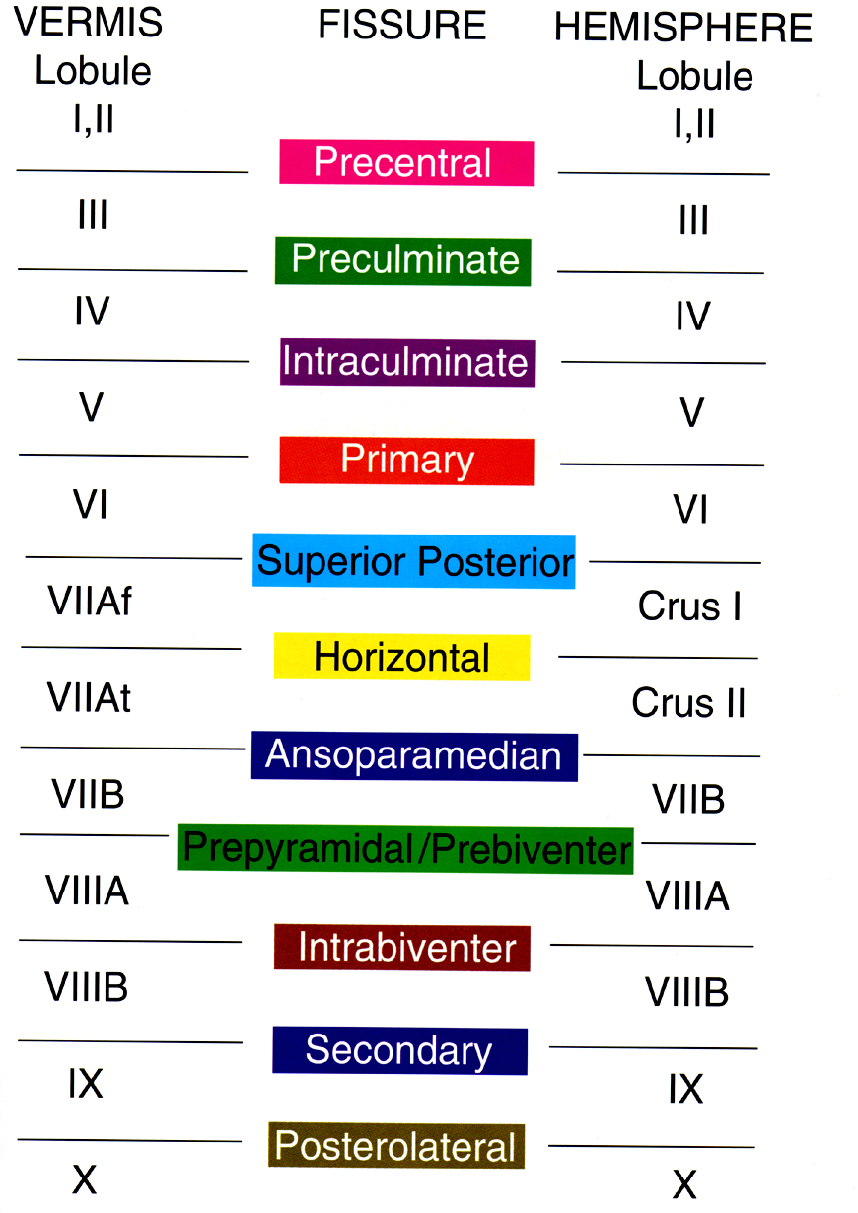
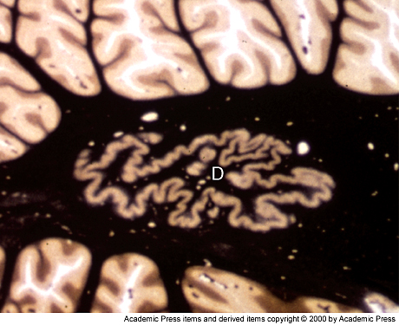
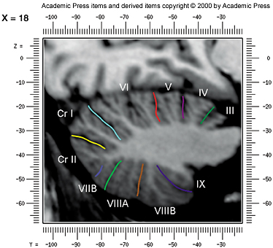
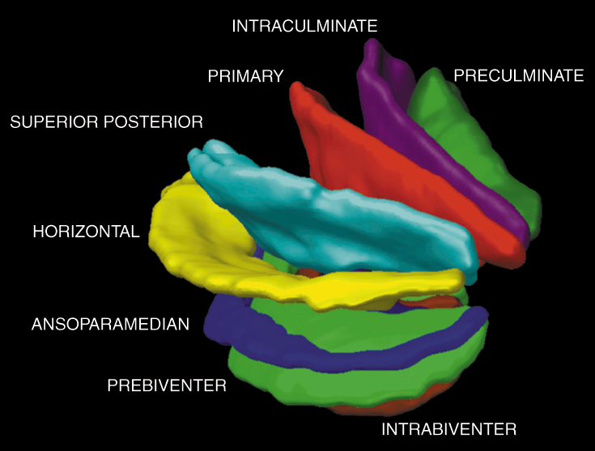
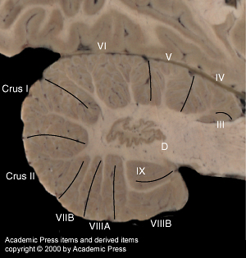
2022 AAC
A Virtual Event
March 17-19
Schmahmann, Doyon, Toga, Petrides, Evans, 2000

Slide 17
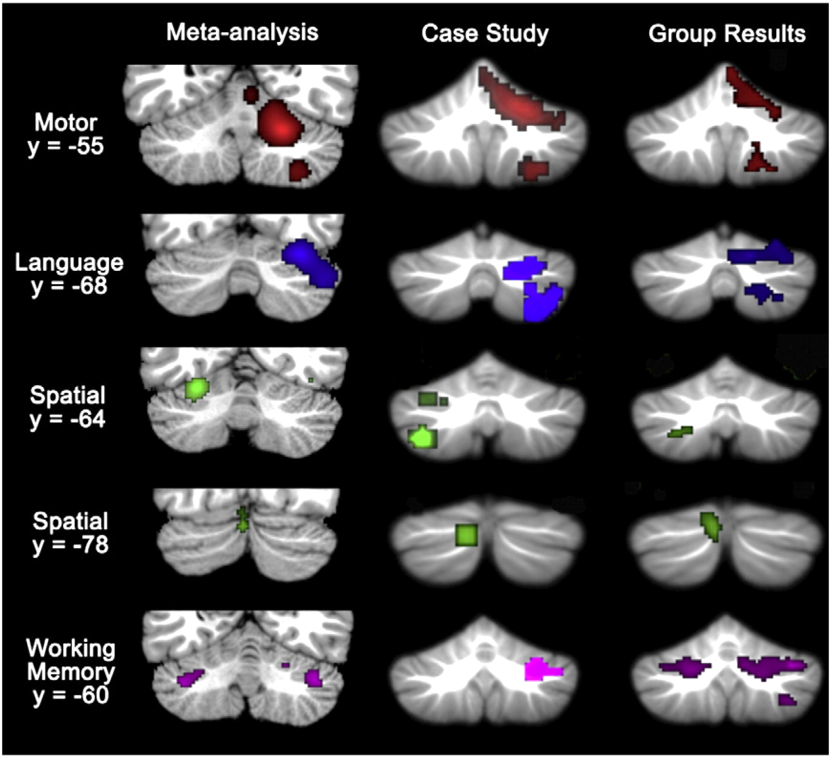
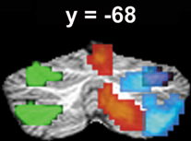
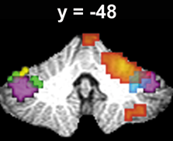
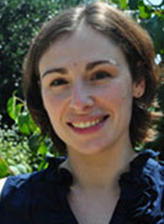
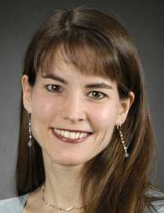
Cerebellar functional topography. Task-based fMRI studies
2022 AAC
A Virtual Event
March 17-19
Stoodley and Schmahmann, NeuroImage 2009
Stoodley, Valera, Schmahmann. Behav Neurol. 2010, NeuroImage 2012
Catherine Stoodley
Eve Valera

Slide 18
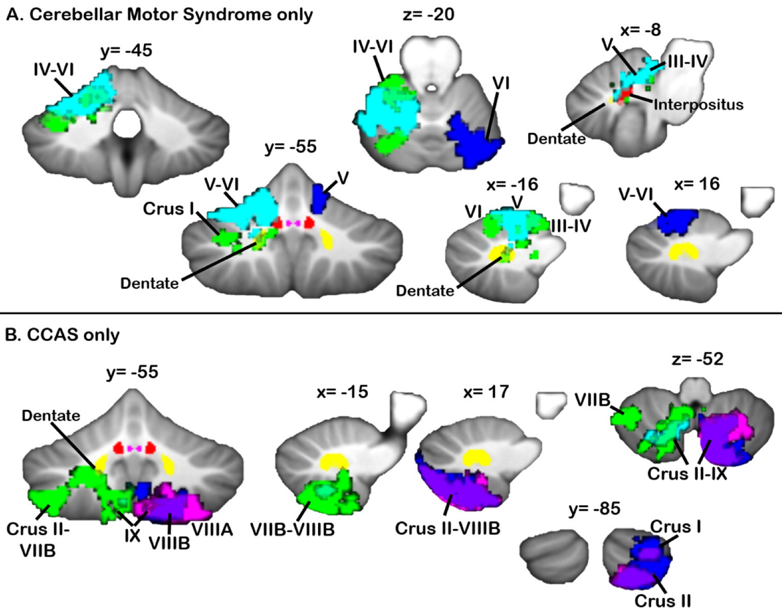
Functional topography in cerebellum for movement
and cognition in patients with stroke
2022 AAC
A Virtual Event
March 17-19
Stoodley, MacMore. Makris, Sherman, Schmahmann. NeuroImage Clinical, 2016
Also – Schmahmann, MacMore, Vangel. Neuroscience 2009; Schmahmann and Sherman, 1998

Slide 19
Functional boundaries in the human cerebellum revealed by a multi-domain task battery
2022 AAC
A Virtual Event
March 17-19
King M, Hernandez-Castillo CR, Poldrack RA, Ivry RB, Diedrichsen J.
Nat Neurosci. 2019; 22: 1371-1378.

Slide 20
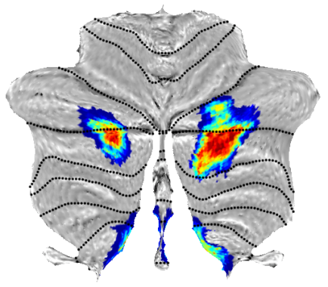
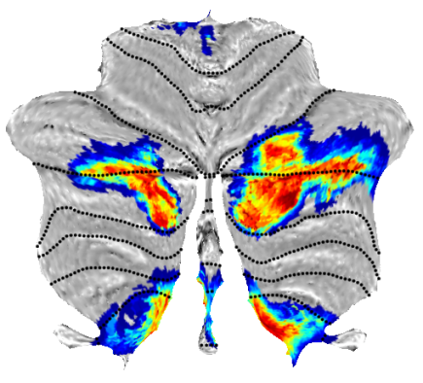
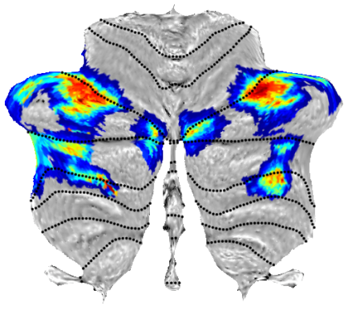
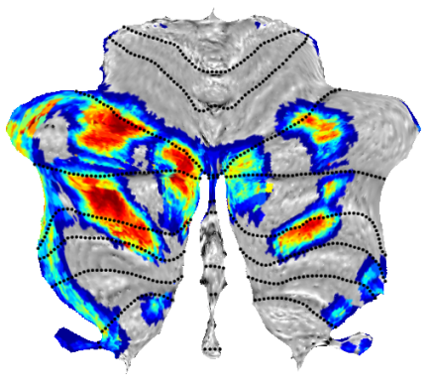
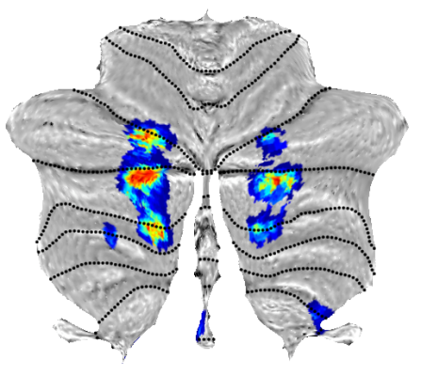
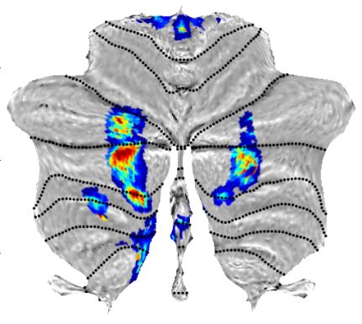
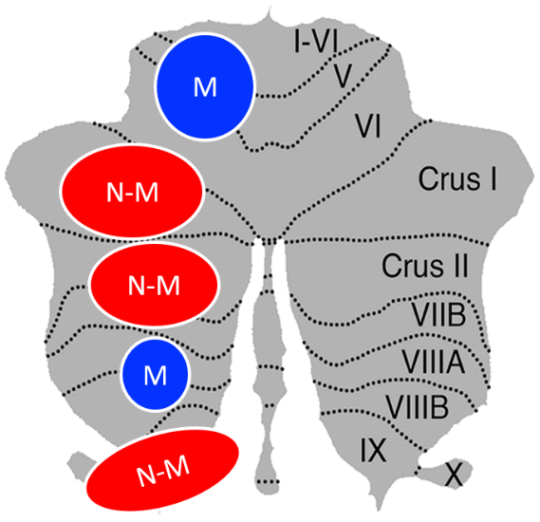
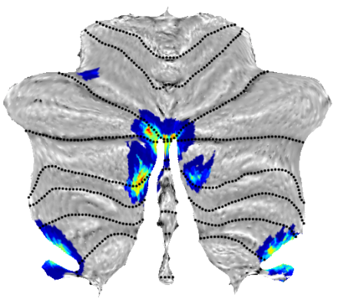
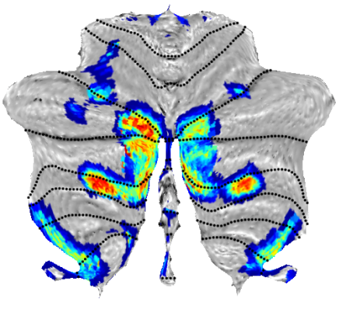
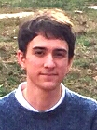
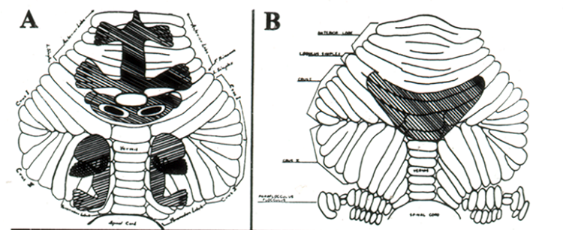
Cerebellum has primary, secondary sensorimotor representations.
And primary, secondary, and tertiary cognitive representations.
Task Activity
Resting state
LANGUAGE
WORKING
MEMORY
SOCIAL
EMOTION
Snider, Stowell, 1946
Snider, 1950
Snider, Eldred, 1951
2022 AAC
A Virtual Event
March 17-19
Xavier Guell
Guell, Gabrieli, Schmahmann. NeuroImage 2018

Slide 21
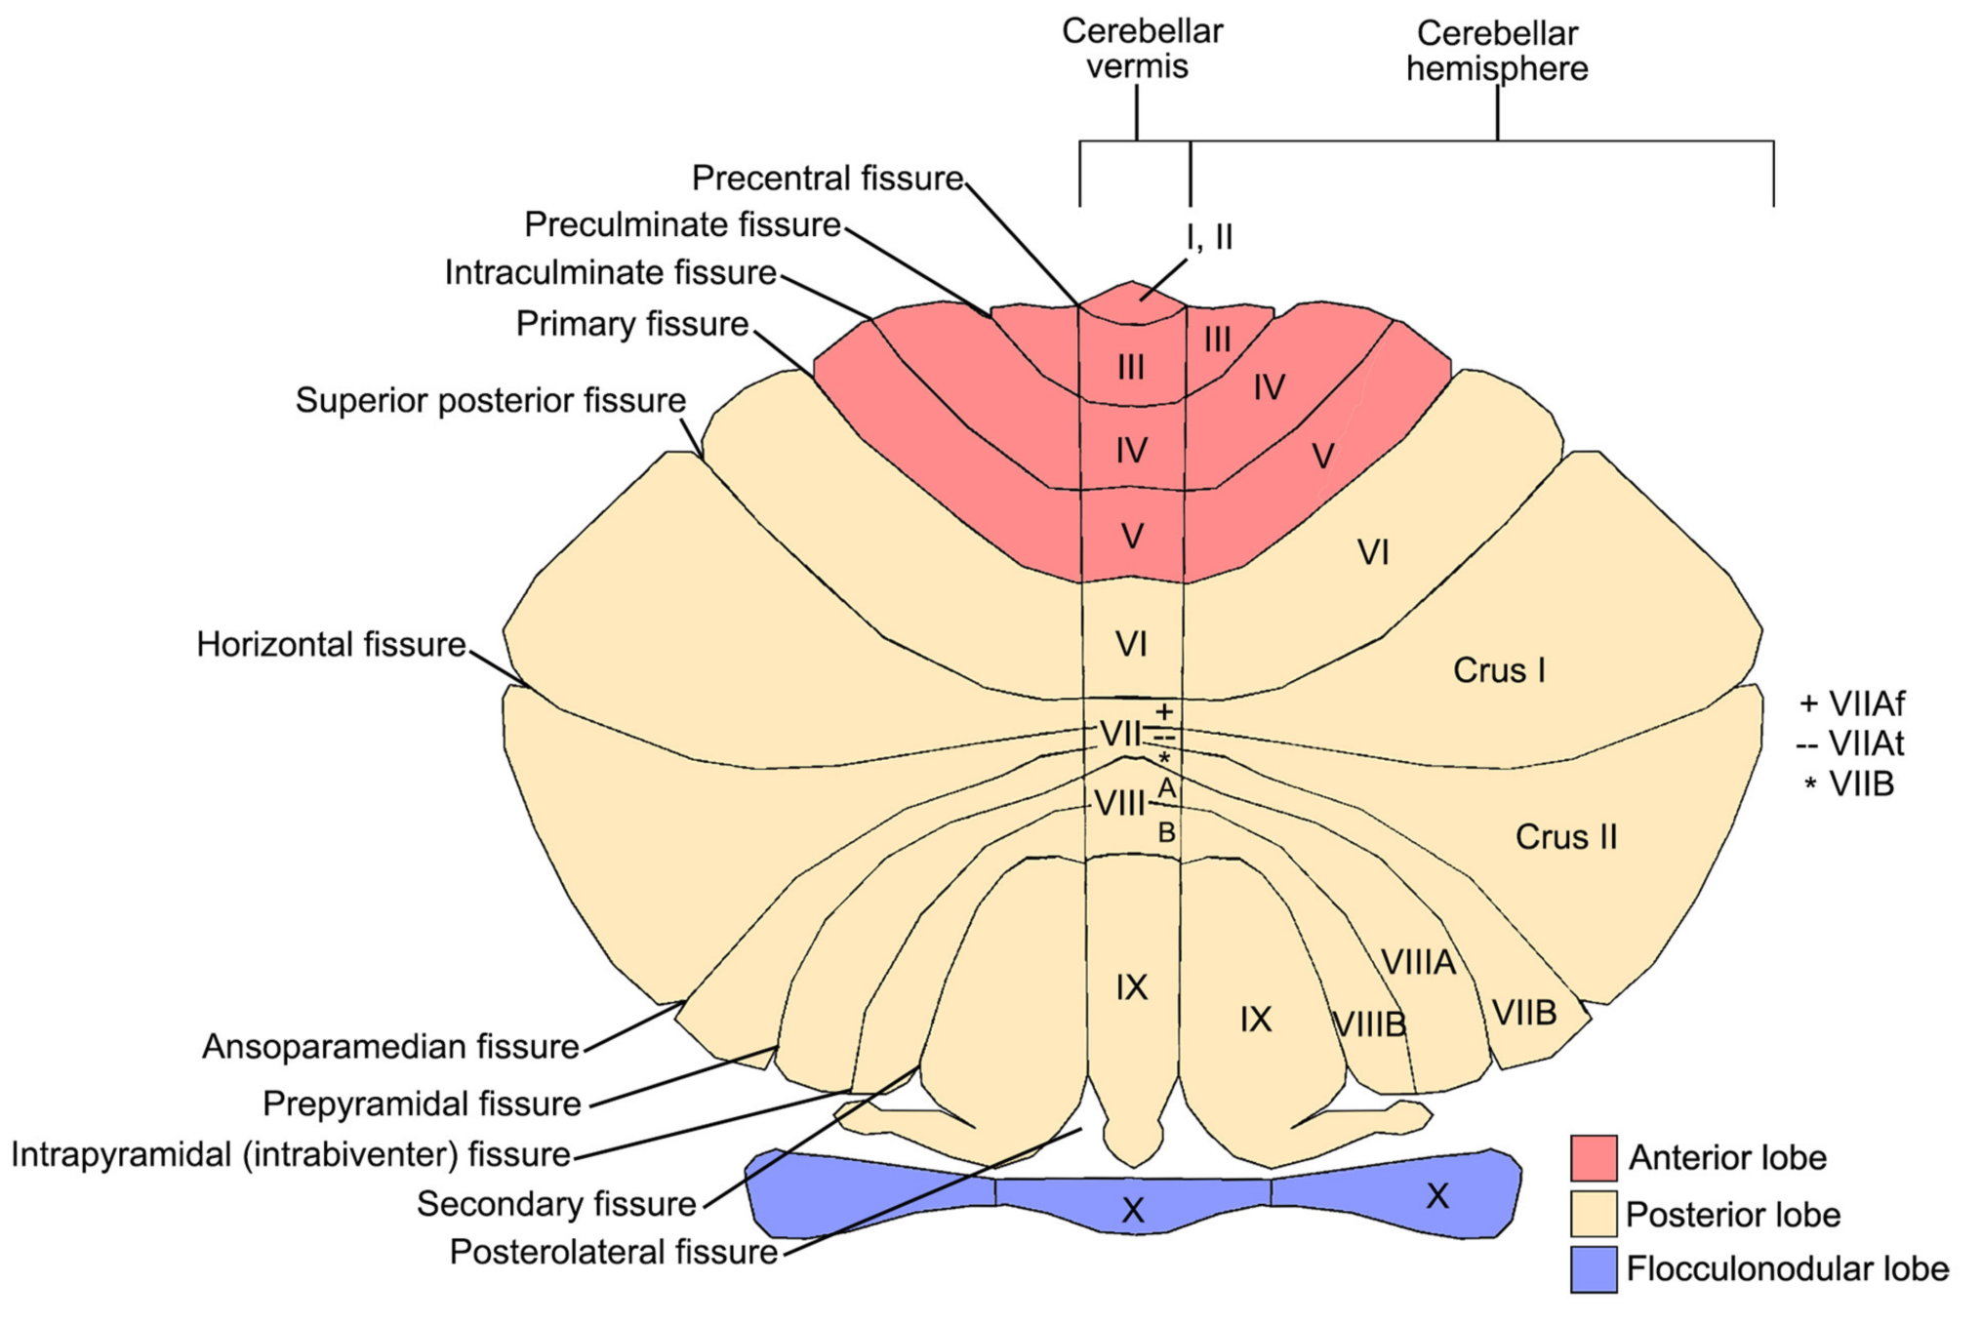
Different regions of cerebellum are engaged in movement, vestibular control, cognition and emotion
2022 AAC
A Virtual Event
March 17-19
Schmahmann, in D’Mello and Stoodley, 2015

Slide 22




Collaborators
Neuroanatomy
Deepak Pandya
Clinical studies
Louis Caplan
Milan Chheda
Alice Cronin-Golomb
Maureen Daly
Franziska Hoche
Stefanie Freeman
Matthew Frosch
Raquel Gardner
Anoopum Gupta
Tessa Hedley-Whyte
Katherine Hermann
Laura Horton
Richard Lewis
Gil L’italien
Lisi Levisohn
David Lin
Jason MacMore
Marygrace Neal
Samantha Pierce
Janet Sherman
Christopher Stephen
Mark Vangel
Jeffrey Weilburg
fMRI, morphometry
Lino Becerra
David Borsook
John Gabrieli
Xavier Guell
Nikos Makris
Eric Moulton
Catherine Stoodley
Eve Valera
Hui Wang
Clinical Consortia
Ataxia Global Initiative
Clinical Research Consortium for the Study of Cerebellar Ataxia (CRC-SCA)
Posterior Fossa Society
Multiple System Atrophy Global Working Group
Cerebellar Atlas
Julien Doyon
Alan Evans
David McDonald
Michael Petrides
Arthur Toga
Diffusion Imaging
George Dai
Ellen Grant
Cristina Granziera
Emi Takahashi
Ruopeng Wang
Van Wedeen
Cerebellar TMS
Jennifer Cromer
Asli Demirtas-Tatlidede
Faranak Farzan
Catarina Freitas
Irene Gonsalves
Mark Halko
Dost Ongur
Alvaro Pascual Leone
Laura Safar
Larry Seidman
William Stone
Primate behavior
Ronald Killiany
Tara Moore
Mark Moss
Douglas Rosene
Photo by
Jinny Sagorin
2022 AAC
A Virtual Event
March 17-19
@SchmahmannLab
MINDlinkFndtn
Funding:
NIMH, National Ataxia Foundation, Harvard CTSC, AT Children’s Project
Birmingham, MINDLink, Sidney R. Baer Jr. Foundations, & Mary Jo Reston

